Slide 1
Data Pipeline
This is just a test database (one sensor over ~ ½ day) automatically transferred from the ITS lab
The tier-2 database will have some filter based on validation rules applied.
The security constraints will be different.
We are focusing on a SQL Database backend with tools to interact with it in python.

Slide 2
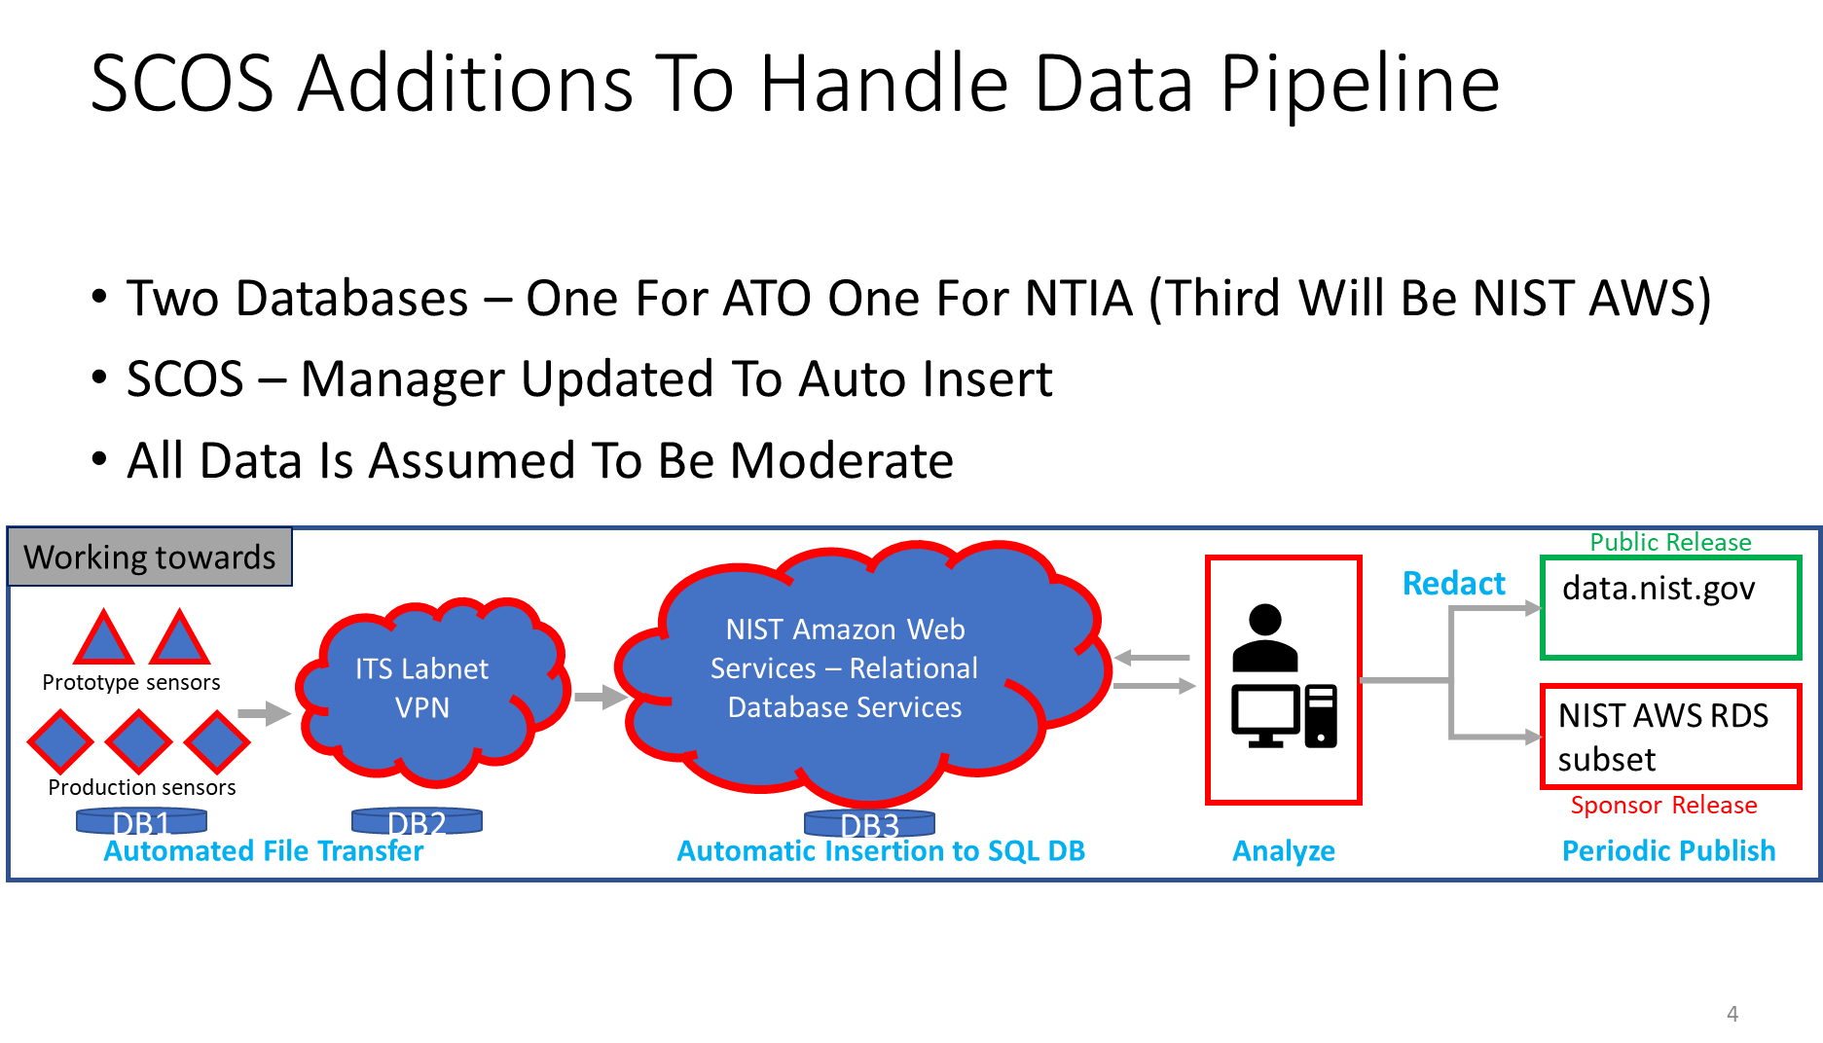

Slide 3
Production Database - Prototype
Download SQL Server Express - https://www.microsoft.com/en-us/sql-server/sql-server-downloads
Download SQL Server Management Studio (SSMS) - https://learn.microsoft.com/en-us/sql/ssms/download-sql-server-management-studio-ssms?view=sql-server-ver16
Right click on Databases in SSMS and click “Attach…” and select the .mdf file for the database you want to attach. As shown in the attached png, you will see a message complaining the Transaction log file not found. Click on the data_pipeline_log.ldf and click the remove button and then click OK to attach the db.

Slide 4
Tables
Sensor
Sense
Sensation
Table | Table
computer | sensors
dft | software_version
diagnostics | spu
digital_filter | ssd_smart_data
hardware_revision
preselector
sensor_location
sensor_software_revision_history
Table
channel
channel_status
channel_summary
provenance
rf_calibration
schedule
signal_analyzer_settings
Table | Table
apd | psd_mean
pfp_mean_max | psd_median
pfp_mean_mean | psd_percentile_25
pfp_mean_min | psd_percentile_75
pfp_peak_max | psd_percentile_90
pfp_peak_mean | psd_percentile_95
pfp_peak_min | psd_percentile_99
psd_max | psd_percentile_99p9
 | psd_percentile_99p99
time_domain_max | time_domain_mean

