Slide 1
HES-SO BELLEVUE · ENERGY MONITORING · SPRINT 6
GROUP 3 · ADF_DataCycleProject
Bellevue Data Cycle
Bronze
Raw CSV · binary copy · ADLS Gen2
Silver
Parquet · cleaned · deduped · GDPR
Gold
Azure SQL · star schema · BI · ML · SAC
An end-to-end Azure data platform — on-prem ingestion, a Bronze / Silver / Gold medallion lakehouse, KNIME-driven ML forecasts, and dashboards in SAP Analytics Cloud and Power BI.
Azure Data Factory
Databricks · PySpark
ADLS Gen2
Azure SQL
KNIME Server
Power BI · SAC
BELLEVUE DATA CYCLE
GROUP 3 · MAY 2025

Slide 2
AGENDA
What we will cover today
01
02
03
04
Introduction
Team Presentation
How We Organised the Work
Architecture & Data Flow
Project context and objectives
Who we are
Agile cadence, sprints, tooling
End-to-end view & daily orchestration
05
06
07
08
Silver & Gold Transformation
Machine Learning
BI Dashboards
Further Improvements
Cleansing, dimensions, facts & views
KNIME Gradient Boosted Tree forecasts
Power BI & SAP Analytics Cloud
Roadmap & technical debt
BELLEVUE DATA CYCLE
02 / 19

Slide 3
01 / INTRODUCTION
01
Bellevue Data Cycle
Context & Objectives
Project Context
Deliverables
HES-SO Bellevue campus runs solar PV , energy meters, weather sensors, and a room-booking system. Data lives on-premises (SMB / SFTP shares on a Windows VM, IP 10.130.25.152 ).
The goal : turn raw operational data into reliable analytics and forecasts that staff and management can use.
1
Daily ingestion
4 sources via ADF + Self-Hosted Integration Runtime
2
Lakehouse + DWH
Bronze / Silver in ADLS Gen2 · Gold in Azure SQL · 8 dims · 7 facts · 9 views
3
ML forecasts
Solar production & building consumption via KNIME Gradient Boosted Trees
4
BI delivery
Why a Medallion Lakehouse?
Power BI reports + SAC dashboards with RBAC & Row-Level Security
Bronze
— keeps raw fidelity & traceability of source files.
Silver
— isolates cleaning, GDPR masking, and dedup logic.
Gold
— star schema in Azure SQL, ready for BI, ML, and SAC.
BELLEVUE DATA CYCLE
03 / 19

Slide 4
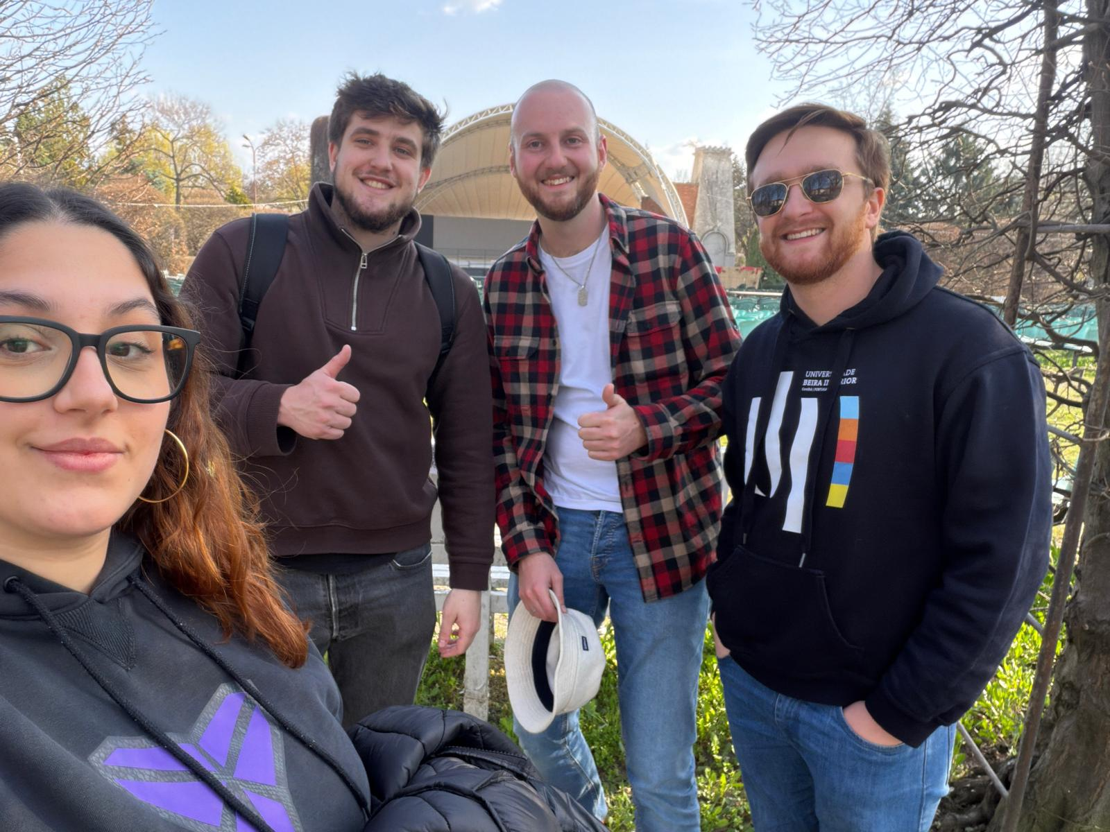
02 / TEAM PRESENTATION
02
Group 3 — HES-SO
ADF_DataCycleProject
The Team
AP
Abril Palau
🇪🇸 Spain
DS
Dylan Sanderson
🇨🇭 Switzerland
FM
Francisco S. Mesquita
🇵🇹 Portugal
AF
Adriel Ferreira
🇷🇴 Romania
BELLEVUE DATA CYCLE
04 / 19

Slide 5
03 / HOW WE ORGANISED THE WORK
03
Agile Scrum
6 Sprints · 39 User Stories · ~228 SP
Practices & Tooling
Sprint 1 — Setup
1
8 SP
✓ Done
MoSCoW prioritisation per user story
Planning poker sizing
Two-week sprints with with a weekly alignment meeting
GitHub Repository for Code and documentation
WhatsApp and Teams for communication
Excel Product Backlog on Teams
GitHub Actions on push to main — OIDC, no secrets
Architecture diagrams in Mermaid + HTML Pages
17 Feb → 02 Mar
2
Sprint 2 — Core Ingestion
24 SP
✓ Done
03 Mar → 16 Mar
3
Sprint 3 — Security & Monitoring
37 SP
✓ Done
17 Mar → 30 Mar
4
Sprint 4 — Silver / Gold / ML
47 SP
✓ Done
31 Mar → 13 Apr
5
Sprint 5 — BI & KNIME
65 SP
✓ Done
14 Apr → 27 Apr
6
Sprint 6 — Docs & Deployment
47 SP
↻ In Progress
28 Apr → 08 May
BELLEVUE DATA CYCLE
05 / 19

Slide 6
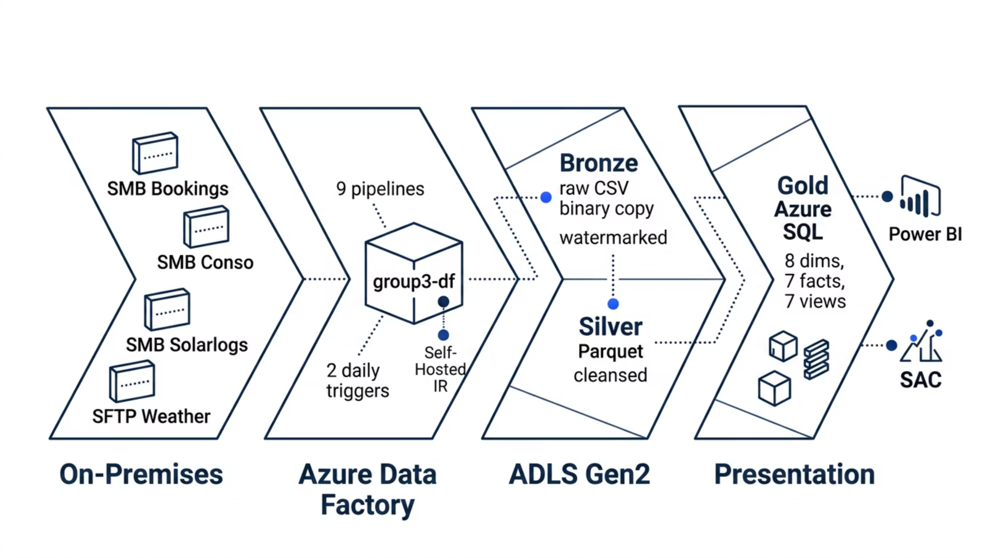
04
04 / ARCHITECTURE
Medallion Lakehouse on Azure
On-premises sources flow through Azure Data Factory into a three-layer lakehouse, then into Azure SQL for BI and ML consumption.
Demo : Link here
BELLEVUE DATA CYCLE
06 / 19

Slide 7
04 / ARCHITECTURE — TECHNOLOGY STACK
What Runs Where, and How It’s Secured
Orchestration
Storage & Serving
Azure Data Factory
ADLS Gen2 · Azure SQL
group3-df · 9 pipelines · 19 datasets · 10 linked services.
Two daily triggers fire the cycle: TRG_Daily_0715 & TRG_Daily_0930.
ADLS containers: bronze · silver · mldata · sacexport · config.
DevDB serverless Gen5
8 dims · 7 facts · 9 analytical views.
Compute & ML
Security & CI/CD
Databricks · KNIME
Key Vault · UAMI · RLS
DataCycleGroup3Keys Key Vault.
gh-datacycle-oidc UAMI — OIDC, no client secrets.
3 SQL roles: Director_Role · Teacher_Role · Technician_Role
RLS BookingDivisionFilter restricts fact_room_booking per division for Directors & Teachers
validate.yml on PR
deploy-adf.yml on main.
6 PySpark notebooks on a single interactive cluster, JDBC with retry-backoff.
KNIME Server — Model_Selection runs weekly and benchmarks 4 algorithms (GBT, LR, RF, Simple Tree)
4 REST endpoints.
BELLEVUE DATA CYCLE
07 / 19

Slide 8
05 / DATA FLOW
05
Daily Orchestration
Two ADF triggers drive the entire cycle
TRG_DAILY_0715
TRG_DAILY_0930
07:15 · Full ETL
09:30 · KNIME Predictions
Bronze → Silver → Gold
PL_Upload_Pred_Gold
07:15
PL_Ingest_Bronze — 4 parallel sub-pipelines
09:30
Data_Preparation (every run)
07:20
silver_transformation.py
09:35
Model_Selection (Mondays only)
07:30
silver_gold_dimensions.py ‖ ml_export_to_knime.py
09:45
Solar predictor ‖ Consumption predictor
07:35
silver_gold_facts.py
09:50
ml_load_predictions.py + sp_backfill_prediction_actuals
07:40
PL_SAC_Export → Azure File Share
The 07:15 trigger runs the full Bronze → Silver → Gold ETL chain.
The 09:30 trigger fires KNIME inference and loads predictions into fact_energy_prediction.
Model_Selection re-evaluates the active model on Mondays only, keeping the pipeline fully deterministic.
In case of an error during the process, an email is automatically send to all the team via Azure.
BELLEVUE DATA CYCLE
08 / 19

Slide 9
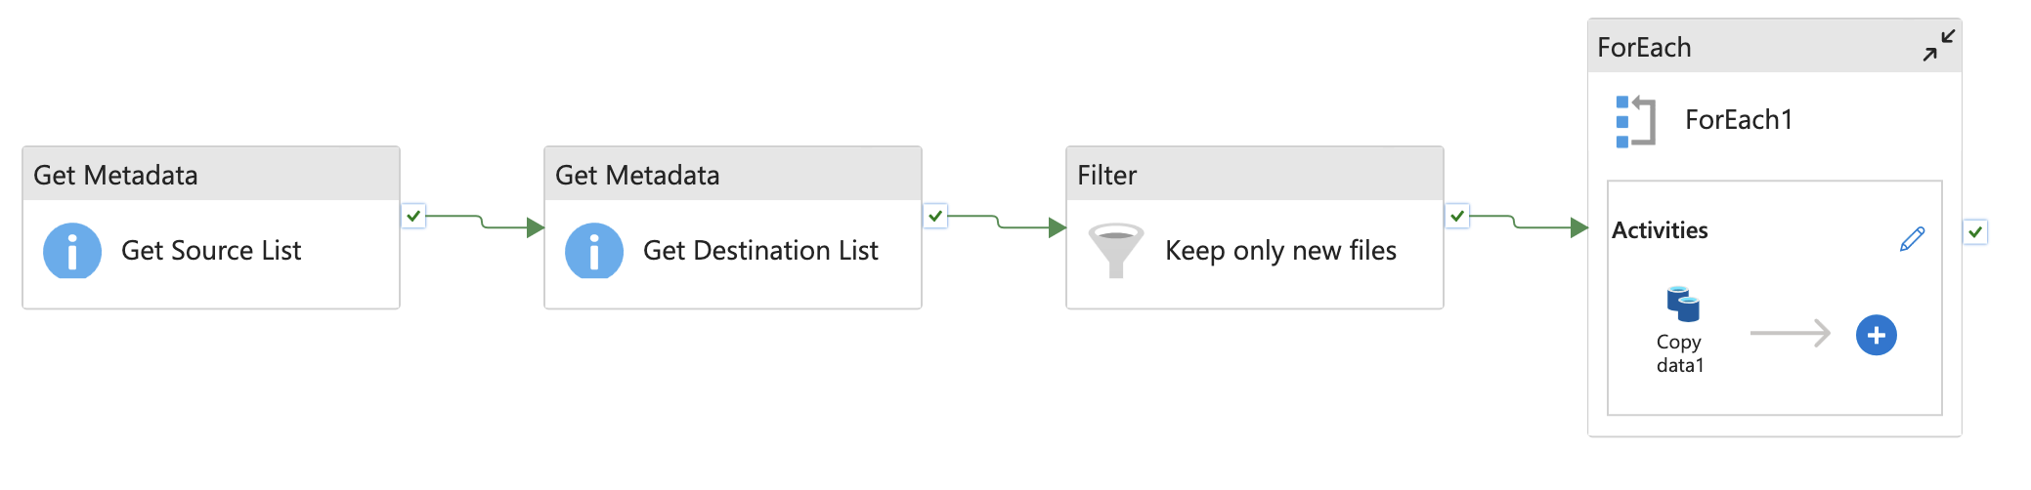
05 / DATA FLOW — BRONZE INGESTION
PL_Bronze_*
Incremental binary copy via Self-Hosted Integration Runtime into the bronze ADLS Container
Common Shape — 4 steps per sub-pipeline
Sub-pipelines
1
GetMetadata · Source
2
GetMetadata · Destination
PL_Bronze_Solar
List files on the SMB / SFTP share.
List files already in bronze/.
Sungrow inverter CSVs (UTF-8) + PV daily rollups (UTF-16 LE).
3
Filter
4
ForEach (batch 50) · Copy
PL_Bronze_Conso
Keep only filenames not yet ingested.
Binary Copy → bronze/<area>/
Energy / temperature / humidity. Dynamic folder routing by filename prefix.
PL_Bronze_Bookings
Room reservations (TSV). French dates parsed in Silver.
PL_Bronze_Meteo
Past weather via SFTP.
PL_Bronze_MeteoFuture exists but is not wired into PL_Ingest_Bronze .
It must be triggered manually from ADF Studio whenever fresh future-forecast files arrive on the SFTP share.
A second known limitation: silver/weather_future_forecasts/ currently mirrors historical Sierre data — the future-forecast synthesis logic is not yet applied it.
⚠️
BELLEVUE DATA CYCLE
09 / 19

Slide 10
06 / SILVER TRANSFORMATION
06
silver_transformation.py
Bronze CSV → Silver Parquet // Managed in Databricks
UTF-16 BOM Cleanup
Dual Date Parsing
Solar Unpivot
Counter-Reset Logic
translate(col, '\u0000', '') before any regex — handles UTF-16 LE files (PV, conso, temp, humidity).
regexp_extract dd.MM.yy and dd.MM.yyyy → coalesce — survives mixed source formats across energy meter files.
5 inverters per wide row → array<struct> + explode() to one row per inverter per 5-min slot.
Cumulative meter decreases ⇒ delta = NULL; lag() re-derives clean deltas downstream. Applies to PV & consumption.
xx:00 Synthesis
French Date Parsing
Sierre Weather Synthesis
GDPR Masking
Source material emits 72 rows/day (xx:15/30/45 only). _synthesize_xx00_rows inserts a linearly-interpolated xx:00 row per hour → 96-slot cadence in Silver & Gold.
Booking dates arrive in French locale ( 8 janv. 2023 ). french_date_to_english() translates month abbreviations before try_to_date.
No physical station — average Sion + Visp forecasts to a synthetic 'Sierre' site. Sentinel −99 999 values replaced with null before averaging.
SHA-256 over Professeur / Nom de l'utilisateur → ProfessorMasked / Utilisateur_Masked . Raw columns dropped from Silver.
BELLEVUE DATA CYCLE
10 / 19

Slide 11
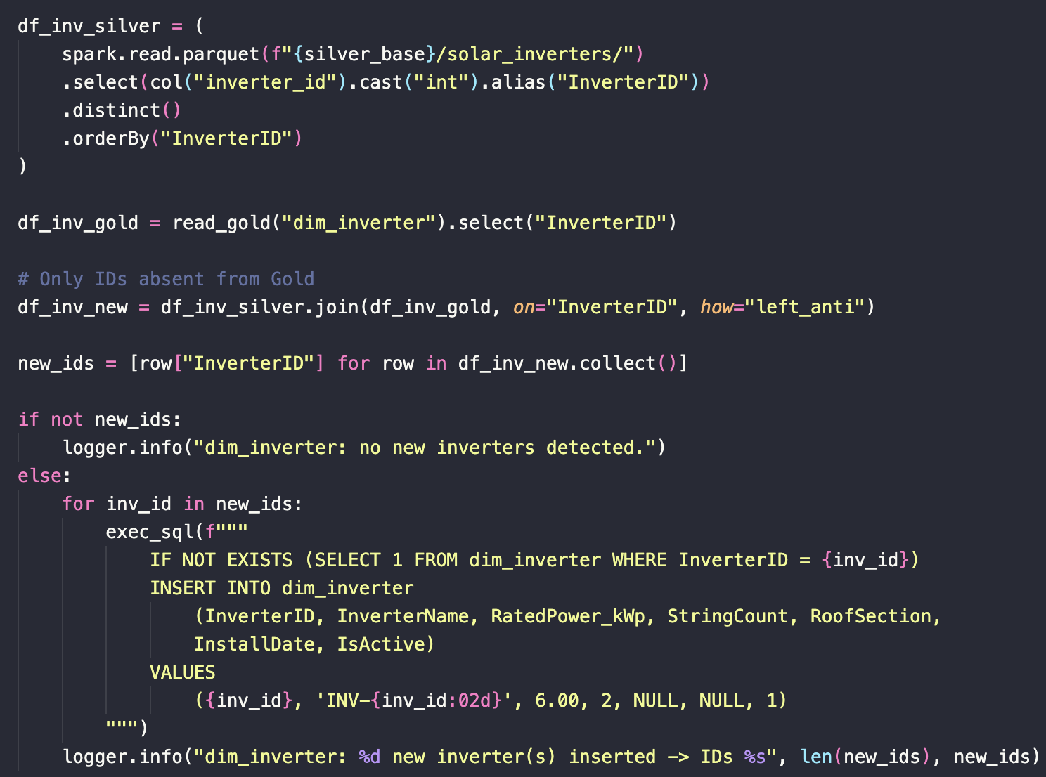
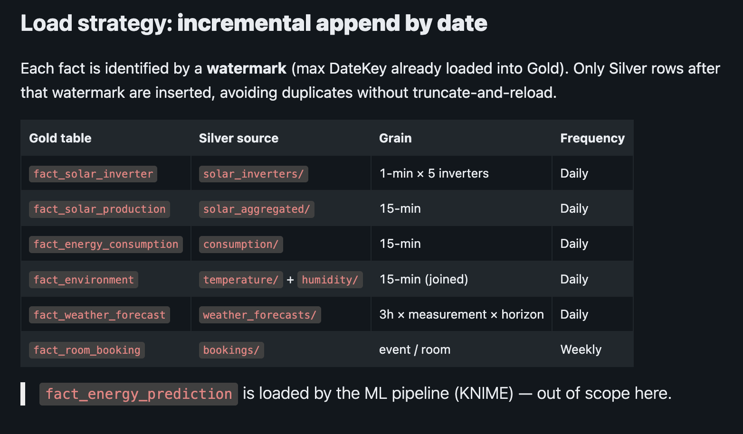
07 / GOLD TRANSFORMATION
07
Silver → Azure SQL Gold
ETL Process within Databricks from ADLS to Azure SQL · Serverless Gen5
D
silver_gold_dimensions.py
F
silver_gold_facts.py
Dimensions
Facts
Insert-only by default. 8 dimensions loaded via LEFT ANTI JOIN. dim_prediction_model updates on payload diff. ref_electricity_tariff uses SCD2. StatusCode = 99 (Unknown) seeded for missing codes.
SELECT MAX(DateKey) keeps only newer silver rows. DateKey = yyyyMMdd::int · TimeKey = hour×60+minute::smallint for cheap joins.
fact_environment uses FULL OUTER JOIN of temperature & humidity.
Serverless pause handled by JDBC retry-with-backoff (20–80 s, max 5 attempts).
BELLEVUE DATA CYCLE
11 / 19

Slide 12
07 / GOLD — SCHEMA & ANALYTICAL VIEWS
SQL Azure DB· 8 Dims · 7 Facts · 9 BI-Ready Views
DIMENSIONS · 8
FACTS · 7
ANALYTICAL VIEWS · 9
dim_inverter
TABLE
GRAIN (PK)
vw_inverter_status_breakdown
dim_inverter_status
fact_solar_inverter
DateKey, TimeKey, InverterKey
vw_inverter_performance
dim_weather_site
fact_solar_production
DateKey, TimeKey
vw_prediction_accuracy
(MAPE)
fact_energy_consumption
DateKey, TimeKey
dim_measurement_type
fact_environment
DateKey, TimeKey
vw_daily_energy_balance
(CHF)
dim_division
fact_weather_forecast
+ SiteKey, MeasurementKey, Horizon
vw_daily_energy_with_predictions
dim_room
fact_room_booking
BookingKey (surrogate)
vw_building_occupation
fact_energy_prediction
+ ModelKey, RunDateKey
dim_prediction_model
vw_building_occupation_hourly
dim_date
vw_kpi_dashboard_home
dim_time
vw_weather_vs_production
Security Model
3 roles: Director_Role (broad read + energy + bookings) · Teacher_Role (energy, bookings, sustainability views — no inverter detail, no forecasts) · Technician_Role (solar, ML, weather — no bookings per GDPR).
BookingDivisionFilter RLS policy applies fn_division_security to fact_room_booking: Directors and Teachers see only their mapped divisions in ref_user_division_access; db_owner / Technician_Role bypass the filter entirely.
BELLEVUE DATA CYCLE
12 / 19

Slide 13
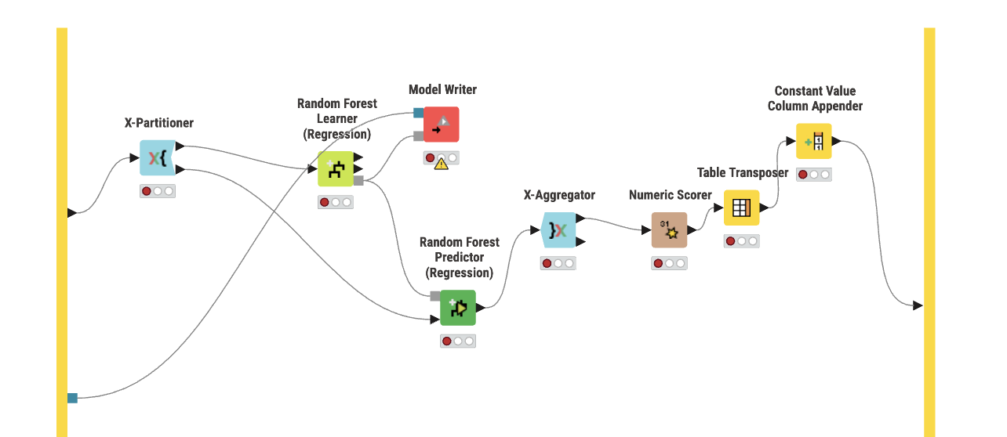
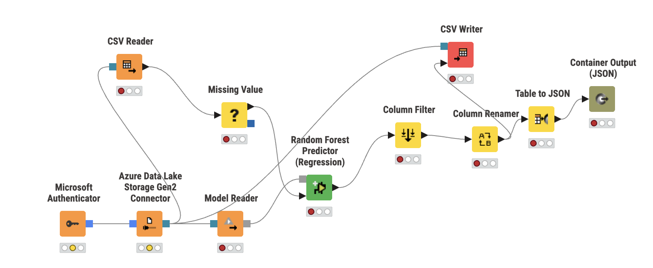
08 / MACHINE LEARNING
08
Two Daily Forecasts
Solar Production & Building Consumption
MODEL · PV_PROD_V1
Solar Production
MODEL · CONS_V1
Consumption
Solar Production Forecast
Building Consumption Forecast
TARGET
TARGET
production_delta_kwh
consumption_delta_kwh
FEATURES
FEATURES
irradiance_wm2, temp_c, hour, minute, month, day_of_week, is_weekend, quarter_hour
temp_c, humidity_pct, precipitation_kgm2, room_occupation_pct, hour, minute, month, day_of_week, is_weekend, is_academic_day, quarter_hour
BELLEVUE DATA CYCLE
13 / 19

Slide 14
08 / ML — LIFECYCLE & INTEGRATION
ml_export_to_knime → KNIME Edu Hub → ml_load_predictions
01
02
03
04
Feature Export
KNIME Orchestration
Predictions Output
Load & Persist
Databricks writes feature CSVs to ADLS mldata/knime_input/.
Data prep daily; Model_Selection on Mondays only.
ADLS mldata/knime_output/ stores production & consumption CSVs.
Databricks clamps negatives, replaces predictions, calls backfill SP.
KNIME Services
Accuracy Tracking
DELETE FROM fact_energy_prediction WHERE PredictionRunDateKey = <today> before INSERT — full replace per run date => Idempotency
sp_backfill_prediction_actuals joins yesterday's actuals onto earlier predictions. vw_prediction_accuracy exposes MAPE for BI consumption.
Data_Preparation : takes the consumption and production data from ADLS as a CSV file, clean it and split it to be ready for training.
Predictions are loaded directly in SQL, allowing comparison between predicted and actual energy consumption and solar energy production.
Model_Selection : Tests each file against 4 different regression models. The best results are stored and only the best model per topic is pushed to the "FINAL" model folder.
Further scores and statistics could be implemented in the future.
REST_Interface : Exposes the best model from Model_Selection to create a prediction and store the predicited outcome in ADLS.
BELLEVUE DATA CYCLE
14 / 19

Slide 15
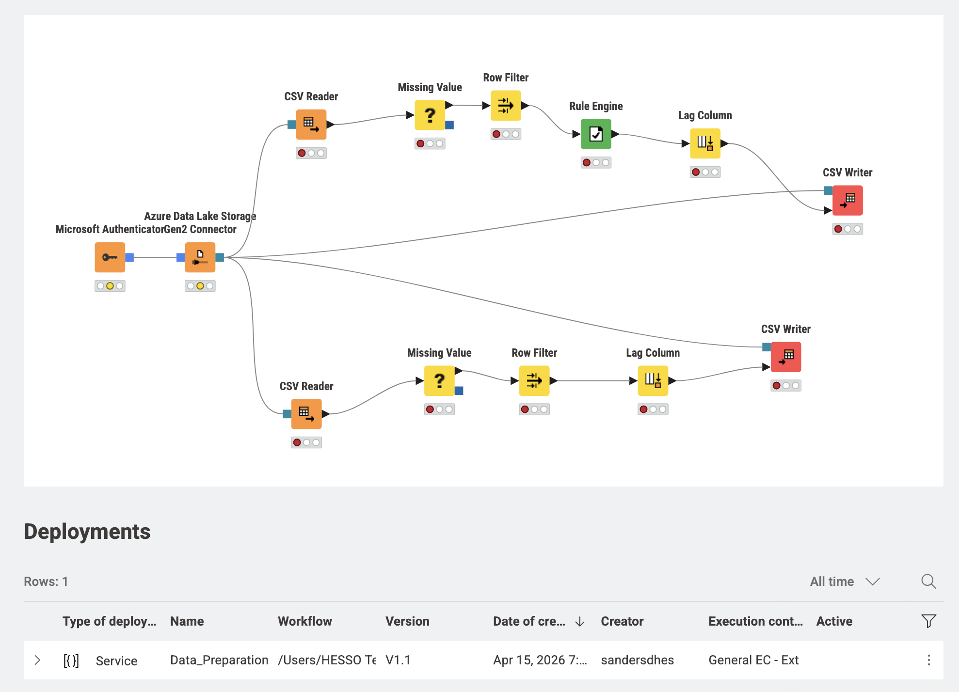
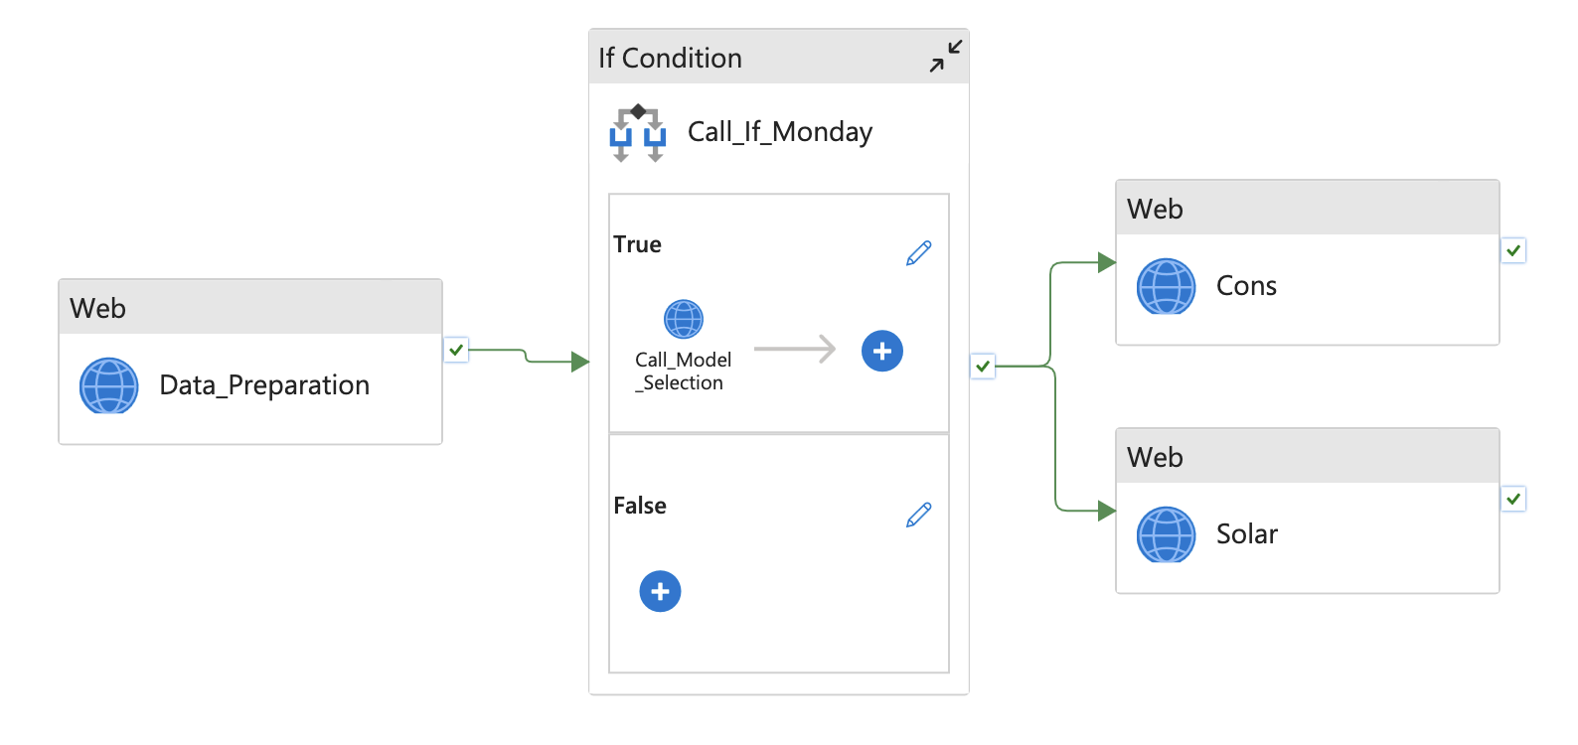
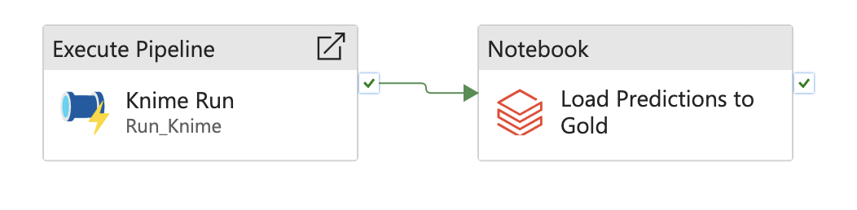
08 / ML — KNIME WORKFLOW INTERNALS
KNIME REST Deployments
Invoked by ADF on the 09:30 trigger
KNIME DEPLOYMENT
CADENCE
Data_Preparation
Every run
Model_Selection
Mondays only
Consumption predictor
Every run
Solar predictor
Every run
BELLEVUE DATA CYCLE
15 / 19

Slide 16
09
09 / POWER BI DASHBOARDS
3 Reports · DirectQuery on Gold · RLS-Aware
Solar
Energy
Rooms
Solar Production
Energy & Financial Overview
Room Occupancy
Backed by: vw_inverter_status_breakdown, vw_inverter_performance, vw_weather_vs_production
Backed by: vw_daily_energy_balance, vw_daily_energy_with_predictions (actual vs. predicted overlay), vw_kpi_dashboard_home (5 KPIs), vw_prediction_accuracy.
Backed by: vw_building_occupation (daily, 10-hour window), vw_building_occupation_hourly (per-hour granularity), fact_room_booking, dim_division, dim_room — through RLS BookingDivisionFilter.
AUDIENCE
AUDIENCE
AUDIENCE
Solar technicians monitoring inverter health and comparing actual production to weather.
Management — net energy balance, self-sufficiency, daily costs, and forecast reliability.
Directors & Teachers — each sees only their mapped divisions (GDPR · RLS). Academic days only.
BELLEVUE DATA CYCLE
16 / 19

Slide 17
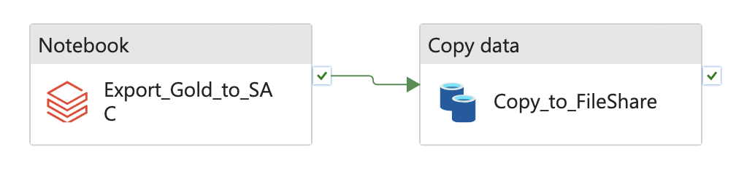
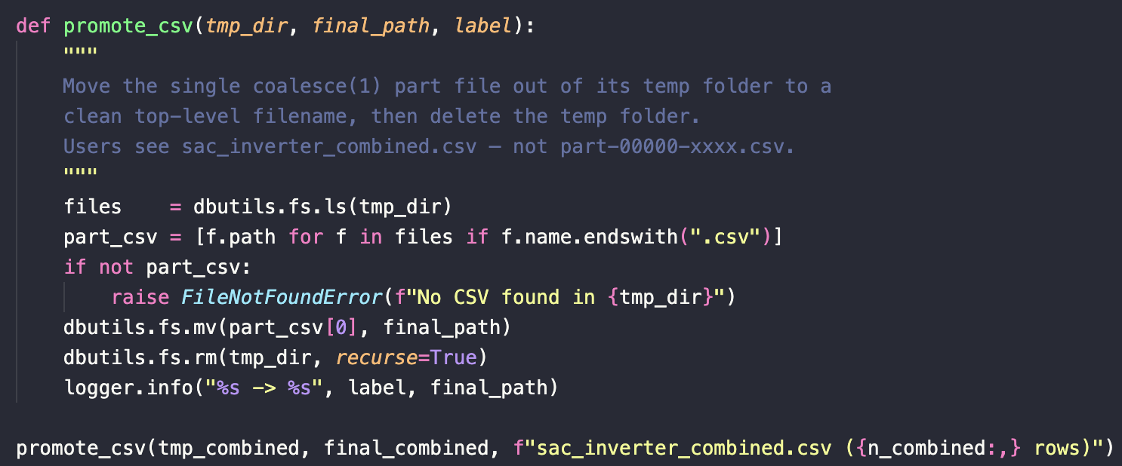
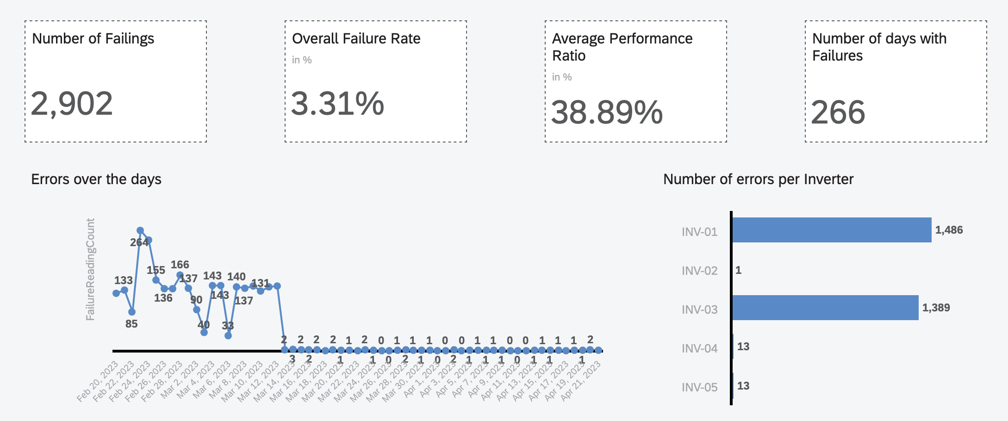
10 / SAC DASHBOARDS
10
SAP Analytics Cloud
Fed via Azure File Share
Export Pipeline
Solar Panel Failure Dashboard
sac_export_to_adls.py reads vw_inverter_status_breakdown and vw_inverter_performance via JDBC, LEFT JOINs at (FullDate, InverterID) , coalesce(1), writes sacexport/sac_inverter_combined.csv .
Status Breakdown
PctOfDayReadings per inverter status — spot inverters spending more than X% of the day in fault states.
Performance Ratio
PL_SAC_Export — ADF binary copy to the sac-export-share Azure File Share, authenticated via LS_AzureFileShare_SAC (sacpassword from Key Vault). SAC polls the share, ingests the CSV, and refreshes dashboard models.
Actual AC power / rated capacity — separates a poorly-performing inverter from one running on a cloudy day.
Combined View
The CSV joins both views at (FullDate, InverterID) so SAC models a single fact table with status + performance attributes.
BELLEVUE DATA CYCLE
17 / 19

Slide 18
11
11 / FURTHER IMPROVEMENTS
Improvements & Roadmap
DR & Reproducibility
Code & Data Quality
Reproducibility & DR
Code & Data Quality
Wire
infrastructure/future/workflows/
→ CI for full Bicep rebuild.
Add
LoadBatchId
/
IngestedAt
to fact tables — no lineage today.
Activate
deploy-sql.yml
(needs Key Vault Secrets User on UAMI).
Wire
PL_Bronze_MeteoFuture
into
PL_Ingest_Bronze
(currently orphaned).
Bacpac seed for fresh DBs already in
infrastructure/exported/
.
Fix
silver/weather_future_forecasts/
— Sierre logic not applied to
df_futureweather_raw
.
Make notebook paths in ADF user-agnostic — currently hard-coded to a specific Repos path.
Harden positional booking column rename (brittle Spark numeric suffix on duplicate headers).
Populate
dim_date
/
dim_time
via CI or a notebook step — empty after a fresh schema deploy.
Unify the tariff source — currently triplicated (SQL, JSON, SCD2 table).
Security & GDPR
Roadmap
Security & GDPR
Product Roadmap
Finish RLS rollout (US#26 / US#27 still in progress).
Provide a written GDPR compliance assessment (US#35).
Audit Key Vault access policies + define a rotation cadence for knimeappsecret
Re-train ML models on a longer window (current data ends 2023-04-19).
Promote
vw_prediction_accuracy
as a first-class BI KPI.
Scalability assessment + capacity forecast (US#34).
Internationalisation of dashboards & stories (US#33).
BELLEVUE DATA CYCLE
18 / 19

Slide 19
11
11 / FURTHER IMPROVEMENTS
Improvements & Roadmap
Reproducibility & Deployment
Code & Data Quality
Wire infrastructure/future/workflows/ → CI for full Bicep rebuild
Activate deploy-sql.yml (needs Key Vault Secrets User on UAMI)
Bacpac seed for fresh DBs already in infrastructure/exported/
Azure Resource Group Review to lower costs.
Add LoadBatchId / IngestedAt to fact tables — no lineage today
Wire PL_Bronze_MeteoFuture into PL_Ingest_Bronze (currently orphaned)
Make notebook paths in ADF user-agnostic (currently hard-coded)
Unify the tariff source — currently triplicated
Security & GDPR
Product Roadmap
Apply RLS and roles directly on PowerBI (need Premium Subscription + AD).
Populate ref_user_division_access for all Directors
Audit Key Vault access policies + define a rotation cadence for knimeappsecret
Re-train ML models with different parameters and fix MAPE anomalies.
Promote vw_prediction_accuracy as a first-class BI KPI
Scalability assessment + capacity forecast (US#34)
Internationalisation of dashboards & stories (US#33)
BELLEVUE DATA CYCLE
18 / 19

Slide 20
END OF DECK
GROUP 3 · ADF_DataCycleProject
Thank You
Questions?
REPOSITORY
ARCHITECTURE DIAGRAM
TECHNICAL GUIDE
github.com/sandersdHES/ ADF_DataCycleProject
docs/ARCHITECTURE.md
docs/TECHNICAL_GUIDE.md
BELLEVUE DATA CYCLE
19 / 19

