Slide 1
Figure plans
Some map with ksn, sediment size, and effect of sed size on ksn
how often sediment and how much sediment is transported by a storm
Could be a proxy for how often HS contributes sed as well, as per new yanites paper
maximum sediment size mobilized by different storms by drainage area and slope
residence time required for differently sized alluvium to steepen channel
for fig 4, if u have a relationship between sediment size (boulders and d50) and ksn (or slope)
then you can replace sediment size with residence time in channel (based on RI)

Slide 2
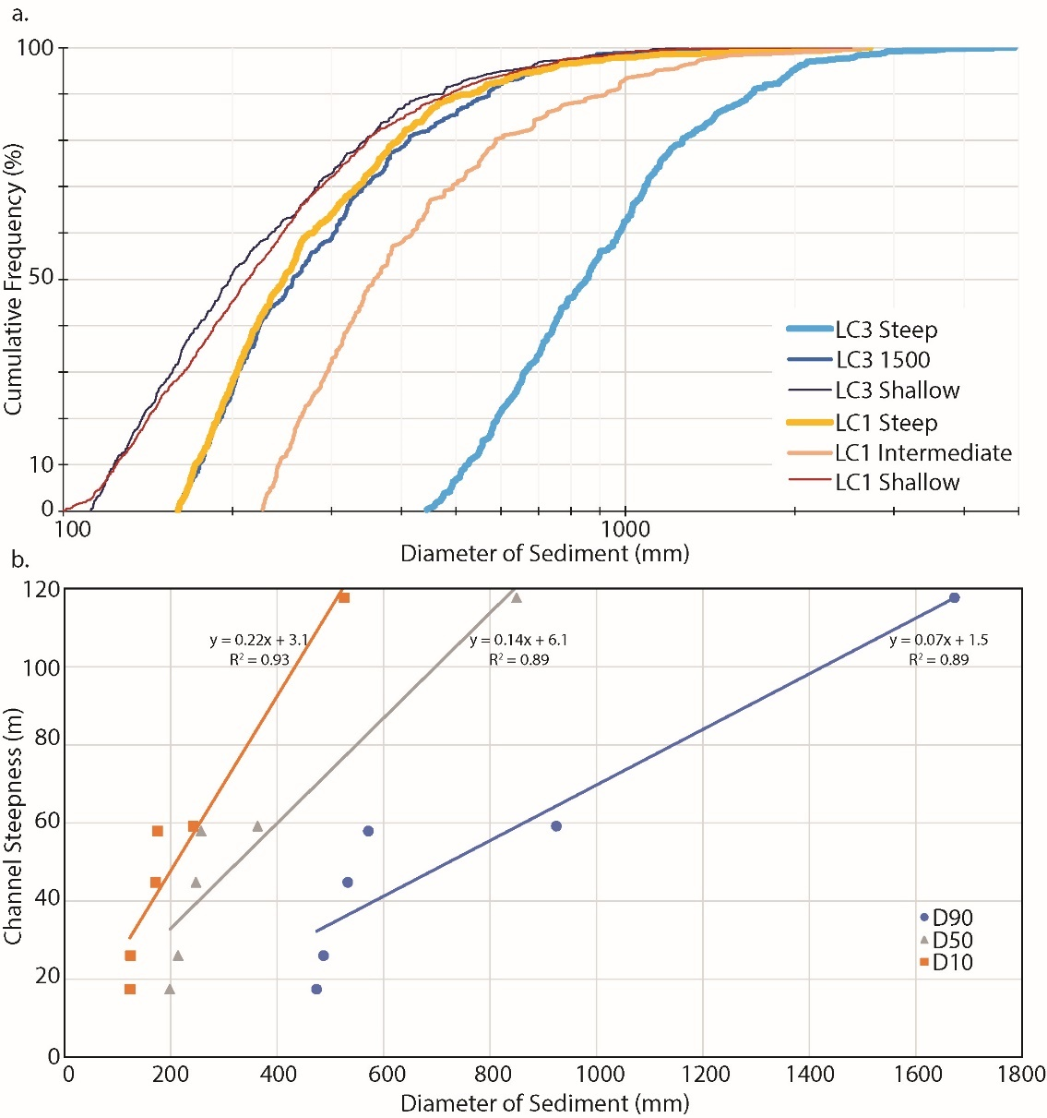
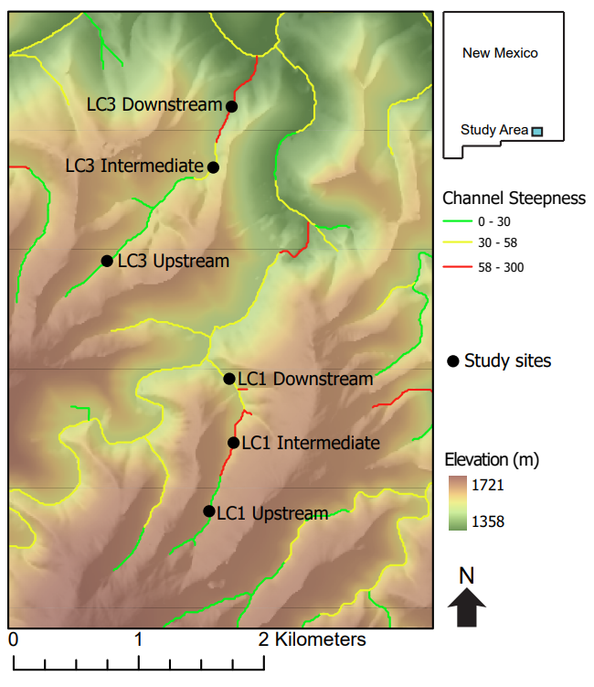

Slide 3
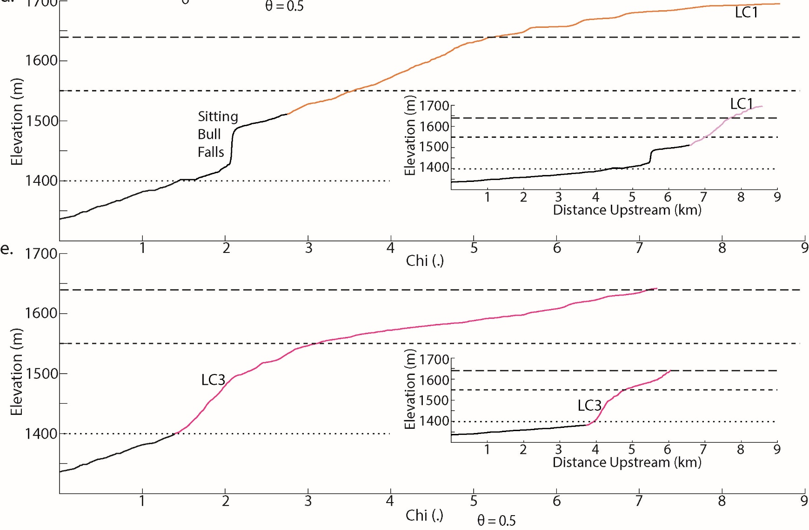
Here I want to map out which parts of the channel have different sediment and boulder sizes

