Slide 2
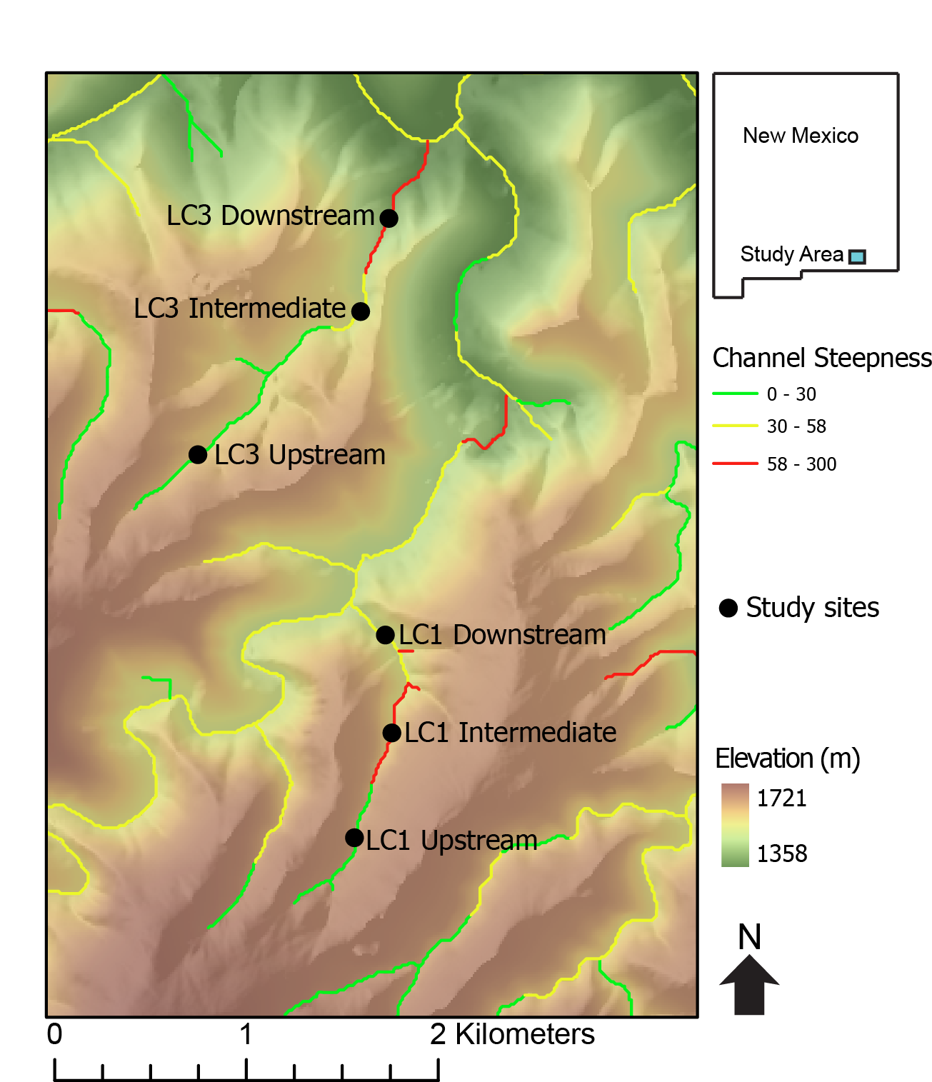

Slide 3
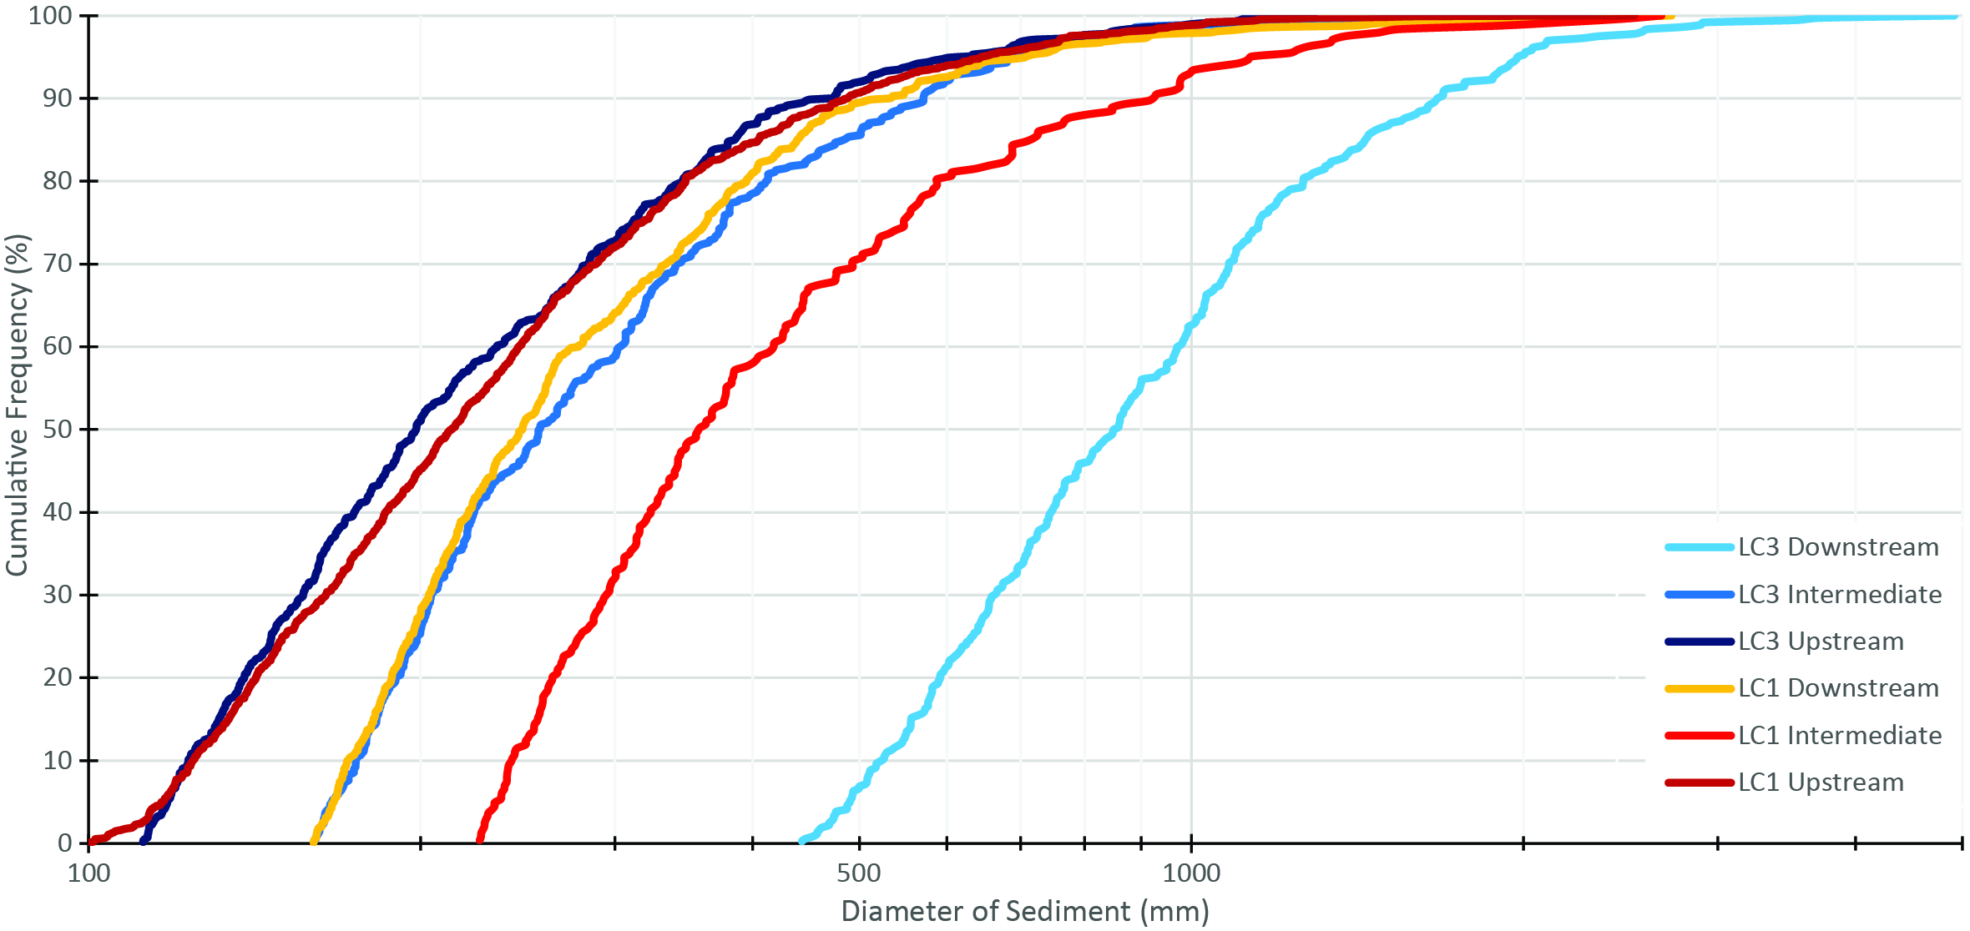

Slide 4
And now for Hillslope stuff

Slide 9
