Slide 1
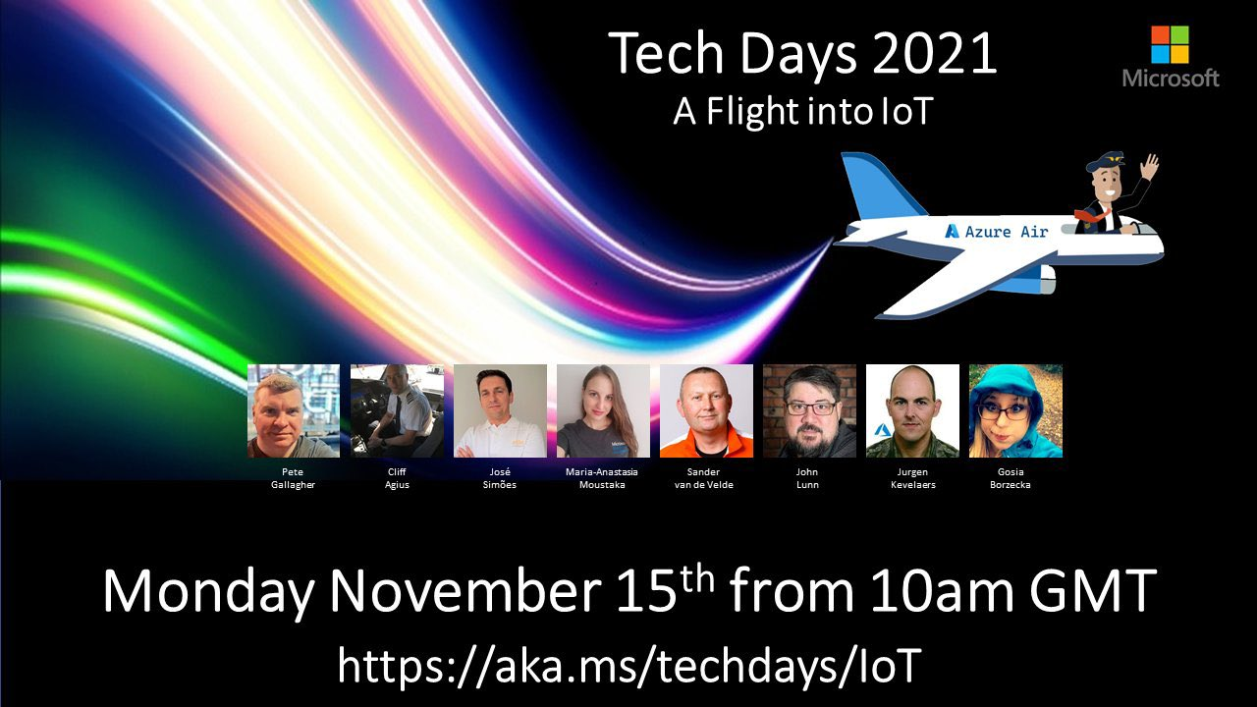
TSI
Sander van de Velde

Slide 2
Who am I?

Slide 3
We see incoming data in the IoT Hub What now?
Questions pop up:
From a Data Scientist perspective:
I want to see if there is a certain trend in the data
I want to check for certain anomalies
I want to see if I have a solid base for certain reports
- From an IoT Developer perspective:
Is there any telemetry coming in?
What telemetry is currently arriving?
Can I check the telemetry for a possible issue?
Can I compare flights over time?
Can I look at all telemetry of that one flight, 15 years ago?

Slide 4
Could we get a quick insight into the data?
We would like to store the incoming data for historical purposes
Check the quality of ingested data
Generate charts, heatmaps, scatter maps, shifting time for comparison, add calculations
Doing some preliminary investigations to confirm suspicions
Setup Basis alerts (eg. when no data is ingested anymore)
We need an Operational Historian in the cloud

Slide 5

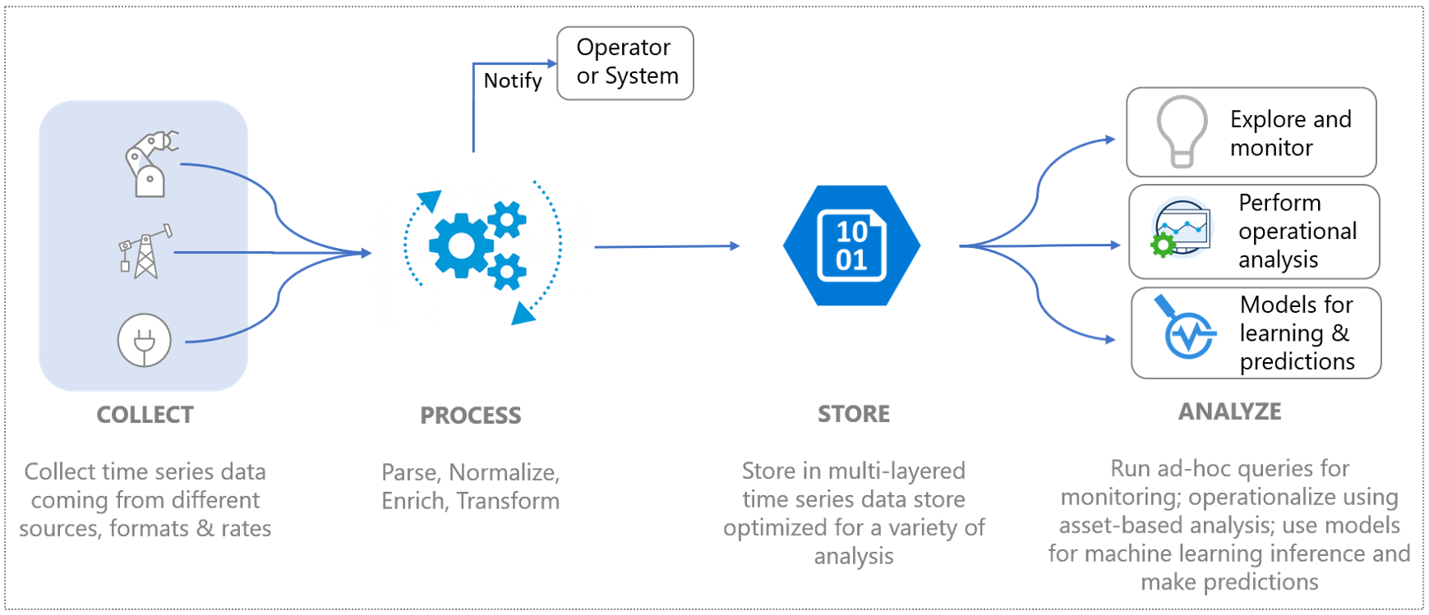
Azure resource: Time Series Insights

Slide 6
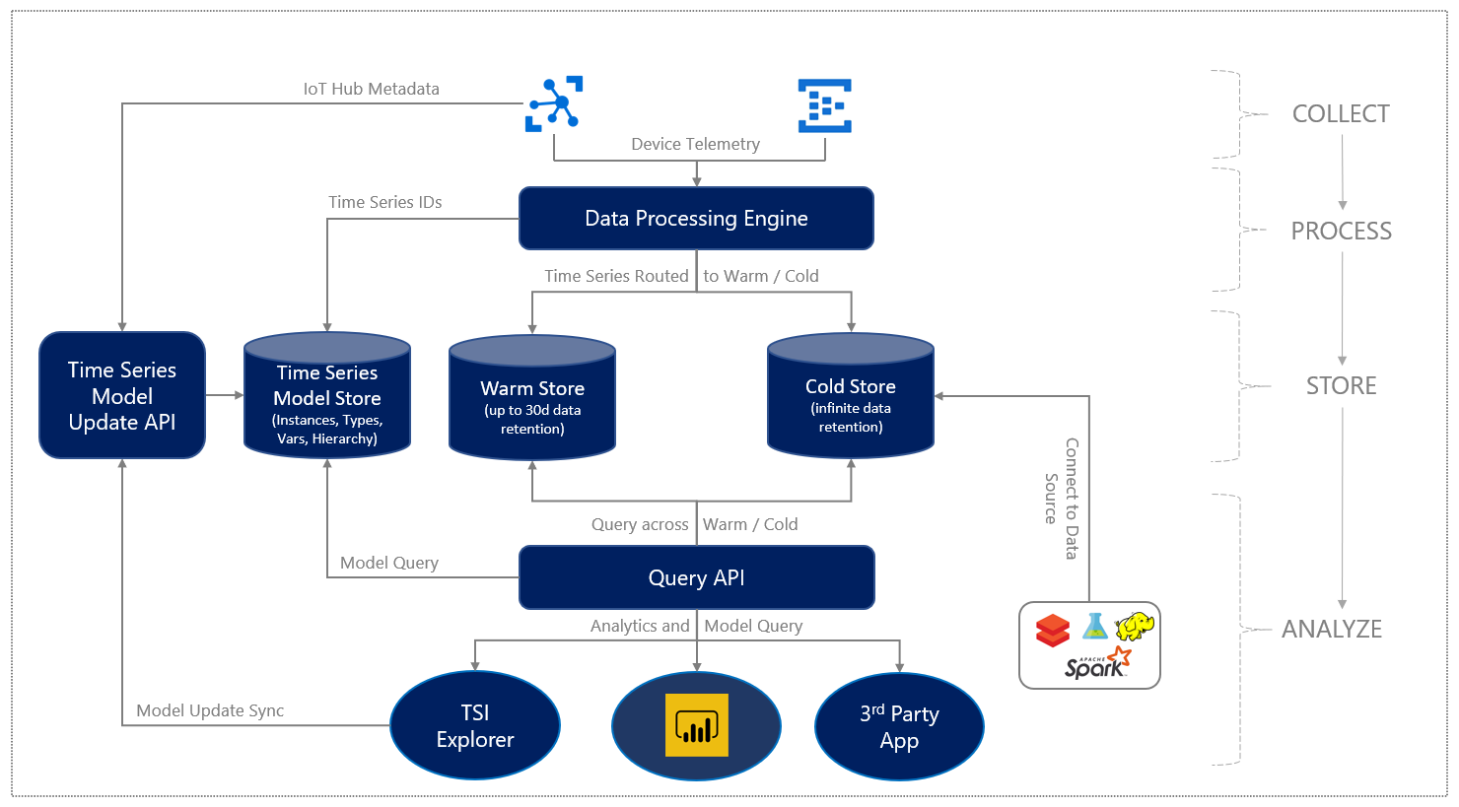
high-level data flow

Slide 7
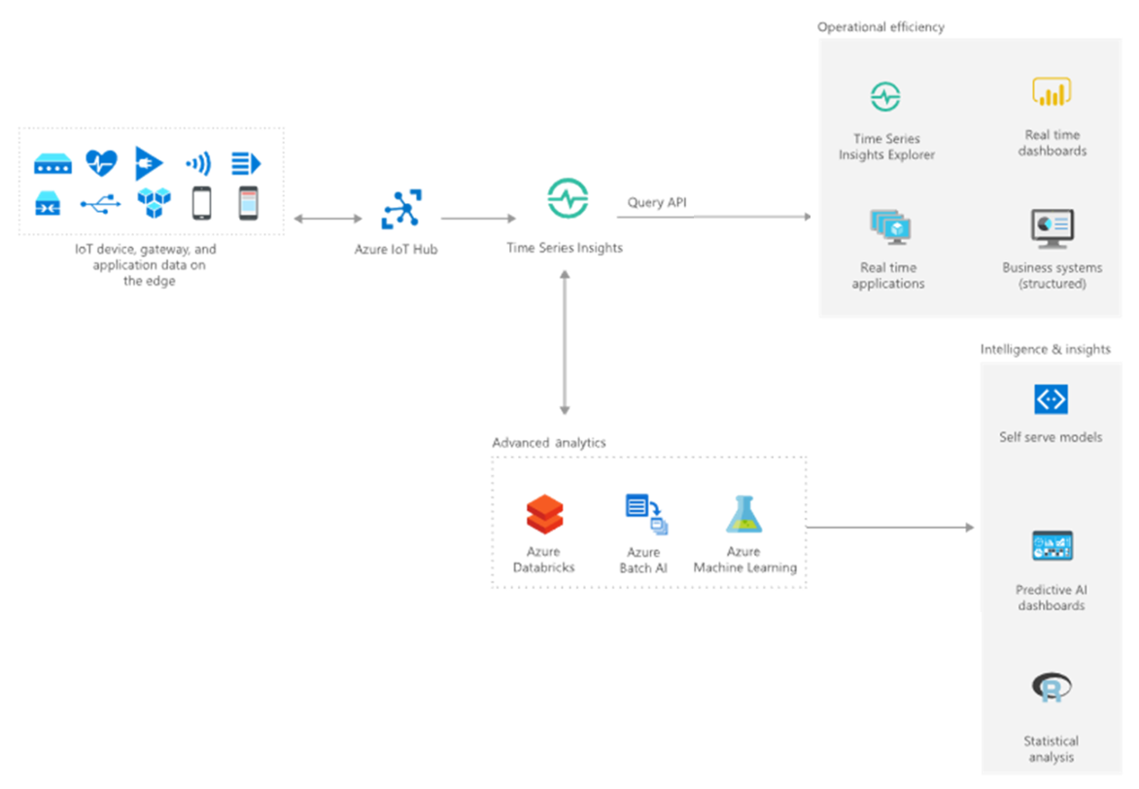
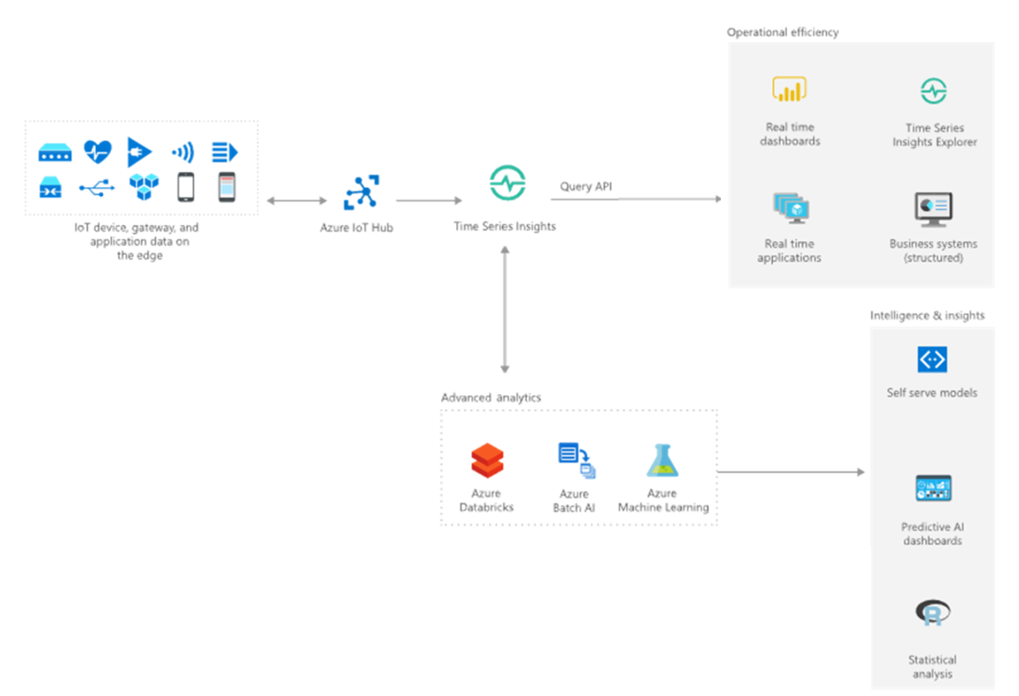
First usecase

Slide 8
Demo

Slide 9
Features
Near real-time data exploration
Multilayered storage for IoT-scale time series data
Time Series Model to contextualize raw telemetry and derive asset-based insights
Smooth and continuous integration with other data solutions using APIs
Custom applications built on the Azure Time Series Insights Gen2 platform
Pay-as-you-go

Slide 10
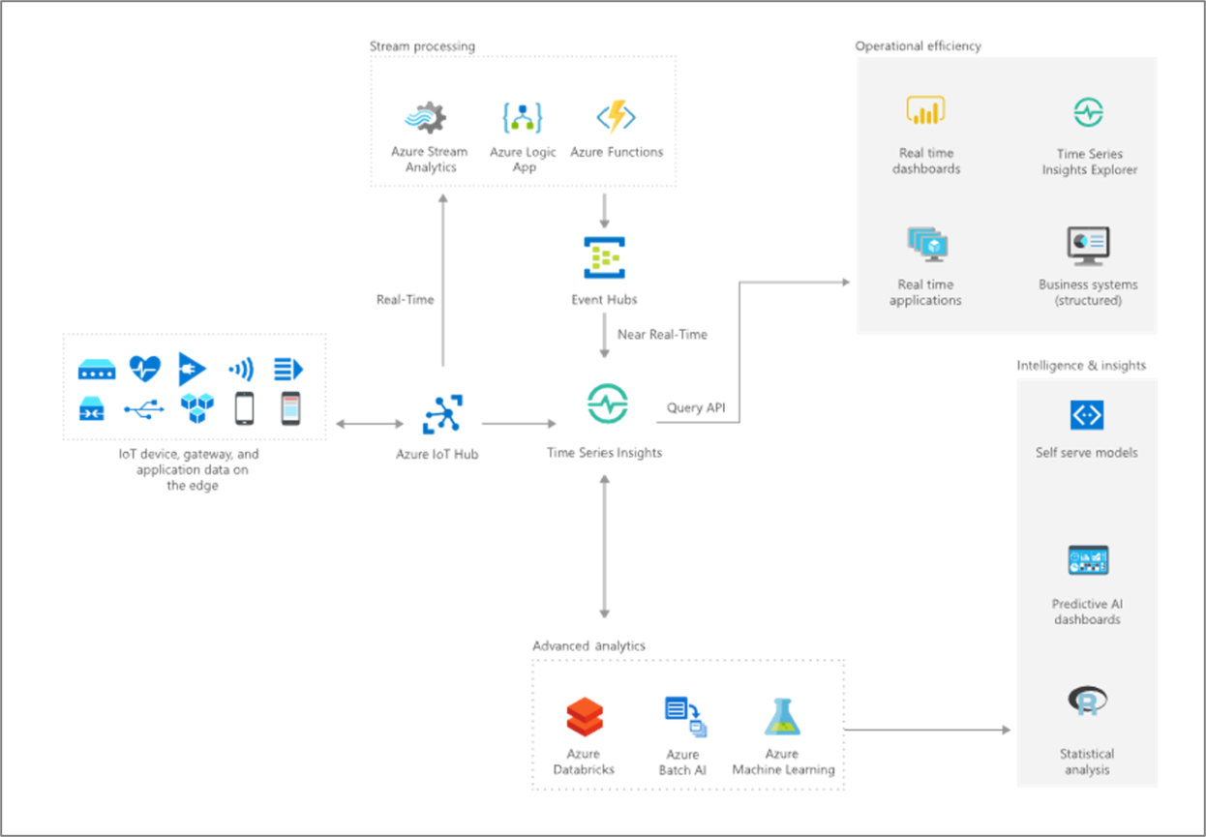
More elaborate use case (out of scope for today)

Slide 11
Q&A
Links with further resources:
MS Learn module
Time Series Insight Documentation
Azure IoT Show – Deep Dive
AZ 220 Reference

