Slide 1

Mutual Fund
Analytics Platform
BLUESTOCK
FINTECH
An End-to-End Data Analytics Solution
10
7
40+
4-Page
Datasets
Days
Funds
Dashboard
Capstone Project · June 2026
Sandesh · Capstone Project Submission
Notes:
Welcome everyone. This is the capstone project for the Mutual Fund Analytics Platform, completed in 7 days as part of my internship with Bluestock Fintech. The project covers the full analytics lifecycle — from raw data ingestion through to advanced risk modeling and a Power BI dashboard.

Slide 2




Executive Summary
Problem
Solution
Scope
Impact
Retail investors lack institutional-grade mutual fund analytics — VaR, Alpha, rolling Sharpe are unavailable on most platforms
End-to-end Python analytics pipeline: ETL → SQLite DB → EDA → Performance Metrics → Power BI Dashboard → Advanced Risk Models
10 datasets · 40+ funds · 7-day sprint · Python + Pandas + SQLAlchemy + Power BI + GitHub
15 key findings · 10 strategic recommendations · Production-ready analytics foundation for Bluestock Fintech
10 Datasets Ingested
9 Performance Metrics
40 Funds Risk-Scored
4-Page Power BI Dashboard
1 Fund Recommender
2 / 12
Notes:
This is the 'so what' slide. The project is a blueprint for Bluestock's analytics product. Every technical deliverable — ETL pipeline, SQLite database, dashboard — maps to an investor-facing use case. Emphasize the business-first approach: we built this to democratize institutional-grade fund intelligence.

Slide 3
Business Problem & Opportunity
India's ₹50 lakh crore MF industry is growing fast — but analytics are locked behind institutional walls
!
!
!
Data Fragmentation
Analytical Complexity
SIP Intelligence Gap
Fund data scattered across AMFI, NSE, BSE and AMC portals — no consolidated view
Alpha, Beta, Sharpe, VaR require expertise & computing power unavailable to retail investors
SIP trend data is rarely linked to market performance — behavioral patterns go undetected
Strategic Opportunity
₹50L Cr
7 Cr+
44
Bluestock Fintech can bridge this gap — democratizing institutional-grade mutual fund intelligence for India's next 100 million retail investors with an analytics-first platform.
Industry AUM
SIP Accounts
AMCs
3 / 12
Notes:
Set the market context first. India's MF industry is at an inflection point — growing fast but serving a narrow, urban base. Bluestock has an opportunity to democratize fund intelligence the way Zerodha democratized trading. Pause after listing the three problems to let the gaps sink in.

Slide 4


Project Architecture & Technology Stack
1. Ingest
2. Transform
3. Store
4. Analyze
5. Visualize
Python · Requests · MFAPI
10 CSVs + Live API
Pandas · NumPy
Clean · Deduplicate · Type-cast
SQLite · SQLAlchemy
bluestock_mf.db · 10 Tables
NumPy · SciPy · Plotly
9 Metrics · VaR · CVaR · Sharpe
Power BI
4-Page Interactive Dashboard
DevOps: GitHub for version control · requirements.txt for full reproducibility · Modular pipeline — each layer independently replaceable
4 / 12
Notes:
Walk through the architecture layer by layer. Emphasize that the pipeline is modular — SQLite can be replaced with PostgreSQL for production, Power BI with Tableau, without touching the analytics layer. The requirements.txt ensures full reproducibility — any team member can clone and run in minutes.

Slide 5
Data Sources & ETL Pipeline
01_fund_master.csv — Fund name, category, AMC, AMFI code
06_industry_folio_count.csv — Total & new folios per month
02_nav_history.csv — Daily NAV per fund (50,000+ rows)
07_scheme_performance.csv — 1Y / 3Y / 5Y returns per fund
03_aum_by_fund_house.csv — Monthly AUM by AMC
08_investor_transactions.csv — Transaction-level investor data
04_monthly_sip_inflows.csv — National SIP inflow time series
09_portfolio_holdings.csv — Sector & stock allocation per fund
05_category_inflows.csv — Net inflows by fund category & month
10_benchmark_indices.csv — Nifty 50, Midcap 150, Small Cap 250
EXTRACT
TRANSFORM
LOAD
VALIDATE
10 CSVs + 5 live
API calls (MFAPI)
Deduplicate · Strip
Normalize · Type-cast
10 tables → SQLite
bluestock_mf.db
Zero errors detected
across all datasets
5 / 12
Notes:
Data quality is the foundation of analytics credibility. The pipeline is idempotent — it can be re-run safely using if_exists='replace' in to_sql(). Zero data quality issues were found across all 10 files, which speaks to the careful dataset curation done on Day 1.

Slide 6
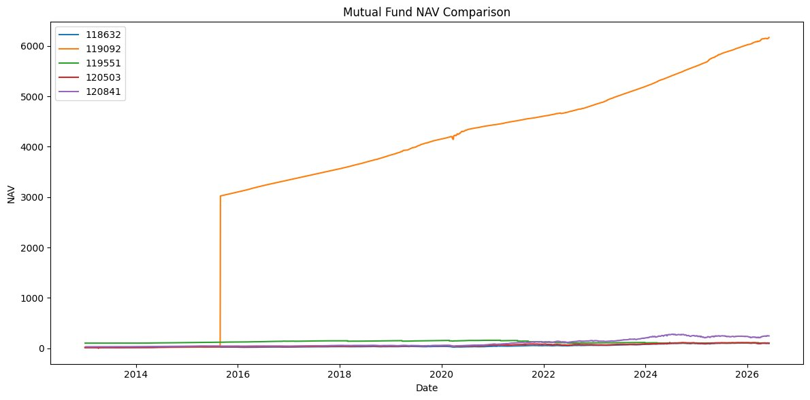



Exploratory Data Analysis — Key Findings
NAV Growth
Fund 119092 NAV exceeds ₹6,000 — 5x average peer growth, reflecting exceptional long-run compounding
SIP Boom
SIP inflows 5× in a decade (₹4K→₹20K Cr/month). Resilient through 2020 and 2022 market shocks
Demographics
Ages 25–40 = 52% of investors. Maharashtra, Karnataka, Delhi = 50% of transaction value
Fig 1: Mutual Fund NAV Comparison 2013–2026
Correlation
AUM concentrated: Top 5 AMCs = 55% of total AUM (SBI, HDFC, ICICI Pru, Aditya Birla, Kotak) · Industry AUM CAGR ~15% over 5 years · Sector concentration: Financial Services = 28–35% of avg equity fund portfolio
NAV correlations 0.55–0.82 among equity funds — multi-fund same-category portfolios don't diversify
6 / 12
Notes:
EDA is where the data tells its story. The SIP 5x growth is the defining trend — India is becoming a SIP nation. The high NAV correlation finding (0.55–0.82) has direct product implications: Bluestock should steer investors toward cross-category diversification rather than multiple funds in the same category.

Slide 7
Fund Performance Analytics
1. Daily Returns
2. CAGR 1Y/3Y/5Y
3. Sharpe Ratio
4. Sortino Ratio
5. Alpha
6. Beta
7. Max Drawdown
8. Fund Scorecard
9. Benchmark vs Actual
Top Funds by Risk-Adjusted Performance
Fund Name | Fund House | Sharpe | 3Y Return | AUM (₹ Cr) | Risk
HDFC Top 100 Fund | HDFC MF | 1.06 | 14.84% | 6,434 | Moderate
Mirae Asset Large Cap | Mirae Asset MF | 1.06 | 14.81% | 11,361 | Moderate
ICICI Pru Bluechip Fund | ICICI Prudential MF | 1.03 | 14.41% | 41,553 | Moderate
7 / 12
Notes:
Sharpe Ratio, not absolute return, is the gold standard for fund comparison. A fund earning 18% with high volatility may be inferior to one earning 15% with low volatility. Highlight that Alpha generation is rare — most active large-cap funds barely outperform their benchmark after fees, which argues for ETFs or Flexi-cap funds.

Slide 8
Power BI Dashboard — 4 Pages
Interactive analytics for industry leaders and fund analysts
Page 1
Page 2
Page 3
Page 4
Industry Overview
Fund Performance
Investor Analytics
SIP & Market Trends
› Total AUM KPI card
› Return vs Risk scatter plot
› State-wise choropleth map
› SIP vs Nifty dual-axis
› SIP Inflows sparkline
› Fund scorecard table
› Age group donut chart
› Category inflow heatmap
› AUM Trend (2018–2026)
› NAV trend comparison
› SIP vs Lumpsum split
› Top categories ranking
› AUM by AMC bar chart
› Alpha / Drawdown view
› Monthly transaction trend
› Date range cross-filter
All pages feature cross-filter slicers: Date Range · Fund Category · AMC · Risk Grade
8 / 12
Notes:
If possible, live-demo the Power BI dashboard. The cross-filter capability is the key differentiator: clicking on a state in the investor map instantly updates transaction trends and age distribution charts. The file bluestock_mf_dashboard.pbix can be opened in Power BI Desktop. Note that all 4 pages were built using the same SQLite database as the backend.

Slide 9
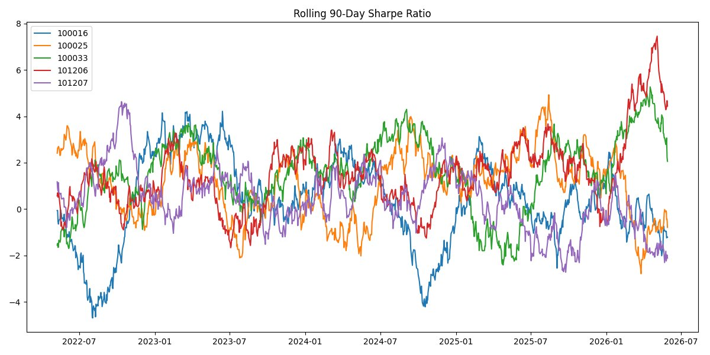
Advanced Analytics — Risk Modeling
Highest Tail Risk
Fund 101207 · VaR: -2.60% · CVaR: -3.25%
Aggressive Only
Lowest Risk
Fund 100025 · VaR: -0.38% · CVaR: -0.50%
Capital Preservation
Rolling Sharpe Peak
Fund 101206 · Sharpe >7.0 · Early 2026
Exceptional Period
Fig 2: Rolling 90-Day Sharpe Ratio (2022–2026)
Funds Analyzed
40 AMFI codes · VaR computed · at 95% CI
VaR (Value at Risk) = Maximum expected daily loss exceeded only 5% of trading days
CVaR (Expected Shortfall) = Average loss in the worst 5% of days — the 'pessimist's metric' for tail risk
Practical use: Fund suitability filter in Bluestock's investor portal — high CVaR funds excluded for risk-averse profiles
Daily returns basis
9 / 12
Notes:
VaR and CVaR are tools used by Goldman Sachs, JPMorgan, and every major asset manager. By bringing this analysis to retail investors, Bluestock operates at a higher analytical tier than most retail platforms. The rolling Sharpe chart is particularly powerful: funds that maintain high Sharpe ratios across bull AND bear markets demonstrate superior management quality — not just lucky timing.

Slide 10
Fund Recommender · Investor Cohort · HHI Analysis
Fund Recommender — Top 3 Picks
SIP Investor Cohort Analysis
Filter: Moderate Risk · Sharpe > 1.0 · 3Y Return > 14%
1
HDFC Top 100 Fund
HDFC MF
Sharpe 1.06 · 14.84% 3Y · AUM ₹6,434 Cr
2
Mirae Asset Large Cap
Mirae Asset MF
Sharpe 1.06 · 14.81% 3Y · AUM ₹11,361 Cr
3
ICICI Pru Bluechip
ICICI Prudential MF
Sharpe 1.03 · 14.41% 3Y · AUM ₹41,553 Cr
Peak dropout: months 9–11
Deploy nudge campaign at month 8!
HHI Concentration: Top 5 AMCs hold ~55% of AUM (Moderate concentration, HHI 1,500–2,500 range) · Recommender pipeline can be operationalized as a weekly automated job refreshing recommendations from latest NAV & performance data
10 / 12
Notes:
The recommender and cohort findings are the most product-relevant. The recommender shows data-driven fund selection is feasible and can be automated — this is the engine behind a robo-advisory feature. The SIP cohort finding (68% continuation, peak dropout at months 9–11) is a direct call-to-action: deploy behavioral nudges at the 8-month mark for every active SIP investor.

Slide 11
15 Key Findings & 10 Strategic Recommendations
Select Findings
Top Recommendations
1
SIP inflows grew 5× in a decade — India is becoming a SIP nation
P1
Risk Profiling Engine
VaR/CVaR fund suitability filters in onboarding
2
Top 5 AMCs = 55% AUM — moderate concentration risk (HHI)
P1
Dynamic Fund Comparator
3
NAV correlations 0.55–0.82 — same-category funds don't diversify
Sharpe, Alpha, Rolling Sharpe on one screen
Fund 101207 CVaR -3.25% — highest tail risk in dataset
P1
SIP Churn Prevention
4
Behavioral nudges at month 8 for SIP investors
5
SIP continuation 68% at 12M — 32% churn is addressable
P2
Tier-2/3 City Expansion
Vernacular content for UP, MP, Rajasthan, Bihar
6
Ages 25–40 = 52% of investors — digital-native cohort
P2
Sector Concentration Alert
7
Financial Services = 28–35% avg sector weight — systemic risk
Flag >40% single-sector exposure in portfolios
+ 5 more recommendations: Automate recommender pipeline · ML fund prediction · Real-time NAV alerts · Robo-advisory · Mobile app
11 / 12
Notes:
Lead with the most actionable recommendations: SIP churn prevention (Rec 3) and risk profiling (Rec 1) can be implemented within 30 days with existing infrastructure. The Tier-2 expansion (Rec 4) is a 6–12 month strategic initiative. Frame P1 recommendations as quick wins and P2 as strategic investments.

Slide 12
Conclusion & Roadmap
"Data is the new capital. Analytics is the new alpha."
Delivered in 7 Days
30 / 60 / 90-Day Roadmap
✓ ETL pipeline (data_ingestion.py, day2_cleaning.py)
30 Days
Productionize ETL with PostgreSQL · Scheduled refresh
✓ SQLite DB — bluestock_mf.db (10 tables)
✓ EDA notebooks — 9 analytical dimensions
60 Days
VaR suitability filter live in Bluestock investor portal
✓ Performance metrics — 9 indicators computed
90 Days
SIP nudge campaign based on cohort analysis deployed
✓ Power BI Dashboard — 4 interactive pages
✓ Advanced analytics — VaR, CVaR, Sharpe, Recommender
6 Months
ML-based fund recommender with collaborative filtering
Sandesh · Capstone Project Submission · github.com/sandesh1234567890/mutual_fund_analytics · Bluestock Fintech · June 2026
12 / 12
Notes:
Close with energy. This project is not the end — it's the start of Bluestock's analytics journey. The infrastructure is built, the insights are validated, and the roadmap is clear. Invite questions. Emphasize the breadth of skills demonstrated: data engineering, financial analytics, BI development, and risk modeling — all in 7 days.

