Slide 1
Redux Form
npm install—save redux-form

Slide 2
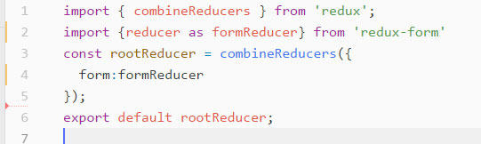
The store should know how to handle actions coming from the form components. To enable this, we need to pass the formReducer to your store. It serves for all of your form components, so you only have to pass it once.
PASSING THE formReducer TO STORE

Slide 3
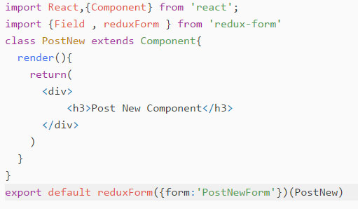
Import the Field and reduxForm methods from ‘redux-form’ module and use redux-form method like connect for connecting the redux form to component
IMPORT {Field , reduxForm} in component

Slide 4
FUNDAMENTAL FORM USING FIELD IN REDUX FORM
FUNDAMENTAL 1
The name prop is required. It is a string path, in dot-and-bracket notation, corresponding to a value in the form values. It may be as simple as 'firstName' or as complicated as contact.billing.address[2].phones[1].areaCode.

Slide 5
FUNDAMENTAL FORM USING FIELD IN REDUX FORM
FUNDAMENTAL 2
The component prop is required. It may be a Component, a stateless function, or a factory, like those provided under React.DOM.

Slide 6
FUNDAMENTAL FORM USING FIELD IN REDUX FORM
FUNDAMENTAL 3
All other props will be passed along to the element generated by the component prop.

Slide 7
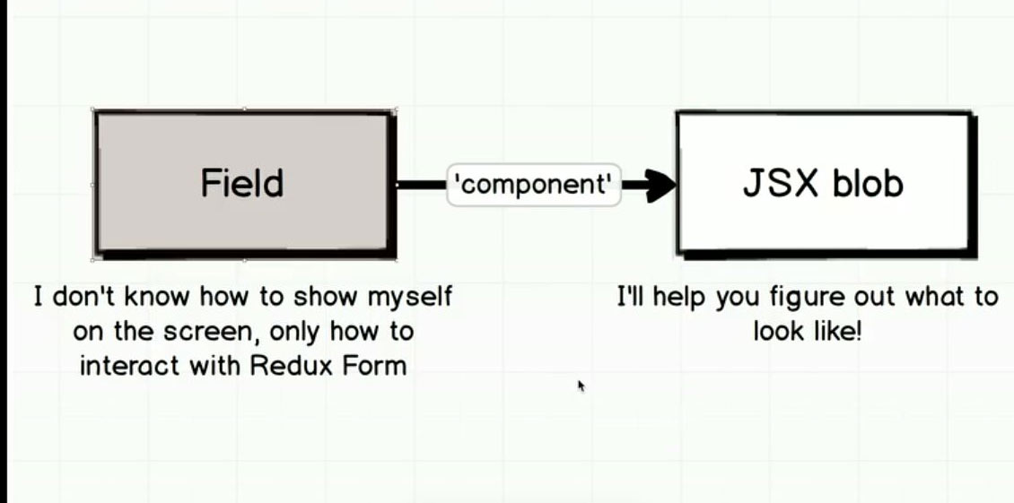
IMPORTANT

Slide 8
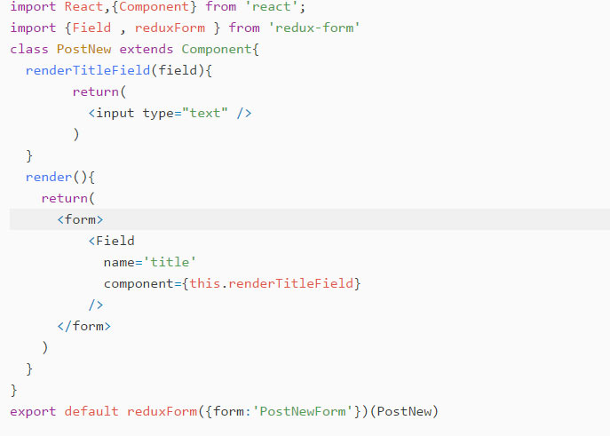
EXAMPLE OF USING FEILD

Slide 9
GENERALIZING THE FIELDS
Using One render function for multiple fields

Slide 10
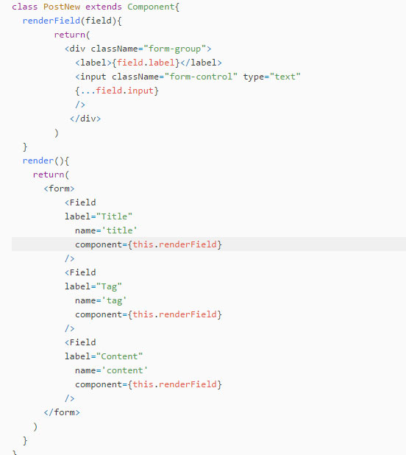
EXAMPLE OF USING FEILD

Slide 11
FORM VALIDATION

Slide 12
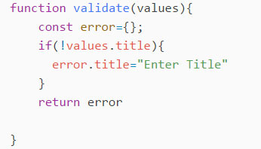
VALIDATION STEPS
Step 1
Define an function with values parameter.
Create an Error empty object

Slide 13
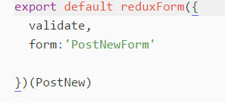
VALIDATION STEPS
Step 2
Call function as a property in reduxForm

Slide 14
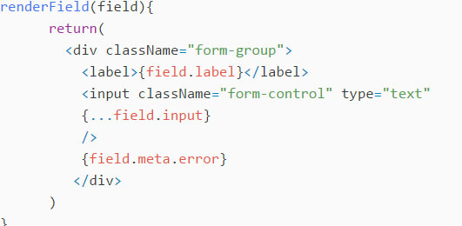
VALIDATION STEPS
Step 3
Show error to User

Slide 15
HANDLING FORM
SUBMITTAL

Slide 16
handleSubmit IN REACT
handleSubmit
redux-form covers handleSubmit functionality by providing a respective handler that you pass as a prop - that is, a handleSubmit method for you to pass to onSubmit.
With that in mind, you can think of the redux-form handleSubmit as a middle layer for your form's submit handler. Simply write your components as you normally would, passing handleSubmit where appropriate

Slide 17
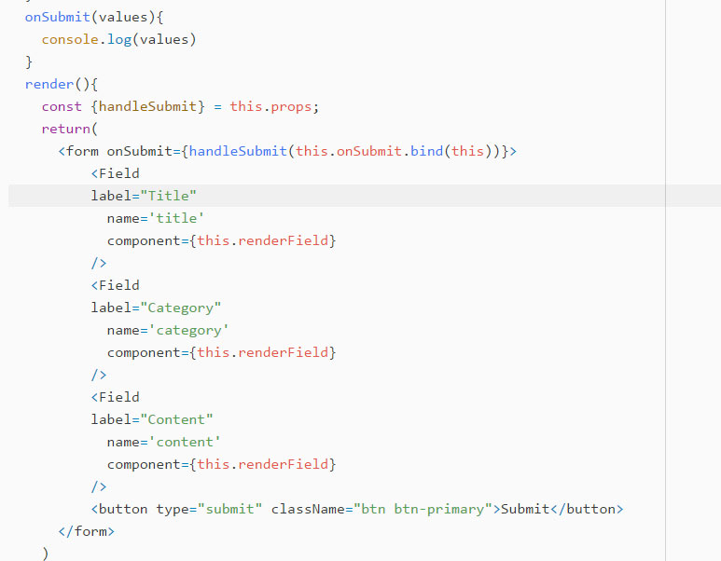
handleSubmit EXAMPLE

