Slide 1
Weather App in React
51. App Overview and Planning
52. Component Setup
53. Controlled Components and Binding Context
54. Form Elements in React
55. Working with API's
56. Introduction to Middleware
57. Ajax Requests with Axios
58. Redux-Promise in Practice
59. Redux-Promise Continued
60. Avoiding State Mutations in Reducers
61. Building a List Container
62. Mapping Props to a Render Helper
63. Quick Note
64. Adding Sparkline Charts
65. Making a Reusable Chart Component
66. Labeling of Units
67. Google Maps Integration
68. Google Maps Integration Continued
69. Project Review

Slide 2
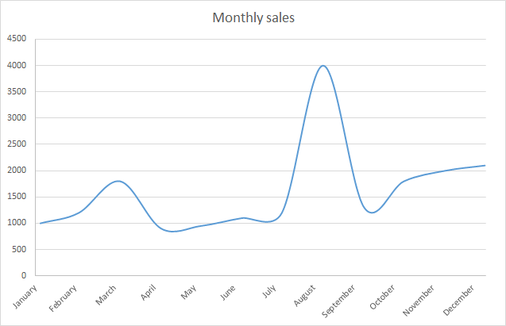
App Wireframe
Search
Search
City | Temperature | Humidity | Pressure
Delhi
Jaipur

Slide 3
Dependencies
openweathermap.org API
redux-promise
Axios
Lodash
react-sparklines

Slide 4
Component Setup
Make a container component for search bar and weather list because both component will access the redux state so first we will add a directory named containers and search bar and weather list component will be created in containers directory.
Search Bar Component(containers/search_bar.js)
Weather List Component(containers/weather_list.js)
import React,{Component} from 'react';
class SearchBar extends Component{
render(){
return(
<div>
<h6> This is Search bar component </h6>
</div>
)
}
}
export default SearchBar;
import React,{Component} from 'react';
class WeatherList extends Component{
render(){
return(
<div>
<h6> This is Weather List component </h6>
</div>
)
}
}
export default WeatherList;

Slide 5
Controlled Components and Binding Context
A Controlled Component is one that takes its current value through props and notifies changes through callbacks like onChange. A parent component "controls" it by handling the callback and managing its own state and passing the new values as props to the controlled component. You could also call this a "dumb component".
import React,{Component} from 'react';
class SearchBar extends Component{
constructor(props){
super(props);
this.state={
term:''
}
this.SerchChange=this.SerchChange.bind(this);
}
SerchChange(event){
this.setState({
term:event.target.value
})
}
render(){
return(
<div>
<form className="input-group">
<input onChange={this.SerchChange} className="form-control" />
<span className='input-group-btn'>
<button type="submit" className="btn btn-primary">Search</button>
</span>
</form>
<p>{this.state.term}</p>
</div>
)
}
}
export default SearchBar;

