Slide 1
Java and Advanced Data Structures
Session 3 – Recursion and Binary Search tree

Slide 2
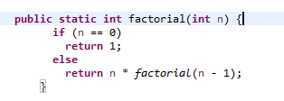
Recursion
Recursion is a programming technique in which a method can call itself to solve a problem and A recursive algorithm is one that refers to itself.
Factorial

Slide 3
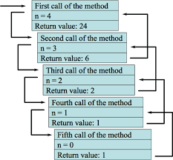
Function call stack

Slide 4
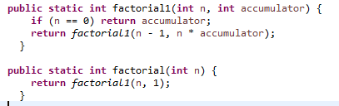
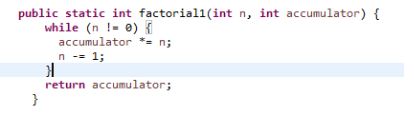
Tail Recursion
Tail recursion is a special kind of recursion where the recursive call is the very last thing in the function.
Since the current recursive instance is done executing at that point, saving its stack frame is a waste.

Slide 5
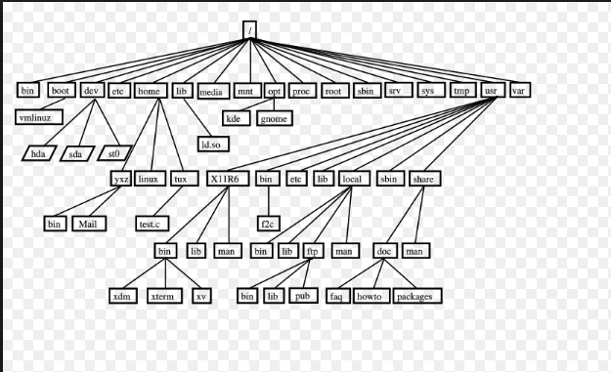
Tree
A tree is a finite nonempty set of elements.
It is an abstract model of a hierarchical structure.
consists of nodes with a parent-child relation.
Applications:
Organization charts
File systems
Programming environments

Slide 6
Tree Terminology
Root: node without parent (A)
Siblings: nodes share the same parent
Internal node: node with at least one child (A, B, C, F)
External node (leaf ): node without children (E, I, J, K, G, H, D)
Ancestors of a node: parent, grandparent, grand-grandparent, etc.
A
B
C
D
E
F
G
H
I
J
K

Slide 7
Tree Terminology
Descendant of a node: child, grandchild, grand-grandchild, etc.
Depth of a node: number of ancestors
Height of a tree: maximum depth of any node (3)
Degree of a node: the number of its children
Degree of a tree: the maximum number of its node.
Subtree: tree consisting of a node and its descendants
A
B
C
D
E
F
G
H
I
J
K

Slide 8
Benefits
Provides faster insertion/deletion and search operations O(log(n))

Slide 9
Different types
Binary Tree
Binary Search Tree
Height balanced Tree
B Tree

Slide 10
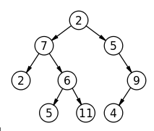
Binary Tree
binary tree is a tree data structure in which each node has at most two children, which are referred to as the left child and the right child.

Slide 11
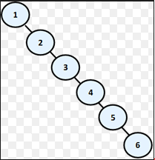
Skewed Tree
Insertion in Sorted order in Binary Tree. It will give worst case performance and similar to linked list.
How to solve ?

Slide 12
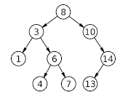
Binary Search Tree
A BST is an ordered binary tree
the keys in the left subtree L < P;
the keys in the right subtree R > P;
duplicate keys are not allowed.

Slide 13
Common Operations
Insert
Delete
Search
Max
Min
Traversals

Slide 14
Common Operations
Insert

Slide 15
Common Operations
Insert sorted array

Slide 16
Common Operations
Delete
https://www.cs.usfca.edu/~galles/visualization/BST.html

Slide 17
Common Operations
Search

Slide 18
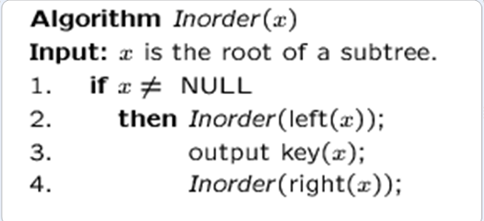
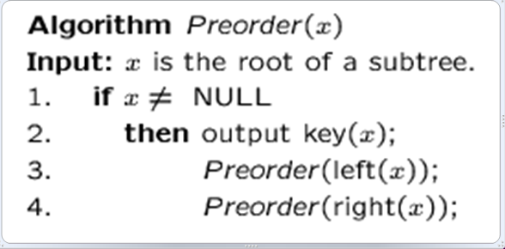
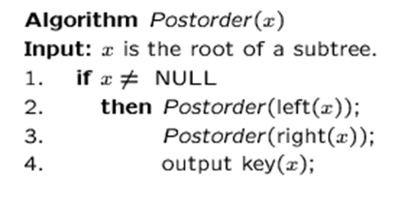
Tree traversals
In-Order Traversal (left –root-right )
Pre-Order Traversal (root –left-right )
Post-Order Traversal (left –right-root )

Slide 19
Examples
A
B
C
D
E
F
G
H
I

Slide 20
Examples
A
B
C
D
E
F
G
H
I
D–>B->H->E->I->A->F->C->G

Slide 21
Examples
A
B
C
D
E
F
G
H
I

Slide 22
Examples
A
B
C
D
E
F
G
H
I
A–>B->D->E->H->I->C->F->G

Slide 23
Examples
A
B
C
D
E
F
G
H
I

Slide 24
Examples
A
B
C
D
E
F
G
H
I
D–>H->I->E->B->F->G->C->A

Slide 25
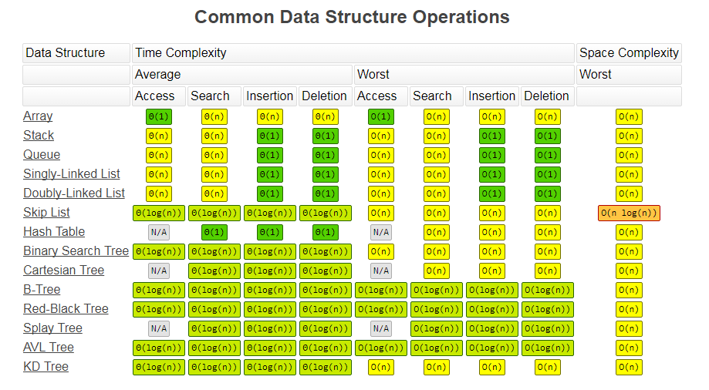

Slide 26
Common Operations and Complexity
 | Access | Search | Insertion | Deletion
Array | Θ(1) | Θ(n) | Θ(n) | Θ(n)
Stack | Θ(n) | Θ(n) | Θ(1) | Θ(1)
Queue | Θ(n) | Θ(n) | Θ(1) | Θ(1)
Linked List | Θ(n) | Θ(n) | Θ(1) | Θ(1
Binary Search Tree | Θ(log(n)) | Θ(log(n)) | Θ(log(n)) | Θ(log(n))

Slide 27
Common Operations and Complexity

Slide 28
Use cases
Expression solvers
Syntax Analysis of source code
Database Indexing

Slide 29
Assignment
Due Date – 22nd September 2017

Slide 30
Additional Material
http://wiki.c2.com/?TailRecursion
https://www.cs.usfca.edu/~galles/visualization/BST.html
https://visualgo.net/en/bst

Slide 31
Session 2 & 3 Pre-reads
Topic | Theory | Implementation | Java’s API
Time Complexity | Computational Complexity Big O Notation
Recursion | Recursion Recursion - older | Algorithms: Recursion | Intermediate Java Tutorial - 3 - Recursion
Arrays | Arrays CS50 2016 - Week 2 - Arrays(Longer Version) | Derek Banas - Arrays | Tutorials 27 to 33 of Java (Beginner) Programming Tutorials

Slide 32
Session 2 & 3 Pre-reads
Topic | Theory | Implementation | Java’s API
Linked List | Structures Singly-Linked List Doubly-Linked Lists | Data Structures: Linked Lists | Tutorials 4 – 8 of Intermediate Java Tutorial
Stacks | Stacks | Data Structures: Stacks and Queues | Intermediate Java Tutorial - 14 - Stacks, push, pop
Queues | Queues Queues – Older Session | Data Structures: Stacks and Queues | Intermediate Java Tutorial - 15 - Queue

