Slide 1
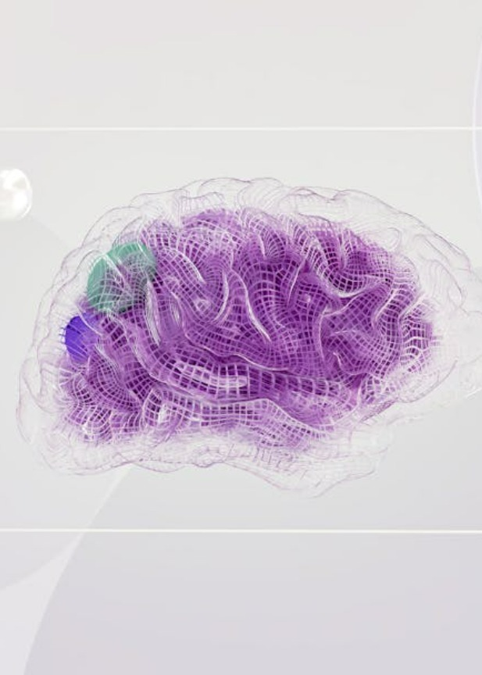
🧠 AI Concepts & Deep Learning
Today’s Agenda
What is Artificial Intelligence?
Applications of AI in Real Life
Evolution of AI ➝ ML ➝ DL
What is Deep Learning?
How Does Deep Learning Work?
Hands-On Practice

Slide 2
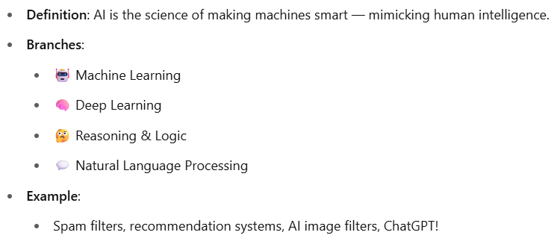
What is Artificial Intelligence?

Slide 3
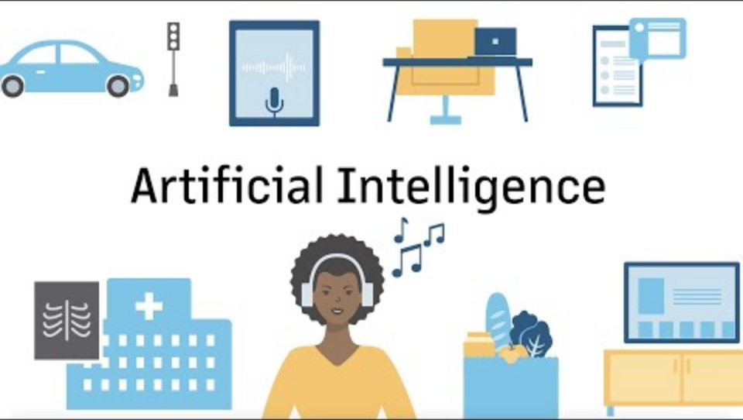

Slide 4
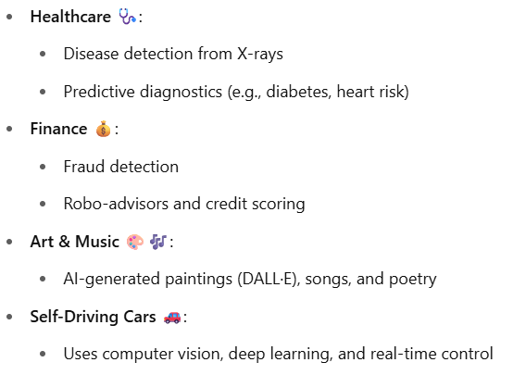
Applications of AI in Real Life

Slide 5
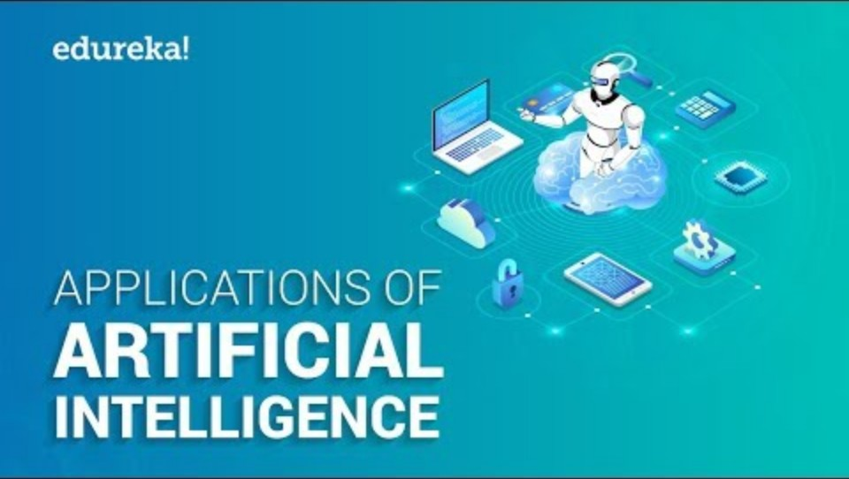

Slide 6
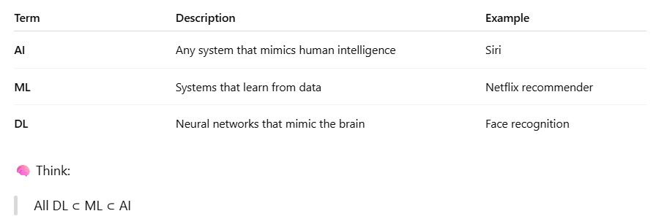
Evolution of AI ➝ ML ➝ DL

Slide 7
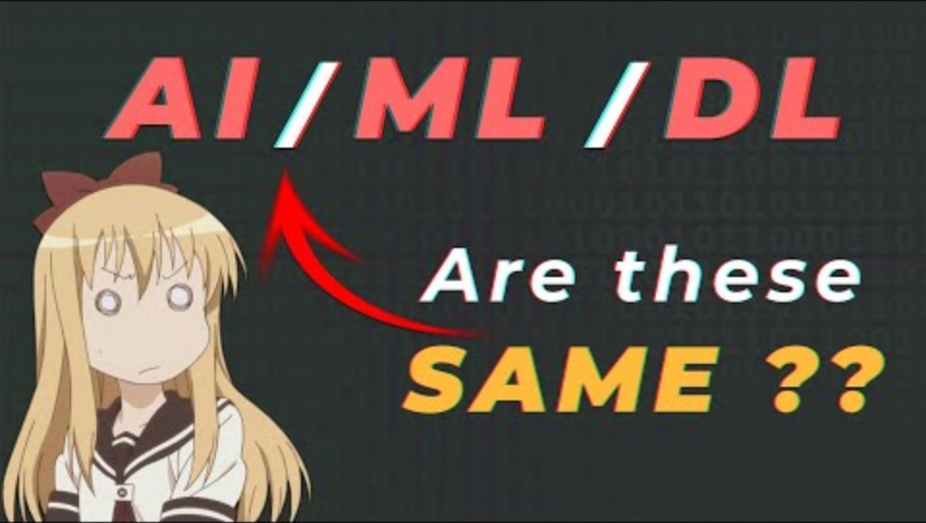

Slide 8
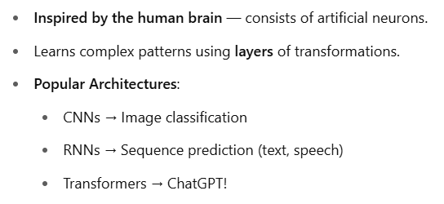
What is Deep Learning?

Slide 9
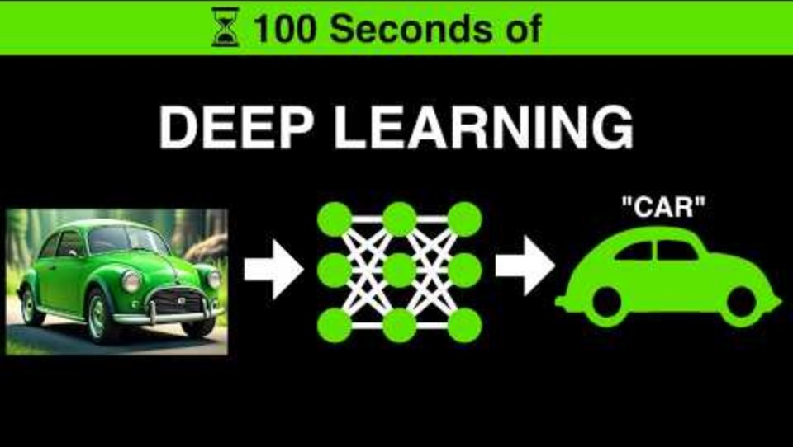

Slide 10
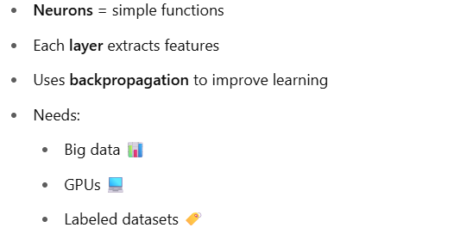
How Does Deep Learning Work?

Slide 11
