Slide 1

Google Developer Student Clubs
Web Development Workshop
Day 3
- Introduction to JavaScript

Slide 2
What is Javascript?
a lightweight programming language, a scripting language i.e. it is designed for executing scripts or small programs within a host environment, such as a web browser.
used to make web pages interactive
insert dynamic text into HTML (ex: user name)
react to events (ex: page load user click)
perform calculations on user's computer (ex: form validation)
get information about a user's computer (ex: browser type)

Slide 3
What is JavaScript for?
What is the purpose of code that we find in the <script> tag?
Perform calculations by using variables, expressions, conditional statements, loops and functions.
Wait for events to occur and take actions when they do. (For example: what happens when a button gets clicked?)
Manipulate the HTML tags found in the <body>
This is what JavaScript has been traditionally used for. These are all actions that take place when JavaScript runs inside in a web browser like Chrome.
JavaScript can also run outside the browser, in its own environment called a node. That implementation of JavaScript is called node.js. Node.js is not covered in this session.

Slide 4
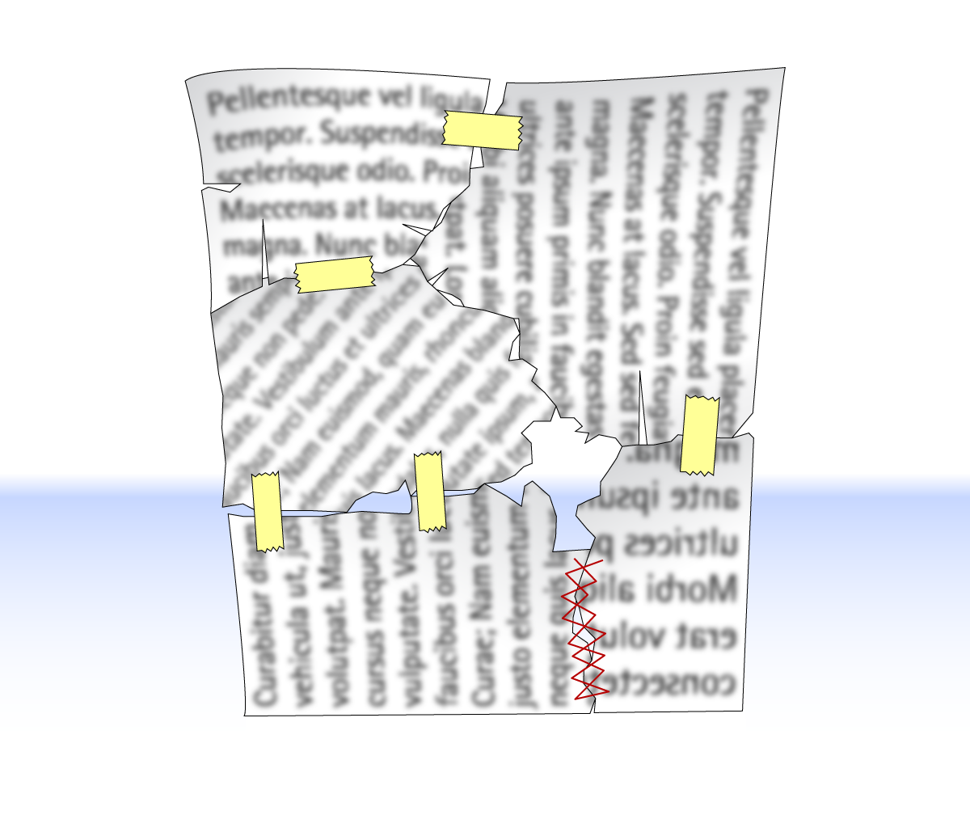
HTML + CSS + JavaScript

Slide 5
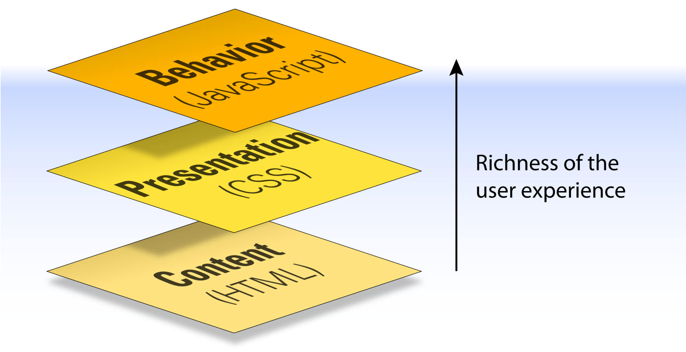
Separation of Concerns

Slide 6
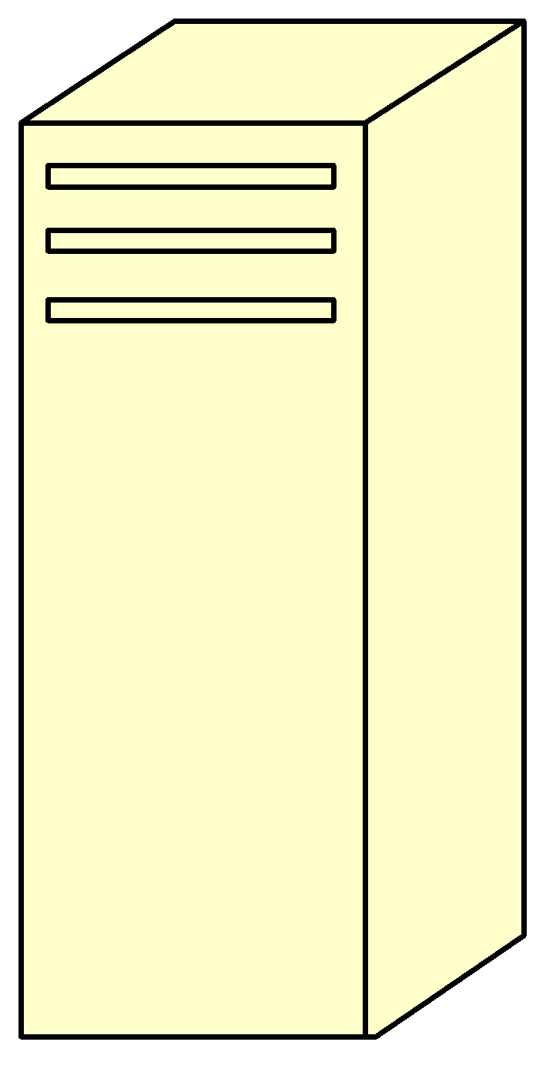


JavaScript is primarily a Client-side Language
User-agent (web browser) requests a web page
http request
http response
Web page (with JavaScript) is sent to PC
JavaScript is executed on PC
Can affect the webpage itself

Slide 7
Why use client-side programming?
client-side scripting (JavaScript) benefits:
usability: can modify a page without having to post back to the server (faster UI)
efficiency: can make small, quick changes to page without waiting for server
event-driven: can respond to user actions like clicks and key presses
client-side scripting (JavaScript) disadvantages:
security: has access to server's private data; client can't see source code
compatibility: not subject to browser compatibility issues
power: can write files, open connections to servers, connect to databases, ...

Slide 8
Putting all together
Javascript
Libraries
.html file
.css
file
application
Web browser
Firefox/ Safari
image and audio files
.js
file
interprets
displays
Style(.css)
Libraries
Prepare/edit files

Slide 9
Console
Browser debuggers have “Console” where can type any JavaScript code
Can see the values of global variables
Can assign values, define functions, evaluate code
“Sources” tab allows breakpoints, editing code
But not saved, so just for experiments
At breakpoints, can see stack (“Scope” tab)
Run code in the context of that function
console.log(anything); output anything to the console without stopping
alert("I am an alert box!");pause

Slide 10
Where can you put JavaScript?
Like styles, can be external, internal, or inline
Use these for different situations
Can be placed In the HMTL page anywhere inside body or head of the html document.
Best practice is to put it at the end of the body.
Commands in JavaScript are case sensitive.

Slide 11
Body example
<html>
<head>
</head>
<body>
<script type="text/javascript">
document.write("This message written by JavaScript");
</script>
</body>
</html>

Slide 12
External JavaScript
External scripts are practical when the same code is used in many different web pages.
JavaScript files have the file extension “.js”.
To use an external script, put the name of the script file in the source (src) attribute of the <script> tag.
<!DOCTYPE html>
<html>
<body>
<script src="myScript.js"></script>
</body>
</html>

Slide 13
Example: “Hello World” displayed using JavaScript
<html>
<head><title>Hello World</title></head>
<body>
<script type="text/javascript">
document.write("Hello World")
</script>
<noscript>
Your browser doesn't support or has disabled JavaScript
</noscript>
</body>
</html>
Notes:
$paper =array(“Copier”, Inkjet”, “Laser”, “Photo”);

Slide 14
JS is Dynamically Typed
Never declare the type of variables, parameters, functions, etc.
let i = 3; i="str"; i = null;
Special undefined value: let x; 🡪 undefined
Arrays can contain multiple types: [3, "foo"]
Numbers are 23 or 45.3 (no distinction int <-> float)
Automatic conversion: "5"+2+3 🡪 "523"
Vs. 2+3+"5" 🡪 "55" or "11" - 1 = 10
str.length note NOT a method str.length()
But lots of other string methods, e.g., str.trim()
Like Java, strings are immutable (cannot change):
str[2] = 'p'; doesn’t work
All string methods return new strings
Empty string "", undefined, null, 0 are all false: if(b){}

Slide 15
Declaring variables
let x – block scope – inside { }
var x – function scope – anywhere in the function
Either at top-level of file – global scope (all code running on this web page)
Reset if page is reloaded
const x – block scope, and cannot be reassigned, so assign on declaration const x = 123;
x = 4; error
But if x is an object or array, it can be modified const x = [2,3]; x[0]=5; OK

Slide 16
Variables
var name = expression; JS
var clientName = "Connie Client";
var age = 32;
var weight = 127.4; JS
variables are declared with the let keyword (case sensitive)
types are not specified, but JS does have types ("loosely typed")
Number, Boolean, String, Array, Object, Function, Null, Undefined
can find out a variable's type by calling typeof

Slide 17
Special values: null and undefined
var ned = null;
var benson = 9;
// at this point in the code,
// ned is null
// benson's 9
// caroline is undefined JS
undefined : has not been declared, does not exist
null : exists, but was specifically assigned an empty or null value
Why does JavaScript have both of these?

Slide 18
String type
var s = "Connie Client";
var fName = s.substring(0, s.indexOf(" ")); // "Connie"
var len = s.length; // 13
var s2 = 'Melvin Merchant'; JS
methods: map, foreach , charAt, charCodeAt, fromCharCode, indexOf, lastIndexOf, replace, split, substring, toLowerCase, toUpperCase
charAt returns a one-letter String (there is no char type)
Length is a property
Strings can be specified with “” or ‘’
concatenation with + :
1 + 1 is 2, but "1" + 1 is "11"

Slide 19
More about String
escape sequences: \' \" \& \n \t \\
converting between numbers and Strings:
var count = 10;
var s1 = "" + count; // "10"
var s2 = count + " bananas, ah ah ah!"; // "10 bananas, ah ah ah!"
var n1 = parseInt("42 is the answer"); // 42
var n2 = parseFloat("booyah"); // NaN JS
accessing the letters of a String:
var firstLetter = s[0]; // fails in IE
var firstLetter = s.charAt(0); // does work in IE
var lastLetter = s.charAt(s.length - 1); JS

Slide 20
The + Operator Used on Strings
To add two or more string variables together, use the + operator.
txt1="What a very"; txt2="nice day"; txt3=txt1 + txt2;
After the execution of the statements above, the variable txt3 contains "What a very nice day".
To add a space between the two strings, insert a space into one of the strings:
txt1="What a very "; txt2="nice day"; txt3=txt1 + txt2;
or insert a space into the expression:
txt1="What a very"; txt2="nice day"; txt3=txt1+" "+txt2;

Slide 21
Splitting strings: split and join
var s = "the quick brown fox";
var a = s.split(" "); // ["the", "quick", "brown", "fox"]
a.reverse(); // ["fox", "brown", "quick", "the"]
s = a.join("!"); // "fox!brown!quick!the" JS
split breaks apart a string into an array using a delimiter
can also be used with regular expressions (seen later)
join merges an array into a single string, placing a delimiter between them

Slide 22
Logical operators
> < >= <= && || ! == != === !==
most logical operators automatically convert types:
5 < "7" is true
42 == 42.0 is true
"5.0" == 5 is true
=== and !== are strict equality tests; checks both type and value
"5.0" === 5 is false

Slide 23
Arrays
var name = []; // empty array
var name = [value, value, ..., value]; // pre-filled
name[index] = value; // store element JS
var ducks = ["Huey", "Dewey", "Louie"];
var stooges = []; // stooges.length is 0
stooges[0] = "Larry"; // stooges.length is 1
stooges[1] = "Moe"; // stooges.length is 2
stooges[4] = "Curly"; // stooges.length is 5
stooges[4] = "Shemp"; // stooges.length is 5 JS
Notes:
two ways to initialize an array
length property (grows as needed when elements are added)

Slide 24
Array methods
var a = ["Stef", "Jason"]; // Stef, Jason
a.push("Brian"); // Stef, Jason, Brian
a.unshift("Kelly"); // Kelly, Stef, Jason, Brian
a.pop(); // Kelly, Stef, Jason
a.shift(); // Stef, Jason
a.sort(); // Jason, Stef JS
array serves as many data structures: list, queue, stack, ...
methods: concat, join, pop, push, reverse, shift, slice, sort, splice, toString, unshift
push and pop add / remove from back
unshift and shift add / remove from front
shift and pop return the element that is removed

Slide 25
Using Comments
Single-line comment
// This is a comment
Multiline comments
/* This is a section
of multiline comments
that will not be
interpreted */
You cannot nest multiline comments, so make sure that you don’t comment out large sections of code that already contain multiline comments.

Slide 26
Local Variables
Parameters passed to a function automatically have local scope.
Arrays are exception and are passed to a function by reference.
Modifying any elements in an array parameter will change the elements of the original array.
To define a local variable that has scope only within the current function use the let keyword.
Example:
<script>
function test()
{ a = 123 // Global scope
let b = 456 // Local scope
}
</script>

Slide 27
Global Variables
Every part of a script have access global variables.
Global variables are:
Variables defined outside of any functions
Defined within functions without the var or let keyword
Examples:
a = 123 // Global scope
let b = 456 // Global scope

Slide 28
Example: Dynamic Welcome Page
A script can adapt the content based on input from the user or other variables
Example:
A prompt box is often used if you want the user to input a value before entering a page.
When a prompt box pops up, the user will have to click either "OK" or "Cancel" to proceed after entering an input value.
If the user clicks "OK“, the box returns the input value. If the user clicks "Cancel“, the box returns null.
<html>
<body>
<script type="text/javascript">
var name;
name=prompt ("Please enter your name", "student");
document.write("<h1>Hello, " + name + ", Welcome to COMP 205!</h1>");
</script>
</body>
</html>

Slide 29
Functions
Functions are a block of code that accomplishes some task which may or may not receive input and may or may not return values.
function myFunction(p1, p2) { return p1 * p2; }
Empty parameters: function myFunc() {}
If no return or if it has return; then returns undefined
Functions can be values: let f = myFunction;
() signals to invoke it: f(1,2);

Slide 30
Anonymous functions
Shorter way to write function definitions
Especially useful when shorter
Very popular, but harder to read
Many people use them exclusively
Emphasizes that the function is a value connected to the name
const hello = function() { return "Hello World!"; }
Arrow functions
hello = () => {return "hello"}; hello = () => "Hello"; omit {} and return if one line hello = (val) => "Hello" + val; parameter hello = val => "Hello" + val; omit () if only one parameter
function hello() { return "Hello World!"; }

Slide 31
Triggering functions
E.g., to call initDetails function when page is loaded, put this in the html file: <body onload="initDetails()">
Call function when button is pressed: myButton.addEventListener("click", myfunction) or element.onclick = myfunction;

Slide 32
Functions are values
Javascript is a functional language
Functions can be stored as values of variables, passed as parameters, and so on
Using the average function :
let f = average;
let result = f(6, 7) // result is 6.5
f = Math.max;
result = f(6,7) // result is 7

Slide 33
Data objects (1)
JavaScript has always had objects, but without classes until recently
A JavaScript object is simply a set of key/value pairs (often called “properties”). Example:
let person = {
name: “Lisa Simpson”, age: 30
}
Note: defined inside of {} (vs. [] for arrays)
Both separated by ,
Once you have an object, you reference properties with “ . ” notation:
let age = person.age;

Slide 34
Data objects (2)
You can add properties
person.instrument = “flute”
Any value can be a function 🡪 method: person.retirementTime = function() {return 64 - this.age;}
Usually use arrow functions
Bracket notation can be used to reference properties
person[“instrument”] = “saxophone”
And properties can be deleted
delete person.age
Property names can be computed
what = “instrument”
person[what] = “tenor sax”

Slide 35
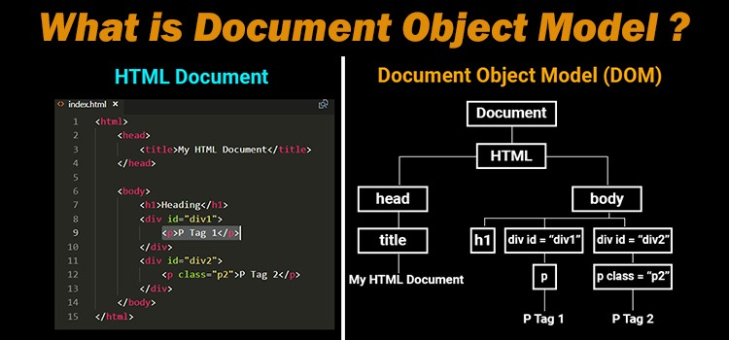
DOM (Document Object Model)

Slide 36
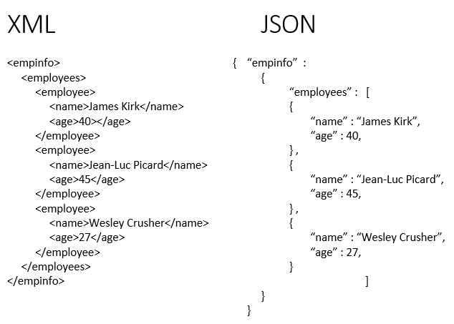
Javascript JSON JSON is a native Javascript format. You can read and write to it directly using a selector. So there is no complicated parsing of data being exchanged, as there is in XML.
https://www.w3schools.com/js/js_json_intro.asp https://www.json.org/

Slide 37


Your Turn!
Remember: It takes practice!!!
In programming there is a HUGE difference between “understanding” and actually being able to “do it”.
Trust me on this one… ya gotta practice.
Go back through every JavaScript example in this lecture and try them out for yourself.
Simply feeling like you “got it” isn’t enough. It is very different when you start typing things out on your own.
Do it… You do not want to fall behind in JavaScript.

