Slide 1
Docker

Slide 2
Docker - a light weight virtual machine
own process space
own network interface
can run stuff as root
can install packages
can run services
can mess up routing, iptables

Slide 3



What makes containers possible ?

Slide 4
NAMESPACES
MNT file system
NET network
UTS hostname
PID process
USER user
IPC inter process communication

Slide 5
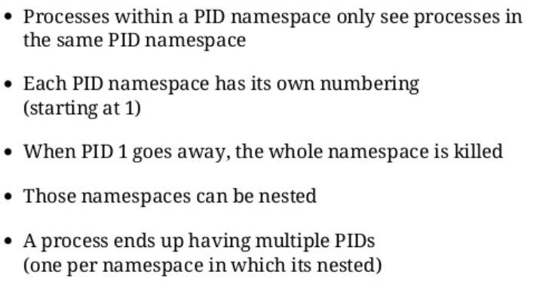
pid namespace

Slide 6
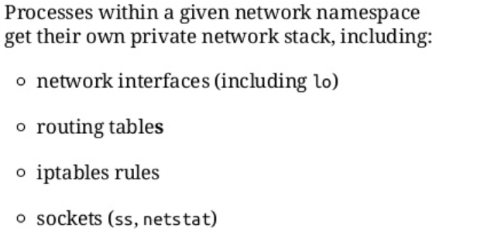
Net namespaces

Slide 7
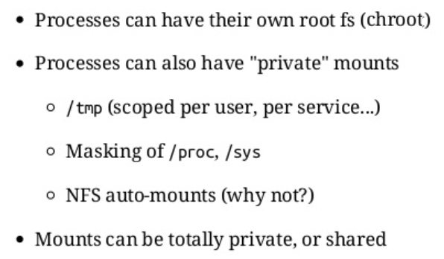
MNT namespace

Slide 8

Uts namespace

Slide 9

user namespaces

Slide 10
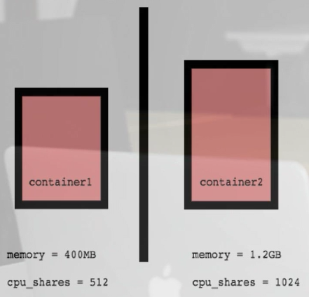
Control Groups
Resource metering and limiting
Memory
CPU
Block IO
Network

Slide 11

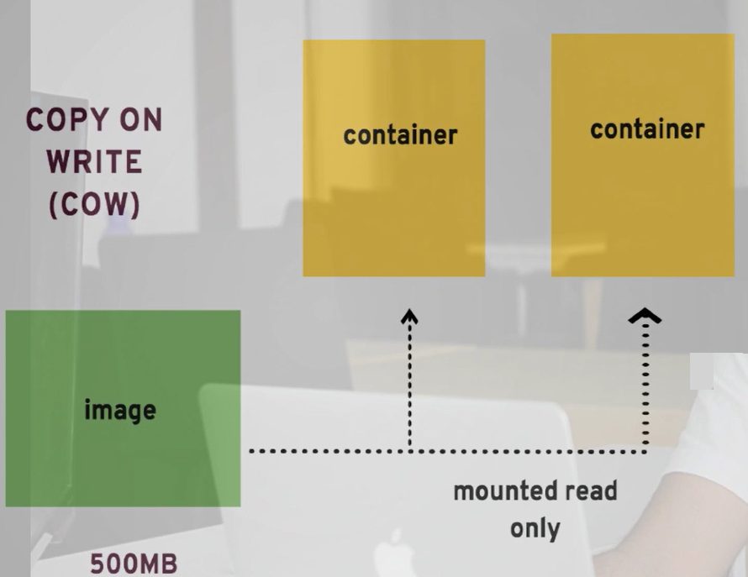


Overlay FS

Slide 12
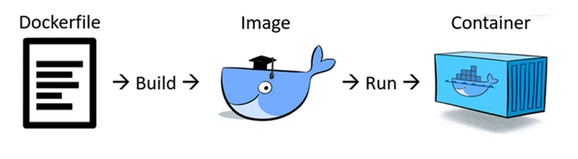
Dockerfile

Slide 13
FROM
Valid docker file should start with FROM
- ARG is the only command that can appear before FROM.
Multiple times.
Clears state.
Different forms
- FROM: tag/digest
- FROM ubuntu:latest AS abc
- FROM ubuntu:latest AS abc

Slide 14
Dockerfile - Execution
CMD
ENTRYPOINT
RUN

Slide 15
RUN
Build time instruction
often used for installing software packages
Executes command(s)
Creates new layer and creates a new image
Two types
RUN param
RUN apt-get update
RUN ["executable", "param", "param2"]
RUN ["/bin/bash", "-c", "echo hello"]
Use to install apps
FROM alpine:latest
RUN echo "hello world"

Slide 16


RUN
Shell form
exec form
RUN echo "hello world"
RUN [ "echo", "$HOME" ]

Slide 17
CMD
Runtime instruction
Execute the instruction during the container at launch time.
Default instruction
This instruction can be overriden when you run.
One per dockerfile
Last one will be executed
Three types
CMD ["<executable>","<param1>","<param2>"]
Shell form
CMD <command> <param1> <param2>
Default to entrypoint
CMD ["<param1>","<param2>"]

Slide 18
CMD
Shell form
exec form
FROM ubuntu
CMD echo "This is a test." | wc -
FROM ubuntu
CMD ["/usr/bin/wc","--help"]
Overriding the default Command
docker build -t cmd-test -f 3.cmdDockerfile .
docker run cmd-test ping google.com
docker run -it cmd-test ls -ltr

Slide 19
ENTRYPOINT
Allows you to configure a container that will run as an executable.
Override all elements in CMD
Default shell
Only one entrypoint
Last one

Slide 20
ENTRYPOINT
Allows you to configure a container that will run as an executable.
Shell form
exec form
ENTRYPOINT top -b
ENTRYPOINT [ "echo", "$HOME" ]

Slide 21
RUN / CMD / ENTRYPOINT
RUN
Build time
Install softwares in images
CMD
Run time
To execute commands in runtime during container launch
Mainly used to specify defaults which are executed after entrypoint
ENTRYPOINT
Runtime
Also used to run commands when container starts.
Mainly used for converting your image as an executable.

Slide 22
ENV
Lets you set environment variables that you can in your Dockerfile, and they'll also be set within the environment of your running container.
FROM ubuntu
ENV HOME /root
CMD echo Read ${HOME}/readme.txt

Slide 23
COPY & ADD
COPY | ADD
Copy one or more file/directory from host to destination. Can use wild character Referenced from WORKDIR or absolute reference Destination is created if missing. Copied at build time Local files always use copy | - Everything that Copy supports + Copy from a URL instead of a local file / directory. Extract a tar file from the source directly into the destination. Copied at build time Use wisely. URL copy can be done using RUN curl. Similarly extract can be done. Appending RUN can reduce the size of image.

Slide 24
EXPOSE
Informs Docker that the container listens on the specified network port(s) at runtime
EXPOSE does not make the ports of the container accessible to the host
Used internally by other containers.

Slide 25
WORKDIR
WORKDIR
WORKDIR </path/to/workdir>
Sets the working directory for
RUN
CMD
ENTRYPOINT
COPY
ADD
Can be used multiple times.
Path can be
Absolute
Relative to previous working directory

Slide 26
ARG
ARG
ARG <name>[=<default value>]
Defines a variable
Pass at build-time.
Multiple variables support
Not for secret keys
ENV override ARG instruction
Predefined
HTTP_PROXY and http_proxy
HTTPS_PROXY and https_proxy
FTP_PROXY and ftp_proxy
NO_PROXY and no_proxy

Slide 27
Other Commands - 1
MAINTAINER
MAINTAINER name mail
VOLUME
Defines mount point
VOLUME [“<PATH>”, “<PATH>”]
USER
Sets username or UID for
- RUN
- CMD
- ENTRYPOINT

Slide 28
VOLUME
FROM alpine:latest
RUN mkdir /data
ADD http://.../somefile1 /data/somefile1
VOLUME /data
CMD somebinary

Slide 29
WORKDIR
Sets the working directory for any RUN, CMD, ENTRYPOINT, COPY, and ADD instructions that follow it.
FROM node:latest
RUN mkdir -p /usr/src/app
WORKDIR /usr/src/app

Slide 30
Containers are ephemeral
Means you should expect them to go down at any moment and lose all data stored inside as containers do not store persistent data.
Any data written to a container's writable layer will no longer be available once the container stops running.

Slide 31
VOLUME
There are three main use cases for Docker data volumes
To keep data around when a container is removed
To share data between the host filesystem and the Docker container
To share data with other Docker containers

Slide 32
VOLUME and Bind Mounts
Field | Volume (-v) | Bind Mounts (-v)
First field | Name of Volume Unique on Host Anonymous volumes : skip this field | Path to file or directory on Host
Second field | Path where the file or directory are mounted in the container. | Path where the file or directory is mounted in the container.
Third field | Optional options like ro | -

Slide 33
Volumes
Bind mounts is a file or folder stored anywhere on the container host filesystem, mounted into a running container. It can exist anywhere on the host filesystem, processes outside of Docker can also modify it.
docker run –it --name bindmount -v /home/docker/mysql-data:/var/lib/mysql mysql
docker run -it --name bindmount --mount type=bind, source= /home/docker/mysql-data,target=/var/lib/mysql mysql
Volumes are the preferred way to store persistent data which docker containers create or use. Docker completely manages them and stores them.
docker run -it --name bindmount --mount type=volume, source= /home/docker/mysql-data,target=/var/lib/mysql mysql

Slide 34
VOLUME
Creates a mount point with the specified name and marks it as holding externally mounted volumes from native host or other containers.
docker volume create data_volume
docker run -v data_volume:/var/lib/mysql mysql
docker run -v data_volume1:/var/lib/mysql mysql

Slide 35
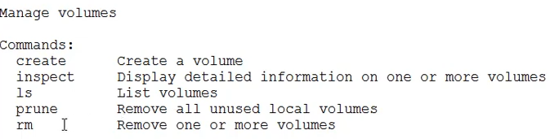
VOLUME

Slide 36
VOLUME
docker run -v ~/sample:/var ubuntu:14.04 ls /var
docker run -v /foo --name data-container busybox
docker run --volumes-from data-container ubuntu:14.04 touch /foo/bar.txt

Slide 37
tmpfs
Stored in memory
Never written to host system’s filesystem.
Can't be shared between containers.
Available only on linux machines.

Slide 38
Advantages of Volume
Volumes are easier to back up or migrate than bind mounts.
You can manage volumes using Docker CLI commands or the Docker API.
Volumes work on both Linux and Windows containers.
Volumes can be more safely shared among multiple containers.
Volume drivers let you store volumes on remote hosts or cloud providers, to encrypt the contents of volumes, or to add other functionality.
New volumes can have their content pre-populated by a container.

Slide 39
Multi-Stage Builds
Method of organizing a Dockerfile to
minimize the size of the final container
improve run time performance
allow better organization of Docker commands and files
provide a standardized method of running build actions

Slide 40
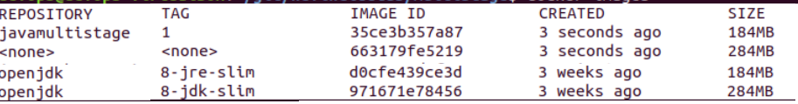
Multi-Stage Builds
is done by creating different sections of a Dockerfile, each referencing a different base image.
FROM openjdk:8-jdk-slim AS builder
RUN echo 'public class Main { public static void main(String[] args) { System.out.println("Hello World"); } }' > Main.java
RUN javac Main.java
FROM openjdk:8-jre-slim
COPY --from=builder /Main.class /
CMD ["java", "Main"]
Docker run –it multi java Main

