Slide 1
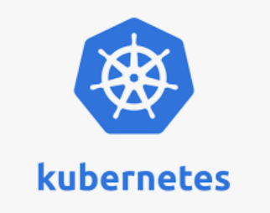


Slide 2
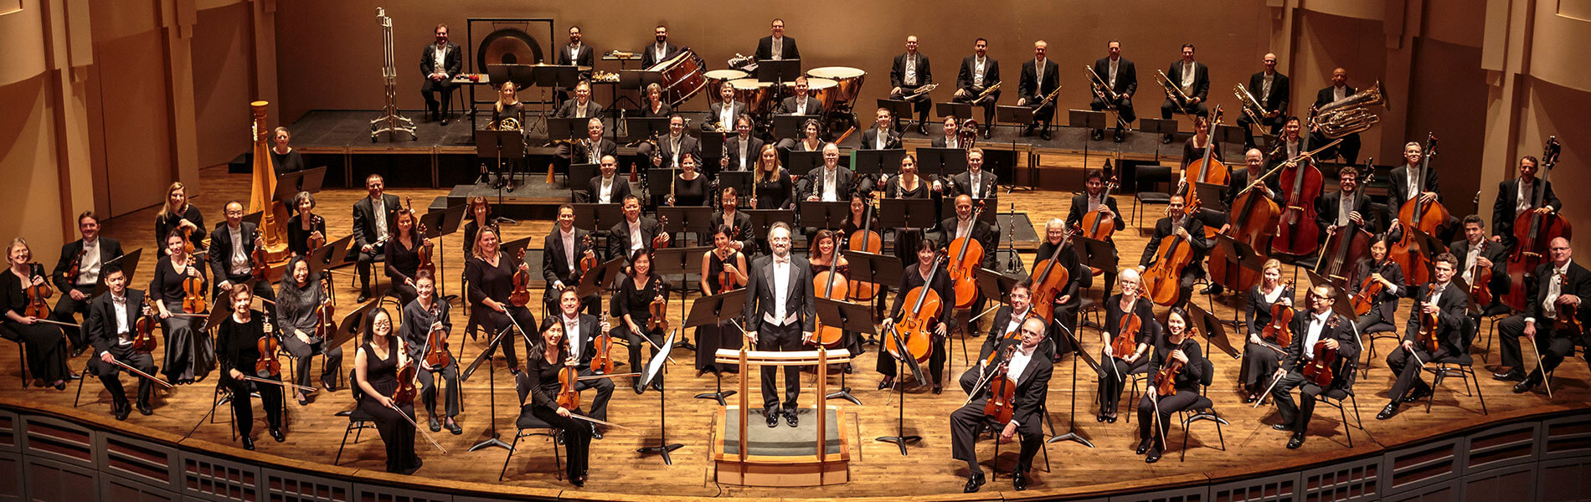
Kubernetes overview

Slide 3
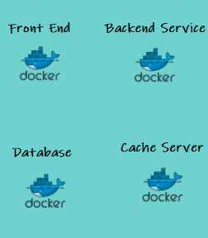
Container Orchestration – Why do we need it ?
Dev
Prod

Slide 4
Challenges in a container environment
How do I decide which container should run on which server ?
How do I know the resource utilization of the servers so that I can deploy my containers based on the resource requirement?
How do I monitor and manage all those server and schedule automate this process ?

Slide 5

Need for Standardization
Notes:
Could you imagine world economy moving like this ? If so how long do you thing you will get your Apple phone in your hand after production ?

Slide 6

If it fits, it ships !

Slide 7
Why Kubernetes (or container orchestration)
Orchestrate containers across multiple hosts
Self organizing and Automatic bin packing
Seamlessly deploy, update and Rollback
Quick and predictable
Self healing
Service discovery and Load balancing
IPAM. Binding to labels
Secret and Configuration Management
Scale out and scale in

Slide 8
Why Kubernetes contd…
Storage orchestration
Optimum hardware utilization
Batch Execution

Slide 9
Software container world
Need to Simplify and standardize how the containers come together to make a usable software system

Slide 10
Why the market has chosen Kubernetes?
Born from a Google internal project (Google BORG)
Google Partnered donated Kubernetes to Cloud Native Computing Foundation
Based on an extensive experience from Google, over a long period of time
Large open source community and project

Slide 11







Kubernetes Architecture – View from 10000 ft
Controller
Kube-proxy

Slide 12
API Server
Interface providing all operations to external world.
Clients can readily communicate with it
Performs administrative tasks
REST
Scale horizontally
Responsibility
Authenticate Clients
Validate Request
Retrieve data
Update ETCD, scheduler and kubelet

Slide 13
ETCD
Stores configuration information
Highly available key value store
Distributed among multiple nodes.
Accessible only by Kubernetes API server
Has sensitive information.
Back up
Only service to backup.
kubectl exec etcd-master -n kube-system etcdctl get / --prefix -keys-only

Slide 14
Controller Manager
The key controllers are
- Node Controller
- Responsible for noticing and responding when nodes go down.
- Replication Controller
- Responsible for maintaining the correct number of pods for every replication controller object in the system.
- Endpoint Controller
- Populates the Endpoints object (that is, joins Services & Pods)
- and Service Account and Token Controller.
- Create default accounts and API access tokens for new namespaces.

Slide 15
Controller Manager
- Watches the desired state and match the current state
- Logically each controller is a separate process
Compiled into a single binary
Run in a single process.
- It is a daemon which
regulates Kubernetes cluster.
- Controller also manages lifecycle functions
- namespace creation and lifecycle,
- event garbage collection,
- terminated-pod garbage collection,
- cascading-deletion garbage collection,
- node garbage collection, etc.

Slide 16
Scheduler
Watches newly created pods and allocates a node.
Schedules the tasks to slave nodes
Stores resource usage information about each node
Considers
quality of the service requirements,
data locality,
affinity,
anti-affinity, etc.

Slide 17
Worker Node
- Can be VM or machine.
- Has container runtime
- Has kubelet, kube-proxy and pod(s)
kubectl get nodes
kubectl describe node <<node name>>

Slide 18
Master to Node Communication
Cluster to Master
All communication to the master on secure HTTPS port (443)
Master to Cluster communication happens between
- Master (api-server) to kubelet
- Master (api-server) to node/pod/service through Kube-proxy.
Master connects to kubelet for
- Master attaching (through kubectl) to running pods
- Fetching logs from pods
- Providing the kubelet’s port-forwarding functionality

Slide 19
Master to Node Communication
Master (api-server) connect to node/pod/service through Kube-proxy.
- Default to plain HTTP connections
- Not encrypted.
- Can be moved to https and secured.

Slide 20
Kubelet
Not inside a container
Service in each node
Relay information to and from control plane service.
Communicates master component
- receive commands and work.
- assumes responsibility
- manages network rules, port forwarding, etc.

Slide 21
Kubernetes Proxy Service
Started as a proxy but Proxy++ now.
- Can do primitive load balancing
- networking is
- predictable
- accessible
- isolated as well.
- manages network for pods, volumes, secrets, health checkup, etc.
- check on host sub-netting
- Ensure that the services are available.
- Sets routes so that POD ect is reachable.

Slide 22
YAML
- What is YAML?
- How to write YAML file

Slide 23
Manifest file
1. apiVersion:
2. kind:
3. metadata:
4. spec:

Slide 24
apiVersion : Manifest file
kind | version
Pod | : v1
ReplicationController | : v1
Service | : v1
ReplicaSet | : apps/v1
Deployment | : apps/v1
DaemonSet | : apps/v1
Job | batch

Slide 25
Kind and metadata : Manifest file
kind: <object type>
metadata:
name:
labels:

Slide 26
kind : Manifest file
spec:
defines the desired state of the object.
For replicas, define a template.
template defines an object.
template can have metadata and spec under it.

Slide 27
Namespaces
Virtual clusters backed by the same physical cluster
Names of resources : unique within a namespace
Namespaces can not be nested
Kubernetes resource can only be in one namespace.
- kubectl get namespaces
default: default namespace for objects with no other namespace
kube-system: The namespace for objects created by the Kubernetes system
kube-public: reserved for cluster usage

Slide 28
Namespaces
Create namespace
kubectl create namespace <name>
Delete namespace
kubectl delete namespaces <name>
Run a container in a namespace
kubectl run nginx --image=nginx --namespace=<ns name>
Get Objects in a ns
kubectl get svc -n kube-system
kubectl describe svc kube-dns -n kube-system
kubectl get pods -o wide -n kube-system
All namespaces
kubectl get pod –-all-namespaces

Slide 29
Namespaces
Namespace
Create: kubectl create ns <Name>
View: kubectl get ns <Name>
kubectl get pod -n <Name>
Delete: kubectl delete ns <Name>
Edit: kubectl edit ns <Name>
kubectl apply -f <fileaname>
Use: kubectl run mynginx --image=nginx -n qa

Slide 30
How to Deploy
1. Pod
2. ReplicationControllers
3. ReplicaSet
4. Deployment
5. DaemonSet
6. StatefulSet

Slide 31
POD Creation
CLI talks to (-) API manager.
API Manager
- authenticates user
- validate request
- Creates and entry in ETCD and returns the message "Pod created!".
- Scheduler is continuously monitoring the changes in ETCD, realizes that a POD has to be created. Scheduler identifies the node where Pod has to be created and informs (call api) API server about it.
- API server updates the ETCD about the node where Pod would be created.

Slide 32
POD Creation
Controller invokes API Server
API server - kubelet
kubelet - Docker
Docker - create POD container.
POD creates (say nginx container)
Docker - creates nginx container.
- Kubelet watches over the container creation.
- Kubelet intimates the API server about Pod creation status
- API server updates the ETCD.

Slide 33
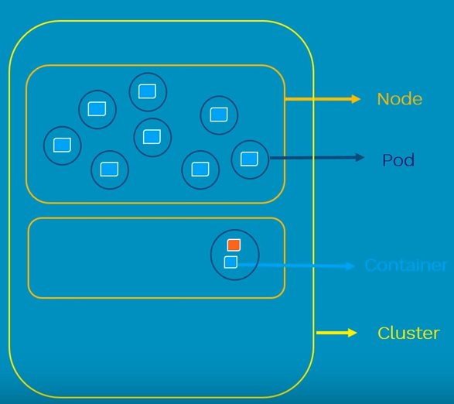
POD
A Pod (as in a pod of whales or pea pod) is a
- group of 2 or more containers
- shared storage/network,
- co-located and co-scheduled,
- run in a shared context.

Slide 34
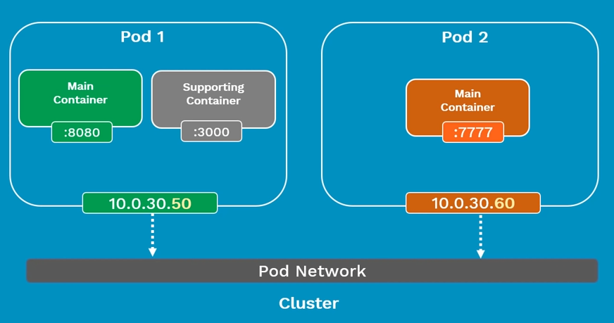
POD

Slide 35
POD
Containers in different Pods have
distinct IP addresses and
Does not communicate by IPC.
These containers can communicate with each other via Pod IP addresses.
ephemeral (rather than durable) entities.
If a Node dies,
the Pods scheduled to that node are scheduled for deletion, after a timeout period.

Slide 36
Uses of POD
Support co-located, co-managed helper programs, such as:
- content management systems, file and data loaders, local cache managers, etc.
- log and checkpoint backup, compression, rotation, snapshotting, etc.
- data change watchers, log tailers, logging and monitoring adapters, event publishers, etc.
- proxies, bridges, and adapters
- controllers, managers, configurators, and updaters

Slide 37
Pod Commands
Pod
create
kubectl create -f <yaml>
kubectl run <name> --image=<image>
view
simple
kubectl get pod <name>
more details
kubectl get pod <name> -o wide
all details
kubectl describe pod <name>
continously monitor
watch -n 1 kubectl get pod
update
kubectl apply -f <name>
delete
kubectl delete pod <name>
kubectl delete -f <name>

Slide 38
Kubernetes for Docker experts
https://kubernetes.io/docs/reference/kubectl/docker-cli-to-kubectl/

Slide 39
Labs of POD
kubectl apply -f nginx-pod.yaml
kubectl get pod
kubectl get pod -o wide
kubectl describe pod <pod id>

Slide 40
Lifecycle of Pod
Optional:
Create a manifest file (yaml or json)
Submit the manifest file to api server using kebectl
It gets scheduled on to a worker node inside the K8s cluster.
pending : scheduled
start downloading images and setting up containers appropriately. remain in pending state until all containers are up and running.
running:
After all containers are running the state of the POD changes to "Running".

Slide 41
Lifecycle of Pod
After the main purpose of the POD is complete,
it succeeds and it's state changes to "Shutdown".
If a POD can't start properly for any reason
It remains in "Pending" state for considerable period of time,
then POD moves to "Failed" state.
If a POD dies,
it is dead.
Cannot make it alive again.
Can replace it with a new one but we cannot bring it up.

Slide 42
Multiple containers in a Pod
We can have multiple containers in a Pod.
Different containers in a Pod share
- Network namespace
- Cgroup (access)
- IP address
- Volumes
- IPC Name
- Can find each other via localhost.
- Communicate with each other using standard inter-process communications.

Slide 43
Labels and Selectors
kubectl apply -f label-selector.yaml
kubectl get pods -l env=development
#-l represents the label we passed.
kubectl delete -f label-selector.yaml

Slide 44
ReplicationController (rc)
What is ReplicationController?
Why do you need to replicate?
How it helps in a microservices world
Ensures that configured number of pods
- if excess, kill.
- if less create.
replicationCount = 1 makes sense

Slide 45
ReplicationController (rc)
Adv
- HA
- Loadbalancing
Labs
kubectl apply -f replication-controller.yaml
kubectl get rc
kubectl get rc -o wide
kubectl describe rc <object>

Slide 46
ReplicaSet (rs)
Advanced version of ReplicationController.
Replacement for ReplicationController.
Works based on sets

Slide 47
ReplicaSet (rs)
Criteria | Equality based | Set based
e.g. | environment = production | enviornment in (production, qa)
 | tier != frontend | tier notin (frontend, backend)
Command line | kubectl get pods –l environment=production | kubectl get pods –l environment in (production, qa)
manifest | selector: environment:production tier: frontend | selector: matchLabels:- {key:environment,operator:In, values:[prod, qa]}
Supports | Services, ReplicationControllers | Jobs, Deployment, ReplicaSet, DaemonSet

Slide 48
Labs for ReplicaSet (rs)
kubectl apply -f replica-set.yaml
kubectl get rs
kubectl get rs -o wide
kubectl describe rs <<rs id>>

Slide 49
Deployment
- Desired state in a Deployment
- DeploymentController : converts desired state to actual state
- Rollback deployment
- Scale up deployment
- Pause deployment
Steps
- Create a deployment
- That creates a ReplicaSet.
- That Creates Pods

Slide 50
Deployment
Status:
- kubectl rollout status deployment.v1.apps/nginx-deployment
Update deployment:
- kubectl --record deployment.v1.apps/nginx-deployment set image deployment.v1.apps/nginx-deployment nginx=nginx:1.9.1
Rollout history:
- kubectl rollout history deployment.v1.apps/nginx-deployment
Rollback:
- kubectl rollout undo deployment.v1.apps/nginx-deployment

Slide 51
Deployment - Windows
Status:
- kubectl rollout status deployment.v1.apps/iisn
Update deployment:
- kubectl --record deployment.v1.apps/iisn set image deployment.v1.apps/iisn iis-container=myiis:2
Rollout history:
- kubectl rollout history deployment.v1.apps/iisn
Rollback:
- kubectl rollout undo deployment.v1.apps/iisn

Slide 52
Scale out
Linux
kubectl scale deployment.v1.apps/nginx-deployment --replicas = 3
Windows
kubectl scale deployment.v1.apps/iisn --replicas = 3

Slide 53
Daemonset and StatefulSet
DaemonSet:
- Only a single instance should run on a node
- An instance should run on all nodes.
- Usecase : for monitoring.
StatefulSet:
- Work along with a service.
- If an instance dies, it would be created back on the same node.
- If the node is not available then it would be kept on pending state.

Slide 54
Services
Is a collection of Pods that is exposed as an endpoint. Is a way of grouping of PODs running in a cluster and how to access them
Different types of Services :
ClusterIP exposes the cluster's internal IP.
NodePort exposes the Service on each node's IP at a static port.
LoadBalancer exposes the Service externally by using a cloud provider's load balancer.

Slide 55
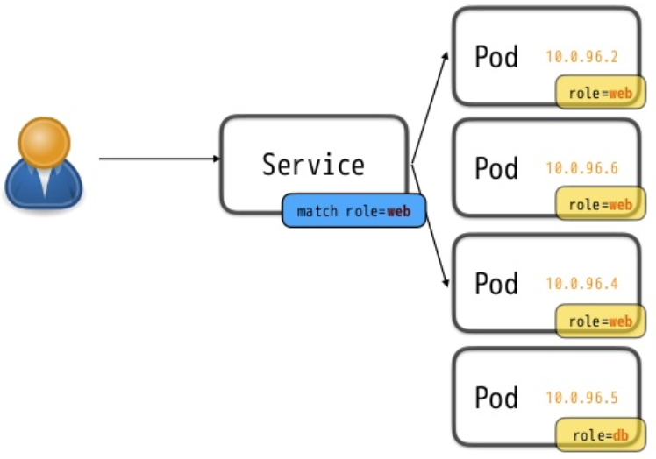
Service
- Pods may die and new PODs are created. How to access the POD as the IP changes
front end Pod talk to back end Pod
external users connect to front end Pod's
Services provide standard services like
- Load balancing
- Service discovery
- Feature to support ZDT app deployment

Slide 56
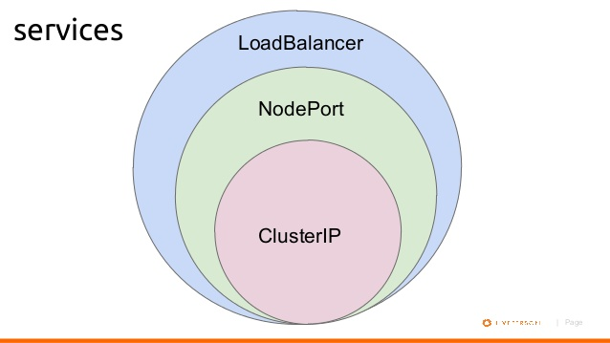
Service
- Pods may die and new PODs are created. How to access the POD as the IP changes
front end Pod talk to back end Pod
external users connect to front end Pod's
Services provide standard services like
- Load balancing
- Service discovery
- Feature to support ZDT app deployment

Slide 57
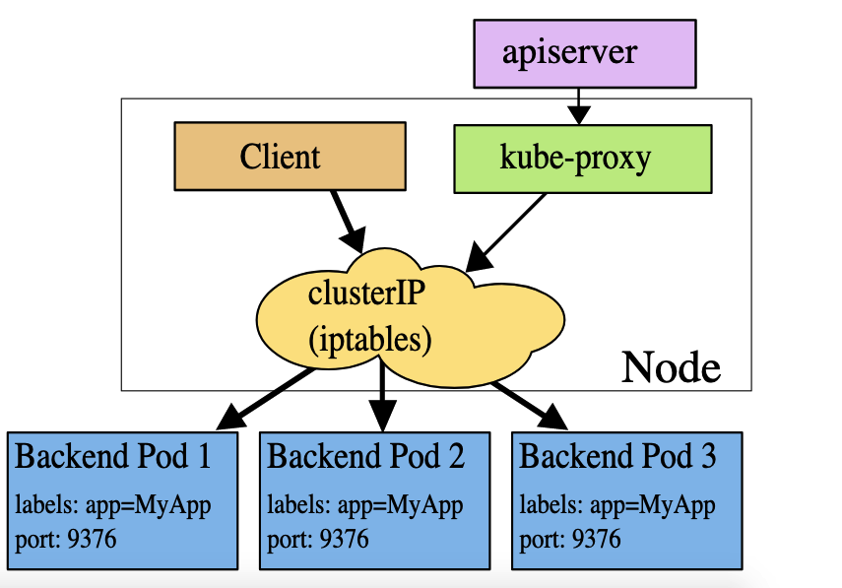
Cluster IP
Gives you a service inside your cluster that other
apps inside your cluster can access.
It is the default Kubernetes service

Slide 58
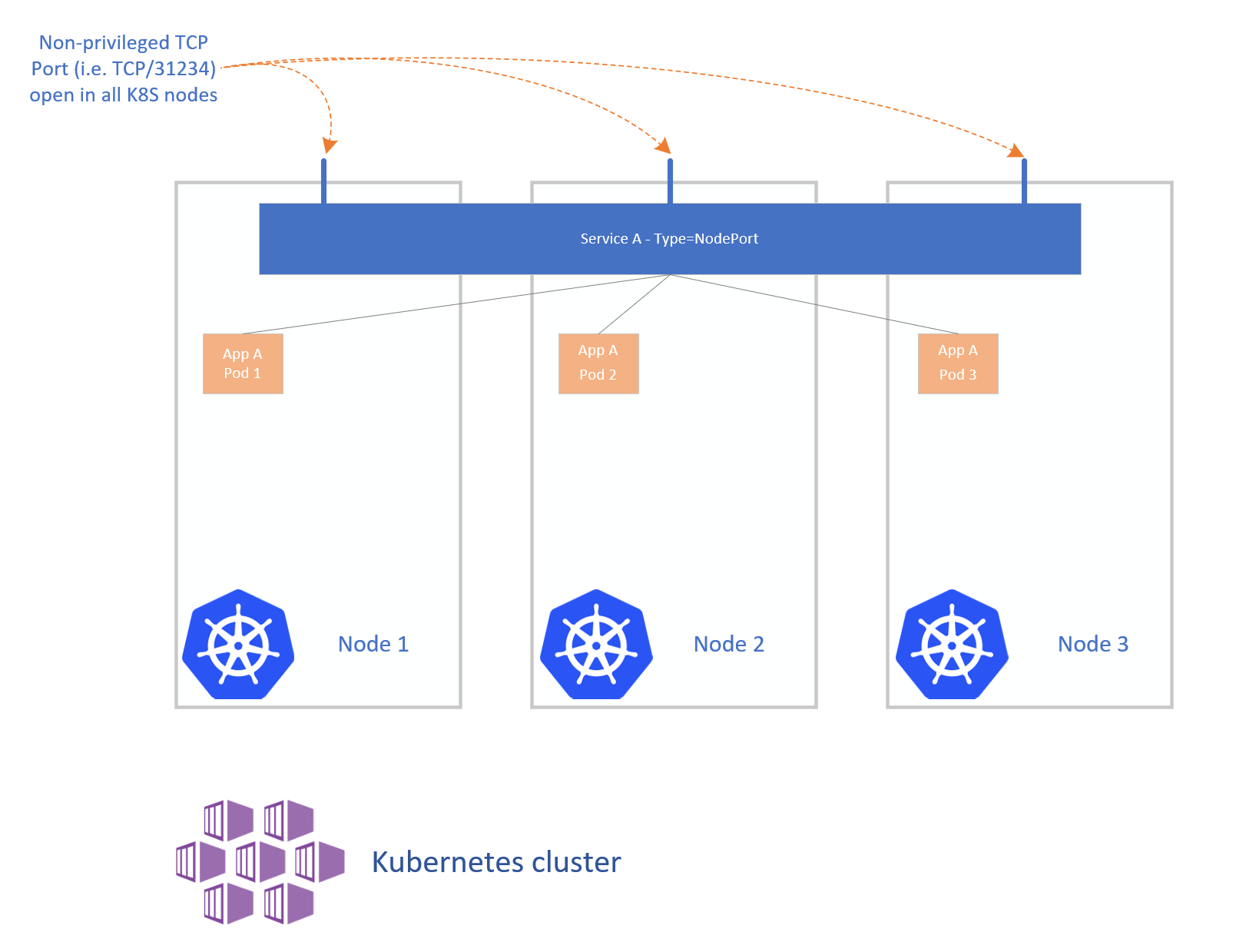
NodePort

Slide 59
NodePort
Lab reference : Refer node-port.yaml - works with deploy-ng.yaml
Port should be between 31000 to 32767
How it work
Exposes the Service on each Node’s IP at a static port (the NodePort).
ClusterIP Service, to which the NodePort Service routes, is automatically created.
Contact the NodePort Service, from outside the cluster, by requesting <NodeIP>:<NodePort>.

Slide 60
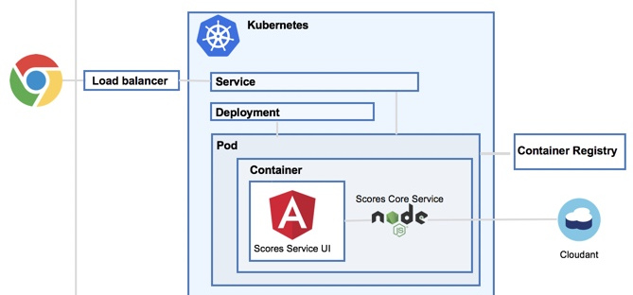
LoadBalancer
Why LoadBalancer :
With NodePort your IP’s would still be spread.
Clients should not connect to a working IP.
A connecting IP can become inaccessible.

Slide 61
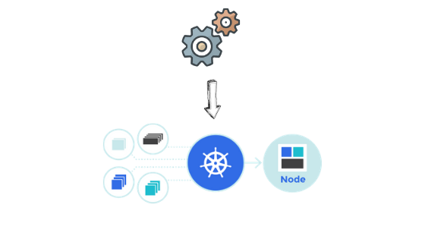
Jobs
Two types
- Jobs: One time jobs
- CronJobs: Scheduled

Slide 62
Jobs
Creates one or more Pods and ensures that a specified number of them successfully terminate.
Primarily meant for short-lived and batch workloads.
Jobs run until the tasks specified in the job is completed.

Slide 63


Jobs
Vi jobs.yaml
You can get the job pod logs using kubectl

Slide 64



CronJobs

Slide 65
Storage Volume
Why Volumes?
Way more powerful than docker volumes
Volume Type

Slide 66
emptyDir
Creates empty directory
Removed when Pod dies
Multiple containers can refer

Slide 67
HostPath
Mounts a file or directory from Host into Pod
Data remain on the HOST after Pod dies
Use cautiously

Slide 68
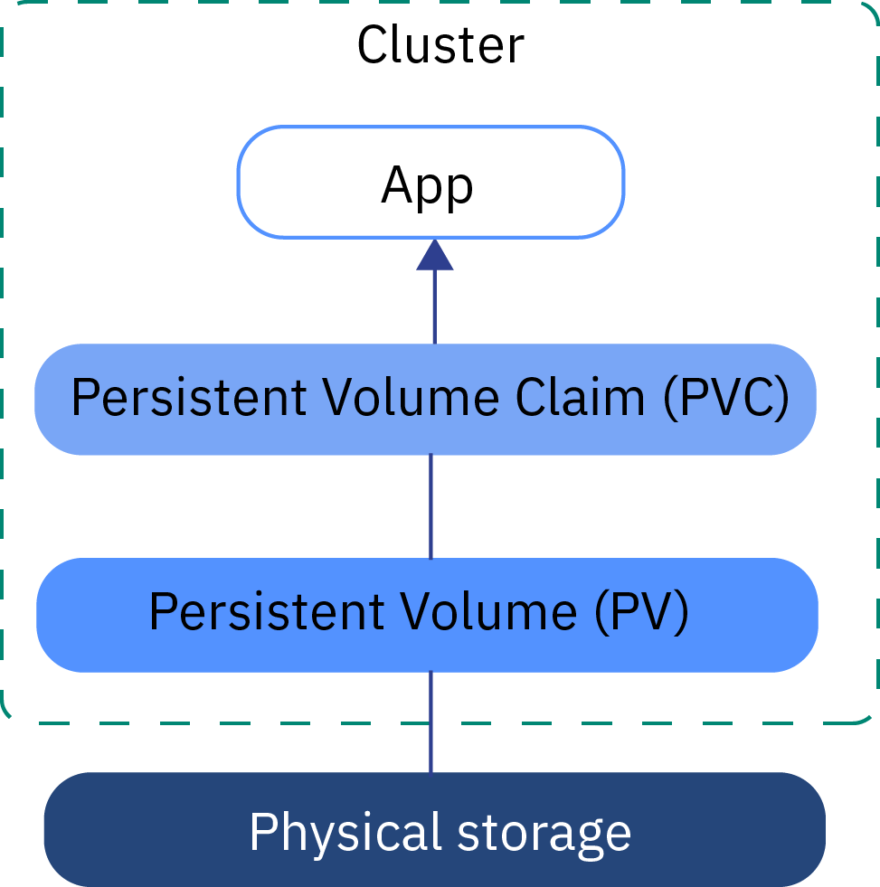
Lifecycle of Volume

Slide 69
Volumes lifecycle
Binding
Using
Storage Object in Use Protection
Reclaim – Reclaim Policy

Slide 70
Secrets
Putting sensitive information inside Docker container is not a good idea
Container can be inspected, exported and published publicly

Slide 71
Questions
?
Contact:
9731588933
vilas_Varghese@yahoo.com

Slide 72
Kubernetes Networking
Container to Container
Pod to Pod
Pod to Service
External to Service

Slide 73
Container to Container Communication
- Highly coupled Pod
Localhost
S
As
Asd
Asd

Slide 74
Pod to Pod Communication
Pod’s have IP address
Containers with in Pod share the network namespace including IP.
Implemented by Network drivers
Rules
pods can communicate with all pods without NAT
agents on a node (e.g. system daemons, kubelet) can communicate with all pods
For platforms that support Pod running in host network (linux)
pods in host network of node can communicate with all pods without NAT
Simple and less friction model
Containers should co-ordinate Port like how it happens on VM’s. IP-per-Pod model.
Asd

Slide 75
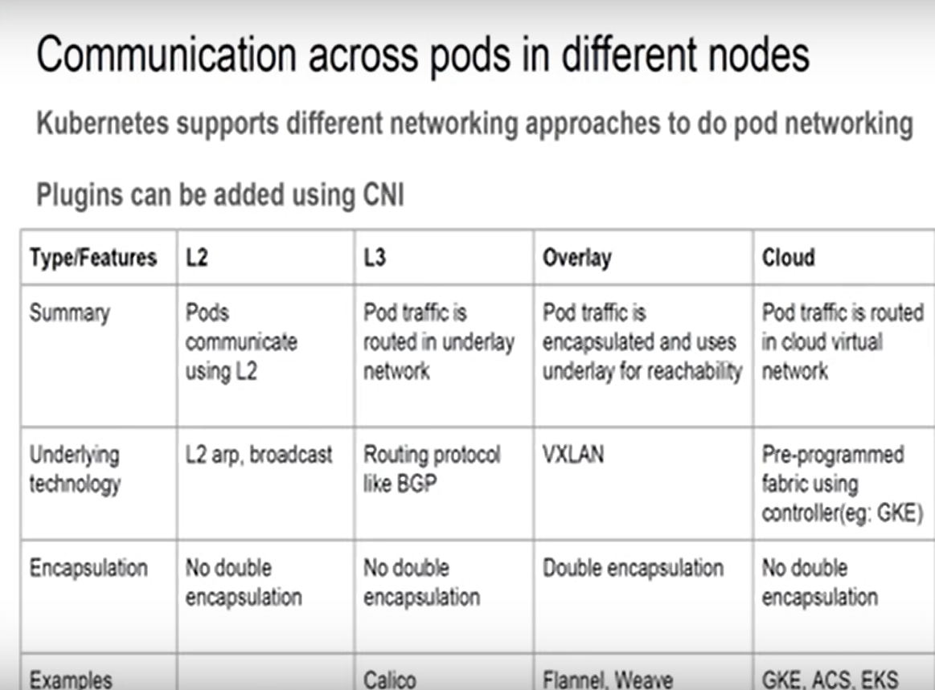
Pod to Pod Communication

Slide 76
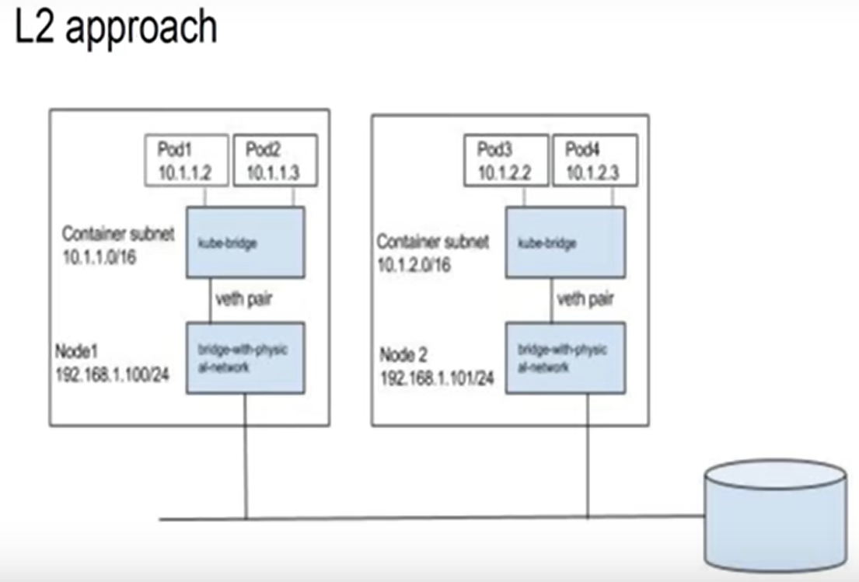
Pod to Pod Communication

Slide 77
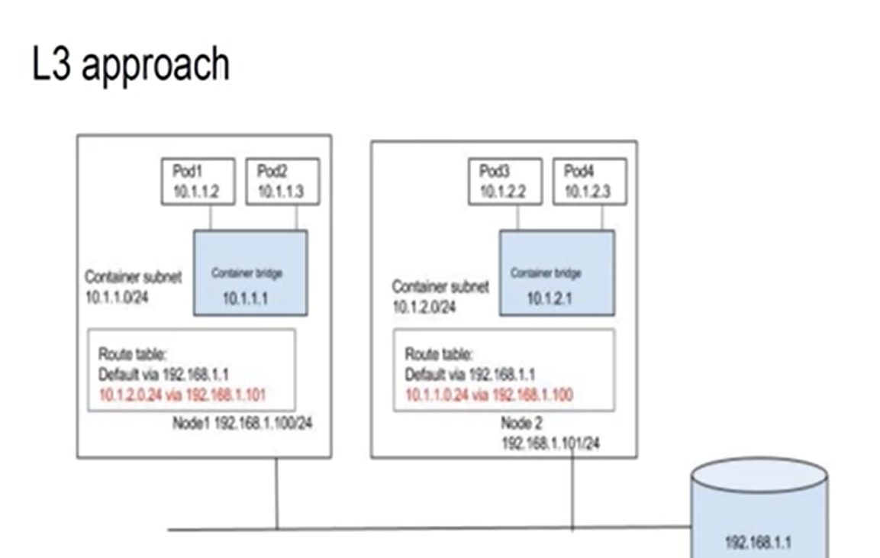
Pod to Pod Communication

Slide 78
Pod to Pod Communication

Slide 79
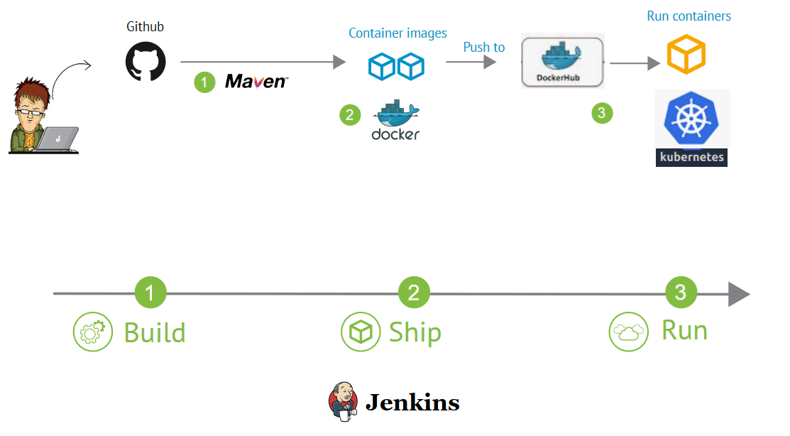
CI/CD

