Slide 1
JVM Memory Management & Garbage Collection
A Deep Dive into JVM Internals, GC Strategies, and JIT Compilation

Slide 2
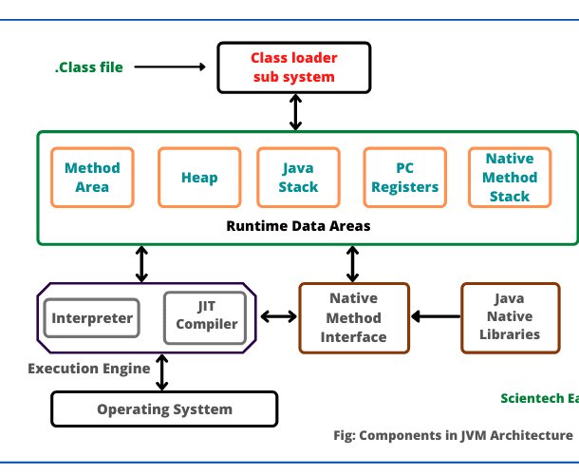
JVM Architecture
• Class Loader: Loads classes into memory.
- Bootstrap, Extension, Application Class Loaders
• Runtime Data Areas:
- Heap (Objects, Class Instances, GC happens here)
- Stack (Method calls, Local variables)
- Method Area/Metaspace (Class metadata, static variables)
- PC Register (Current instruction per thread)
- Native Method Stack (Native method execution)

Slide 3
JVM Memory Model
• Heap Memory (Shared):
- Young Generation (Eden + Survivor S1, S2)
- Old Generation (Tenured Space)
- Metaspace (Replaces PermGen in Java 8)
• Stack Memory (Per Thread):
- Stores method call frames, local variables
• Other Memory:
- PC Register (Tracks execution)
- Native Method Stack

Slide 4

Execution Engine
• Converts bytecode into machine code.
• Components:
Interpreter (Executes bytecode line-by-line)
JIT Compiler (Optimizes performance by compiling bytecode to native code)
Garbage Collector (GC, reclaims unused memory)

Slide 5

Garbage Collection (GC) Phases
1. Mark Phase - Identifies live objects
1
2. Sweep Phase - Removes unreachable objects
2
3. Compact Phase - Rearranges memory to eliminate fragmentation

Slide 6

Types of Garbage Collectors
• Serial GC: Single-threaded, for small apps.
• Parallel GC: Multi-threaded, used for high throughput.
• CMS GC (Deprecated in Java 9): Low-latency, concurrent collection.
• G1 GC (Java 9+ Default): Divides heap into regions, reduces pause times.
• ZGC (Java 11+): Ultra-low latency (<1ms pause time).
• Shenandoah GC(Java 12): high-performance, low-latency stop-the-world (STW) pauses.

Slide 7
Choosing the Right GC
GC Type | Best for | Pause Times | Throughput | Memory Usage
Serial GC | Small apps | High (STW) | Low | Low
Parallel GC | High throughput apps | Medium | High | Medium
CMS GC | Low-latency apps | Low | Medium | High
G1 GC | Large-scale apps | Low | High | Medium
ZGC | Real-time apps | Very Low (<1ms) | Medium | High

Slide 8

Just-In-Time (JIT) Compiler
• Compiles bytecode into optimized native code at runtime.
• Optimizations:
Inlining, Loop Unrolling, Dead Code Elimination
• Improves performance by caching compiled code.

Slide 9

JVM Garbage Collection Strategies
• Mark & Sweep
Identifies and removes unused objects.
Stop-the-World - Temporarily stops application threads.
Compacting - Moves live objects to remove fragmentation.
Different GC algorithms for various performance needs.

Slide 10
Choosing the Right GC
• Serial GC - Best for small apps.
• Parallel GC - Best for high-throughput apps.
• CMS GC - Low-latency applications.
• G1 GC - Large-scale applications.
• ZGC - Real-time applications with ultra-low latency.

Slide 11
GC Monitoring & Optimization
• Enable GC logs: java -XX:+PrintGCDetails -jar myapp.jar
• Verbose-gc is a JVM option that enables logging of garbage collection (GC) activities(verbose:gc).
• Use GC tuning options:
- java -XX:+UseG1GC -jar myapp.jar (G1 GC)
- java -XX:+UseZGC -jar myapp.jar (ZGC)
• Optimize heap sizes: -Xms -Xmx options
• Avoid System.gc() for manual GC calls.

