Slide 1
Capstone Project
EDA On Hotel Booking Analysis
By: Sandesh M H

Slide 2
Project Summary:
The given dataset is of hotel booking. I explored and analyzed the given dataset and discovered some important factors regarding hotel booking. For this, I first read the given data in my collab notebook and then understand the whole data like what are variables in the given data. After that cleaned the data frame in data wrangling. For that I used some functions like drop(), fillna(), isna()/isnull() functions.
I added some columns which are required in the analysis and removed some columns which are not required. Using this data frame I explored some variables using visualization charts like pie charts, count plots, line chart, barplot, heatmaps and pairplot and I can find out some insights which are important factors. From these insights, I can suggest some business objectives to clients.

Slide 3
Problem Statement :
In this project we are going to analyses Hotel Booking dataset. This dataset contains information of city hotel and resort hotel, and includes information of booking time, length of stay, number of adults, children and/or babies, also have information of available parking space, among other thing.
The objective of this project is explore and analyze the data to discover important factors regarding Hotels booking and its attributes.
Define Your Business Objective?
Analyses the data on Hotel Booking and discover the different factors which affects the booking.

Slide 4
What did you know about your dataset?
The above dataset has 119390 rows and 32 columns. The duplicate value count is 31994 rows and 32 columns. There are 4 columns in dataset which have missing values and those columns are company, agent, country and children.
Variables Description
Hotel: Type of hotel(City or Resort). is_cancelled: If the booking was cancelled(1) or not(0). lead_time: Number of days before the actual arrival of the guests. arrival_date_year: Year of arrival date. arrival_date_month: Month of arrival date. arrival_date_week_number: Week number of year for arrival date. arrival_date_day_of_month: Day of arrival date. stays_in_weekend_nights: Number of weekend nights(Saturday or Sunday) spent at the hotel by the guests. stays_in_weel_nights: Number of weeknights(Monday to Friday) spent at the hotel by the guests. adults: Number of adults among the guests. children: Number of children. babies: Number of babies.

Slide 5
meal: Type of meal booked. country: country of the guests. market_segment: Designation of market segment. distribution_channel: Name of booking distribution channel. is_repeated_guest: If the booking was from a repeated guest(1) or not(0). previous_cancellation: Number of previous bookings that were cancelled by the customer prior to the current booking. previous_bookings_not_cancelled: Number of previous bookings not cancelled by the customer prior to the current booking. reserved_room_type: Code from room type reserved. assigned_room_type: Code of room type assigned. booking_changes: Number of changes made to the booking. deposit_type: Type of deposited made by the guest. agent: ID of travel agent who made the booking. comapny: ID of the company that made the booking. days_in_waiting_list: Number of the days the booking was in the waiting list. required_carcustomer_type: Type of customer, assuming one of four categories
ADR: Average daily rate.
Required_car_parking_spaces: Number of car parking spaces required by the customer. total_of_special_requesrs: Number of special requests made by the customer. reservation_statuse: Reservation status(Canceled, check-out or no-show). reservation_status_date: Date at which the last reservation status was updated.

Slide 6
What all manipulations have you done and insights you found?
In the given data frame, there were 31994 duplicate values. So those values were removed.
There were 4 columns which have missing values and the columns were 'company’, 'agent’, 'country’, 'children'. The values from these columns are replaced by zero.
In data frame added two columns tatal_stay and total_people.
Three columns 'adults’, 'children’, ’babies' had values zero which means no booking has done here, so these columns were removed.

Slide 7
Data Visualization, Storytelling & Experimenting with charts Understand the relationships between variables
EDA will be divided into following 3 analysis.
Univariate analysis: Univariate analysis is the simplest of the three analyses where the data you are analyzing is only one variable.
Bivariate analysis: Bivariate analysis is where you are comparing two variables to study their relationships.
Multivariate analysis: Multivariate analysis is similar to Bivariate analysis but you are comparing more than two variables.

Slide 8
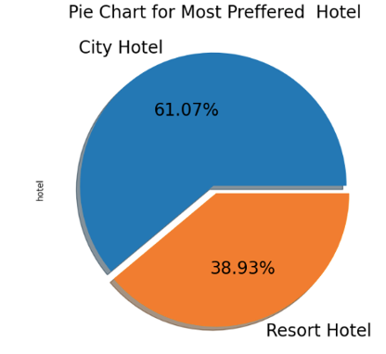
Univariate Analysis
1. Which type of hotel is mostly preferred by the guests?
Why did you pick the specific chart?
I use pie chart because pie chart gives simple and easy to understand picture that shows which hotel has more bookings.
What is/are the insight(s) found from the chart?
I found that city hotel has more bookings which are 61.07% and Resort hotel has less bookings which are 38.93%.
Will the gained insights help creating a positive business impact? Are there any insights that lead to negative growth? Justify with specific reason.
Yes, gained insights help creating a positive business impact.
City hotel can find more services to attract more guests to increase more revenue.
Resort hotel can find solution to attract guest and also find which facilities provided by city hotel to attract the guest.

Slide 9
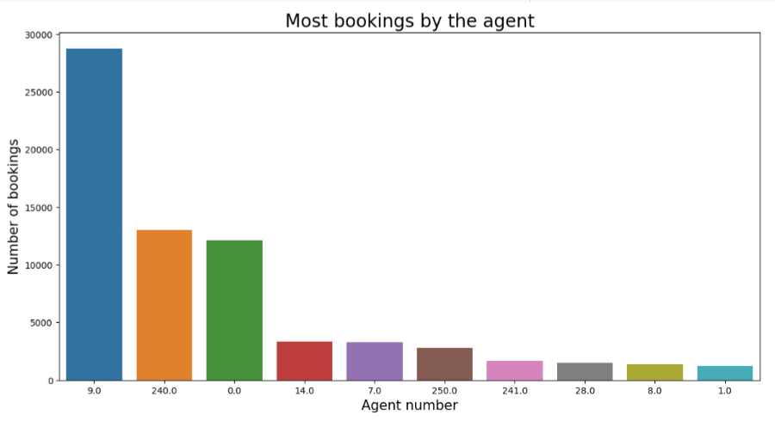
2. Which agent made the most bookings?
1. Why did you pick the specific chart?
I choose barplot here because it gives data visualization in pictorial form and due to this comparison of data is easy.
2. What is/are the insight(s) found from the chart?
The insight found here is Agent no. 9 made most of the bookings.
3. Will the gained insights help creating a positive business impact? Are there any insights that lead to negative growth? Justify with specific reason.
Yes, Agent no.9, 240 has more booking which makes positive impact.
Agent no. 8 and 1 has less booking which makes negative impact.
Booking made by agent no 1 and 6 are about 4.27% of agent no 9 which has highest bookings.

Slide 10
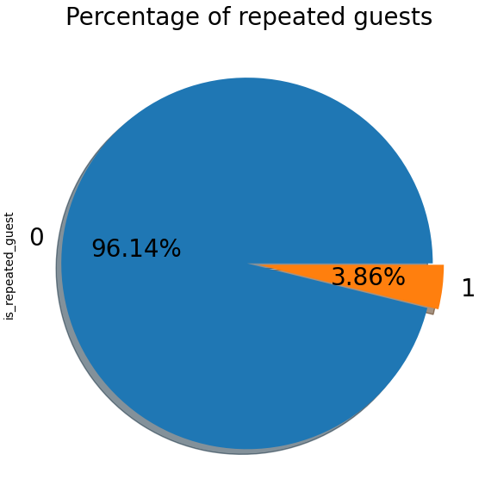
3. What is the percentage of repeated guests?
1. Why did you pick the specific chart?
I use pie chart because pie chart gives simple and easy to understand picture that shows how many guests book particular hotel repeatedly.
2. What is/are the insight(s) found from the chart?
The insight found from the chart is there are very few guests booking for the same hotel again.
3. Will the gained insights help creating a positive business impact? Are there any insights that lead to negative growth? Justify with specific reason.
Yes, the gained insights help creating a positive business impact like the hotels which do not booked repeatedly by guests can take feedbacks from the guests and try to improve there services.

Slide 11
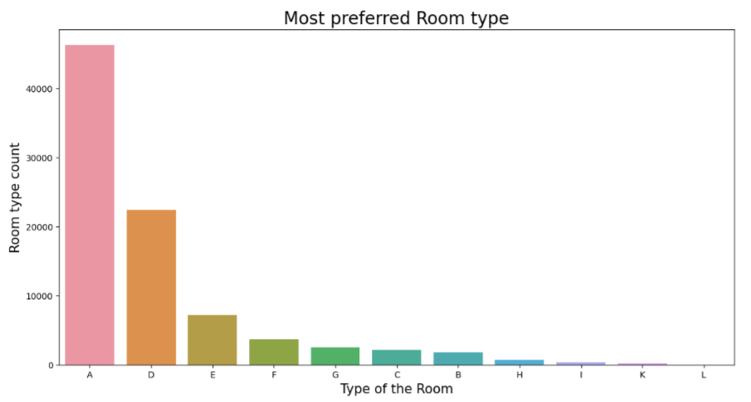
4. What is the most preferred room type by the customers?
1. Why did you pick the specific chart?
I have choose countplot to visualize most preferred room type because countplot display the count of each observation for each category and here we have to represent room type vs room type count.
2. What is/are the insight(s) found from the chart?
The insight found from the chart is A type rooms are most preferred rooms and the count is 46283 and after that D type rooms are preferred by the guest and count is 22419.
3. Will the gained insights help creating a positive business impact? Are there any insights that lead to negative growth? Justify with specific reason.
A type rooms are most preferred rooms. This make positive impact on business.
H,I,K,L type rooms are less preferred this insight makes negative impact.
This is because type A rooms have 46283 bookings and type L room has only one booking.

Slide 12
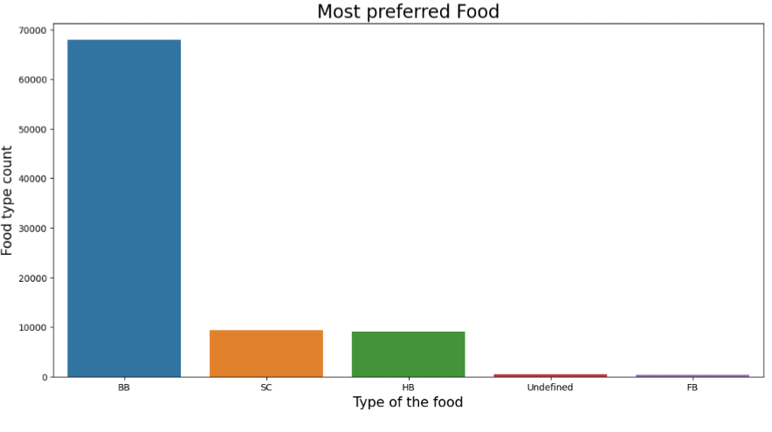
5. What type of food is mostly preferred by the guests?
1. Why did you pick the specific chart?
I have choose countplot to visualize most preferred food because countplot display the count of each observation for each category and here we have to represent food type vs food type count.
2. What is/are the insight(s) found from the chart?
The insight found here is BB type food is most preferred and FB type of food is less preferred.
3. Will the gained insights help creating a positive business impact? Are there any insights that lead to negative growth? Justify with specific reason.
BB type of food is most preferred food this makes positive impact on business.
Undefined and FB type of food is less preferred this insight makes negative impact on business.
The BB type food is preferred by 67907 guests and FB type of food is preferred by only 360 guests.

Slide 13
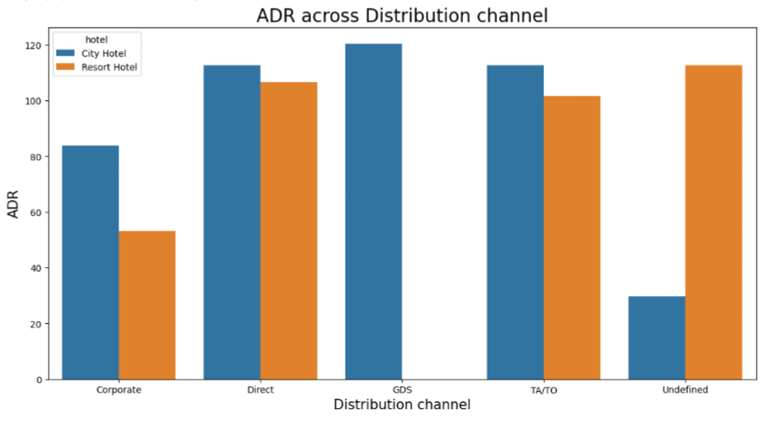
Bivariate and Multivariate analysis
1. Which distribution channel contributed more to adr in order to increase the income?
1. Why did you pick the specific chart?
I choose here barplot to visualise ADR across distribution channel because it give easy to understand visualization to large data.
2. What is/are the insight(s) found from the chart?
The insight found from the above chart is that GDS channel contributed most in ADR in city hotel and Direct and TA/TO has nearly equal contribution in adr in both hotel types
3. Will the gained insights help creating a positive business impact? Are there any insights that lead to negative growth? Justify with specific reason.
GDS distribution channel contributed more to adr for city hotel and Undefined distribution channel contributed more to adr for resort hotel this makes positive impact.
GDS distribution channel has no any contribution to adr for resort hotel and undefined distribution channel contributed less to adr for city hotel this makes negative impact.

Slide 14
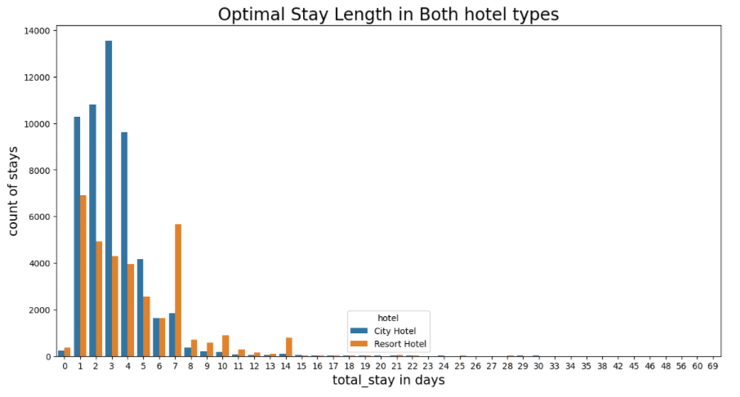
2. What is optimal stay length in both types of hotel?
1. Why did you pick the specific chart?
Because it gives simple visualization
2. What is/are the insight(s) found from the chart?
Optimal stay length in both hotel type is less than 7 days.
3. Will the gained insights help creating a positive business impact? Are there any insights that lead to negative growth? Justify with specific reason.
Most common stay length is less than 4 days and generally people prefer City hotel for short stay, but for long stays, Resort Hotel is preferred.
Full_stay length and lead_time have slight correlation. This may means that for longer hotel stays people generally plan little before the actual arrival date.

Slide 15
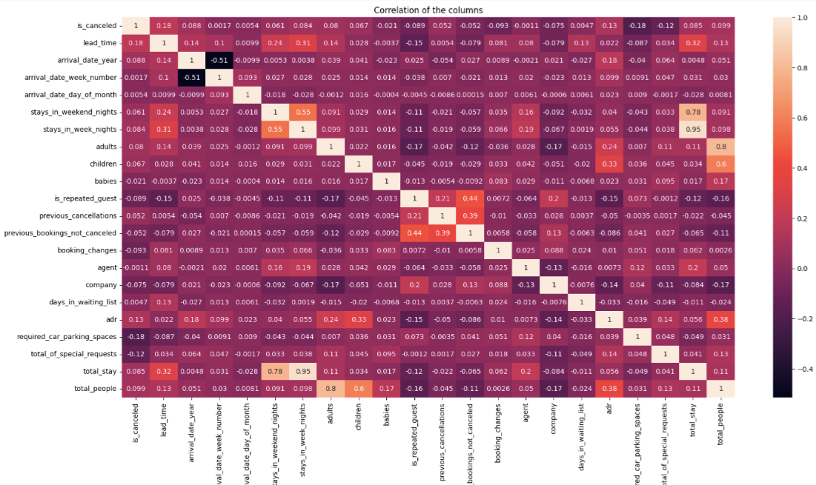
Relationship between ADR and total number of people?
1. Why did you pick the specific chart?
I choose heatmap here because heatmap display a more generalized view of numeric values and also utilize colour coded systems
2. What is/are the insight(s) found from the chart?
arrival_date_year and arrival_date_week_number columns has negative correlation which is -0.51.
stays_in_week_nights and total_stay has positive correlation which is 0.95

Slide 16
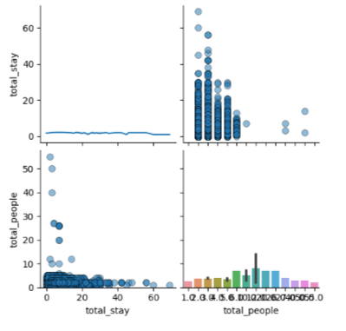
1. Why did you pick the specific chart?
Pair plot to show the relationships between pairs of variables in a dataset.
2. What is/are the insight(s) found from the chart?
The pair plot provides a matrix of scatterplots that show how 'total_stay' and 'total_people' are distributed and their relationship with each other.
The line chart shows how 'total_people' varies with 'total_stay'.
The bar chart presents a visualization of 'total_people' with bars representing different values of 'total_stay'.

Slide 17
Solution to Business Objective
To increase hotel business some factors are important like high revenue, generation, customers satisfaction, facilities provided by hotel etc.
I am able to achieve the same things by showing to client which hotel is most preferred , percentage of repeated guests, mostly preferred food by guests, then which hotel has highest adr etc.
Most preferred room type is achieved by countplot so the client can be well prepare in advance and this insight help client for further enhancement of their hospatility.
I am able to show which food type is mostly preferred so client can offer the mostly preferred food to the guests.
Most preferred month are shown by barplot so client can be well prepared in advanced so that minimum
Using barplot I am able to show which hotel type has high adr so client can analyse which hotel has high income.
I am able to show which hotel is busiest hotel so client can do relatable changes in facilities in less busy hotel type.
I am able to show the relationship between repeated guests and previous bookings not cancelled so client can preferred repeated guests.
Using barplot relationship between adr and total number of people is shown so client can preferred maximum number of people.

Slide 18
Conclusion
City hotel is mostly preferred hotel by guests.
Agent no. 9 made the most bookings.
Percentage of repeated guest is less which is 3.86%.
Room type A is mostly preferred room type.
Mostly preferred food type is BB type food.
August month has most bookings and after august july has most bookings.
TA/TO distribution channel is mostly used and percentage is 79.13%.
City hotel has highest ADR. Highest ADR means more revenue.
2016 year had highest bookings and bookings were 42313.
City hotel has higher waiting time means city hotel is busier hotel.
GDS distribution channel contributed most in ADR in city hotel but no contribution in resort hotel.
Optimal stay length in both hotel type is less than 7 days.
Repeated guests do not cancel their bookings but not repeated guests cancel.
If number of people is more then ADR is also increases means revenue increases.
arrival_date_year and arrival_date_week_number columns has negative correlation which is -0.51.
stays_in_week_nights and total_stays has positive correlation which is 0.95.

