Slide 1

3T (Time To Time): Milk Today. Money Today.
Problem Statement ID: SIH1620 / AgriTech & FinTech Track
Problem Statement Title: Real-Time Quality-Indexed Dairy Payment & Micro-Fintech Ecosystem
Theme: Smart Agriculture / Rural Financial Inclusion
PS Category: Software / FinTech / AgriTech
Team Name: Team 3T Innovators
Team Leader: Sandesh Kadam
Core Mission: Sub-2-Second Bank Payouts & 100% Quality Transparency for 80M+ Dairy Farmers

Slide 2
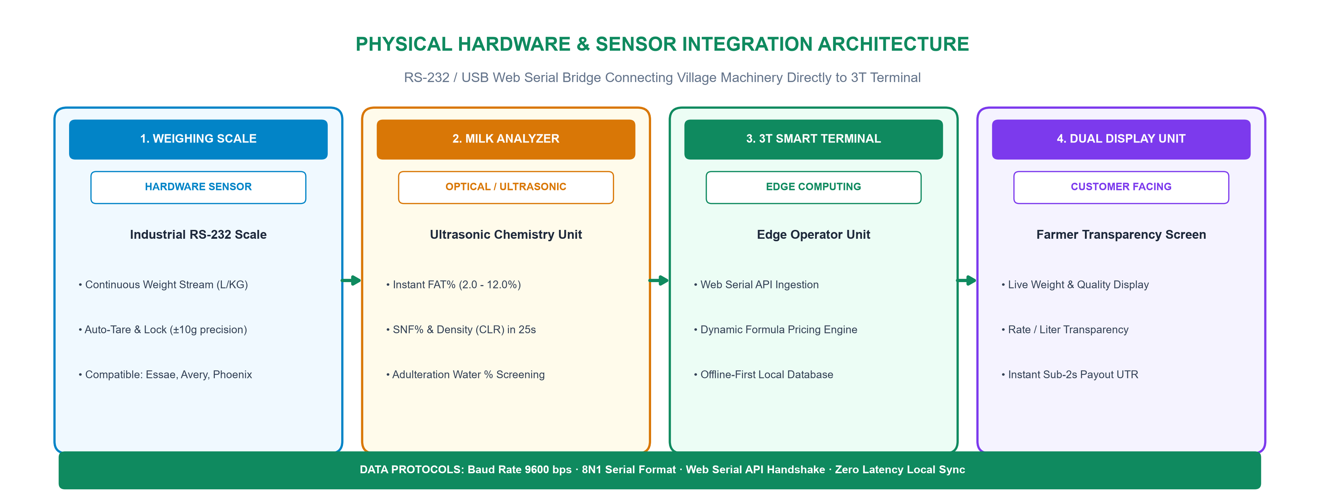
PROPOSED SOLUTION: PHYSICAL MACHINES & 3T TERMINAL
Your Team Name
1. Hardware-to-Edge Bridge
• Universal Compatibility: Ingests RS-232 serial data from Essae/Avery scales and Lactoscan analyzers.
• Zero Latency Sync: Web Serial API directly streams weight and FAT% into 3T with sub-second accuracy.
2. Dual-Display Transparency
• Farmer-Facing Screen: Displays live weight, FAT%, SNF%, calculated rate, and payout total.
• Eliminates Corruption: Destroys manual entry tampering, building 100% farmer trust in the dairy.
3. Quality-Indexed Valuation
• Dynamic Formula: Rate = Base ₹20 + (FAT × 5.5) + (SNF × 2.0), rewarding clean, high-protein milk.
• Adulteration Detector: Real-time SNF screening flags water dilution before payment dispatch.

Slide 3
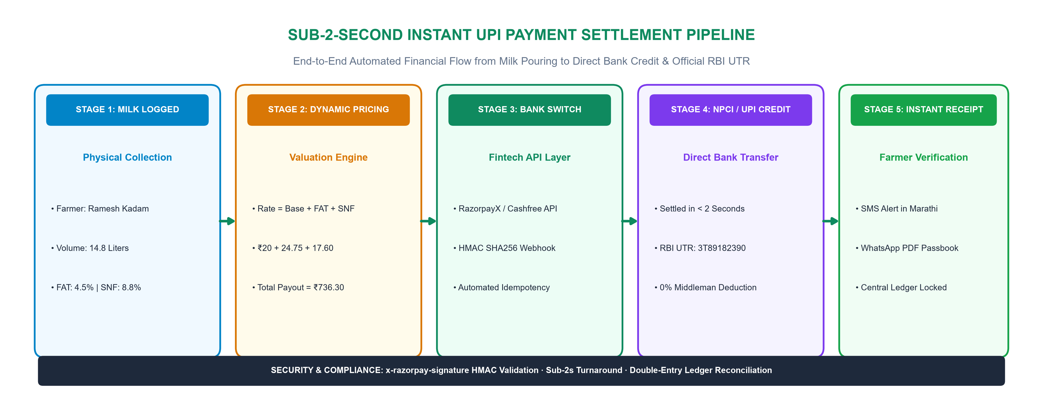
TECHNICAL APPROACH: SUB-2S PAYMENT SETTLEMENT PIPELINE
Your Team Name
1. Full-Stack Modern Tech Stack
• Frontend & UI: Next.js 16 App Router (Turbopack), React 19, Tailwind CSS, Framer Motion, Recharts.
• Backend Core: Node.js, Express, MongoDB, LowDB local persistent fallback database.
2. Enterprise FinTech Security
• Cryptographic Signatures: SHA256 HMAC webhook verification (x-razorpay-signature) ensures authenticity.
• Zero Idempotency Loss: Double-entry transaction ledger with automatic UTR reconciliation.
3. Offline-First Resilience
• Rural 4G Outages: PWA Service Worker + IndexedDB queue stores cryptographically signed batches.
• Auto-Sync Engine: Automatically settles queued transactions the second internet reconnects.

Slide 4
FEASIBILITY, VIABILITY & RISK MITIGATION MATRIX
Your Team Name
Operational Feasibility & Low-Cost Deployment
• Zero Proprietary Hardware Lock-In: Works with existing village scales (Essae, Avery) and milk analyzers (Lactoscan, MasterEco) via standard USB converter.
• 70% Cheaper than Custom POS: Complete village branch setup costs only ₹12,000–₹16,000 (standard Android tablet + cables) vs ₹60,000+ proprietary kiosks.
• Fast 10-Second Village Throughput: Optimized 4-digit farmer ID keyboard entry allows operators to process 150+ farmers during the morning rush.
• Sustainable SaaS Economics: Dairies pay ₹499–₹799/month per hub + 0.20% payout fee, recouping full investment in under 45 days via adulteration savings.
Risk Analysis & Engineering Mitigation Strategy
• Risk 1: Village 4G / WiFi Drops: Mitigation: Local IndexedDB offline queue records collections; auto-triggers UPI disbursements on reconnection.
• Risk 2: Milk Dilution & Adulteration: Mitigation: Algorithmic anomaly detector flags batches with SNF < 8.0% or unnatural FAT:SNF deviations before payment.
• Risk 3: Payment Gateway Outage: Mitigation: Multi-gateway failover cascading across RazorpayX, Cashfree, and IMPS fallback channels.
• Risk 4: Operator Miscalculations: Mitigation: Dual-display customer unit + instant WhatsApp receipt voucher prevents rate tampering.

Slide 5
IMPACT, BENEFITS & NATIONAL SCHEME ALIGNMENT
Your Team Name
1. Farmer Socio-Economic Impact
• 8–12% Net Income Boost: Eliminating predatory moneylender interest (24-36%) and unfair testing deductions increases annual income.
• Daily Cashflow Security: Instant liquidity enables daily purchases of nutritious cattle feed, mineral mixtures, and medicines.
• Women Empowerment: 70%+ of Indian dairy labor is performed by rural women; direct mobile UPI credits ensure funds reach women directly.
2. Dairy Enterprise Benefits
• 100% Farmer Retention: Instant payment guarantee gives dairies a decisive competitive edge over private middlemen.
• Zero Adulteration Loss: Real-time quality screening protects milk processing yields and end-consumer brand quality.
• Automated Reconciliation: Eliminates physical ledger books, cash-handling leakages, and manual accounting delays.
3. National Scheme Alignment
• Digital India & UPI: Drives formal digital payment adoption into deep rural Tier 3/4 agricultural economies.
• NDDB Clean Milk Mission: Quality-indexed pricing formula rewards high-protein, clean dairy production.
• PM-KISAN & AHIDF: Creates verifiable digital delivery records for formal bank loans and livestock subsidies.

Slide 6
COMPETITIVE MATRIX, RESEARCH & REFERENCES
Your Team Name
Evaluation Metrics | Traditional Cooperatives | Generic Dairy Softwares | 3T (Time To Time)
Payment Settlement Time | 15 to 30 Days (Delayed) | 3 to 7 Days (Batch) | < 2 Seconds (Instant Bank UPI)
Quality Transparency | Manual paper receipt / None | Operator monitor only | Dual-Monitor Farmer Display
Pricing Algorithm | Static lookup chart | Manual table entry | Dynamic Formula (FAT+SNF)
Rural Offline Support | Paper ledger fallback | Fails without internet | PWA IndexedDB Auto-Sync
Creditworthiness Data | None (No credit data) | Basic invoice PDF | Kisan Milk Score (300-900)
Key Research References & Academic Citations
• National Dairy Development Board (NDDB 2024): Study on dairy cooperative settlement friction and smallholder farmer working capital deficits in rural India.
• NABARD Rural Financial Inclusion Survey: Empirical evidence showing 64% of dairy farmers rely on high-interest informal moneylenders due to delayed milk payouts.
• FSSAI Milk Quality & Adulteration Report: Analysis of SNF dilution patterns and real-time monitoring across collection centers in Maharashtra & Gujarat.

Slide 7
PROTOTYPE READINESS & 90-SECOND JURY DEMO FLOW
Working Prototype Capabilities (100% Functional)
• Live Multi-Branch Portals: Functional branch operator terminals (/branch/B-01 to B-05) with isolated village datasets.
• Farmer Portal & AI Mitra: OTP-authenticated farmer profile with real-time passbook and multilingual agritech assistant.
• Dual-Display Customer Unit: Dedicated customer transparency screen ready for secondary monitor/tablet demo.
• Security & Webhooks Active: HMAC webhook verification, NoSQL injection protection, and rate-limiting active.
90-Second SIH Jury Presentation Script
• Step 1 (The Pour): Agent opens /branch/B-01; selects Farmer Ramesh Kadam; inputs 14.8 L @ 4.5% FAT.
• Step 2 (The Dual Display): Farmer watches rate dynamically compute to ₹736.30 on their customer screen.
• Step 3 (The Instant Payout): Agent taps 'Verify & Pay'; sub-2-second banking webhook generates official RBI UTR.
• Step 4 (The Impact): Shows real-time dashboard volume updates and algorithmic Kisan Credit Score enhancement.

