Slide 1
AI BUILDER CUP · SUSTAINABILITY & SOCIAL IMPACT
Submission Deck
TerraGrid
Disaster Intelligence, End to End
One connected lifecycle — Predict, Prepare, Respond, Recover — replacing four disconnected tools with a single auditable platform.
Predict
Prepare
Respond
Recover
Team
Problem Statement
Sentinel AI — Sandesh Shinde
Sustainability & Social Impact — an AI-powered solution strengthening resilience and enabling more informed, sustainable decision-making.

Slide 2
BRIEF ABOUT THE IDEA
TerraGrid — Disaster Intelligence, End to End
Full lifecycle: Predict → Prepare → Respond → Recover
The problem — detection isn't the gap. Coordination is.
The solution — one connected lifecycle
Natural disasters across APAC cost thousands of lives every year. Response today is siloed: meteorologists forecast in isolation, planners allocate resources days later, field responders lack real-time intel, and lessons never feed back into prevention.
01
Predict
6-month early-warning signal from climate indicators — ENSO, seasonal rainfall outlook
02
Prepare
AI-generated 7-day risk forecasts across 8 cities, preparedness checklists, and automated agency alert drafts
Detect
Forecast
03
Respond
Satellites & sensors catch threats instantly
Isolated in agency-specific tools
Live multi-hazard dashboard, Gemini-powered decision support, and evacuation-route pre-calculation
Allocate
Respond
04
Recover
Resources assigned days too late
No real-time field intel or feedback loop
Before/after satellite damage assessment and recovery-progress tracking
Every AI recommendation is logged — the data sources and model reasoning behind it are auditable, not a black box.
TerraGrid — AI Builder Cup Submission
02 / 16

Slide 3
THE 4-PHASE MODEL — HOW THE IDEA OPERATES
From A 6-Month Signal To A 24-Hour Recovery Window
T - 6 MONTHS
T - 30 DAYS
T - 24H TO NOW
T + 24 HOURS
Predict
Prepare
Respond
Recover
El Niño / La Niña signals
ENSO outlook
Rainfall anomalies
Seasonal forecast
Regional risk baseline
Evacuation route planning
Operational hazard forecast
Active incident monitoring
Live AI decision support
Impact assessment
Damage tracking
Recovery planning
Target band: 50–80%
Target band: 70–90%
Target band: 85–99%
Target band: 70–85%
Confidence bands are design targets for how the system should communicate certainty at each phase — not measured accuracy, since no formal accuracy benchmarking has been run yet (see Performance).
TerraGrid — AI Builder Cup Submission
03 / 16

Slide 4
COMPETITIVE DIFFERENTIATION
How Is TerraGrid Different?
NASA / USGS Dashboards
Weather Forecasting Apps
Emergency Management Tools
Routing Apps (Google Maps)
Fire & earthquake detection only — no response coordination
Forecast only — no actionable planning or response integration
Manual, spreadsheet-driven decisions with high latency
General point-to-point navigation — not disaster-aware
 | Others | TerraGrid
Scope | Single phase, usually response only | Full lifecycle — Predict, Prepare, Respond, Recover — one platform
Intelligence | Shows raw data | AI-generated recommendations with confidence scoring
Auditability | Black box | Source of Truth — 4-layer data lineage (raw -> validated -> enriched -> stored), plus every AI recommendation logged
Alerting | Manual, single-channel | Automated, audience-tailored email — WhatsApp/SMS channels in progress
Integration | One source, one tool | 6 live data sources unified in one dashboard
Resilience | Fails silently on source outage | Automatic retry with backoff on failed sends
TerraGrid bridges the gap between raw data and actionable AI decision-making, with full operational resilience.
TerraGrid — AI Builder Cup Submission
04 / 16

Slide 5
HOW WILL IT SOLVE THE PROBLEM?
From Hours To Minutes — Automating The Decision Pipeline
Decision-to-action today can take hours; preventable lives are lost to delayed information. TerraGrid automates the data-gathering and recommendation pipeline so the response team starts from a drafted plan, not a blank page.
Multi-Source Intelligence
AI Decision Support
Evacuation Route Pre-Calc
Auto-ingests 6 live data sources — NASA EONET, USGS, NOAA, GDACS, OpenWeatherMap, OpenStreetMap/Overpass — with zero manual data-gathering
Gemini 2.5 Flash generates action timelines, preparedness checklists, and agency alert drafts with confidence scoring
OSRM road-network routing, with an automatic geodesic-distance fallback if the routing service is unreachable
Audience-Tailored Alerts
Transparent Logging
Result
Tone-adapted email for farmers, hospitals, NGOs, and municipal corps — WhatsApp/SMS channels in progress
Every external API payload and Gemini response is saved as a timestamped, auditable record — never a black box
A single automated pipeline replaces hours of manual cross-referencing with one auditable dashboard.
EXPECTED IMPACT — ILLUSTRATIVE, NOT MEASURED
Directional only, based on the automation above — not from field trials or load testing: removing the manual data-gathering and first-draft-writing steps shortens decision time from hours toward minutes, and consolidates work that today spans several agency-specific tools into one dashboard.
TerraGrid — AI Builder Cup Submission
05 / 16

Slide 6
Unique Selling Proposition (USP)
Six core differentiators that set TerraGrid apart from legacy disaster-tech point tools.
1
Unified Lifecycle
2
Action Recommendations
3
Decision Lineage
Connects Prepare and Respond today, with Predict and Recover planned next, into one continuous platform instead of four disconnected tools.
Gemini generates specific, confidence-scored instructions and alert drafts — not raw maps the responder has to interpret.
Every recommendation keeps a full trail — data source → model reasoning → output — logged and inspectable, not a black box.
★ First integrated full-lifecycle platform
★ Turns data into actionable intelligence
★ Auditable, evidence-based response
4
Resilient Routing
5
Audience-Aware Alerting
6
Google Cloud Native
Evacuation routes are pre-calculated per incident via OSRM, with an automatic geodesic-distance fallback if the routing service fails.
Email messaging is tone-adapted per recipient — farmers, hospitals, NGOs, municipal corps — not one generic broadcast. WhatsApp/SMS channels are in progress.
Built on Vertex AI (Gemini 2.5 Flash), Google Earth Engine, and Cloud Run — a deployment target chosen for auto-scaling, ahead of production rollout.
★ Degrades gracefully, never silently
★ Zero-friction, audience-matched delivery
★ Built for enterprise-grade scale
TerraGrid — AI Builder Cup Submission
06 / 16

Slide 7
FEATURES
Features Offered By The Solution — Across The 4-Phase Model
Predict
Prepare
Respond
Recover
Designed, not yet built
7-day risk forecast across 8 cities (OpenWeatherMap)
AI-generated risk-escalation timeline
Gemini-drafted preparedness checklists per agency
Audience-tailored alert drafts — farmers, hospitals, NGOs, municipal corps — dispatched via WhatsApp + email
Confidence-based alerting — real agreement-ratio math, not a fabricated score
Proactive evacuation-route pre-calculation (OSRM)
Interactive live incident map — Mapbox GL, evacuation zones
Gemini 2.5 Flash decision support with confidence scoring
Deterministic cascade & resource optimizer (Hamilton apportionment, not AI-guessed)
Satellite image + Sentinel-1 SAR cross-validation
Impact scoring — Hazard + Exposure + Vulnerability (0–100)
Phased response timeline — Immediate / Urgent / Sustained
Causal chain explanation flowchart
Designed, not yet built
Climate-signal dashboard — ENSO + seasonal rainfall outlook (NOAA, IMD)
Regional risk baseline per district
Historical disaster database for pattern matching
Before/after satellite damage comparison
Damage mapping + recovery priority sequencing
Resource & cost estimation for rebuilding
8 items scoped — see Future Development
12 items scoped — see Future Development
COMMON CAPABILITIES — BUILT ONCE, RUNNING ACROSS EVERY PHASE
Source of Truth — 4-layer data lineage & audit trail, live in Prepare + Respond, scoped for Predict + Recover
Multi-source live ingestion — 6 APIs (NASA EONET, USGS, NOAA, GDACS, OpenWeatherMap, OSM/Overpass)
Real-time WebSocket updates — across the dashboard — no manual refresh
Multi-language UI — vue-i18n across the full dashboard
Predict and Recover are part of the 4-phase design (see The 4-Phase Model) but have no functionality built yet — only Prepare and Respond are shipped today.
TerraGrid — AI Builder Cup Submission
07 / 16

Slide 8
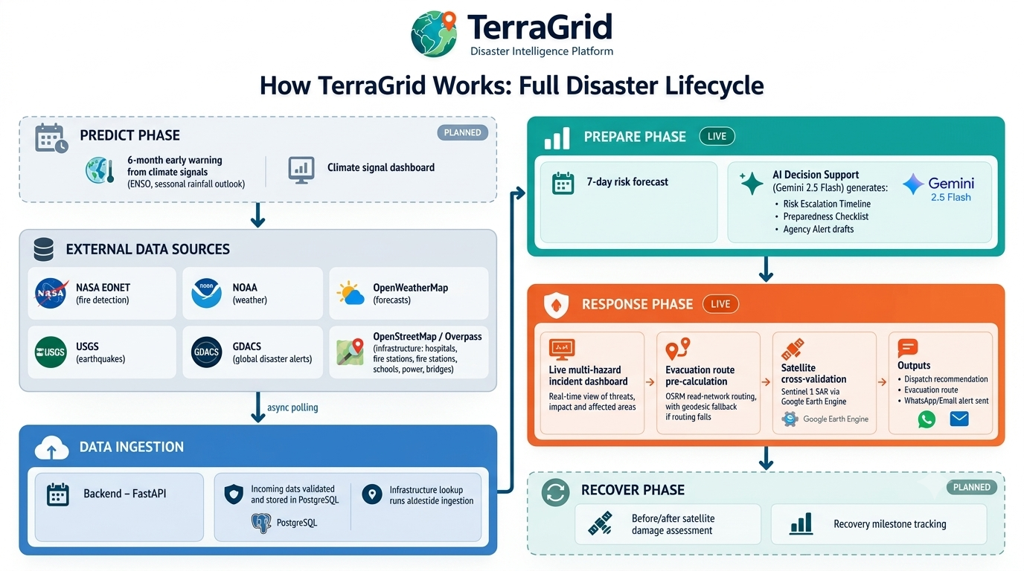
PROCESS FLOW DIAGRAM
The Full Disaster Lifecycle, As Built
TerraGrid — AI Builder Cup Submission
08 / 16

Slide 9
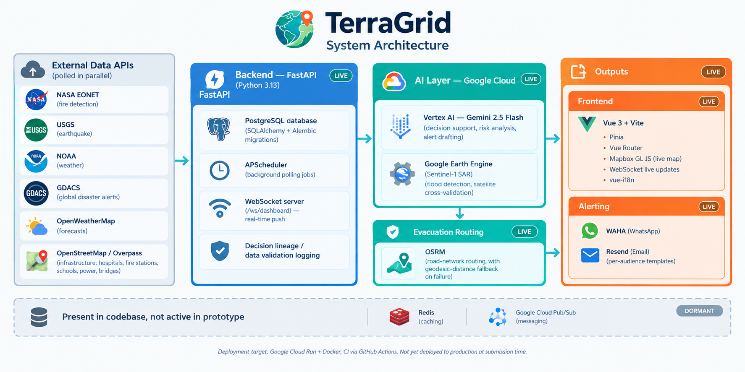
ARCHITECTURE DIAGRAM
System Architecture, As Deployed
TerraGrid — AI Builder Cup Submission
09 / 16

Slide 10
TECHNOLOGIES
The Stack, Verified Against The Codebase
Frontend
Backend
AI Layer — Google Cloud
Vue 3 + Vite · Pinia · Vue Router
Mapbox GL JS (live map)
WebSocket live updates · vue-i18n
FastAPI (Python 3.13)
PostgreSQL — SQLAlchemy + Alembic
APScheduler · WebSocket server
Source of Truth — 4-layer data lineage (raw -> validated -> enriched -> stored)
Vertex AI — Gemini 2.5 Flash
Decision support, risk analysis, alert drafting
Google Earth Engine — Sentinel-1 SAR flood detection
Evacuation Routing
Alerting
External Data (6 sources)
OSRM road-network routing
Automatic geodesic-distance fallback on failure
Email — Gmail SMTP, per-audience templates
WhatsApp (WAHA) built, self-hosted — not yet production-reliable
NASA EONET · USGS · NOAA
GDACS · OpenWeatherMap
OpenStreetMap / Overpass
In the codebase but dormant/unreliable in this prototype: Redis (caching), Pub/Sub (messaging), OSM/Overpass (frequently times out, fails gracefully).
Deployment targets: Firebase Hosting (frontend) + Google Cloud Run (backend API) + Docker, CI via GitHub Actions — not yet deployed to production at submission time.
TerraGrid — AI Builder Cup Submission
10 / 16

Slide 11
ESTIMATED IMPLEMENTATION COST (OPTIONAL)
Built Mostly On Free & Open Tiers
Illustrative — based on public list pricing for each service, not an audited cost model. No formal cost analysis has been run.
Component | Cost tier | Why
NASA EONET, USGS, NOAA, GDACS, OpenWeatherMap, OSM | Free | Public disaster & weather APIs, no license cost
OSRM routing | Free (self-hosted) | Open-source routing engine, no per-call fee
Google Cloud Run, PostgreSQL hosting | Low, usage-based | Generous free tier, scales with traffic
Vertex AI — Gemini 2.5 Flash | Low, usage-based | Flash tier is the low-cost Gemini model; billed per call
Google Earth Engine (Sentinel-1 SAR) | Free for this use | Non-commercial / research usage tier
Mapbox GL JS tiles | Free tier | Covers prototype-level map-load volume
Gmail SMTP (email) | Free | Standard email account — no per-send cost
TerraGrid — AI Builder Cup Submission
11 / 16

Slide 12
SNAPSHOTS OF THE PROTOTYPE
Product Screens
[ Dashboard screenshot ]
[ Prepare screenshot ]
[ Respond screenshot ]
Dashboard — real-time situational awareness
Prepare — 7-day risk forecasting
Respond — live incident command center
Placeholders only — replace each panel with a real screenshot from the running prototype before presenting.
TerraGrid — AI Builder Cup Submission
12 / 16

Slide 13
RELIABILITY & VALIDATION STATUS
What's Already Resilient vs. What's Left To Measure
Left: resilience mechanisms that exist in the code today, checked directly against the source. Right: the formal testing not yet run — scoped honestly instead of filled with invented numbers.
Built into the code today
Not yet measured — planned before launch
OSRM routing falls back to geodesic distance automatically on failure
Alert sends retry with backoff instead of failing silently
WebSocket push keeps the dashboard live without manual refresh
Every API call and Gemini response is logged as a timestamped, inspectable record
Formal load testing (e.g. JMeter) under concurrent users
Security scanning (e.g. OWASP ZAP) and a penetration pass
Measured uptime and Gemini decision-support accuracy against ground truth
We'd rather report these honestly as not-yet-run than publish invented benchmark numbers.
TerraGrid — AI Builder Cup Submission
13 / 16

Slide 14
ADDITIONAL DETAILS / FUTURE DEVELOPMENT
What's Next
Predict phase
Recover phase
6-month early-warning signal from climate indicators — ENSO, seasonal rainfall outlook — surfaced on a climate-signal dashboard.
Before/after satellite damage assessment and recovery-milestone tracking once an incident stabilizes.
ENSO + Seasonal Outlook
Satellite Damage Comparison
Multi-Channel Dispatch
IMD Integration
Predict near-term: NOAA CPC El Niño/La Niña monitoring, seasonal rainfall outlook, and a climate-signal dashboard.
Recover near-term: before/after Sentinel-2 optical imagery and a damage-mapping dashboard.
WhatsApp + SMS alerting alongside email — once WAHA's reliability is re-validated and an SMS provider is evaluated.
Added once the government grants live API access; until then, open-source imdlib supplies historical gridded rainfall/temperature data.
Hardening the live platform
✓ Production deployment to Google Cloud Run
✓ Formal load testing and a security review
✓ Activate Redis and Pub/Sub once traffic needs multi-instance scaling
TerraGrid — AI Builder Cup Submission
14 / 16

Slide 15
ADDITIONAL DETAILS / FUTURE DEVELOPMENT
Future Scientific API Integrations
Cataloged for post-MVP implementation to keep the live prototype on real, working data only — no API is wired in until it actually works.
API | What it adds | Phase it helps | Status
NOAA NWPS | Real-time river gauge and streamflow telemetry — live flood staging instead of static buffers | Respond | Not started
CHIRPS | 40+ years of global precipitation data for long-term drought-trend modeling | Predict | Not started
GEFS | Probabilistic weather ensembles — confidence intervals on the 7-day storm timeline | Prepare | Not started
NASA SMAP | Satellite soil-moisture monitoring, feeding landslide-risk alerts | Prepare | Not started
WorldPop | Live demographic GeoJSON queries, replacing today's density-tier population estimate | Respond | Not started
Sentinel-2 | Optical before/after imagery for automated building and transit-corridor damage comparison | Recover | Not started
✓ Already live, not future: Sentinel-1 SAR flood detection via Google Earth Engine — see Technologies. (IMD integration status — see Future Development.)
TerraGrid — AI Builder Cup Submission
15 / 16

Slide 16
LINKS
Where To Find It
GitHub Public Repository
[ add repository URL ]
Demo Video (3 minutes)
[ add demo video link ]
Final Product Link
[ add live product link ]
TerraGrid — AI Builder Cup Submission
16 / 16

