Slide 1
Department of Information Technology
Walchand College of Engineering,Sangli (Academic Year 2023-24)
Student To Student Consultancy

Slide 2


MiniProject
Under the guidance of
Prof. M.B.Shinde
Name of Student :
Gaurav Gokhale
Mahemud Borgave
Sandesh Shinde
Panel Member
Prof. S.P.Sonawane
PRN:
23620004
23620005
23620006

Slide 3

Agenda
Problem Statement Introduction Objectives Methodology Technologies and Tools Flowchart
UI Design References

Slide 4
Problem Statement
In the college admission process, students seek transparent and detailed information about colleges from current students to make informed decisions

Slide 5
Introduction
A platform for students seeking information about specific colleges or universities
Connect directly with peers who are currently enrolled in those institutions
Facilitating direct communication channels
Provide transparent and authentic exchange

Slide 6

Objectives
Providing Easy User-Interface
Communication Feature
A request-response based service.
Enhanced User Experience

Slide 7
Methodology
Requirement Analysis
User Interface Design Database Design
Real-time Communication Features
System Testing and Debugging
Deployment
Continuous Improvement

Slide 8



Technologies and Tools
Development
Technologies

Slide 9
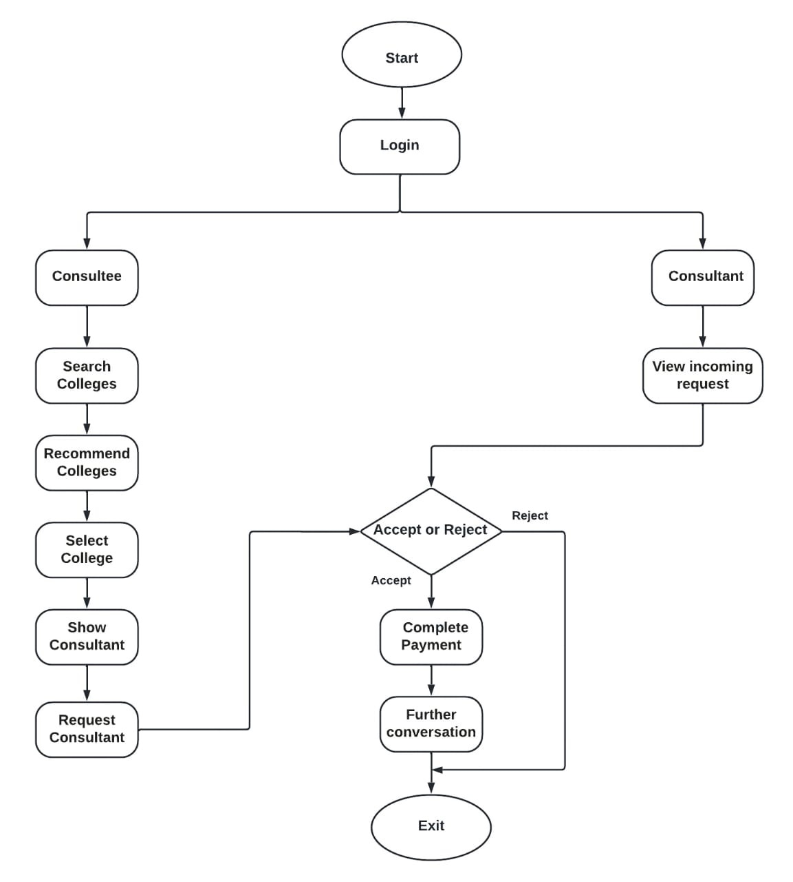
Flowchart

Slide 10


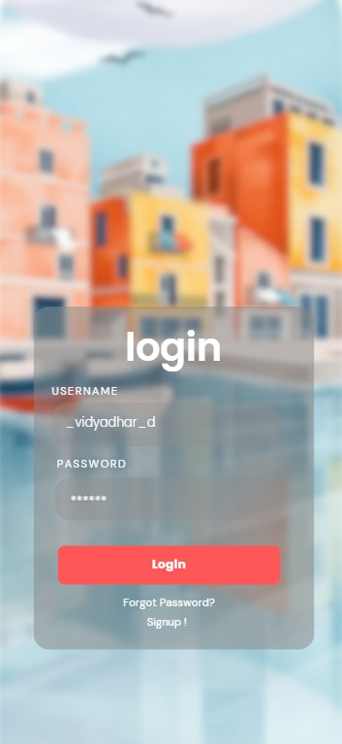

UI Design
roomRadar

Slide 11
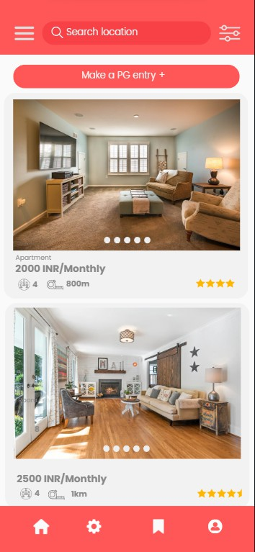
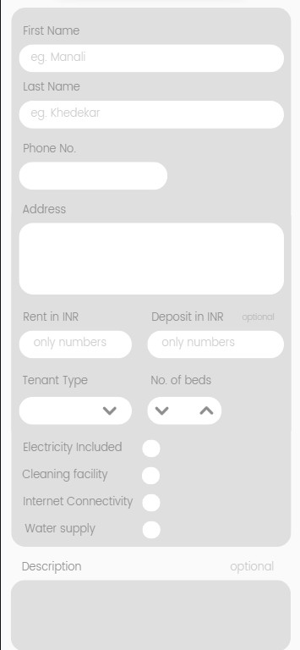
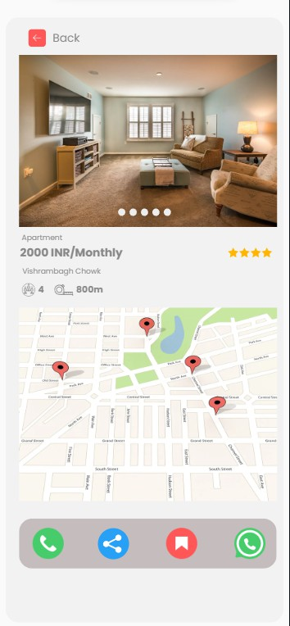
UI Design

Slide 12
References
Mr .Nawale Rohit Ramhari , Mr. Mouriya Narayan Dilip ,Mr.Saindane Sumit Madhukar, Mr.Wagh Prasad Sunil UG Student, Department of Computer Engineering BVCOE & Rc Nashik Prof. S.R.Jadhav Assistant Professor, Department of Computer Engineering BVCOE & Rc Nashik https://www.ijres.org/papers/Volume-10/Issue-5/Ser-15/1005105110.pdf
Vaishali S. Rajput, Satyajeet B. Jadhav, Makarand D. Jadhav, Rohit D. Jadhav, Rohan D. Jadhav, Pranav B. Jadhav Vishwakarma Institute of Technology, Pune, 411037, Maharashtra, India https://ymerdigital.com/uploads/YMER2111P9.pdf
Sagar Janokar , Atharva Raut , Yogeshwar Rekhawar , Shravani Raut , Reva Buche , Om Raut , Pranav Raundal Department of Engineering, Sciences and Humanities (DESH) Vishwakarma Institute of Technology, Pune, 411037, Maharashtra, India
https://www.ijraset.com/best-journal/pg-finder

