Slide 1
Exploring deep RL Algorithms on Open AI GYM Environments CSE 510 – Final Project
Sandesh Kumar Srivastava(sandeshk)
Venkata Narayana Rohit Kintali(vkintali)

Slide 2
Proposal(planned)
We plan to use DQN and DDQN algorithms to solve more complex environments like Atari Breakout for the final project.
In addition to solving the environment, we will also study the effect of different hyperparameters on the performance of the agent and improvise the existing model built.
We will demonstrate the improvement in performance by showing the agent behavior in the beginning and after training is done.

Slide 3
Proposal(revised)
We plan to use DQN and DDQN algorithms to solve more complex environments like Atari Breakout CartPole and Acrobat for the final project.
In addition to solving the environment, we will also study the effect of different hyperparameters on the performance of the agent and improvise the existing model built.
We will demonstrate the improvement in performance by showing the agent behavior in the beginning and after training is done.

Slide 4
ENVIRONMENT
The Open AI Gym environments used for comparing the DQN and Double DQN (DDQN) algorithm are:
CARTPOLE
ACROBOT

Slide 5
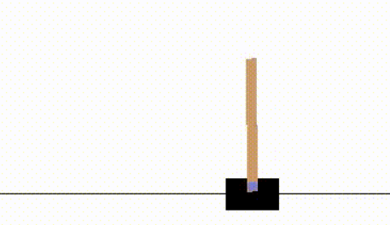
CARTPOLE-V1
Goal: To balance the pole connected with a joint on the top of a moving cart.
Actions: It is of the form of Discrete (2) and consists of Action set (A) = {0,1} where 0 means push cart to left and 1 means push cart to right.
State: The state space will be continuous and consists of cart position, cart velocity, pole angle and pole velocity at tip.
Reward: It is 1 for each step till the game terminates. Reward set (R) = {1}.

Slide 6
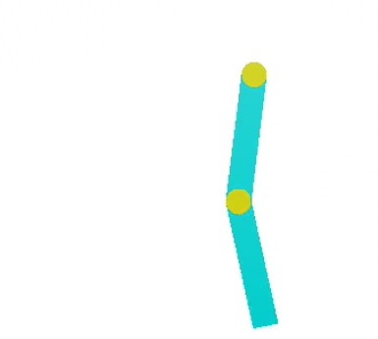
ACROBOT-V1
Goal: To swing the end of the lower link up to a given height.
Action: The action is either applying +1, 0 or -1 torque on the joint between the two pendulum links.
State: The state consists of the sin() and cos() of the two rotational joint angles and the joint angular velocities.
Reward: It is -1 for each step and 0 when the game terminates. Reward set (R) = {0,-1}.

Slide 7
Base Parameters of DQN and DDQN on CartPole and Acrobot
gamma = 0.9
epsilon_max = 1.0
epsilon_min = 0.001
epsilon_decay = 0.9
batch_size = 32
tau = 0.99(DDQN)
C=1
episodes = 500

Slide 8
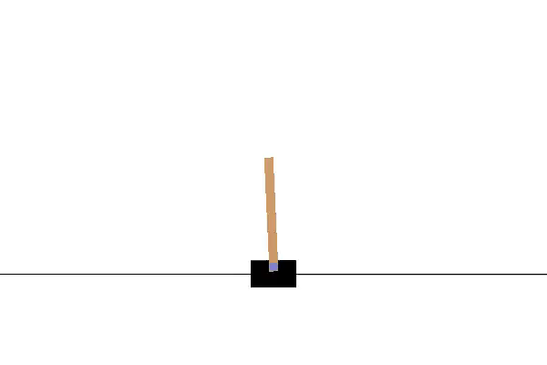
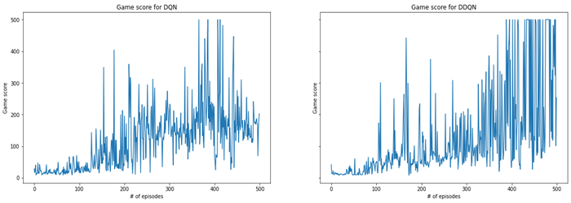
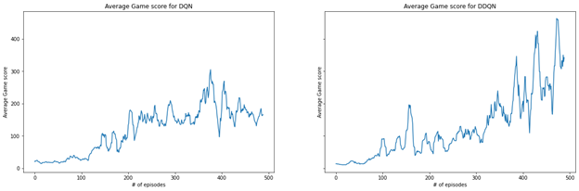
Performance of DQN and DDQN on CartPole

Slide 9
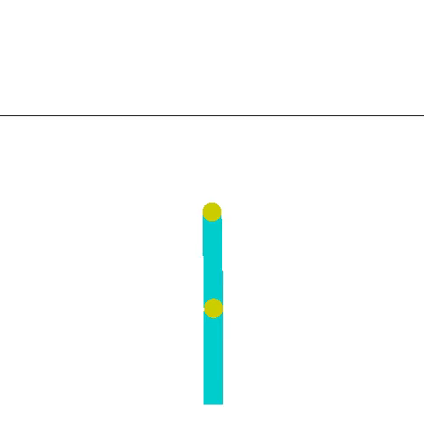
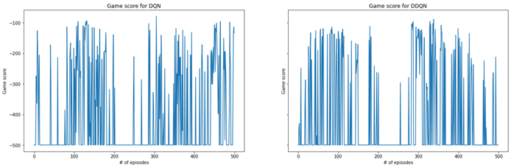
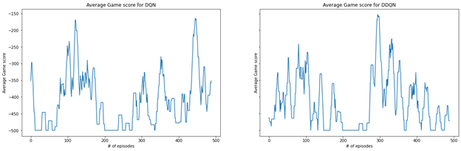
Performance of DQN and DDQN on Acrobot

Slide 10
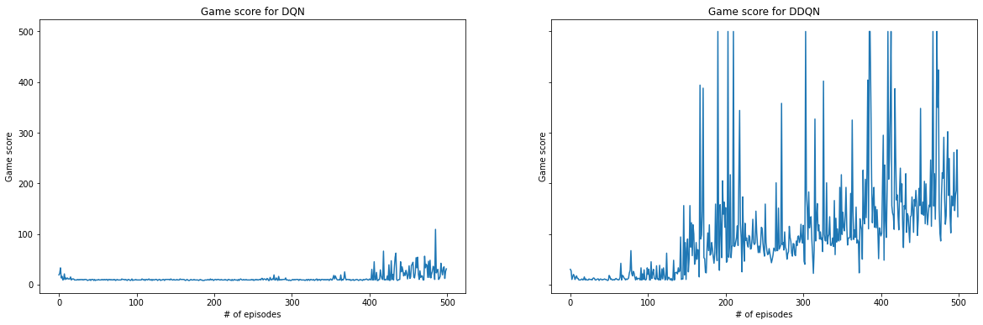
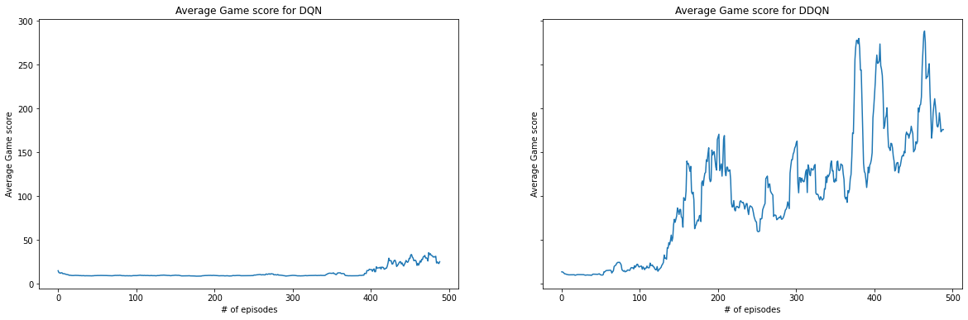
CartPole - Playing with hyper-parameters (C = 10)

Slide 11
Acrobot - Playing with hyper-parameters (C = 10)

Slide 12
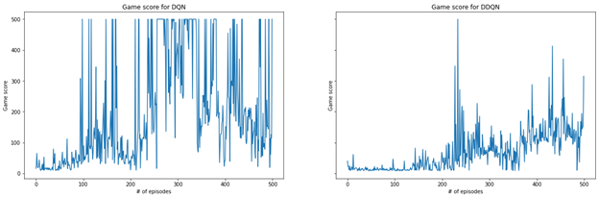
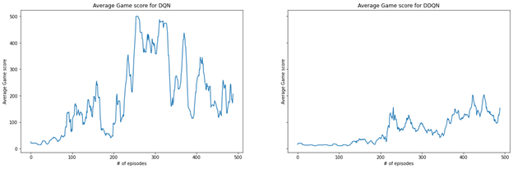
CartPole - Playing with hyper-parameters
(gamma = 0.8)

Slide 13
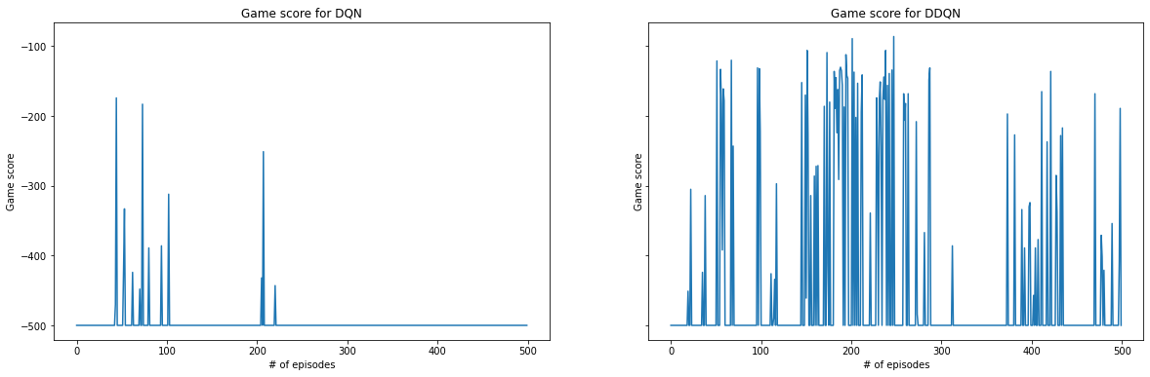
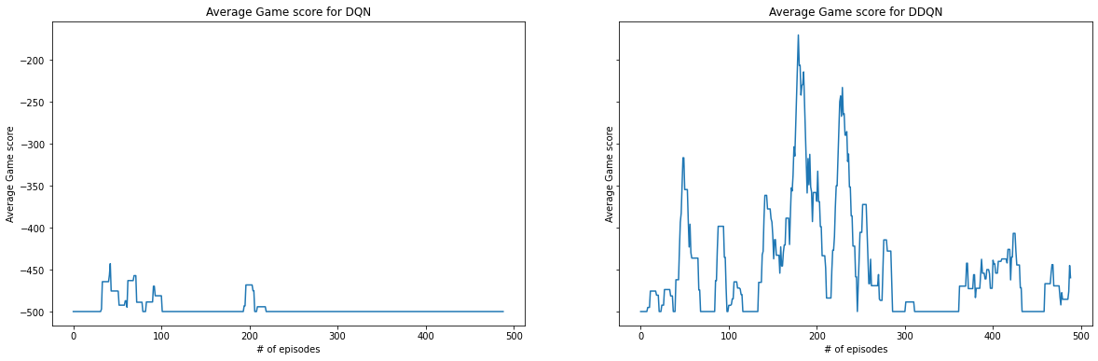
Acrobot - Playing with hyper-parameters(gamma=0.8)

Slide 14
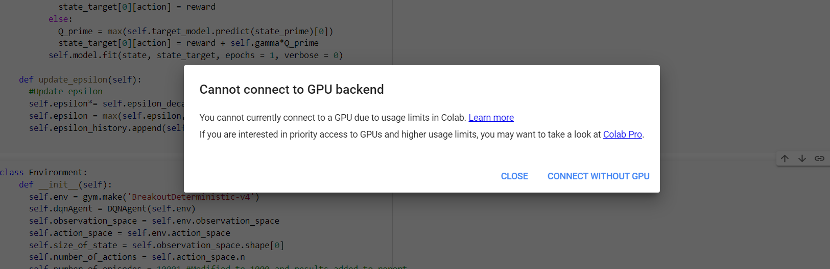
Challenges which forced us to change proposal
Time: Very less time to get the model trained, tune in parameters, modify algorithm
Computing Resources: Colab

Slide 15
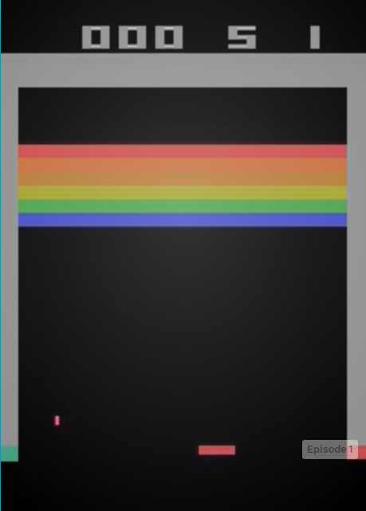
Still, what is Atari Breakout (BreakoutDeterministic-v4)
Goal: To maximize our score.
Actions: There are 4 possible actions (A) = {'NOOP', 'FIRE', 'RIGHT', 'LEFT'}
State: It is an RGB image of the screen, which is an array of shape (210, 160, 3).
Reward: It is the score obtained with each step. It can be 0 or more. (R) = {0,1,2..}

Slide 16
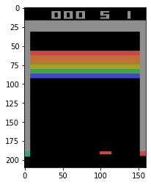
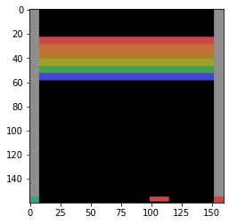
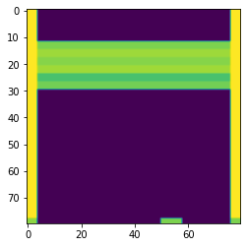
Preprocessing
Two stages of preprocessing : cropping and scaling

Slide 17
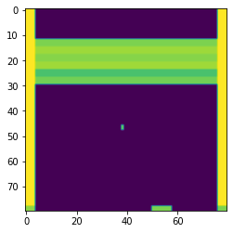
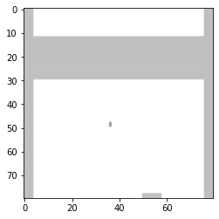
Stacking 4 frames together

Slide 18
Model
def build_model(self):
model = Sequential()
model.add(Conv2D(32, kernel_size=(3,3), activation='relu', input_shape=( 80, 80,4)))
model.add(Conv2D(64, (3,3), activation='relu'))
model.add(MaxPooling2D(pool_size=(2,2)))
model.add(Dropout(0.2))
model.add(Flatten())
model.add(Dense(128, activation='relu'))
model.add(Dropout(0.2))
model.add(Dense(self.number_of_actions, activation='softmax'))
model.compile(loss=keras.losses.huber_loss,
optimizer=keras.optimizers.Adadelta(),
metrics=['accuracy'])
return model

Slide 19
DDQN hyperparameters
self.memory = deque(maxlen=350000)
self.gamma = 0.9
self.epsilon_max = 1.0
self.epsilon_min = 0.1
self.epsilon_decay = 0.0001
self.batch_size = 32
self.epsilon = self.epsilon_max
self.tau = 0.2
self.number_of_episodes = 100001
self.C = 10
self.random_step_count = 10000 # take random action for these many steps
self.frequency_save_models = 10 # save model after these number of episodes
self.frequency_replay = 30 # call replay after these number of steps

Slide 20
Handling game life loss
We do not get any bad reward for losing life from the environment. So to handle this we used the info element ‘ale.lives’. Whenever we lose game life this value decreases and we attach a reward of -1 just in the memory. Hence, the agent will know that losing life is bad and it will avoid this state.
current_lives = info['ale.lives']
if current_lives < lives:
self.dqnAgent.memory.append([observation, action, -1, observation_prime, True])
lives = current_lives
else:
self.dqnAgent.memory.append([observation, action, reward, observation_prime, done])

Slide 21
Tricks to overcome resources crunch
Saving model continuously as Colab times out randomly.
On resuming model, change hyperparameters like epsilon to mimic actual running conditions.

Slide 22
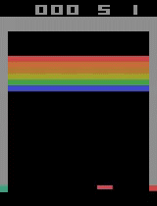
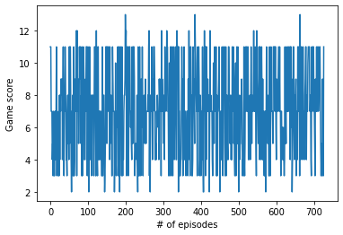
So finally what could we achieve
Episode: 10072, episode_reward: 9.0, max_score: 16.0
Episode: 10073, episode_reward: 17.0, max_score: 17.0

Slide 23
Some observations
On changing from DQN to DDQN, we observed a sudden jump in score from 5-7 to 11.
Due to limited training, the agent has not learnt to “fire” immediately after losing life so it causes a delay in episode to complete which in turn increases such states in memory.
As can be seen from the video, the agent learns to sit on the left end as the ball initially lands there. However, due to learning this behavior and our manipulation with epsilon we realized that agent was not exploring much. So, we reset the epsilon to higher value and the agent could start exploring more and reached the maximum score of 17.

Slide 24
Factors affecting training
Because of restarting the learning at multiple times, we could not store the memory and past experience was not stored over a long time.
We could not store all states in replay due to resource crunch and so the agent does not have all the states available for training.

Slide 25
Proposal(achieved)
We plan to use DQN and DDQN algorithms to solve more complex environments like Atari Breakout CartPole and Acrobat for the final project.
In addition to solving the environment, we will also study the effect of different hyperparameters on the performance of the agent and improvise the existing model built.
We will demonstrate the improvement in performance by showing the agent behavior in the beginning and after training is done.
Implement DDQN algorithm to solve Atari Breakout. Even though the agent is not able to learn a good policy but it is able to start playing the game.

Slide 26
References
For video rendering : https://star-ai.github.io/Rendering-OpenAi-Gym-in-Colaboratory/

Slide 27
Thank you!!

