Slide 1
Malignant Comment Classification
SANDES P

Slide 2
Proliferation of social media has a good side and bad side
There is nothing to prevent harmful comments to post in social media
Hateful comments cost a lot of people’s lives
Our objective to create a model that finds a comment is harmful or not

Slide 3
DATA
●We are provided with customer data of comments on social media
●The data is in csv format and it contains test and train datasets
●Data contains 159571 rows and 8 columns

Slide 4
DATA PREPROCESSING
There were no missing values
Removed the stopwords from the message
Lemmetized the message
Created three new columns which
Character length of the message
Word length of the message
The intensity of badness(sum of the column values loathe, abuse, threat, rude, malignant, highly malignant

Slide 5
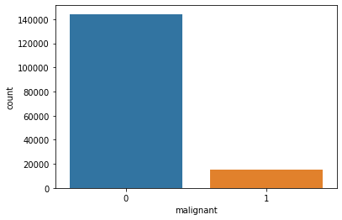
PLOTS
Malignant

Slide 6
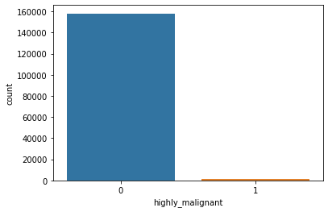
Highly malignant

Slide 7
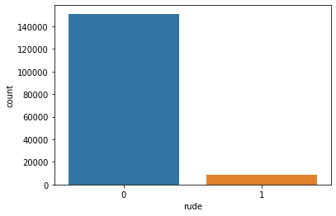
Rude

Slide 8
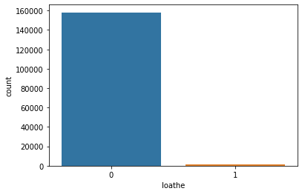
Loathe

Slide 9
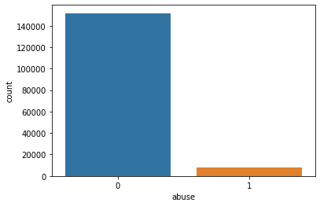
Abuse

Slide 10

Threat

Slide 11
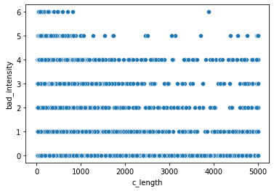
Bad intensity vs char length of the message

Slide 12
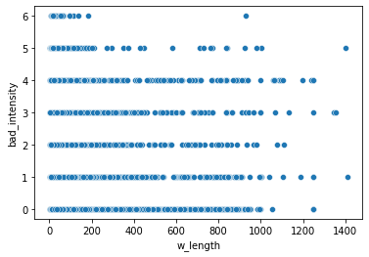
Bad intensity vs word length of the message

Slide 13
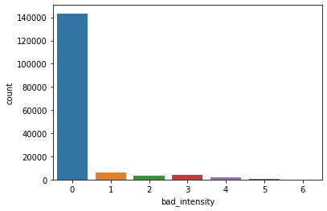
Count of bad intensity

Slide 14
Most of the messages are not hateful
The training dataset is imbalanced
High bad comments contain less number of words
Output accuracy is lesser in test dataset

Slide 15
TRAINING
Used models with accuracy
BinaryRelevance - 49%
ClassifierChain - 51%
LabelPowerset - 37%
MLkNN - 90%

Slide 16
CONCLUSION
All comments are vectorized and trained to find out the bad words and find out the toxicity of the message.

Slide 17
LIMITATION
Had to cut off the feature number to 3000 because of lesser resources

