Slide 1
Cloth Classification
SANDES P

Slide 2
Our objective to create a model that can classify the image whether it is a saree, jeans or trousers
For the image data, we had to scrap from e-commerce websites
Here, we used BeautifulSoup and scraped the images from www.amazon.in

Slide 3
DATA
●Scraped 1200 images 400 belongs to each category
●The images are in PNG format

Slide 4
DATA PREPROCESSING
Only preprocessing done is read the images and label and converted to array
One hot encoded the label values

Slide 5
TRAINING
Used sequential model to train with the images
We used 8 inner layers of neurons
The output activation function is softmax
Accuracy is found out by categorical cross entropy

Slide 6
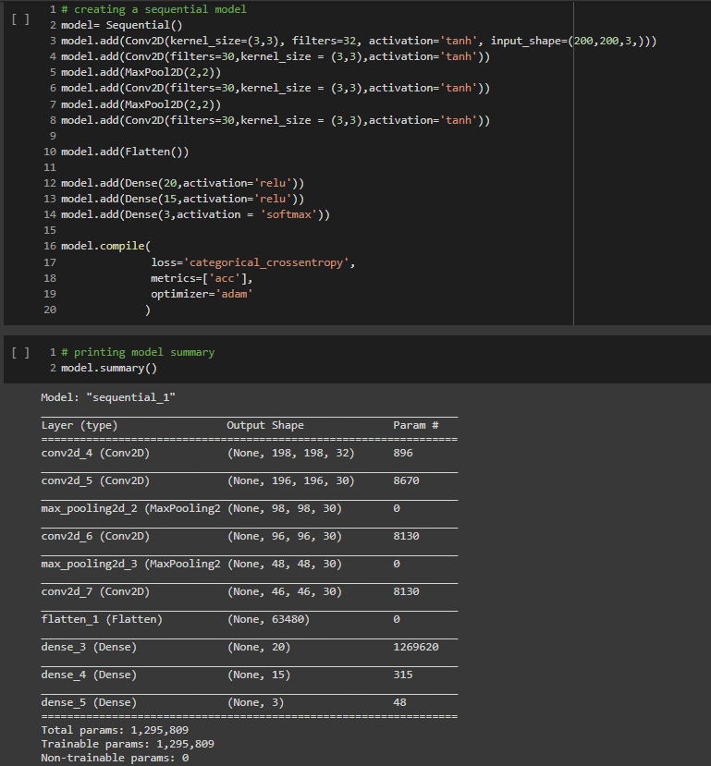

Slide 7
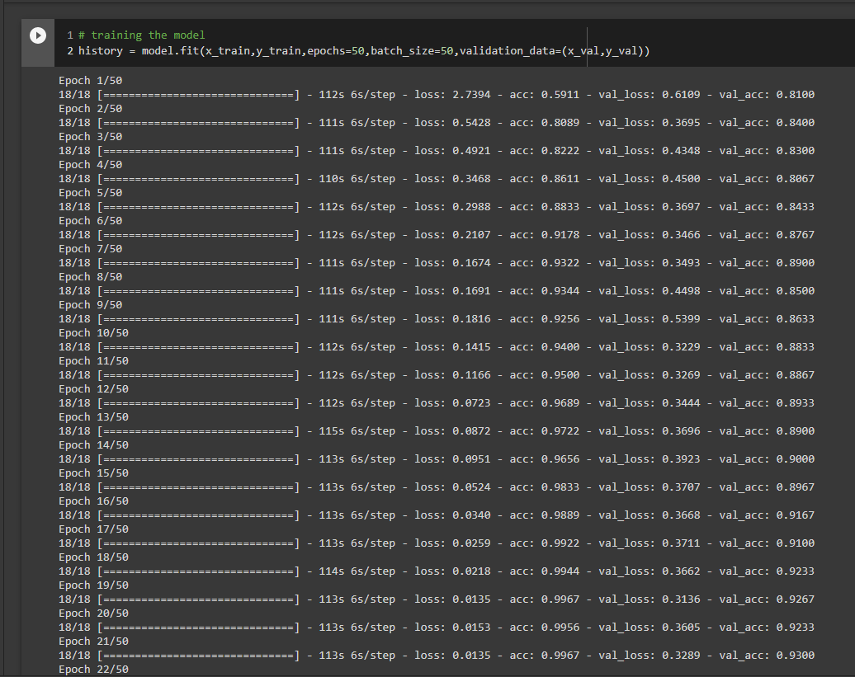

Slide 8
CONCLUSION
All images are converted to arrays and fed to CNN
Got an accuracy around 93%

