Slide 1
SRM INSTITUTE OF SCIENCE AND TECHNOLOGY
Explainable AI-Driven
Decision Support for
Predictive Inventory &
Procurement Optimization
TEAM
Sandhiya S
RA2411003010045
Nishanth Kannan
RA2411003010051
in ERP Systems
Netti Nithin Chakravarthy
RA2411003010033
PBL-1 · Machine Learning · Units 1 & 2
A working system that forecasts demand, flags stockout risk,
recommends how much to order — and explains why.
Dataset
UCI Online Retail II
1,067,371 real transactions
CC BY 4.0 · no credentials
XAI Decision Support for Inventory & Procurement · Sandhiya S · Nishanth Kannan · Netti Nithin Chakravarthy
1 / 15
Notes:
Good morning ma'am. We are Sandhiya, Nishanth and Nithin. Our project builds a decision-support system for retail inventory. It answers three questions for a shopkeeper or a warehouse manager: how much of a product will sell, are we about to run out, and how much should we order. And most importantly it explains why it gave that answer. Everything we show today comes from code that runs on just over a million real retail transactions.

Slide 2
IN PLAIN LANGUAGE
What is our project?
A shop has thousands of products. Every week somebody must decide:
“Which items do I buy more of, and how many?”
Today that decision is mostly guesswork.
EXAMPLE OUTPUT
Product : 20727
Stock available : 347 units
Predicted 7-day sale : 486 units
Supplier lead time : 8 days
Stockout risk : HIGH
Reorder : YES
Order quantity : 1,380 units
OUR SYSTEM ANSWERS SIX QUESTIONS, AUTOMATICALLY:
1
How much will this product sell in the next 7 days?
Regression
2
Is the stock we have enough?
Inventory logic
3
Are we at risk of running out?
Classification
4
Should we reorder — yes or no?
Classification
Not just a prediction — a DECISION.
And every recommendation comes with a plain-English reason, so a human can check it before approving the purchase order.
5
Exactly how many units should we order?
Decision policy
6
WHY did it recommend that number?
Explainable AI
XAI Decision Support for Inventory & Procurement · Sandhiya S · Nishanth Kannan · Netti Nithin Chakravarthy
2 / 15
Notes:
In simple terms: a shop has thousands of products, and every week someone has to decide what to buy more of. Today that is mostly guesswork. Our system answers six questions automatically. The first five are standard machine learning - predict demand, check stock, flag risk, decide reorder, compute quantity. The sixth is what makes our project different: it explains WHY. On the right you can see a real output from our system for product 20727.

Slide 3
WHY THIS MATTERS
The problem we are solving
Inventory fails in two directions at once — and fixing one
usually makes the other worse.
79.9%
2,027
Fill rate using today's
guesswork method
(1 in 5 units unavailable)
Days a product was
out of stock
in the test period
TOO LITTLE STOCK
TOO MUCH STOCK
• Customer wants it,
shelf is empty
• Sale is lost
• Customer may not
come back
• Cash locked on
the shelf
• Storage cost
• Goods may expire
or go out of season
Why is this hard?
Demand is wildly uneven — skewness 25, and 32% of product-days have NO sales at all.
An average-based rule is wrong on most days.
The deciding factor: how much to order, and when.
KEY INSIGHT THAT SHAPED OUR WHOLE PROJECT: a forecast by itself changes nothing. We proved this — using a machine-learning forecast with no safety buffer made the fill rate WORSE than the simple baseline (79.2% vs 79.9%). The value comes from handling UNCERTAINTY.
XAI Decision Support for Inventory & Procurement · Sandhiya S · Nishanth Kannan · Netti Nithin Chakravarthy
3 / 15
Notes:
Inventory fails in two directions at once. Too little stock and you lose the sale and maybe the customer. Too much and your cash is locked on a shelf. In our test environment the simple moving-average rule that most small retailers actually use achieves only a 79.9% fill rate - one unit in five that a customer wanted was not there. And it is hard because demand is extremely uneven. The key insight that shaped our whole project is at the bottom: a forecast by itself changes nothing.

Slide 4
MEASURED, NOT CLAIMED
Benefits — who gains, and how much
93.9%
+14.0pp
-76%
-68%
Fill rate achieved
up from 79.9%
Improvement over
the baseline rule
Fewer stockout days
2,027 → 496
Lower shortage cost
(simulated)
Who benefits | What they get
Shop owner / buyer | Fewer lost sales; less cash stuck in slow stock
Warehouse team | A ranked daily list of what to reorder, not a spreadsheet
Finance | Stockout cost cut by 68% in simulation; spend is justified per order
Supplier | Earlier, steadier orders instead of panic purchases
Auditor / manager | Every order has a written reason that adds up exactly
ACADEMIC VALUE
• Unit 1 and Unit 2 topics implemented
in running, tested code
• 13 models compared on one problem
• 81 automated tests
• Fully reproducible: one command
Honest framing: the cost figures come from a simulated supply chain, so the RANKING of methods is a real result — the rupee amounts are not a claim about a real shop. We say this openly on the next slide.
XAI Decision Support for Inventory & Procurement · Sandhiya S · Nishanth Kannan · Netti Nithin Chakravarthy
4 / 15
Notes:
These are the benefits, and they are measured rather than claimed. Our best policy raises the fill rate from 79.9% to 93.9% - fourteen percentage points - and cuts the number of stockout days by 75%. The table shows who gains. But I want to be careful: the cost figures come from a simulated supply chain, so the ranking of methods is a real result, the exact money amounts are not. We explain that honestly on the next slide.

Slide 5
REAL DATA, OPENLY SOURCED
Dataset — where our data came from
Property | Value
Name | Online Retail II
Source | UCI Machine Learning Repository
Business | UK online giftware wholesaler
Period | 01 Dec 2009 → 09 Dec 2011
Raw records | 1,067,371 invoice lines
After cleaning | 1,024,819 (96.01% retained)
Licence | CC BY 4.0 (free to use with attribution)
Credentials | None — direct download
WHAT EACH RECORD CONTAINS
Invoice · bill number
StockCode · product ID
Description · product name
Quantity · units sold
InvoiceDate · date & time
Price · unit price
Customer ID · buyer (22.8% blank)
Country · 43 countries
SOURCE LINKS
WHY THIS DATASET?
Kaggle's Favorita set is richer (it has promotions and holidays) but needs a personal login token, which cannot be automated.
We chose reproducibility: our project downloads its data and runs with ONE command, on any machine.
▸ Dataset page: archive.ics.uci.edu/dataset/502/online+retail+ii
▸ DOI: https://doi.org/10.24432/C5CG6D
▸ Alternative considered — Kaggle Store Sales (Favorita)
XAI Decision Support for Inventory & Procurement · Sandhiya S · Nishanth Kannan · Netti Nithin Chakravarthy
5 / 15
Notes:
Our data is real. It comes from the UCI Machine Learning Repository - the Online Retail II dataset, which is a UK online giftware wholesaler's complete sales record for two years, just over a million invoice lines, free to use under Creative Commons. The links are on the slide. We did consider Kaggle's Favorita dataset which is richer, but it needs a personal login token that cannot be automated, so we chose this one - our project downloads its own data and runs with one command on any machine.

Slide 6
DATA HONESTY
What is real and what we had to simulate
The dataset records what was SOLD. It does not record what was in the warehouse. But you cannot decide a purchase order without stock, suppliers and costs — so we generate those, and we say so everywhere.
REAL — straight from the dataset
SIMULATED — generated by us, seeded
✓ units sold per product per day
✓ dates and the trading calendar
✓ unit prices
✓ product codes and descriptions
✓ invoice and customer records
✓ country of the buyer
✓ returns / cancellations
✗ stock level in the warehouse
✗ suppliers and their reliability
✗ delivery lead times
✗ minimum order quantity, pack size
✗ supplier capacity
✗ purchase / holding / shortage costs
✗ purchase orders
How we keep this honest: all simulated values come from one config file (sim/supply_config.yaml) with a fixed random seed, every row is flagged is_simulated, and the dashboard shows a warning. Because all methods face the SAME real demand and the SAME simulated terms, comparing them is valid — we just never call a simulated number a measurement.
XAI Decision Support for Inventory & Procurement · Sandhiya S · Nishanth Kannan · Netti Nithin Chakravarthy
6 / 15
Notes:
This slide is about honesty, and we think it is the most important slide in the deck. The dataset records what was sold. It does not record what was sitting in the warehouse, who the suppliers were, how long delivery took, or what anything cost. But you cannot decide a purchase order without those. So we generate them, from one config file with a fixed seed, and we label them as simulated everywhere - in the code, the dashboard and the report. Because every method faces the same real demand and the same simulated terms, comparing the methods is still valid. We just never call a simulated number a measurement.

Slide 7
METHODOLOGY
How the system works
RAW DATA
1.07M rows
CLEANING
7 rules
EDA
16 charts
FEATURES
43 / 52
MODELS
13 compared
DECISION
policy
EXPLAIN
SHAP
TWO MACHINE-LEARNING PROBLEMS
REGRESSION
How many units will
sell in 7 days?
→ e.g. 486 units
CLASSIFICATION
Will we run out before
the delivery arrives?
→ YES / NO
Split | Rows | Period
Train | 66,859 | Jan 2010 – May 2011
Validation | 16,239 | May – Aug 2011
Test | 16,689 | Aug – Dec 2011
THE RULE THAT PROTECTS US FROM CHEATING
Why split by date?
Two days in a row share almost all their history. If one went into training and the next into testing, the model would effectively have seen the answer — and our scores would look great but be meaningless.
A decision on day t may use data from day t−1 and earlier ONLY.
The answer (days t … t+6) is never visible to the model.
We split by DATE, never randomly — and 8 automated tests check it.
XAI Decision Support for Inventory & Procurement · Sandhiya S · Nishanth Kannan · Netti Nithin Chakravarthy
7 / 15
Notes:
This is how the system works end to end. Raw data, cleaning with seven documented rules, exploratory analysis, feature engineering, thirteen models, then the decision policy and the explanation layer. We solve two machine learning problems: a regression that predicts how many units will sell, and a classification that says whether we will run out. The bottom-left box is the rule that stops us cheating - a decision on day t can only use data up to the day before, and we split by date rather than randomly, because two consecutive days share almost all their history.

Slide 8
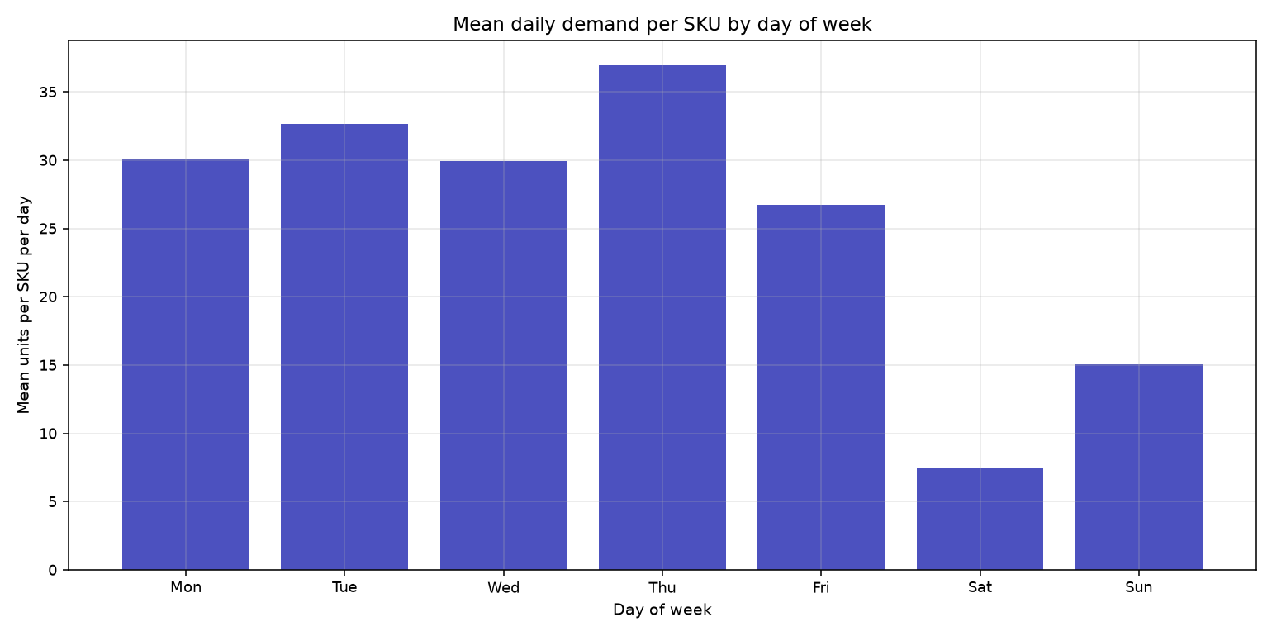
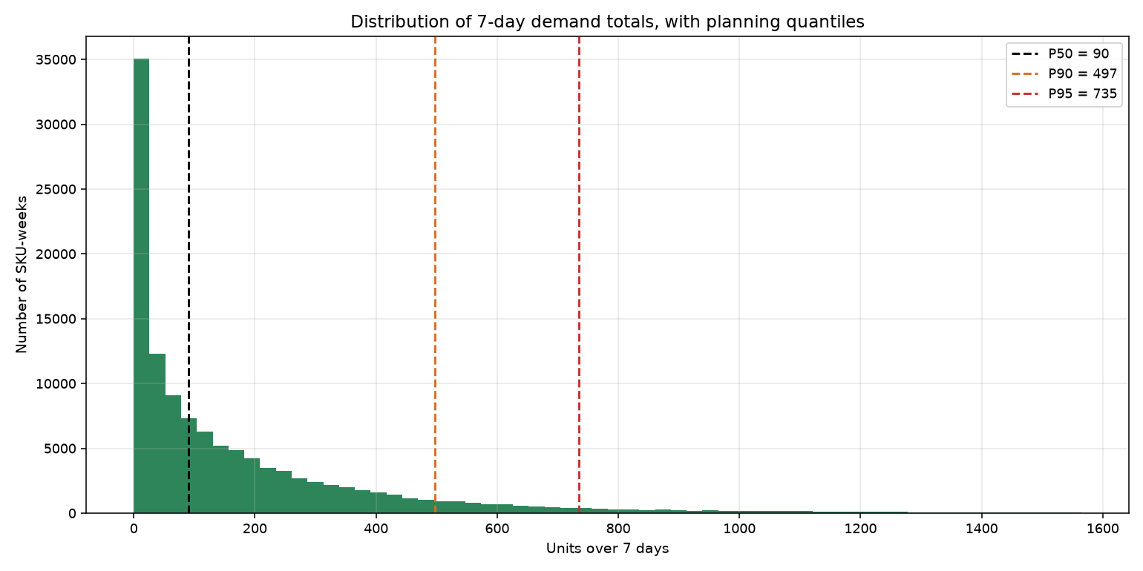
EXPLORATORY DATA ANALYSIS
What we discovered in the data
30 vs 8,167
25
32%
8.2×
Saturday invoices vs
Thursday — the shop is
CLOSED on Saturdays
Skewness — demand is
nothing like a
normal bell curve
of product-days have
ZERO sales
A busy week sells 8×
a typical week
The Saturday discovery nearly broke our project: if we had filled those closed days with zeros, we would have added ~17% FAKE no-sale records and pushed every forecast downwards. We build the calendar from days the shop actually traded — 604 of 739.
XAI Decision Support for Inventory & Procurement · Sandhiya S · Nishanth Kannan · Netti Nithin Chakravarthy
8 / 15
Notes:
Four discoveries shaped everything. First and most important: this shop does not trade on Saturdays - thirty invoices against eight thousand on a Thursday. If we had filled those closed days with zeros we would have added about seventeen percent fake no-sale records and pushed every forecast down. Second, demand is skewed at 24, nothing like a bell curve. Third, nearly a third of product-days have no sales at all. Fourth, a busy week sells eight times a typical week - and that last number is the reason our whole uncertainty layer exists.

Slide 9
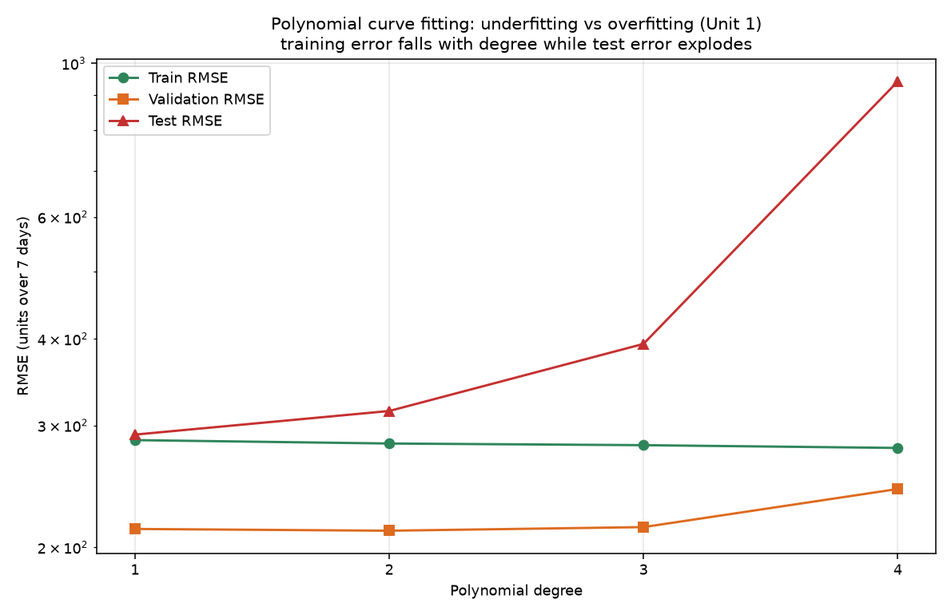
SYLLABUS CONCEPT, MEASURED ON REAL DATA
Unit 1 — Polynomial curve fitting & overfitting
Degree | Terms | Train error | Test error | Test R²
1 | 4 | 285.8 | 291.1 | 0.5
2 | 14 | 282.6 | 314.8 | 0.42
3 | 34 | 281.0 | 393.5 | 0.09
4 | 69 | 278.4 | 942.0 | -4.23
As we increase the polynomial degree:
▸ Training error keeps IMPROVING 285.8 → 278.4
▸ Test error gets 3.2× WORSE 291.1 → 942.0
▸ R² becomes NEGATIVE at degree 4 — the model is
worse than simply guessing the average
The penalty is held constant, so only capacity changed.
This is the bias–variance trade-off from Unit 1 — not drawn as a textbook cartoon, but measured on our own data. A more powerful model is not automatically a better model.
XAI Decision Support for Inventory & Procurement · Sandhiya S · Nishanth Kannan · Netti Nithin Chakravarthy
9 / 15
Notes:
This is the Unit 1 concept of polynomial curve fitting, and we measured it on real data rather than drawing a textbook cartoon. As we raise the degree, the training error keeps improving - the model fits the data it has seen better and better. But the test error gets 3.2 times worse, and at degree four the R-squared actually goes negative, meaning the model is worse than just guessing the average. Same data, same penalty, only the capacity changed. That is overfitting, and you can watch it happen.

Slide 10
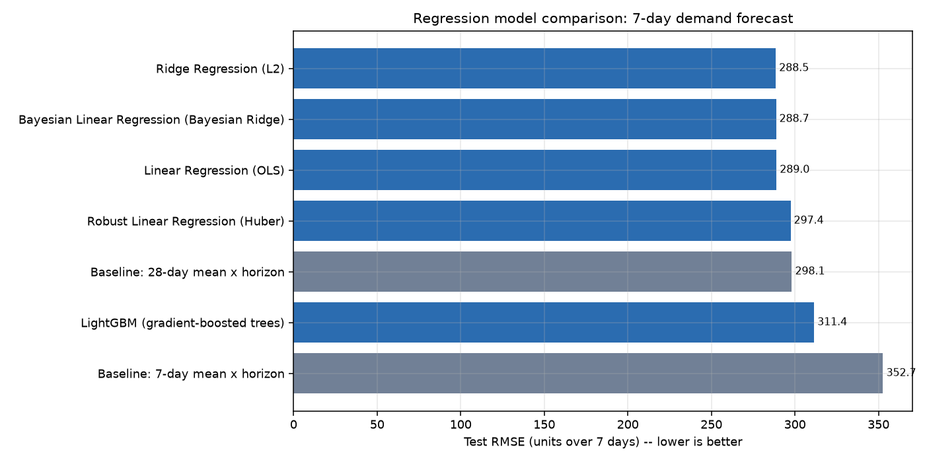
7 MODELS COMPARED, INCLUDING 2 SIMPLE BASELINES
Unit 2 — Demand forecasting results
Model | MAE | RMSE | R²
Ridge Regression (L2) | 136.4 | 288.5 | 0.51
Bayesian Linear Regression | 136.3 | 288.7 | 0.509
Linear Regression (OLS) | 134.2 | 289.0 | 0.508
Robust Linear Regression (Huber) | 124.0 | 297.4 | 0.479
★ Baseline: 28-day mean | 136.7 | 298.1 | 0.477
LightGBM | 142.3 | 311.4 | 0.429
★ Baseline: 7-day mean | 160.3 | 352.7 | 0.267
Unit 2 link: minimising squared error IS maximising the Gaussian likelihood — so ordinary least squares already is a Maximum Likelihood Estimator. Ridge adds an L2 penalty.
HONEST RESULT: LightGBM — the most advanced model — came 6th of 7, behind a simple moving average. We report it instead of hiding it.
Why did the advanced model lose? Demand is 31.7% zeros, which fragments decision trees; and the test period is the Christmas peak, which lies outside the range the trees ever saw — trees cannot extrapolate, linear models can.
XAI Decision Support for Inventory & Procurement · Sandhiya S · Nishanth Kannan · Netti Nithin Chakravarthy
10 / 15
Notes:
Here are our forecasting results - seven models including two simple baselines so we can tell whether machine learning actually added anything. Ridge regression won. The Unit 2 connection is on the left: minimising squared error is the same thing as maximising the Gaussian likelihood, so ordinary least squares already is a maximum likelihood estimator. And on the right is our honest result: LightGBM, the most advanced model, came sixth of seven, behind a moving average. We report it rather than hide it, and we can explain why - zero inflation and a test period outside the training range.

Slide 11
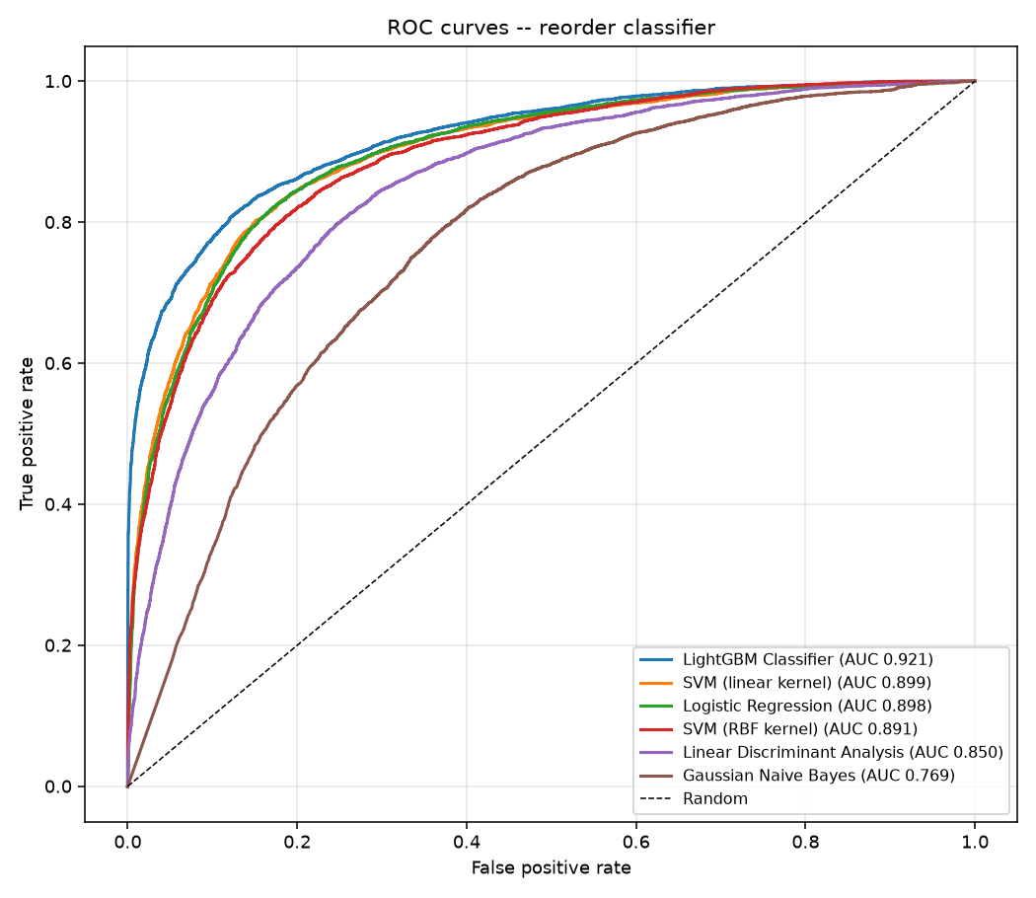
6 CLASSIFIERS, EACH MAPPED TO A SYLLABUS TOPIC
Unit 2 — Reorder prediction & the kernel trick
Model | Precision | Recall | F1 | AUC
LightGBM | 0.744 | 0.816 | 0.778 | 0.921
SVM (linear kernel) | 0.691 | 0.816 | 0.748 | 0.899
Logistic — discriminative | 0.684 | 0.826 | 0.748 | 0.898
SVM (RBF kernel) | 0.616 | 0.859 | 0.718 | 0.891
LDA — discriminant function | 0.781 | 0.426 | 0.552 | 0.85
Gaussian NB — generative | 0.374 | 0.969 | 0.54 | 0.769
GENERATIVE vs DISCRIMINATIVE (Unit 2)
Naive Bayes uses Bayes' rule on p(x|y) — recall 0.969 but precision only 0.374: it flags almost everything. Logistic models p(y|x) directly: F1 0.748 vs 0.540.
KERNEL TRICK: Linear SVM (F1 0.748) BEAT the RBF kernel SVM (0.718) — same settings, same data, only the kernel changed. The infinite-dimensional feature map did not help, which tells us the boundary is nearly linear here. Another negative result, reported.
XAI Decision Support for Inventory & Procurement · Sandhiya S · Nishanth Kannan · Netti Nithin Chakravarthy
11 / 15
Notes:
Six classifiers, each one mapped to a Unit 2 topic. Two results are worth explaining. Generative versus discriminative: Naive Bayes models the feature distribution and applies Bayes rule - it catches 97% of the real cases but its precision is only 37%, so it flags almost everything. Logistic regression models the probability directly and is much better balanced. And the kernel trick: the linear SVM actually beat the RBF kernel SVM with identical settings, which tells us the decision boundary is nearly linear here. That is a negative result and we report it.

Slide 12
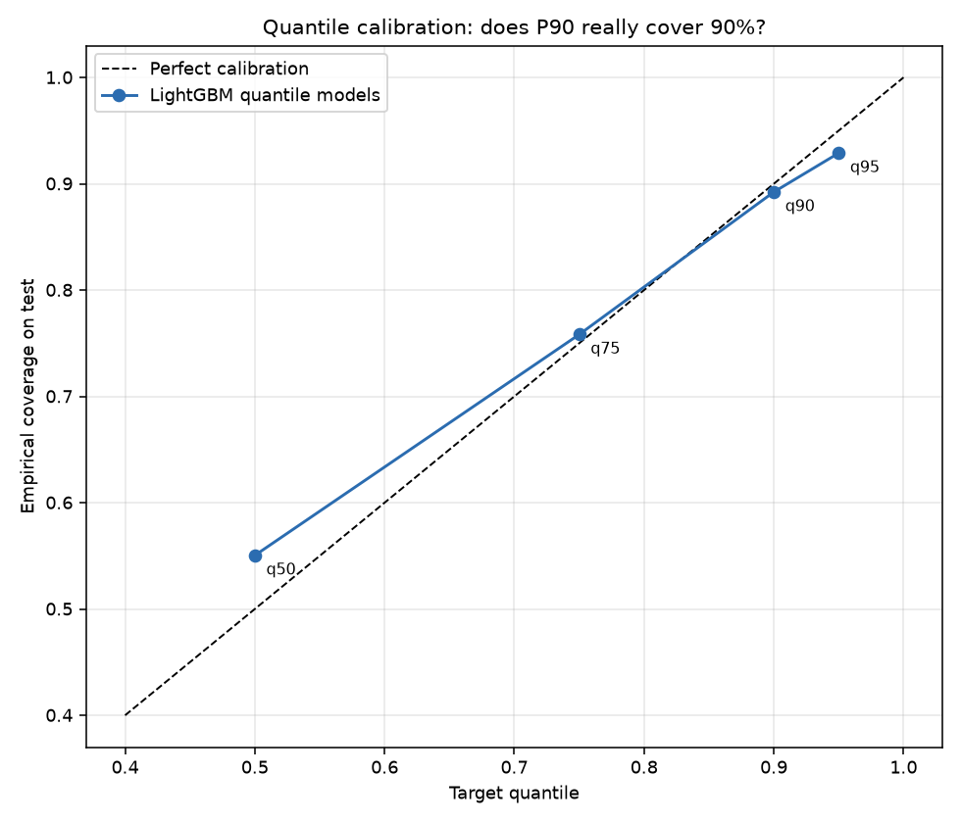
PROBABILITY, MEAN, VARIANCE AND QUANTILES APPLIED
Unit 1 — Handling uncertainty with quantiles
Target | Actual coverage | Error
P50 | 0.55 | 0.05
P75 | 0.758 | 0.008
P90 | 0.892 | -0.008
P95 | 0.929 | -0.021
A single predicted number is not enough for stock planning.
▸ P50 = the typical week
▸ P90 = a busy week — stock for this and you are short
only 1 week in 10
▸ P95 = a very busy week
The gap between P95 and P50 becomes our SAFETY STOCK —
learned from the data, not assumed from a bell curve.
Calibration check — does our P90 model really cover 90% of weeks? It covers 89.2%. Every level is within 2.1 percentage points of its target, with no normality assumption — which matters because our demand skewness is 24.6.
XAI Decision Support for Inventory & Procurement · Sandhiya S · Nishanth Kannan · Netti Nithin Chakravarthy
12 / 15
Notes:
A single predicted number is not enough to plan stock with. So we also predict quantiles - the typical week, the busy week, the very busy week. The gap between the 95th percentile and the median becomes our safety stock, and because it is learned from the data we do not have to assume a bell curve, which matters a lot when the skewness is 24. The table checks calibration: does our P90 model really cover ninety percent of weeks? It covers 89.2 percent. Every level is within about two points.

Slide 13
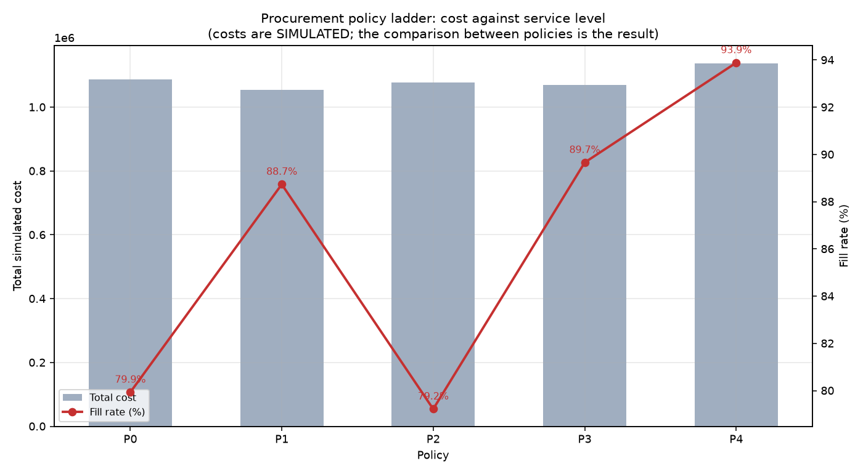
OUR MOST IMPORTANT RESULT
From prediction to DECISION
Method | Fill rate | Stockout days | Cost vs P0
P0 Simple moving average | 79.9% | 2,027 | +0.0%
P1 Classical reorder point | 88.7% | 966 | -2.9%
P2 ML forecast, no buffer | 79.2% | 1,570 | -0.8%
P3 ML + classical buffer | 89.7% | 767 | -1.6%
P4 ML + learned buffer | 93.9% | 496 | +4.6%
LOOK AT P2.
The machine-learning forecast with NO safety buffer scores 79.2% — WORSE than the simple baseline's 79.9%.
A better prediction, on its own, did not help at all.
What DID work is handling uncertainty. P1 gains 8.8 points using a classical buffer and no ML at all. Our full method P4 reaches 93.9% — a 14-point gain with 75% fewer stockout days — for 4.6% more cost. Whether that trade is worth it depends on how the business prices a lost sale.
XAI Decision Support for Inventory & Procurement · Sandhiya S · Nishanth Kannan · Netti Nithin Chakravarthy
13 / 15
Notes:
This is our most important result. Look at P2 - the machine learning forecast with no safety buffer. It scores 79.2 percent, which is worse than the simple baseline. A better prediction on its own did not help at all. What did work is handling uncertainty. P1 gains almost nine points using a classical safety buffer and no machine learning whatsoever. Our full method, P4, combines the ML forecast with the learned buffer and reaches 93.9 percent - fourteen points better, with 75 percent fewer stockout days, for 4.6 percent more cost.

Slide 14
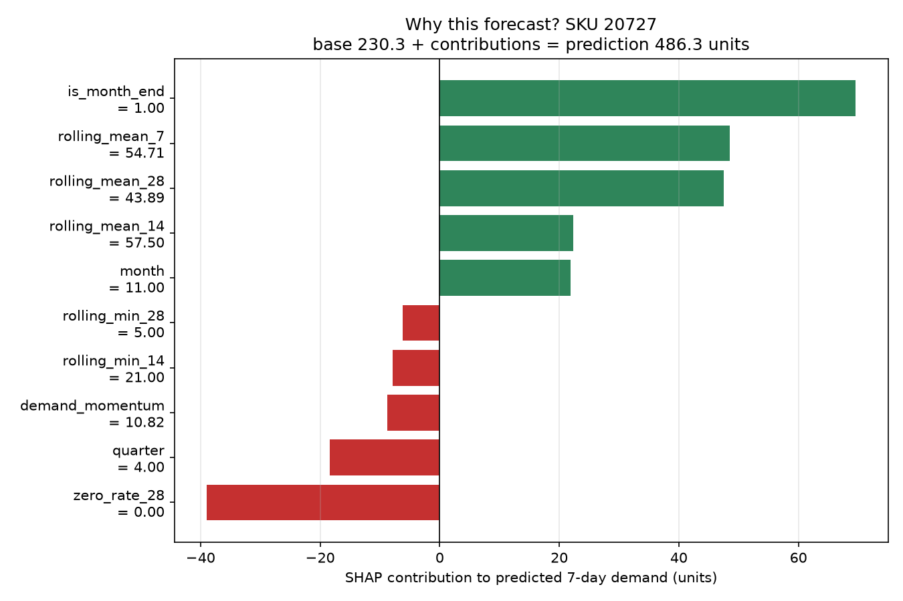
THE PART THAT MAKES IT USABLE
Explainable AI — why THIS number?
PRODUCT 20727 · RISK HIGH · ORDER 1,380 UNITS
+1,042.1 expected demand over lead time
+675.0 safety stock
-347.2 less: stock already available / on order
+0.0 clip at zero (never order negative)
+0.0 supplier minimum order quantity
+10.1 pack-size rounding
+0.0 supplier capacity cap
────────────────────────────────────────────
1,380 FINAL ORDER QUANTITY
What if… | New order | Change
Current situation | 1,380 | —
Lead time halved (8 -> 4 days) | 924 | -456
Lead time doubled (8 -> 16 days) | 2,292 | +912
Stock fully depleted (0 units) | 1,728 | +348
Stock = 50% of lead-time demand | 1,200 | -180
Two layers of explanation
1. WHY this forecast — SHAP. Our winning model is linear, so the attributions are EXACT, not estimated.
2. WHY this quantity — the arithmetic adds up to the order with residual 0.000000 across all 16,689 decisions.
XAI Decision Support for Inventory & Procurement · Sandhiya S · Nishanth Kannan · Netti Nithin Chakravarthy
14 / 15
Notes:
Most explainable-AI demos stop at saying which feature was important. That does not tell a shopkeeper why the system asked for 1,380 units. So we built two layers. The first explains the forecast using SHAP - and because our winning model is linear, the values are exact rather than estimated. The second explains the quantity as simple arithmetic you can check by hand: expected demand, plus safety stock, minus what we already have, plus pack rounding. It adds up exactly, on every one of the 16,689 decisions. And the bottom-left table is our what-if feature, so the buyer can test a scenario before committing.

Slide 15
WHAT WE BUILT, WHAT WE LEARNED
Conclusion
0.510
0.778
93.9%
81 / 51
Forecast R²
Ridge Regression
Reorder F1 score
LightGBM
Fill rate achieved
up from 79.9%
Tests passing /
rubric checks
WHAT WE LEARNED
LIMITATIONS WE ACKNOWLEDGE
▸ A better forecast alone did NOT help — handling
uncertainty is what improved service
▸ The most advanced model lost the forecasting task
▸ The non-linear kernel lost to the linear one
▸ Explaining the decision matters more than
explaining the model
▸ Supply-side data is simulated
▸ One retailer, one country, two years
▸ Top 200 products = 42% of revenue
▸ No promotion data in the dataset
▸ Human approval is still required —
nothing is ordered automatically
LIVE DEMO — Streamlit dashboard, 6 pages
Sandhiya S · RA2411003010045
Nishanth Kannan · RA2411003010051
Netti Nithin Chakravarthy · RA2411003010033
Overview · Demand Prediction · Inventory Risk · Procurement Recommendation · WHY? · Model Comparison
XAI Decision Support for Inventory & Procurement · Sandhiya S · Nishanth Kannan · Netti Nithin Chakravarthy
15 / 15
Notes:
To conclude. Our system forecasts demand with an R-squared of 0.51, predicts reorder need with an F1 of 0.78, and raises the fill rate from 79.9 to 93.9 percent. Eighty-one automated tests pass and all fifty-one rubric checks pass. What we learned matters more than the numbers: a better forecast alone did not help, the most advanced model lost, and the non-linear kernel lost to the linear one. We report all of that honestly, because a project that only reports what worked has not really tested anything. We acknowledge our limitations, especially that the supply-side data is simulated. Thank you - we will now show the live dashboard.

