Slide 1

INDUSTRIAL TRAINING/INTERNSHIP-2
PYTHON FULL STACK DEVELOPMENT
04/12/2024

Slide 2
A Python full stack developer is a professional who creates web applications by working on both the front-end and back-end of a website or application:
Front-end
The client-side of the application, which users see. Python full stack developers use technologies like HTML, CSS, and JavaScript, often with frameworks like React or Angular.
Back-end
The server-side of the application, which includes the server and database. Python full stack developers use Python for server-side tasks.

Slide 3
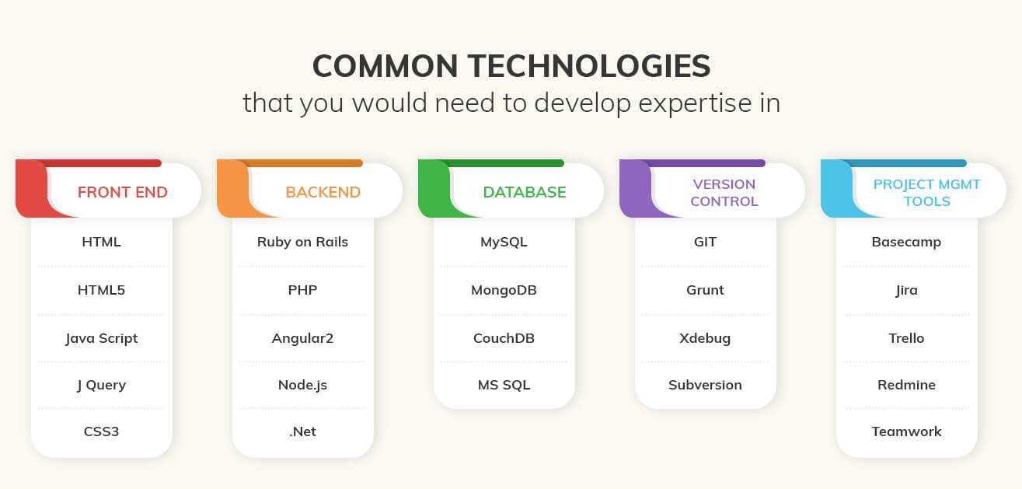

Slide 4
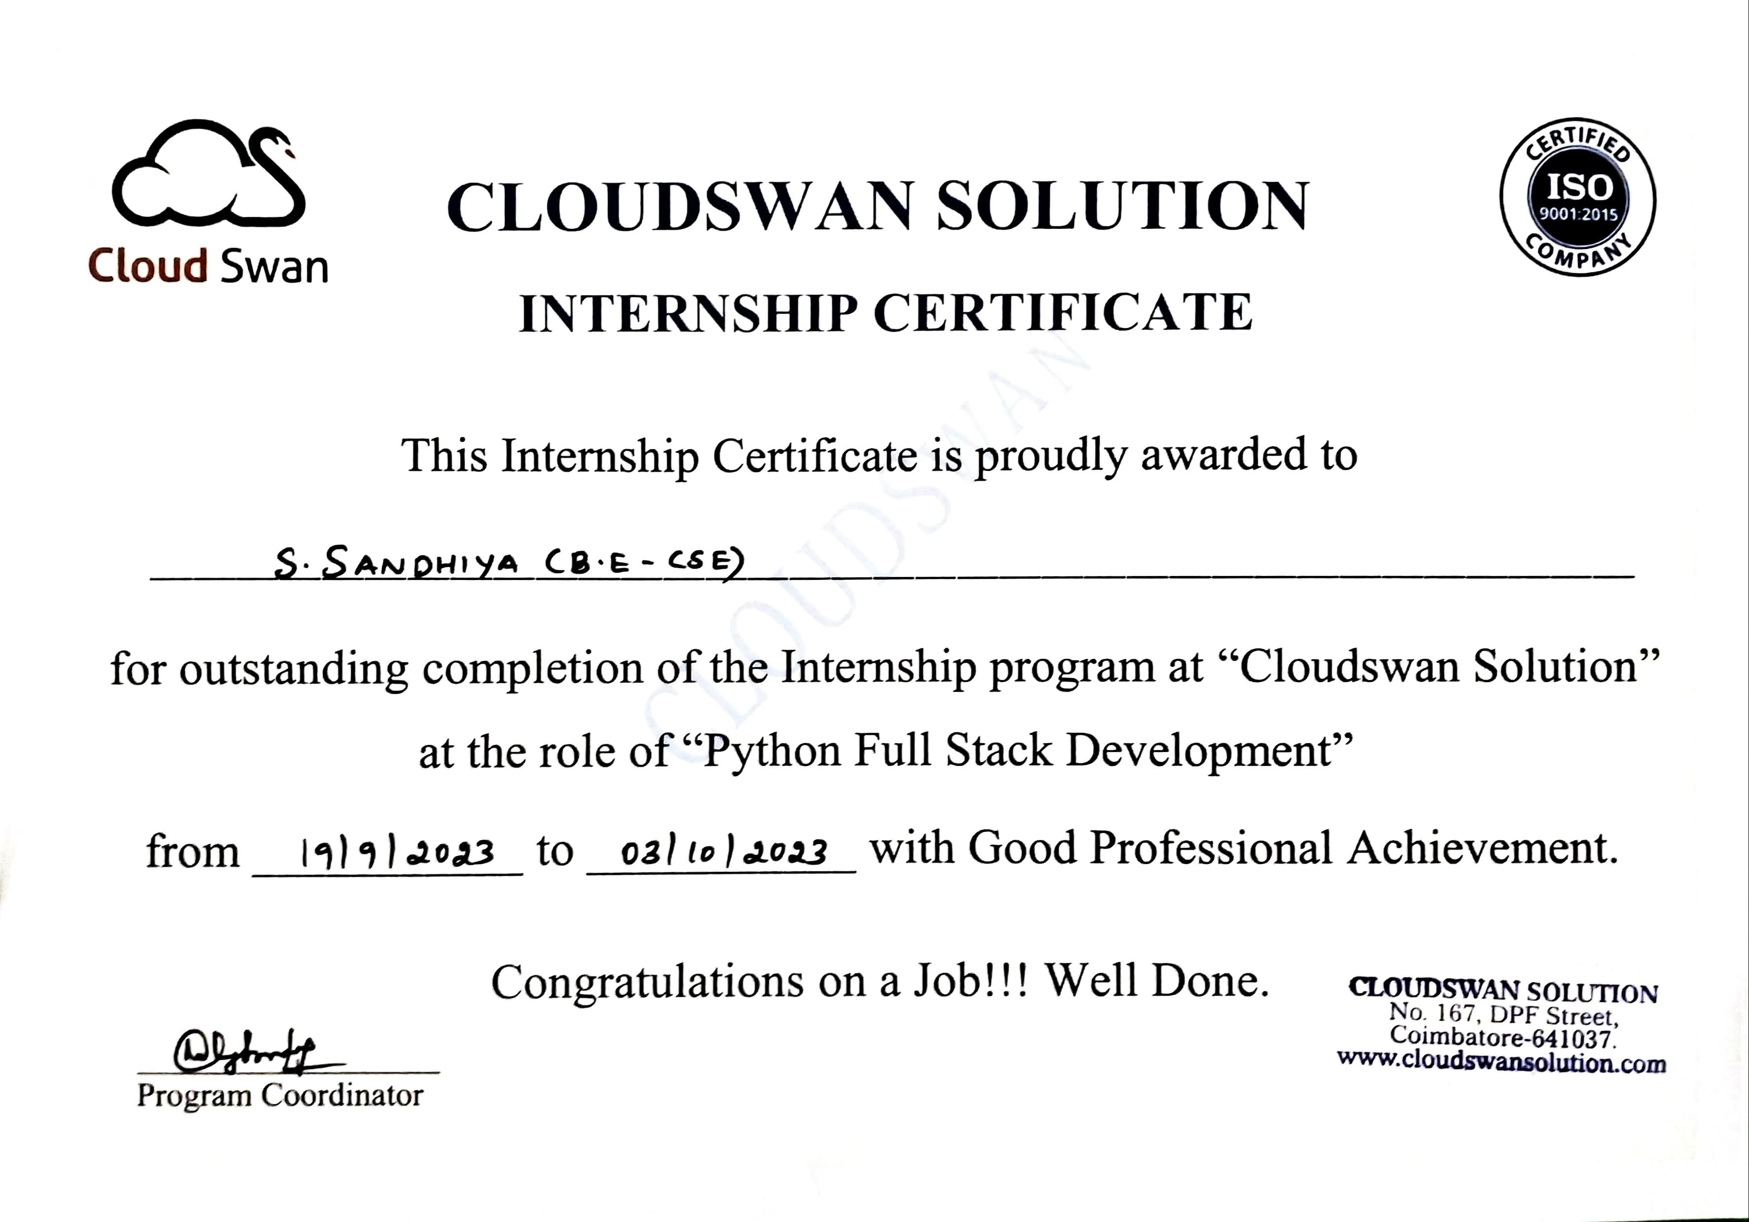
29.07.2024
07.08.2024

