Slide 1

Digital Food Expiry Detector
Domain: Artificial Intelligence & Machine
Learning
By
A.SANDHIYA.MCA

Slide 2

ABSTRACT:
This project focuses on detecting the freshness of food items using Deep Learning techniques. A Convolutional Neural Network (CNN) model is trained on image datasets categorized into Fresh, Slightly Spoiled, and Rotten. The system automates food quality analysis, reduces manual inspection, and helps minimize food wastage. It processes images, classifies them, and provides accurate predictions efficiently.

Slide 3
INTRODUCTION
• Scope: Intelligent inventory for households & retail.
• Objectives: Automate spoilage detection using CNN architectures.
• System: Neural sensor-based food monitoring.
• Proposed: Cloud-edge hybrid for real-time inference.

Slide 4
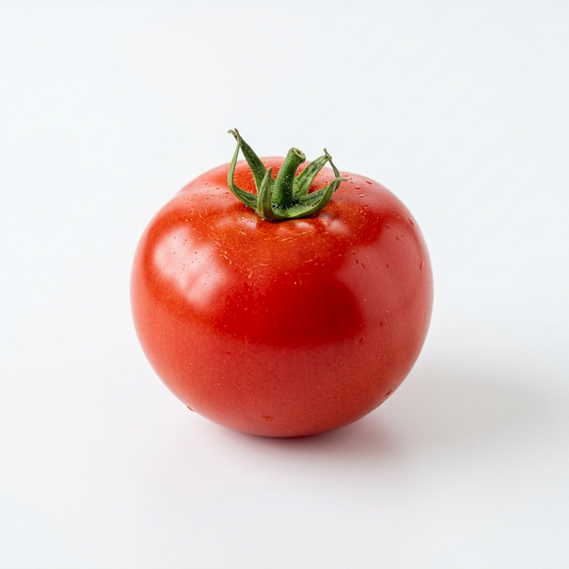
OVERALL DESCRIPTION
• Hardware: Optical sensors (Camera), 8-core CPU.
• Software: Python 3.13, Flask, TensorFlow, SQLite.
• Characteristics: Low latency, high precision classification.
• Compatibility: Cross-platform Web/Mobile.

Slide 5
SPECIFIC REQUIREMENTS
• Functional: Capture -> Sync -> Analyze -> Alert.
• Non-Functional: 95% Accuracy, <2s Response Time.
• Security: Multi-user data isolation (Auth).
• Reliability: Redundant AI core retries.

Slide 6

SYSTEM FLOW & ARCHITECTURE

Slide 7
METHOD OF SOLUTION
• Input Sample: 224x224 RGB Frame.
• Process: Feature extraction -> Softmax classification.
• Output: Freshness telemetry + Expiry forecast.
• Data: SQLite persistent tracking system.

Slide 8
PROGRAMMING STANDARDS
• Standardization: PEP 8 compliant Python.
• Resilience: Robust Error Handing (Network Fallbacks).
• Concurrency: SocketIO for real-time dashboard updates.
• AI: Connection pooling for speed.

Slide 9
TESTING & VALIDATION
• Test Methodology: Unit & Integration testing.
• Tooling: PyTest, Browser Debugging.
• Results: Validation of 1-day critical alert system.
• Accuracy: High-precision identification of spoiled bio-matter.

Slide 10
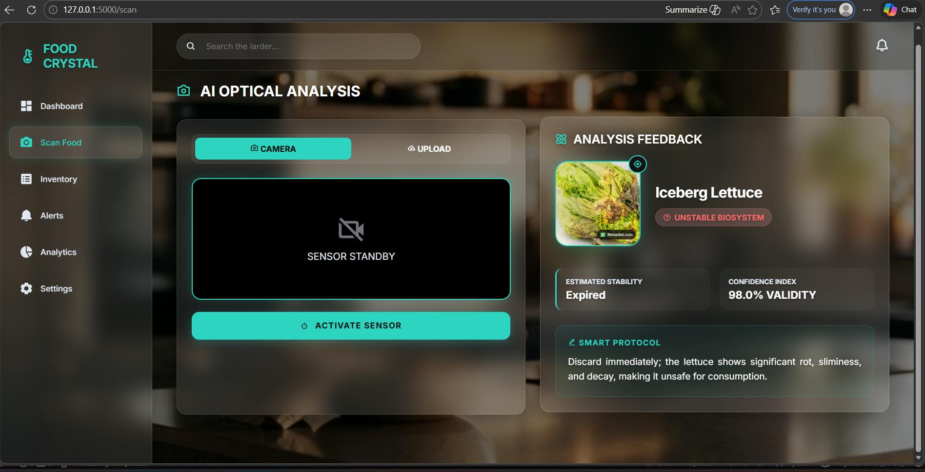
RESULT

Slide 11
Thank You

