Slide 1
VISUALIZATION EMPLOYEE ATTANDANCE TRENDS WITH EXCEL CHART
STUDENT NAME : R.Sandhiya
REGISTER NO 312217046(asunm1659312217046)
DEPARTMENT : B.COM(GENERAL)
COLLEGE : SHRI KRISHNASWAMY COLLEGE FOR WOMEN

Slide 2
PROJECT TITLE
VISUALIZATION EMPLOYEE ATTANDANCE TRENDS WITH EXCEL CHART

Slide 3


AGENDA
Problem Statement
Project Overview
End Users
Our Solution and Proposition
Dataset Description
Modelling Approach
Results and Discussion
Conclusion
3/21/2024 Annual Review

Slide 4

Problem statement
Briefly describe the issues with monitoring and analyzing employee attendance .
Explain why visualizing attendance trends is crucial for decision-making.

Slide 5

PROJECT OVERVIEW
Provide an overview of the project, including the objectives and scope .
Mention how Excel will be used as the primary tool for visualization.

Slide 6

WHO ARE THE END USERS?
Identify who will benefit from the visualization (e.g., HR managers, team leaders, executives).
Explain how they will use the insights generated from the charts.

Slide 7

OUR SOLUTION AND ITS VALUE PROPOSITION
Describe the proposed solution, focusing on the type of Excel charts you will use (e.g., line charts, bar graphs).
Highlight the advantages of using Excel for this purpose, such as ease of use and accessibility.

Slide 8
Dataset Description
Provide a brief description of the dataset, including the type of data collected (e.g., employee ID, attendance records).
Mention the data sources and any preprocessing steps taken.

Slide 9

THE "WOW" IN OUR SOLUTION
Innovative Use of Excel: Emphasize any advanced Excel features you’ve leveraged, such as pivot charts, conditional formatting, or dynamic data ranges.
Customization: Showcase how the visualizations can be customized for different departments or time periods, making them highly adaptable.
Automation: If you’ve incorporated any level of automation (e.g., using Excel macros or formulas to update charts automatically), highlight that as a significant efficiency gain.
Insightful Visualizations: Point out any particularly revealing trends or patterns that your charts uncovered, which might not have been obvious from raw data .
3/21/2024 Annual Review
9

Slide 10
MODELLING
Explain the methodology for creating the visualizations .
Discuss how you chose the types of charts and any relevant data transformations.
10

Slide 11
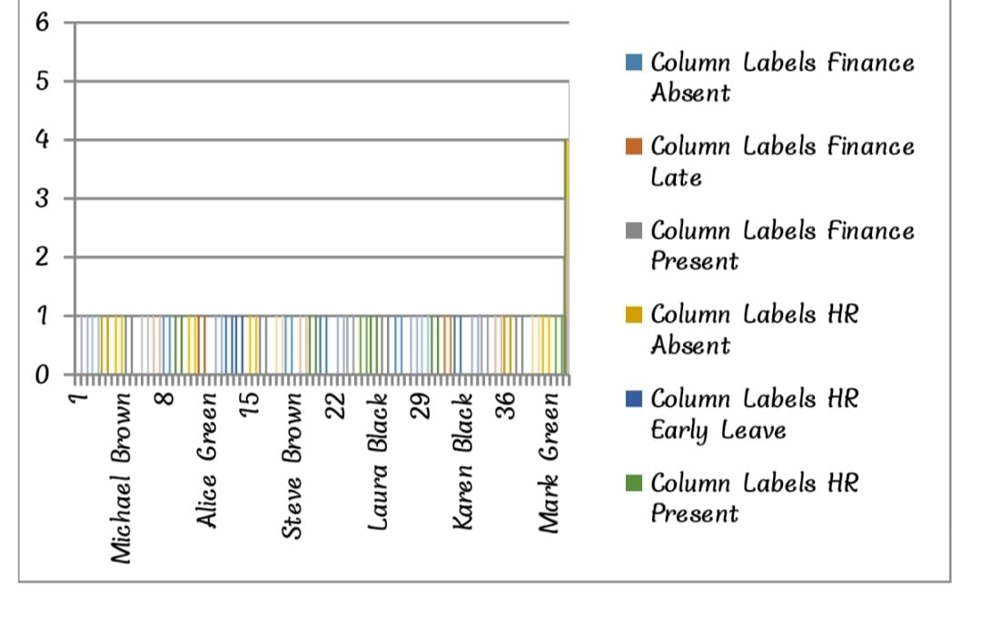
RESULTS
11

Slide 12
conclusion
Summarize the key takeaways from the project .
Discuss the potential impact of these visualizations on improving employee attendance management.

