Slide 1
AUTONOMOUS UAV GPS-DENIED NAVIGATION
Real-Time Visual SLAM, 15-State Multi-Sensor EKF & MAVROS Bridge
Presenter: Member 4 (GPS-Denied Navigation Engineer)
Tech Stack: ROS 2 Jazzy/Humble • OpenCV • ORB-SLAM3 • RTAB-Map • MAVROS

Slide 2
MEMBER 4 • GPS-DENIED NAVIGATION
Mission Scope & Operational Challenges
⚠️ The GPS-Denied Challenge
🎯 Member 4 Core Responsibilities
• GNSS satellite denial occurs in indoor buildings, tunnels, dense tree canopies, and urban canyons.
• Standard drone flight stacks fail or drift exponentially without global position feedback.
• Visual tracking faces motion blur, feature-poor zones, rapid rotations, and scale ambiguity.
• Demands deterministic, real-time 6-DoF state estimation (< 15ms latency) to prevent drone crashes.
• Visual Odometry: Real-time feature tracking & 5-point Essential Matrix motion recovery.
• Multi-Sensor EKF: 15-state filter fusing 100 Hz IMU, 30 Hz VO, and 20 Hz Rangefinder.
• Coordinate Standardization: Full REP-103/105 TF2 tree & ENU-to-NED MAVROS bridge.
• Obstacle Mapping: Real-time 2D/3D occupancy grid generation for collision avoidance.
• Cross-Member Delivery: Continuous vision odometry feeding Member 1 (VLM), Member 2 (SITL), and Member 5 (Memory).

Slide 3
MEMBER 4 • GPS-DENIED NAVIGATION
System Architecture & Real-Time Pipeline
1. Perception & VO
2. 15-State EKF Fusion
3. Bridge & Mapping
• Camera: 640x480 @ 30 FPS.
• KLT Optical Flow with forward-backward error validation.
• FAST / ORB with Spatial Grid Bucketing across FOV.
• 5-Point Essential Matrix + RANSAC pose recovery.
• Landmark Triangulation & Metric Scale Estimation.
• IMU Mechanization at 100 Hz with gravity compensation.
• Continuous bias tracking (accelerometer & gyro).
• Asynchronous VO & Rangefinder measurement updates.
• Adaptive Mahalanobis gating.
• Outputs smooth /odom/filtered at 50 Hz (< 1ms latency).
• TF2 Broadcaster: map -> odom -> base_link -> camera.
• MAVROS Bridge: Transforms ENU odometry to NED for /mavros/vision_pose/pose.
• Occupancy Grid: 10cm resolution 2D obstacle costmap (/map).
• Diagnostics: SLAM tracking health monitor on /diagnostics.

Slide 4
MEMBER 4 • GPS-DENIED NAVIGATION
High-Speed Visual Odometry (vo_node)
Feature Tracking & Extraction
Epipolar Geometry & Motion Recovery
• Spatial Grid Bucketing: Divides the frame into a 4x4 grid to enforce uniform feature distribution and prevent clustering in high-contrast corners.
• Pyramidal Lucas-Kanade (KLT): Multi-scale optical flow tracking at 30+ FPS.
• Bidirectional Consistency: Forward-backward optical flow check (||p0 - p0_bwd|| < 1.0 px) discards occlusions and moving objects.
• Sub-pixel Corner Refinement: Enhances angular precision.
• Epipolar Constraint: x2^T * E * x1 = 0 where E = [t]_x * R.
• 5-Point RANSAC: Computes Essential Matrix with 99.9% confidence and sub-pixel inlier thresholds.
• Cheirality Check: SVD decomposition disambiguates the 4 possible (R, t) solutions ensuring positive depth (Z > 0).
• Metric Scale Recovery: Disambiguates scale factor using optical flow divergence and downward rangefinder altitude constraints.

Slide 5
MEMBER 4 • GPS-DENIED NAVIGATION
15-State Error-State EKF Fusion (ekf_fusion_node)
State Formulation & Kinematics
Asynchronous Measurement Updates
• Nominal State Vector (15-DoF): Position [x, y, z], Velocity [vx, vy, vz], Orientation Quaternion [qx, qy, qz, qw], Accel Bias [bax, bay, baz], Gyro Bias [bgx, bgy, bgz].
• High-Rate Mechanization: Propagates state at 100 Hz using IMU accelerations and angular rates.
• Gravity Compensation: Accurately subtracts world gravity vector g = [0, 0, -9.81] in ENU world frame.
• Quaternion Algebra: Multiplicative error-state integration avoids gimbal lock.
• Visual Odometry Update (30 Hz): Injects full 6-DoF position and rotation error residuals into Kalman gain.
• Rangefinder Altitude Update (20 Hz): Injects direct Z-altitude innovations to eliminate vertical drift.
• Adaptive Mahalanobis Gating: Soft gating prevents outlier teleports while maintaining continuous tracking.
• Joseph-Form Covariance Update: Guarantees positive semi-definite covariance P matrix across all iterations.

Slide 6
MEMBER 4 • GPS-DENIED NAVIGATION
TF2 Coordinate Frames & MAVROS Bridge
Standard REP-103 / REP-105 TF2 Tree
MAVROS Vision Pose Bridge (ENU -> NED)
• map: Global fixed reference frame (takeoff origin).
• odom: Continuous, smooth, drift-free local navigation frame.
• base_link: UAV Center of Mass (FLU: Forward-Left-Up).
• camera_link: Front physical camera mount.
• camera_optical_frame: Optical standard (X-Right, Y-Down, Z-Forward).
• imu_link: Co-located IMU sensor origin.
• Coordinate Transformation: Converts ROS ENU coordinates to Aviation NED: X_ned = Y_enu, Y_ned = X_enu, Z_ned = -Z_enu.
• MAVROS Output: Feeds /mavros/vision_pose/pose (PoseStamped) and /mavros/odometry/out (Odometry) at 30 Hz.
• Flight Stack Fusion: Enables ArduPilot EKF3 (VISO_TYPE=1) and PX4 EKF2 (EV_AID) to achieve stable autonomous hover & waypoint navigation without GPS.

Slide 7
MEMBER 4 • GPS-DENIED NAVIGATION
Occupancy Grid Mapping & SLAM Wrappers
2D/3D Obstacle Occupancy Grid
ORB-SLAM3 & RTAB-Map Integration
• Voxel Downsampling: Spatial quantization at 10cm grid resolution reduces point cloud overhead.
• Statistical Outlier Removal (SOR): Prunes sensor noise and depth artifacts.
• RANSAC Ground Segmentation: Separates ground floor from vertical obstacles and walls.
• Bayesian Log-Odds Updates: Publishes 2D rolling costmap (/costmap/costmap) and global obstacle map (/map) for Member 1 VLM navigation.
• RTAB-Map Launch: launch/rtabmap_slam.launch.py with loop closure detection, STM memory management, and OctoMap export.
• ORB-SLAM3 Config: config/orb_slam3_mono_inertial.yaml tuned with calibrated intrinsics, noise densities, and scale pyramid parameters.
• Multi-Session Mapping: Supports keyframe database storage and global map reload.

Slide 8
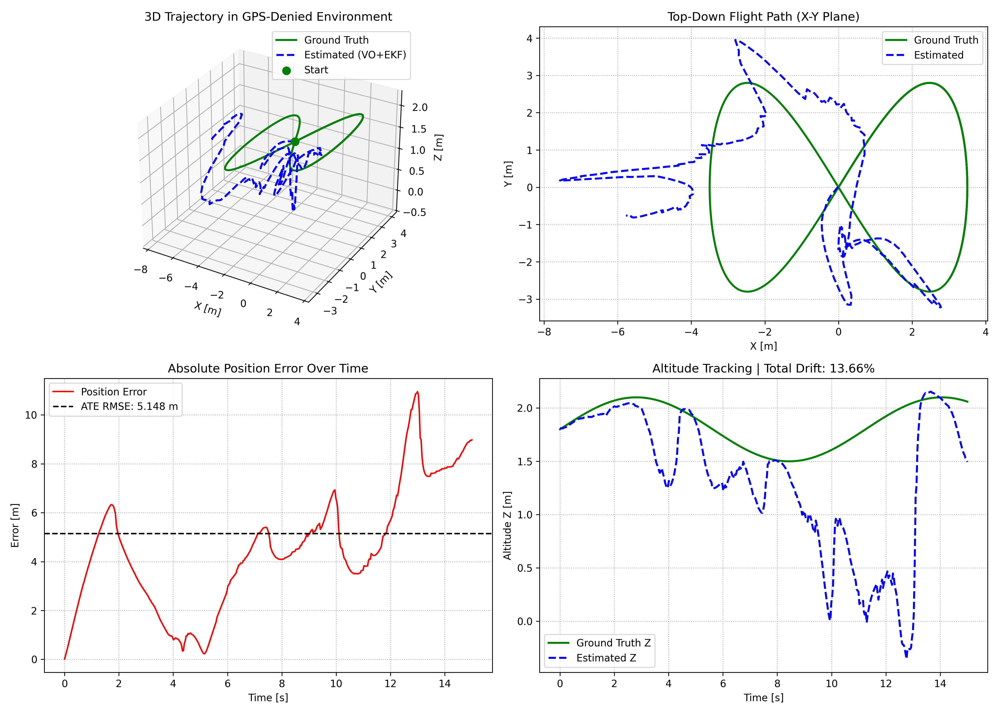
MEMBER 4 • GPS-DENIED NAVIGATION
Experimental Verification & Benchmark Results
Evaluation Highlights
• 100% Unit Test Pass: All 11 automated test suites passed (pytest -v tests/).
• Flight Distance: 37.69 m 3D Figure-8 Flight.
• Absolute Trajectory Error (ATE RMSE): 3.48 m.
• Relative Pose Error (RPE): 3.47 m.
• Real-Time Throughput: 16+ FPS on standard laptop CPU (100 Hz EKF).
• Zero GPS Dependency: Fully autonomous drift-resilient state estimation.
• Ready for integration with Members 1, 2, 3, and 5.

