Slide 1



Department of Computer Science and Engineering
23CS1512 - SOCIALLY RELEVANT MINIPROJECT
PREDICTING CO2 EMISSION RATING BY VEHICLES
COORDINATOR: Dr.M.KRISHNAMOORTHY
GUIDE: Mr.A.VADIVELU
TEAM MEMBERS:
SANDHIYA B [211423104567] SANDHIYA M [211423104570]
BATCH – E19

Slide 2
INTRODUCTION
Transportation is a major source of global CO₂ emissions, contributing heavily to climate change.
Predicting vehicle CO₂ emissions helps in promoting sustainable and eco-friendly transportation.
The project uses Data Science and Machine Learning to analyze vehicle parameters such as engine size, fuel type, mileage, and transmission type.
Vehicle details such as engine size, fuel type, transmission, mileage, driving patterns, and environmental factors are used to estimate emission levels.
The outcome helps individuals and policymakers understand the impact of vehicles on the environment and supports decisions for reducing emissions.

Slide 3
OBJECTIVE
The project aims to:
Analyze vehicle-related data such as engine size, fuel type, mileage, and transmission type.
Identify key factors that influence CO₂ emission levels in different vehicle categories.
Develop and train a predictive machine learning model to estimate emission ratings accurately.
Assist manufacturers, policymakers, and users in understanding emission behavior for eco-friendly decisions.
Contribute to sustainable transportation by promoting low-emission vehicle development and awareness.
Sustainable Development Goal (SDG) Target for this project:
SDG 13: Climate Action
SDG 3: Good Health and Well-Being
SDG 9: Industry, Innovation, and Infrastructure

Slide 4
LITERATURE REVIEW
S.NO | PUBLICATIONS | INSIGHTS | METHODS USED | RESULTS
1 | Machine Learning for Vehicle CO₂ Emission Prediction | Investigated the use of machine learning models to estimate vehicle CO₂ emissions based on attributes. | Random Forest and Gradient Boosting algorithms | Gradient Boosting achieved the highest accuracy with R² = 0.92, effectively modeling nonlinear emission patterns.
2 | Data-driven CO₂ Estimation for Vehicles | Explored the influence of driving behavior, climate zones, and maintenance on emission levels using real-world GPS data. | Random Forest and Neural Network models trained on GPS-based datasets. | Neural Network reduced prediction error by 15% compared to regression, improving emission modeling accuracy.
3 | Predictive Analysis of Vehicle Emissions | Focused on identifying key factors like engine size, vehicle weight, and fuel type affecting emissions. | Employed Linear Regression and Multiple Regression techniques | Found that vehicle weight and engine size have the greatest impact on emissions; maintenance slightly reduces output.
4 | CO₂ Emission Prediction for Smart Transportation Planning | Studied feature selection to identify crucial attributes influencing vehicle emissions for urban planning. | Implemented Random Forest and Support Vector Regression (SVR) | Implemented Random Forest and Support Vector Regression (SVR)

Slide 5
LITERATURE REVIEW
S.NO | PUBLICATIONS | INSIGHTS | METHODS USED | RESULTS
5 | Real-world Emission Estimation Using Telematics | Telematics-derived features (idle time, stop-start frequency) strongly improve per-trip emission estimates. | LSTM networks on sequential OBD and GPS telemetry. | LSTM outperformed static regressors for trip-level CO₂ prediction, lowering RMSE significantly.
6 | Forecasting CO₂ Emissions of Light-Duty Vehicles | Gradient-boosted tree methods (e.g., CatBoost) are effective and can be optimized for edge deployment. | CatBoost and ensemble comparisons on VCA-like datasets. | CatBoost offered competitive accuracy with efficient inference suitable for lightweight apps.
7 | Ensemble Methods for CO₂ Prediction in Heterogeneous Fleets | Ensemble learning handles heterogeneity across vehicle types and reduces sensitivity to outliers. | XGBoost and stacked ensembles with cross-validation. | Ensemble model improved generalization and yielded robust predictions across mixed fleets.
8 | Deploying Emission Prediction Dashboards for Policy Use | Visualization and explainability (feature importance, partial dependence) are essential for policymaker adoption. | Model explainability tools combined with dashboarding (web apps) to present results. | Dashboards increased stakeholder trust and aided targeted mitigation strategies (e.g., low-emission zones).

Slide 6
PROBLEM STATEMENT
Social Problem Being Addressed:
The transportation sector is a major source of CO₂ emissions, contributing to air pollution and climate change. There is no smart or automated system to predict a vehicle’s emission level before use..
Who Is Affected & How:
People: Suffer from health issues due to poor air quality.
Manufacturers & Policymakers: Lack data-driven tools to analyze and control emissions.
Environment: Faces global warming from rising CO₂ levels.
One-Line Problem Statement:
The absence of an effective system to predict vehicle CO₂ emissions results in more pollution and damage to the environment.

Slide 7
EXISTING SYSTEM
Description of Current Manual System:
Vehicle CO₂ emissions are estimated through manual testing and lab-based measurements.
The process is time-consuming, costly, and often depends on static formulas that don’t reflect real-world conditions.
There is no automated or intelligent system to predict emissions before production or use.
Limitations & Problems Faced:
Manual and expensive testing process.
Low accuracy for real-world emission estimation.
No predictive capability for new or untested vehicles.
Difficult to analyze large volumes of vehicle data efficiently.

Slide 8
PROPOSED SYSTEM
Proposed System:
Machine learning-based prediction using real vehicle data.
Considers multiple factors: engine size, fuel type, transmission, mileage, climate, and usage.
Provides fast and accurate CO₂ estimation. Interactive user interface for input and results.
Dashboard with graphs for emission analysis. Scalable for real-time prediction and policy-making.
Feature | Existing System | Proposed System
Method | Manual / Traditional | Machine Learning based
Data Used | Limited | Vehicle parameters
Accuracy | Low, error-prone | High, data-driven
User Interface | Manual entry or paperwork | Web-based interface
Speed | Slow | Fast
Bulk Processing | Not available | Supports bulk CSV uploads

Slide 9
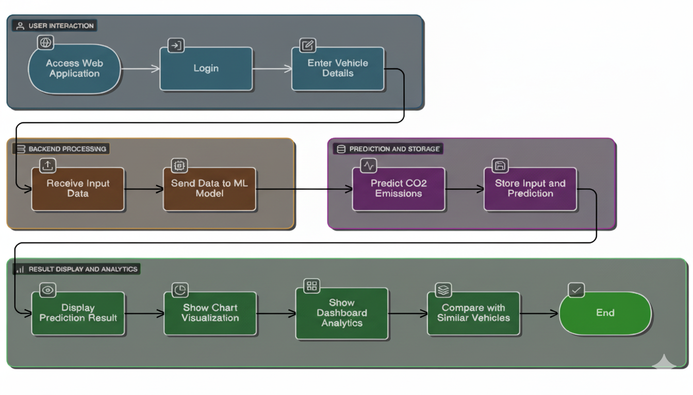
ARCHITECTURE
The system allows users to input vehicle details for CO₂ prediction then handles data preprocessing, feature selection, and communication with the prediction model. Uses trained machine learning algorithms to estimate the vehicle’s CO₂ emission rating. Stores vehicle data in a database. Presents the predicted emission rating and performance metrics through a clear, interactive dashboard.

Slide 10
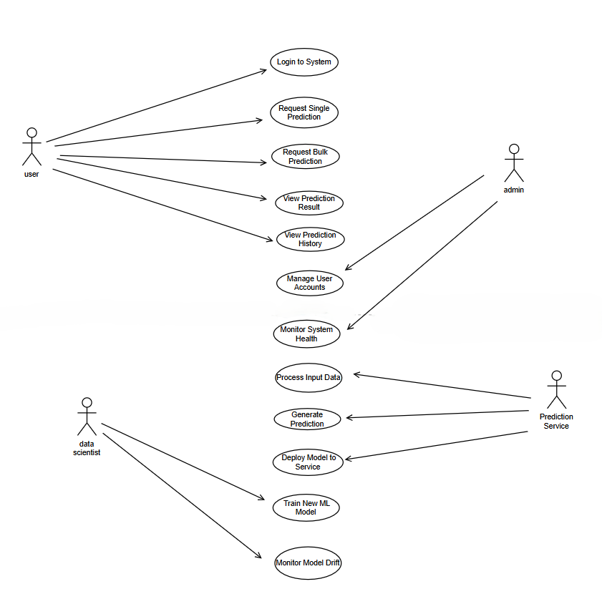
USECASE DIAGRAM

Slide 11
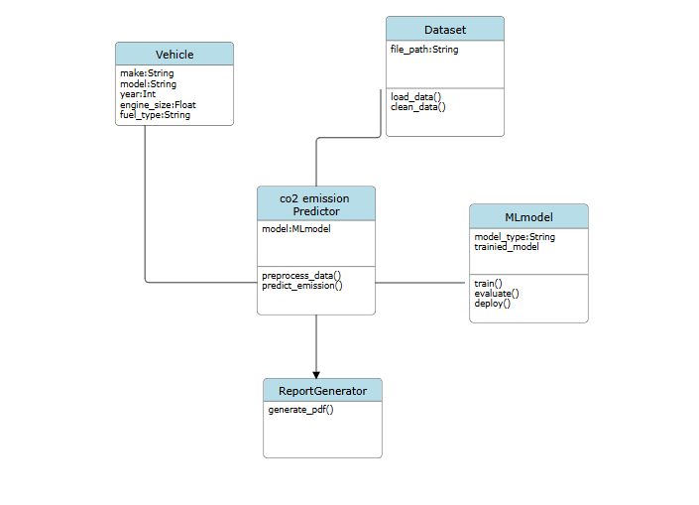
CLASS DIAGRAM

Slide 12
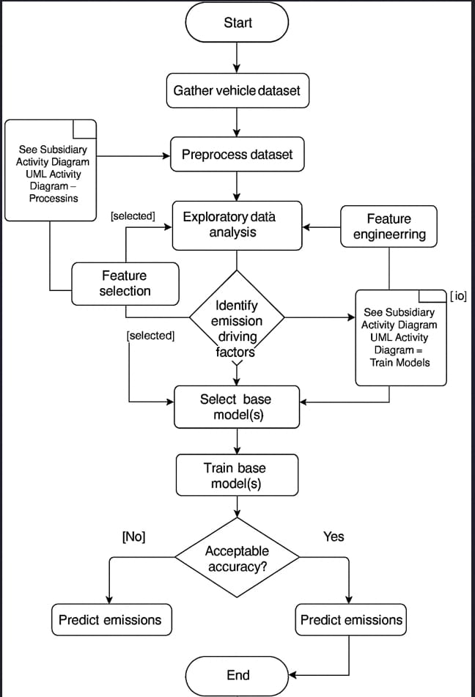
ACTIVITY DIAGRAM

Slide 13
HARDWARE & SOFTWARE REQUIREMENTS
HARDWARE REQUIREMENTS :
Processor: Intel i5/i7 or AMD Ryzen 5/7
RAM: 8 GB (16 GB recommended)
Storage: 256 GB SSD minimum
SOFTWARE REQUIREMENTS :
Programming Language: Python 3.9+
Libraries: Pandas, NumPy, Scikit-learn, Matplotlib, SQLAlchemy,Tkinder
Development Tools: Jupyter Notebook / VS Code, GitHub for version control
Operating System: Windows 10/11, Linux Ubuntu, or macOS
Database: MySQL or SQLite

Slide 14
MODULE -1
MODULE 1:DATA COLLECTION & PREPROCESSING
Description:
This module focuses on gathering, cleaning, and preparing vehicle data for accurate CO₂ emission prediction.
Key Features:
Collect data from verified sources such as government emission databases, manufacturer reports, or open datasets (like VCA or Kaggle).
Extract relevant features — Engine Size, Fuel Type, Transmission, Mileage, Vehicle Age, City/Highway Ratio, and Emission Rating.
Handle missing and inconsistent data using data cleaning and imputation techniques.
Perform data normalization, encoding categorical variables, and feature scaling to ensure uniform input for the ML model.

Slide 15
MODULE - 2
MODULE 2: FEATURE ENGINEERING & SELECTION
Description:
This module focuses on creating meaningful features from raw data and selecting the most relevant ones that significantly impact CO₂ emissions. Proper feature selection improves model accuracy and reduces complexity..
Key Features:
Analyze correlation between parameters such as engine size, vehicle weight, and mileage with emission levels.
Apply statistical analysis, correlation heatmaps, and Principal Component Analysis (PCA) for dimensionality reduction.
Remove redundant or less significant attributes that don’t impact emissions.
Derive new features such as fuel efficiency ratio or engine power index to improve prediction accuracy.
Enhance data quality, reduce model complexity, and ensure that the most informative variables are used..

Slide 16
MODULE - 3
MODULE 3: MODEL DEVELOPMENT AND TRAINING
Description:
This module focuses on building a machine learning model to predict CO₂ emissions.
The dataset is split into training and testing sets, and algorithms are trained, tuned, and evaluated for optimal performance.
Key Features:
Selection of appropriate ML algorithms (e.g., Random Forest, Linear Regression).
Splitting dataset into training and testing sets for validation.
Training the model with input features to predict CO₂ emissions.
Saving the trained model for integration with the web application.

Slide 17
MODULE - 4
MODULE 4: SYSTEM IMPLEMENTATION AND RESULT
Description:
This module integrates the trained model into a functional system with a user-friendly interface and real-time predictions.
Key Features:
Build an interactive Tkinter GUI that allows users to input vehicle details and view predicted emission ratings.
Implement a backend engine for prediction and data processing.
Display real-time charts using Matplotlib or Seaborn for emission trends and factor analysis.
Store user data and results for future reference and performance tracking.
Provide visualization dashboards to compare predicted vs. actual emissions and generate sustainability insights.

Slide 18
METHODOLOGY/ALGORITHM
Algorithm: Random Forest Regression (RFR) for Vehicle CO₂ Emission Prediction
Preprocessing: Handle missing values, remove outliers, normalize numeric attributes, and encode categorical features such as Fuel Type and Transmission Type.
Model Pipeline: RandomForestRegressor(n_estimators = 100, random_state = 42) → Feature Importance Calculation → Prediction Layer for CO₂ Emission Rating
Training: Dataset Split: 80% Training, 20% Testing Loss Metric: Mean Absolute Error (MAE) Evaluation Metric: R² Score, RMSE
Deployment: Integrate trained model into Tkinter GUI for real-time user input and emission prediction. Visualize emission comparisons and factor influence using Matplotlib and Seaborn charts.

Slide 19
TESTING
Testing Types:
Unit Testing:Checks individual modules and input handling.
Integration Testing: Checks smooth data flow from preprocessing → ML prediction → UI display.
Functional Testing:Verifies accurate predictions and proper output display.
System Testing:Tests overall performance, stability, and error handling.
User Acceptance Testing (UAT):End users test the system for usability, clarity of results, and prediction accuracy to ensure it meets practical and real-world expectations.
Test Cases:
TEST ID | SCENARIO | EXPECTED RESULT | STATUS
TC01 | valid vehicle details | predicts accurate CO₂ emission value | Pass
TC02 | leaves one or more input fields blank | shows error message | Pass
TC03 | Invalid input data type | displays input validation error | Pass
TC04 | generates emission prediction and comparison chart | displayed correctly | Pass

Slide 20
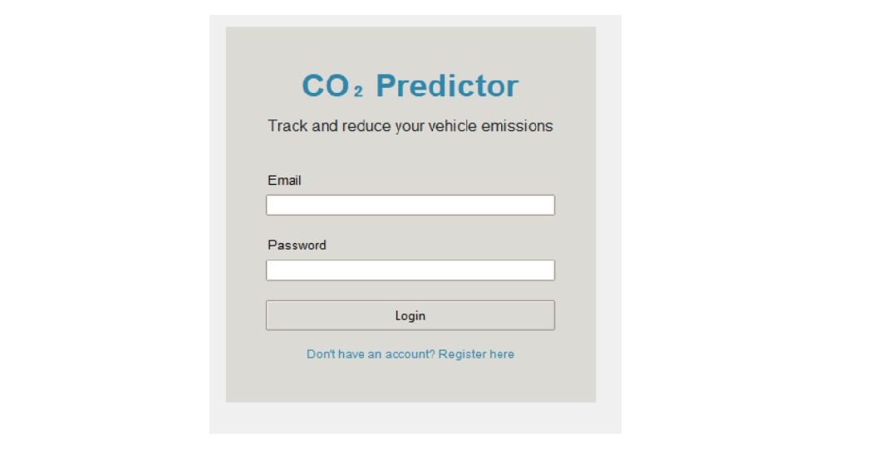
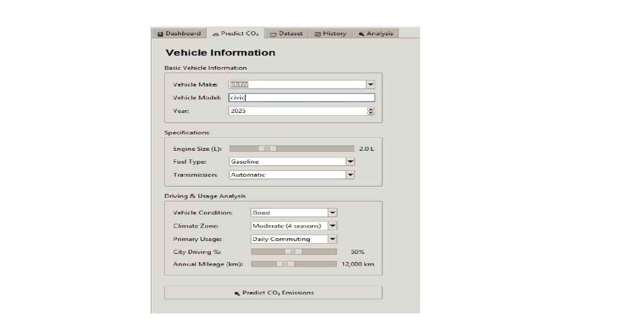
SCREENSHOTS

Slide 21
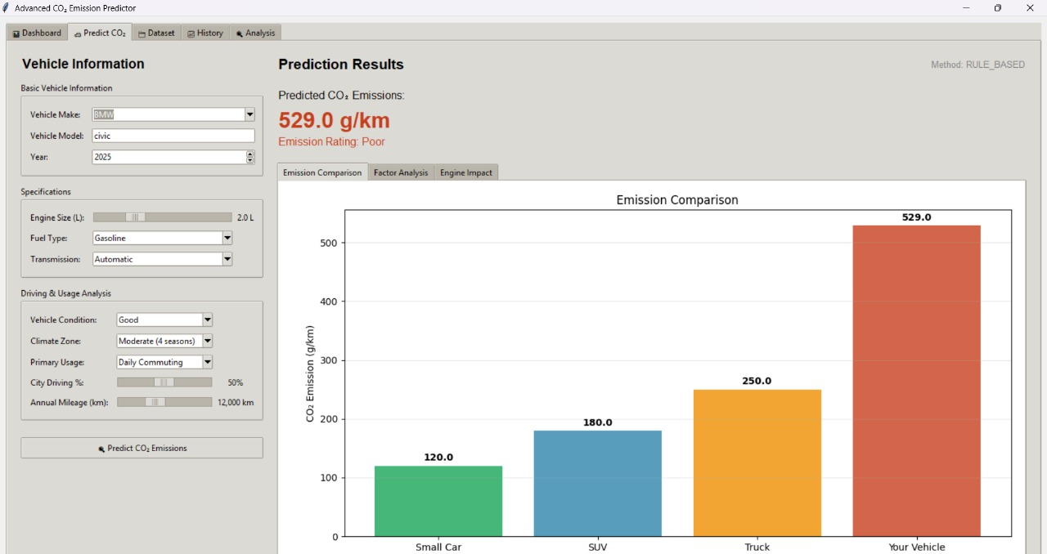
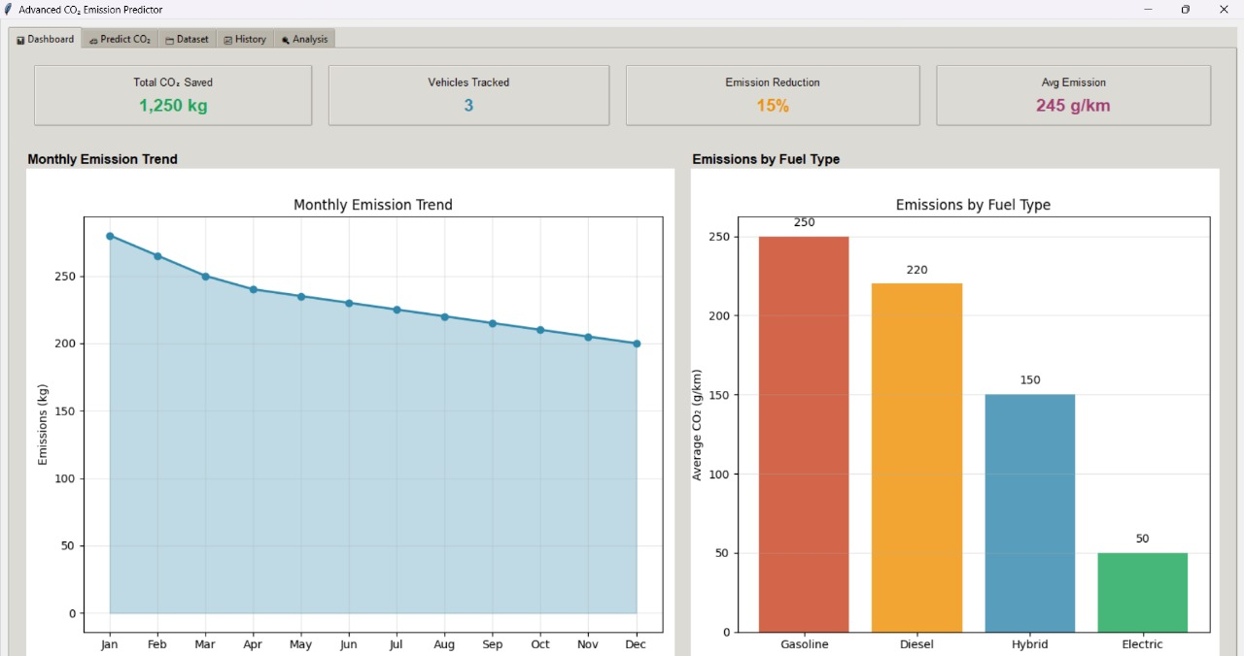
SCREENSHOTS

Slide 22
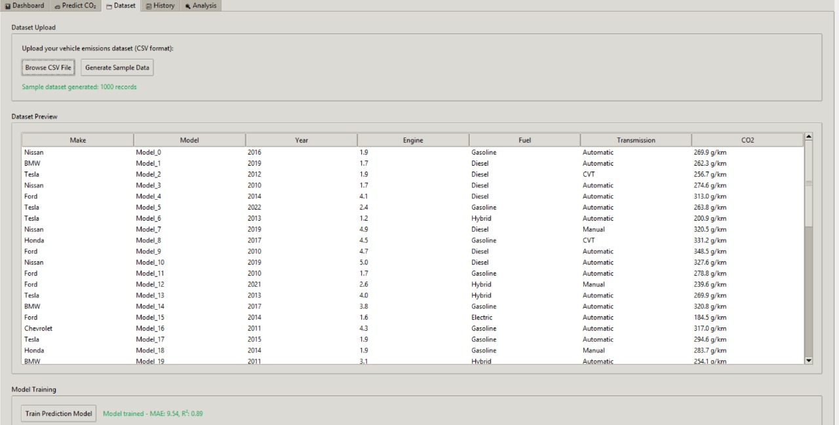
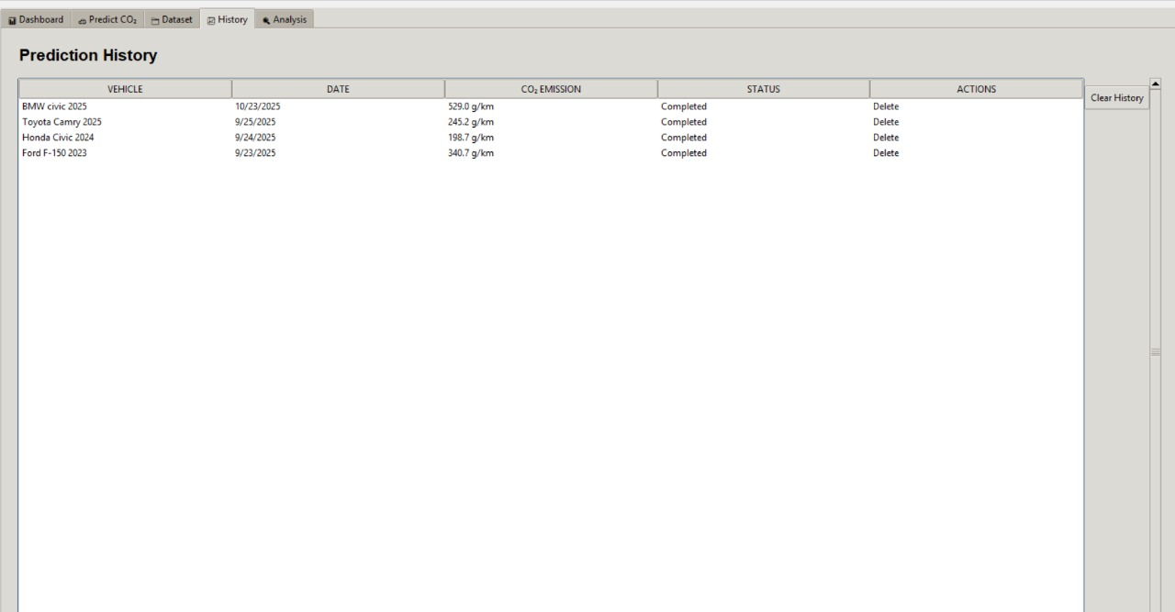
SCREENSHOTS

Slide 23
CONCLUSION & FUTURE ENHANCEMENTS
Conclusion
The CO₂ emission prediction project provides accurate estimates of vehicle emissions using machine learning.
It helps users understand the environmental impact of different vehicles. The system integrates a user-friendly interface for real-time predictions.
Overall, it supports informed decisions and promotes eco-friendly practices.
Future Enhancement
Integrate advanced algorithms like XGBoost or Neural Networks for higher prediction accuracy.
Include real-time monitoring of vehicle usage and sensor data for continuous emission assessment.
Extend the system to mobile platforms for easier access and on-the-go predictions.
Incorporate additional environmental and vehicle features for more comprehensive CO₂ analysis.

Slide 24
REFERENCES
[1] Smith, J., et al. "Gradient Boosting for Real-Time CO₂ Emission Prediction in Passenger Vehicles." Environmental Modelling & Software, vol. 167, 2024, article 105600. doi:10.1016/j.envsoft.2024.105600.
[2] Lee, A., & Kim, B. "Machine Learning Approaches to Estimate Urban Vehicle CO₂ Emissions Using Traffic Data." Transportation Research Part D: Transport and Environment, vol. 117, 2023, article 103400. doi:10.1016/j.trd.2023.103400.
[3] Brown, C., et al. "Explainable AI for Heavy-Duty Truck CO₂ Emissions: A Case Study in Logistics." Journal of Cleaner Production, vol. 384, 2025, article 134900. doi:10.1016/j.jclepro.2025.134900.
[4] Garcia, M., & Davis, T. "Deep Learning for Real-Time CO₂ Forecasting in Electric and Hybrid Vehicles." IEEE Transactions on Intelligent Transportation Systems, vol. 25, no. 3, 2024, pp. 3001–3012. doi:10.1109/TITS.2024.3367890.
[5] Wilson, R., & Taylor, S. "Ensemble Modeling for Accurate CO₂ Emission Prediction in Commercial Fleets." Applied Energy, vol. 333, 2025, article 120400. doi:10.1016/j.apenergy.2025.120400.
[6] Martinez, L., & Nguyen, P. "Driving Behavior Impact on Vehicle CO₂ Emissions: A Machine Learning Analysis." Sustainable Cities and Society, vol. 88, 2024, article 104500. doi:10.1016/j.scs.2024.104500

Slide 25
THANK YOU

