Slide 1
Digital Portfolio
STUDENT NAME: M. Sandhiya
REGISTER NO AND NMID: 2428b0243, 3D3CC89F72860B8BFDB43EE27
DEPARTMENT: Bsc computer science with data analytics
COLLEGE: COLLEGE/ UNIVERSITY: tiruppur kumaran college for women/Bharathiyar university

Slide 2
PROJECT TITLE MY DIGITAL PORTFOLIO

Slide 3


AGENDA
Problem Statement
Project Overview
End Users
Tools and Technologies
Portfolio design and Layout
Features and Functionality
Results and Screenshots
Conclusion
Github Link
3/21/2024 Annual Review

Slide 4

PROBLEM STATEMENT
Chef’s like professionals in any creative field ,need a way to show case
Their talents, skills and specialties to potential employer, restaurant or
Customers traditional resume often fail to capture the creativity, signature
Dishes and passion that chefs bring to their work.
The challenge and difficulties are that allows the chef to present a key
Information about them a structure and appealing way and without a proper
platform chefs struggle to present their talents in professional and visually appealing manner

Slide 5

PROJECT OVERVIEW
The chef portfolio is a personalized showcase designed to highlight the skills, creativity and professional journey of a chef . It provides an organized platform to display culinary expertise achievement and unique cooking style.
KEY OBJITIVES
To create a professional profile highlighting the chefs background and experience and training
To showcase skills such as cooking styles, cuisines mastered and
kitchen management abilities
CORE SECTION
It contains about me, skills and expertise, signature
Dish achievements , experience and abilities

Slide 6

WHO ARE THE END USERS
CIENTS AND CUSTOMERS
Individuals or organization planning private dinning or event checks the portfolio to see the chefs dishes, style and specialities
CULINARY SCHOOL And TRAINING INSTITUATIONS
When applying higher education, internship, or certification school uses the portfolio to understand the chefs passion, learning and growth in culinary field
RECRUITERS AND EMPLOYEES
they are restaurant owner, catering and hotel companies who use the portfolio to access the chefs talent and creativity and professional experience

Slide 7

TOOLS AND TECHNIQUES
HTML
used to structure the content of the portfolio such as about me, skills, signature dishes and contacts.
CSS
helps in styling the portfolio by adding colours, layouts, fonts and responsiveness to make it attractive.
JAVA SCRIPT
can be used to add interactively like sliders, animation or a contact of chef.
CODE PEN
platform and editors used to build test and preview the portfolio easily

Slide 8
POTFOLIO DESIGN AND LAYOUT
COVER PAGE
Full page high quality photo (chef in uniform/ signature
Dish) name, title(chef/culinary artist)
ABOUT ME
A professional photo of the chef, short biography (culinary background, experience, cooking philosophy)
SKILLS AND EXPERTISE
Use icons or graphics for visual appeal
Culinary skills
Kitchen skills
Specialization
SIGNATURE DISH
Grid layout with dish images+ short description each entry name of the dish, ingredients focus and playing style highlight awards or customer favorites
8

Slide 9
FEATURES AND FUNCTIONALITY
SOCIAL MEDIA LINKS
Direct connection to Instagram, YouTube or Facebook where dishes
Are showcase
MENU SAMPLE
Example menus for events like
fine dining
casual dining
SEARCH AND FILTER IN DISHES
Visitors can filter dishes by type of
Vegetarian
Non- vegetarian
Deserts
Beverages, etc..
INTRACTIVE MENU TO VIEWRS
Digital menus format where users can click to see dish details

Slide 10
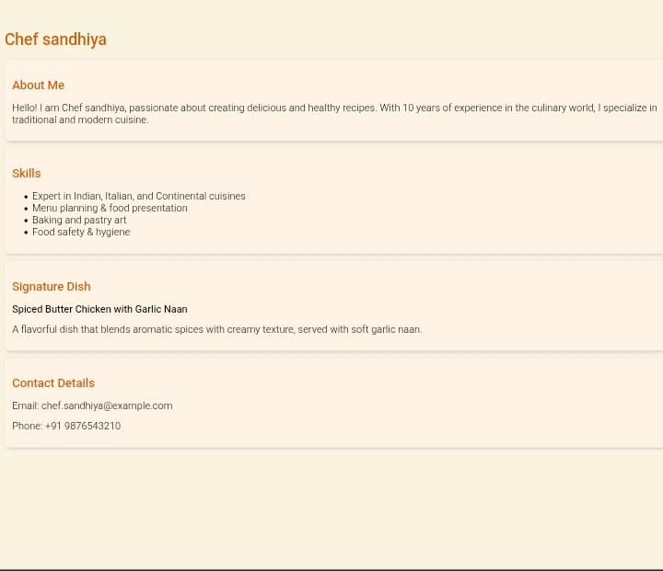

RESULTS AND SCREENSHOTS
3/21/2024 Annual Review
10

Slide 11
CONCLUSION
This portfolio reflects my journey, skills, and passion as a chef it highlights not only my ability to create favourable and visually appealing dishes but also my commitment to innovative, quality and continues learning cooking for me is more than a profession it is an art of bringing people together and creating memorable experience
11

