Slide 1
AMS 520.01 : Machine Learning in Quantitative Finance
AI Powered Personal Finance Advisor

Slide 2
Abstract
Our project presents an financial chatbot that leverages Lama 3.1 8-B tuned model to provide financial insights. The system is built on three core pillars:
Advanced Language Model
LLaMA 3 architecture
Tuned through LoRA adaptation
Optimized for financial domain
2. Real-time Data Integration
Market data metrics
News API integration
3. Sentiment Analysis
Financial news processing
Market sentiment evaluation
Trend analysis

Slide 3
Background & Motivation
Industry Challenge:
The data available is fragmented and needs a proper channel.
Current State of Data Quality in AI
High-quality data is crucial for training effective AI models.
Common challenges include noisy data, biased datasets, and incomplete information, which can lead to inaccurate or unreliable outputs.
Technical Opportunity:
Advancement in large language models enables better financial text understanding
Improved efficiency in processing lengthy financial documents
Enhanced capability to provide contextual financial insights

Slide 4
Key Insights and Learning
Quality Data is really important while tuning the model.
The choice of whether to tune depends on the use case, Many use cases can be solved with RAG approach which uses additional Context.
Prompt Engineering is again a powerful tool to ensure a specific Behaviour of the model.
Training parameters are highly important, when using strategies like QLORA it is important to define the rank and the alpha . The Thumb rule is 1:2 for Rank:alpha.

Slide 5
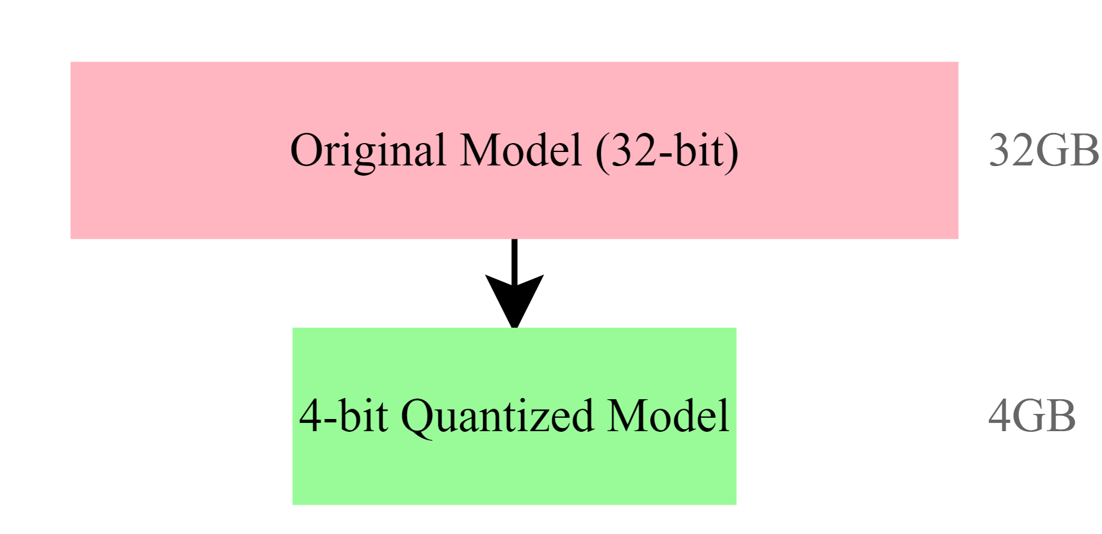
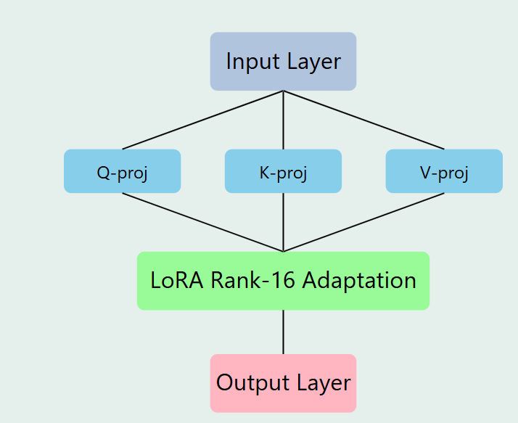
Quantized Low-Rank Adaptation (QLoRA)
Model Architecture and Quantization The LLaMa 3 8B model is compressed using 4-bit precision, dramatically reducing memory requirements while maintaining performance. This enables running the model on consumer GPUs like the T4.
Low-Rank Adaptation (LoRA) Implementation : Using rank-16 matrices for efficient parameter updates across seven key projection layers (query, key, value, output, gate, up/down), enabling fine-tuning with minimal additional parameters.

Slide 6
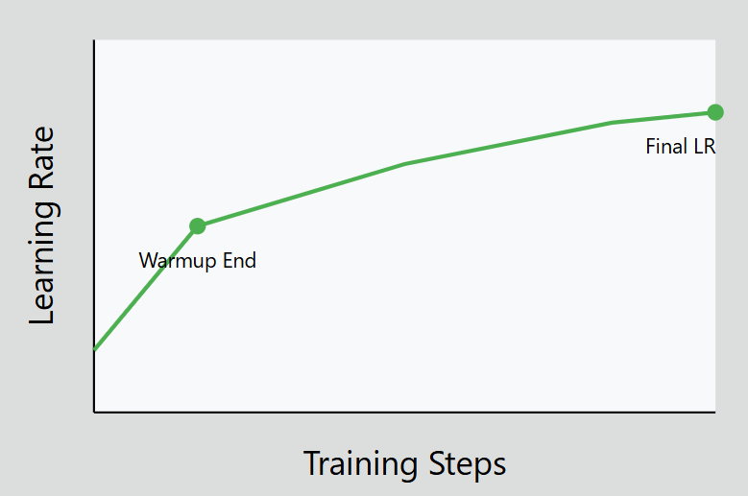
Quantized Low-Rank Adaptation (QLoRA)
Training Optimization Implements "unsloth" gradient checkpointing with a learning rate of 2e-4 and weight decay of 0.01, using a linear scheduler for optimal training efficiency.

Slide 7
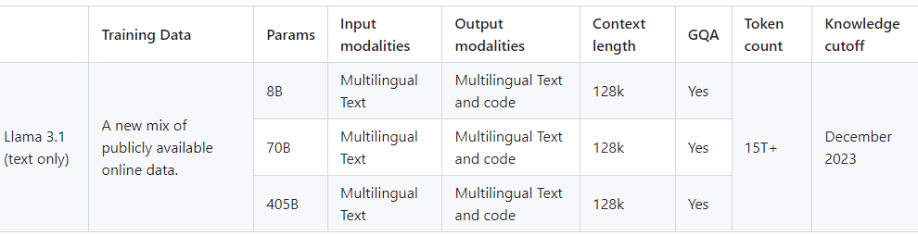
LlAMA 3:
The descriptor is related to what the model was fine-tuned for : Chat is aimed at conversations, questions and answers, back and forth - while Instruct is for following an instruction to complete a task.
Notes:
We chose llama 3 8B as our foundational model because it has balance between performance and computational efficiency. Also It has a strong language understanding. It handles financial data really well. We didnt use llama chat because we wanted our model to work on a definitive task and have direct control over model responses. It will ensure that model strictly adheres to financial domain.

Slide 8
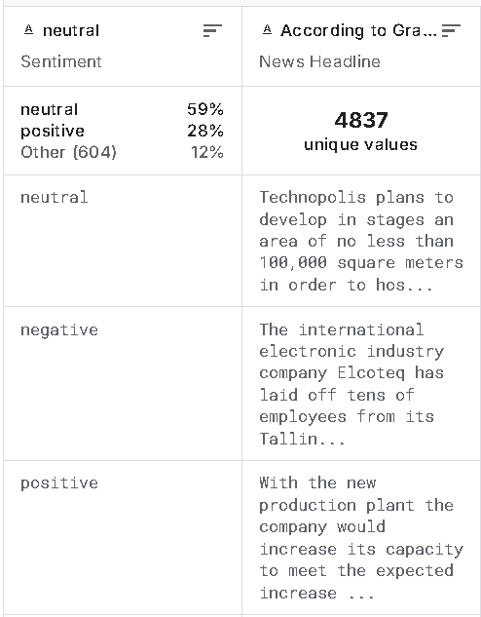
Dataset Preparation
Financial News Sentiment Dataset:
Source: Kaggle financial news sentiment analysis
Features: Headlines, sentiment labels (Positive, Negative, Neutral)
Processing Pipeline:
Sentiment label encoding
Data formatting for model input
Notes:
Financial PhraseBank: A dataset containing financial sentences labeled with sentiments such as positive, neutral, and negative, created specifically for sentiment analysis in the financial domain.It contains annotations from multiple financial experts, giving high-quality labeled data.

Slide 9
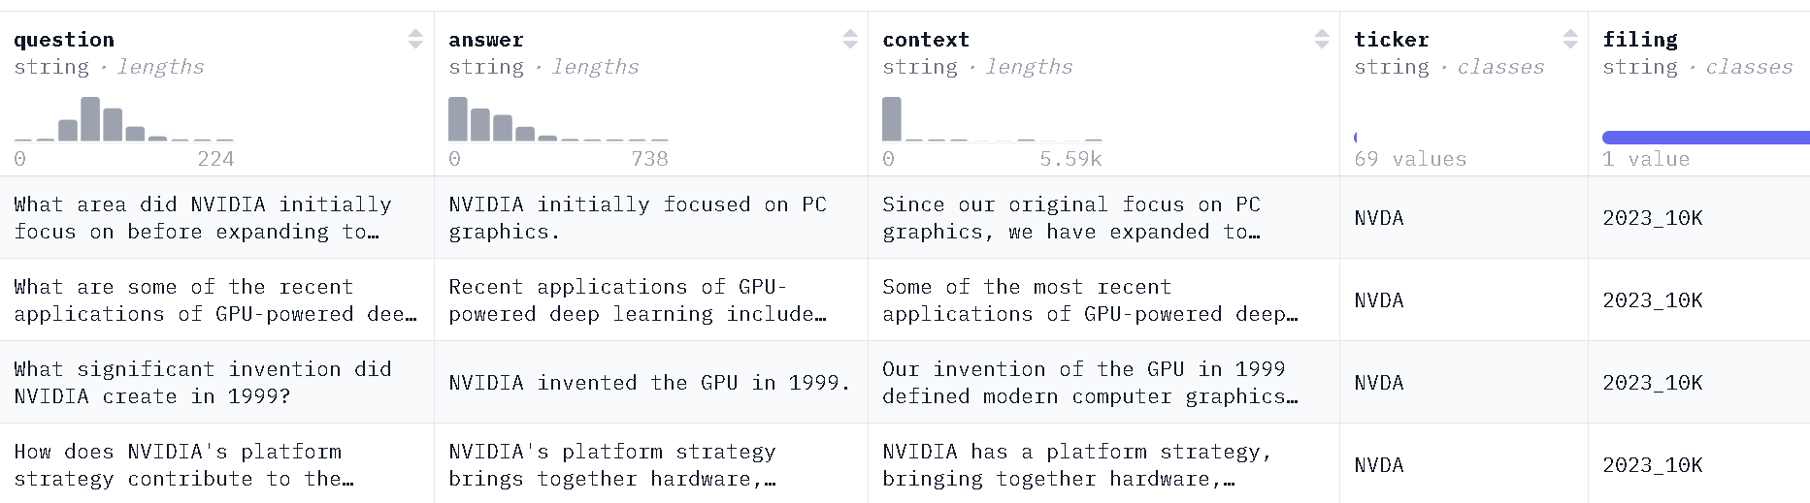
Dataset Preparation
Form 10-K QA Dataset: Source: HuggingFace virattt/financial-qa-10K
Structure: Question-Answer pairs from SEC filings
Notes:
Question answer pairs from financial reports.
wide range of topics
relevant to finance.
each entry has….

Slide 10
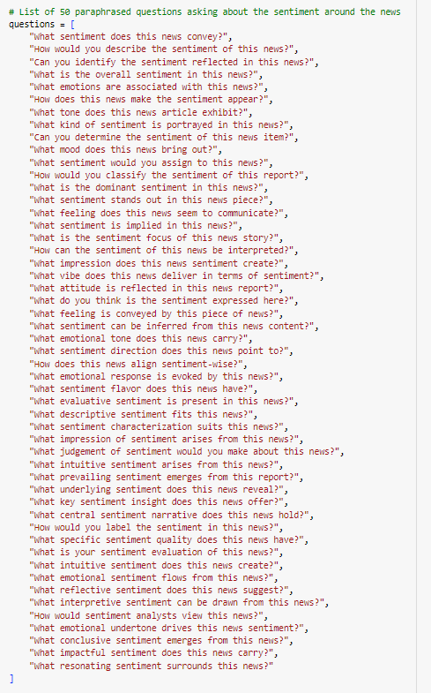
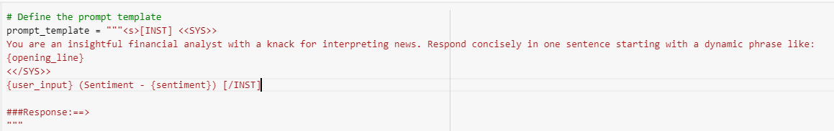
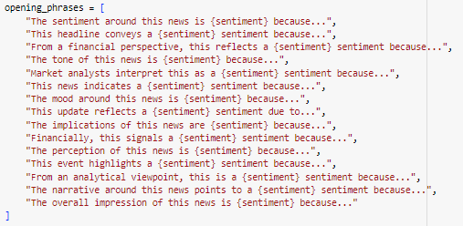
Sentiment Data Gen:
Notes:
we generated and refined data using llama 3 to create high quality data for our chatbot
focus was to convert raw sentiment data into meaningful sentences.
We designed 15 dynamic opening phrases like, "The sentiment around this news is {sentiment} because…" or "From a financial perspective, this reflects a {sentiment} sentiment because…".
These phrases were fed into LLaMA 3 alongside sentiment labels to generate full sentences for the entire dataset.
To enhance the chatbot's ability to interpret sentiment-related queries, we created a set of 50 random paraphrased questions.
The result is a well-rounded dataset that combines structured sentiment sentences and paraphrased sentiment queries.

Slide 11
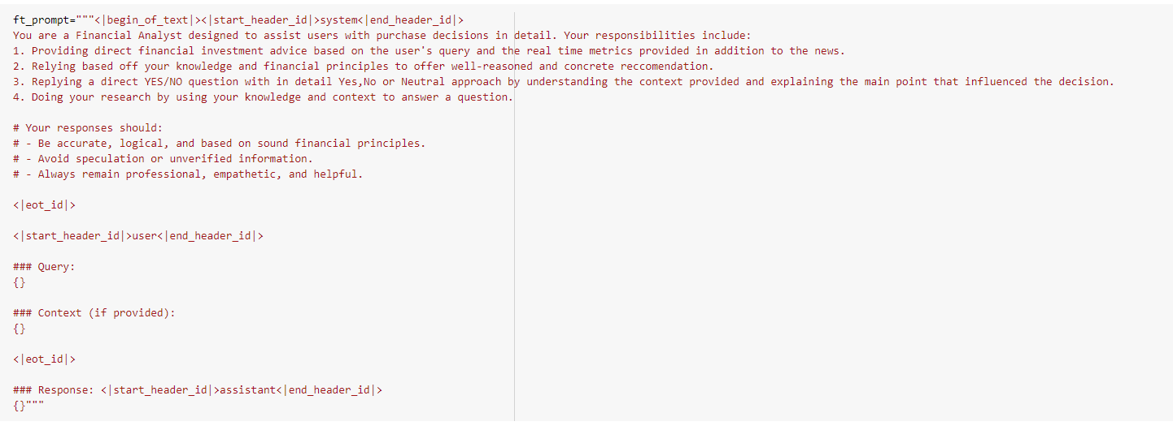
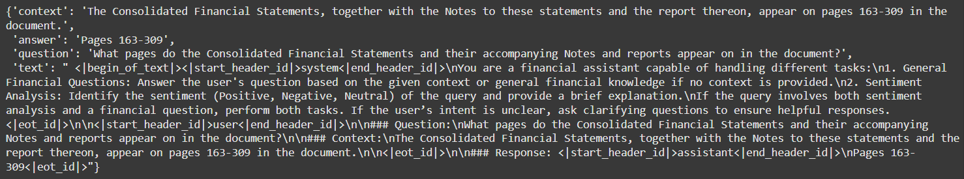
Prompt Formatting:
Notes:
This slide focuses on how we transformed our dataset, which included questions, answers, and context, into a format compatible with our base model for fine-tuning.

Slide 12
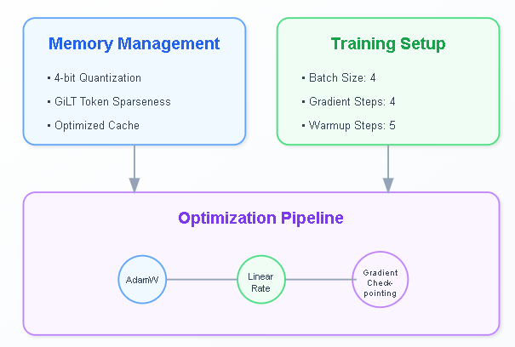
Unsloth Optimization
The Unsloth optimization framework represents a sophisticated approach to improving model training efficiency through three key components:
Memory Management System : The system implements advanced memory optimization techniques.
Training Configuration : The training process is optimized through carefully tuned parameters.
Optimization Pipeline : The pipeline incorporates multiple optimization technique for parameter updates.
Our implementation begins with Meta's LLaMA 3 8B Instruct Model with fine-tuning process which enhances LLaMA 3's capabilities for financial analysis

Slide 13
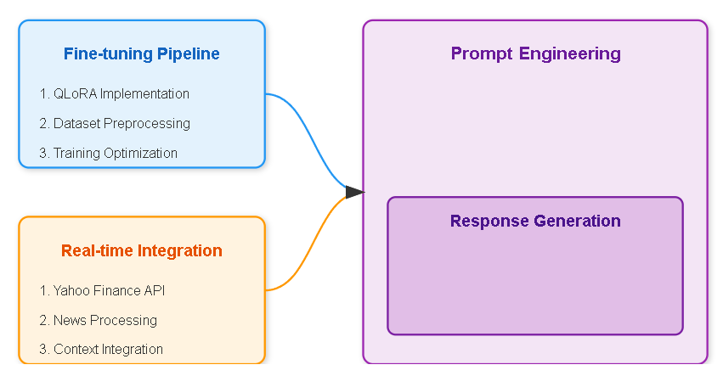
Methodology

Slide 14
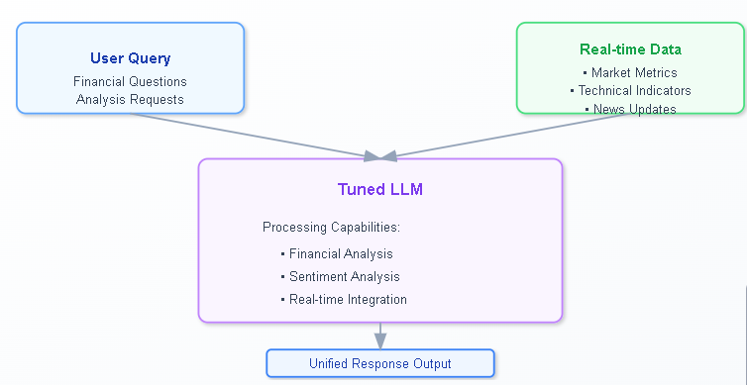
Yahoo Finance API Integration
The integration system consists of three main components:
Market metrics for fundamental analysis
Technical indicators for market trends
Real-time news updates with sentiment analysis
This provide comprehensive, upto the minute financial analysis, considering both qualitative and quantitative factors like market sentiment.

Slide 15
Fine Tuning Metric
Time required for Training
Dataset Size: 12K samples
Training Time: 3.5 hours on L4 GPU
Memory Usage: Reduced by 75% through quantization
Trainable parameters: 41,943,040
Total parameters: 8B

Slide 16
Results
Ask a question based on the context (or type 'x' to exit): Should I invest in UNH stocks right now?
Finance Agent: No, I would not recommend investing in UNH stocks right now. The company's CEO was shot and killed outside a hotel in New York, and there is no clear motive for the shooting. The company is also facing scrutiny for allegedly high claim denial rates, and the true extent of these denials remains uncertain.
—---------------------------------------------------------------------------------------
Ask a question based on the context (or type 'x' to exit): Should I consider investing in TSLA for short term or long term?
Finance Agent: From an analytical viewpoint, TSLA is not a suitable investment for long-term due to its high valuation and volatile stock price
---------------------------------------------------------------------------------------
Ask a question based on the context (or type 'x' to exit): What would you recommend to an investor who is risk-averse based on the metrics and news?
Finance Agent: Based on the metrics and news, I would recommend a cautious approach due to the high PEG ratio, high price to book ratio, high enterprise to revenue ratio, and high enterprise to EBITDA ratio, indicating a high valuation and potential for volatility. Additionally, the high beta indicates a high level of volatility, and the recent news suggests that the company is facing challenges in its supply chain and is struggling to meet demand for its vehicles.

Slide 17
Test Yourself
https://colab.research.google.com/drive/1GLbBMEw4x7uUveYP0riK_DAeywDlZl_z#scrollTo=OX7jYxuxaKgI
https://github.com/sandhu1/Finance-llm

Slide 18
Thank You!
Submitted By: Atharva Kulkarni Rashtardeep Sandhu Virti Jain

