Slide 1
Operating System tutorials (CS5C02) – 2021-22
To the Course Instructor
Dr. JAYASRI BS
(Associate Professor)
Operating System Report
Title: Page replacement and Scheduling Algorithms
Team Details
Sl. No. | USN | NAME
1. | 4NI19CS097 | SANJANA URS K
2. | 4NI20CS406 | SANDHYA HS

Slide 2
FIFO (First In First Out page replacement algorithm)
Introduction
In operating systems that use paging for memory management, page replacement algorithm are needed to decide which page needed to be replaced when new page comes in. Whenever a new page is referred and not present in memory, page fault occurs and Operating System replaces one of the existing pages with newly needed page. Different page replacement algorithms suggest different ways to decide which page to replace. The target for all algorithms is to reduce number of page faults.
First In First Out (FIFO) page replacement algorithm is the simplest page replacement algorithm. In this algorithm, operating system keeps track of all pages in the memory in a queue, oldest page is in the front of the queue. When a page needs to be replaced page in the front of the queue is selected for removal.

Slide 3
How it works !
Operating system keeps track of all the pages in a queue
If a page is already present in set, it’s a hit and there will be no change in the queue. If the page in the string is not present, it’s a page fault.
If set holds less pages than capacity, insert page into the set one by one until all page requests are processed. Simultaneously maintain the pages in the queue to perform FIFO and increment page faults. If current page is already present, it does nothing.
If the queue is full, remove the first page from the queue, replace that first page with current page in the string and store it back in the queue.
Then page faults are incremented.

Slide 4
Pseudocode
Data: Pages P, Number of Pages N, Capacity C
Result: Number of page fault PF
Function FindPage Fault(P, N, C)
S = set();
QPage Queue();
PF = 0;
for i = 0 to length(N) do
if length(S) < C then
if P[i] not in S then
S.add(P[i]);
PF = PF +1;
QPage.put(P[i]);
end

Slide 5
else
if P[i] not in S then
val = QPage.queue[0];
QPage.get();
S.remove(val);
S.add(P[i]);
QPage.put(P[i]);
PF = PF +1;
end
end
end
return PF:

Slide 6
Program
#include<bits/stdc++.h>
using namespace std;
// Function to find page faults using FIFO
int pageFaults(int pages[], int n, int capacity)
{
/* To represent set of current pages. We use an unordered_set so that we quickly check if a page is present in set or not */
unordered_set<int> s;
// To store the pages in FIFO manner
queue<int> indexes;
// Start from initial page
int page_faults = 0;

Slide 7
for (int i=0; i<n; i++)
{
// Check if the set can hold more pages
if (s.size() < capacity)
{
/* Insert it into set if not present already which represents page fault */
if (s.find(pages[i])==s.end())
{
// Insert the current page into the set
s.insert(pages[i]);
// increment page fault
page_faults++;
// Push the current page into the queue
indexes.push(pages[i]);
}
}

Slide 8
/* If the set is full then need to perform FIFO i.e. remove the first page of the queue from set and queue both and insert the current page */
else
{
// Check if current page is not already present in the set
if (s.find(pages[i]) == s.end())
{
// Store the first page in the queue to be used to find and erase the page from the set
int val = indexes.front();
// Pop the first page from the queue
indexes.pop();
// Remove the indexes page from the set
s.erase(val);
// insert the current page in the set
s.insert(pages[i]);
// push the current page into the queue
indexes.push(pages[i]);
// Increment page faults
page_faults++;
}
}
}
return page_faults;
}

Slide 9
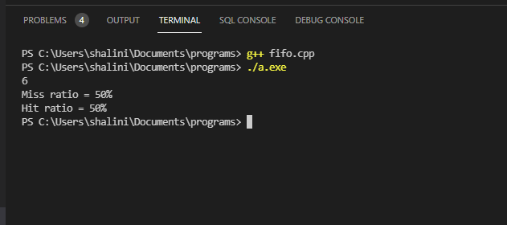
int main()
{
int pages[] = {7, 0, 1, 2, 0, 3, 0, 4,
2, 3, 0, 3, 2};
int n = sizeof(pages)/sizeof(pages[0]);
int capacity = 4;
float miss_per, hit_per;
cout << pageFaults(pages, n, capacity);
miss_per = ((pageFaults(pages, n, capacity)*1.0)/n)*100;
hit_per = 100 - miss_per;
cout<<"\nMiss ratio = "<<miss_per<<"%";
cout<<"\nHit ratio = "<<hit_per<<"%";
return 0;
}

Slide 10
Advantages:
It is easy to understand and implement.
The number of operations is limited in a queue makes the implementation simple.
Disadvantages:
It does not consider the priority or burst time of the processes.
When the number of incoming pages is large, it might not provide excellent performance.
When we increase the number of frames or capacity to store pages in the queue, it should give us less number of page faults.
Sometimes FIFO may behave abnormally, and it may increase the number of page faults. This behavior of FIFO is called Belady’s anomaly.
In FIFO, the system should keep track of all the frames. Sometimes it results in slow process execution.

Slide 11
FCFS (First Come First Serve CPU scheduling algorithm)
Introduction:
A Process Scheduler schedules different processes to be assigned to the CPU based on particular scheduling algorithms. These algorithms are either non-preemptive or preemptive. Non-preemptive algorithms are designed so that once a process enters the running state, it cannot be preempted until it completes its allotted time, whereas the preemptive scheduling is based on priority where a scheduler may preempt a low priority running process anytime when a high priority process enters into a ready state.
First come first serve (FCFS) scheduling algorithm simply schedules the jobs according to their arrival time. The job which comes first in the ready queue will get the CPU first. The lesser the arrival time of the job, the sooner will the job get the CPU.

Slide 12
How it works !
Number of processes and process id’s are given as input in the order of their arrival time
Waiting Time and Turn Around Time is calculated with Burst Time known
The following formulas are used for calculation
1. Completion time of current process = Completion Time of previous process + Burst Time of previous process
2. Wait Time of current process = Completion Time of current process - Arrival Time of current process
3. Turn Around Time of current process = Burst Time of current process + Waiting Time of current process
Total Waiting Time and Total Turn Around Time are calculated
Finally, Average Waiting Time and Average Turn Around Time are calculated by using following formulas
1. Average Waiting Time = Total Waiting Time / Number of processes
2. Average Turn Around Time = Total Turn Around Time / Number of processes

Slide 13
Pseudocode
Data: Processes p[], No. of Processes n,
Burst Time bt[], Wait Time wt[n], Turn Around Time tat[n],
findWaitingTime(processes,n,bt,wt), findTurnAroundTime(processes,n,bt,wt,tat)
findAvgTime(processes,n,bt)
for(i=0;i<n;i++) do
total_wt = total_wt + wt[i]
total_tat = total_tat + tat[i]
avgWaitingTime = total_wt / n
avgTurnAroundTime = total_tat / n
end
end

Slide 14
Program
#include<iostream>
using namespace std;
// Function to find the waiting time for all processes
void findWaitingTime(int processes[], int n, int bt[],
int wt[], int at[])
{
int completion_time[n];
completion_time[0] = at[0];
wt[0] = 0;
// calculating waiting time
for (int i = 1; i < n ; i++)
{
// Add burst time of previous processes
completion_time[i] = completion_time[i-1] + bt[i-1];
// Find waiting time for current process = sum - at[i]

Slide 15
wt[i] = completion_time[i] - at[i];
// If waiting time for a process is in negative
// that means it is already in the ready queue
// before CPU becomes idle so its waiting time is 0
if (wt[i] < 0)
wt[i] = 0;
}
}
// Function to calculate turn around time
void findTurnAroundTime(int processes[], int n, int bt[],
int wt[], int tat[])
{
// Calculating turnaround time by adding bt[i] + wt[i]
for (int i = 0; i < n ; i++)
tat[i] = bt[i] + wt[i];
}
// Function to calculate average waiting and turn-around times.
void findavgTime(int processes[], int n, int bt[], int at[])
{
int wt[n], tat[n];
// Function to find waiting time of all processes
findWaitingTime(processes, n, bt, wt, at);

Slide 16
// Function to find turn around time for all processes
findTurnAroundTime(processes, n, bt, wt, tat);
// Display processes along with all details
cout << "Processes " << " Burst Time " << " Arrival Time "
<< " Waiting Time " << " Turn-Around Time "
<< " Completion Time \n";
int total_wt = 0, total_tat = 0;
for (int i = 0 ; i < n ; i++)
{
total_wt = total_wt + wt[i];
total_tat = total_tat + tat[i];
int compl_time = tat[i] + at[i];
cout << " " << i+1 << "\t\t" << bt[i] << "\t\t"
<< at[i] << "\t\t" << wt[i] << "\t\t "
<< tat[i] << "\t\t " << compl_time << endl;
}
cout << "Average waiting time = "
<< (float)total_wt / (float)n;
cout << "\nAverage turn around time = "
<< (float)total_tat / (float)n;
}

Slide 17
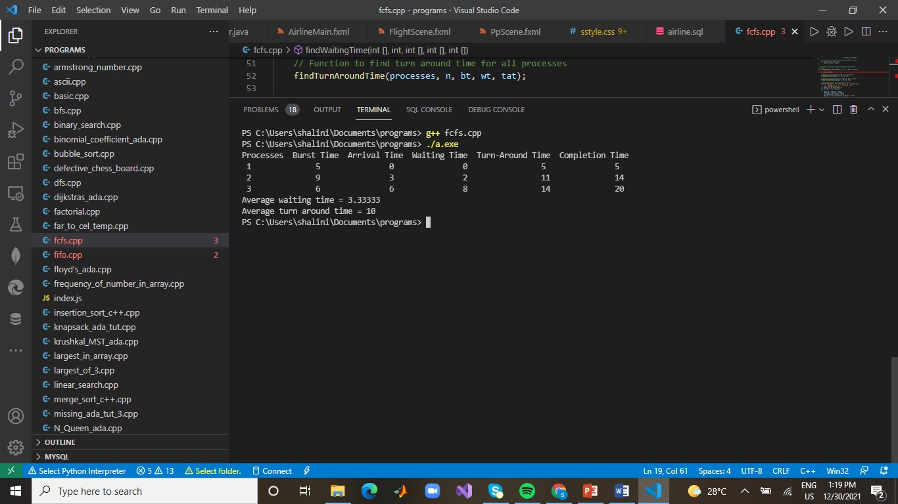
// Driver code
int main()
{
// Process id's
int processes[] = {1, 2, 3};
int n = sizeof processes / sizeof processes[0];
// Burst time of all processes
int burst_time[] = {5, 9, 6};
// Arrival time of all processes
int arrival_time[] = {0, 3, 6};
findavgTime(processes, n, burst_time, arrival_time);
return 0;
}

Slide 18
Advantages:
This scheduling algorithm is simple, easy and based on First In First Out principle
Disadvantages:
The scheduling method is non preemptive, the process will run to the completion.
Due to the non-preemptive nature of the algorithm, the problem of starvation may occur.
Although it is easy to implement, but it is poor in performance since the average waiting time is higher as compare to other scheduling algorithms.

