Slide 1
DASHBOARD EXPORT IMPORT ANALYSIS
NAME SANDHYA GOYAL
ROLL NO : 102017182
GROUP: CS8

Slide 2
dataset
VARIABLES | DESCRIPTION
Country or Area | Three Countries – Austrilia,Canada,USA
Year | Year range 1988-2016
Commodity Code | Item code unqiue for all
Commodity | Type of item
Flow | Indicate flow of trade- Export Import Re-Import Re-Export
Trade USD | Trade value is US Dollars

Slide 3
dataset
Weight | Total weight of traded items in Kgs
Quantity Name | Quantity name of traded items
Quantity | Total quantity of the traded items
Category | 12 unique categories

Slide 4
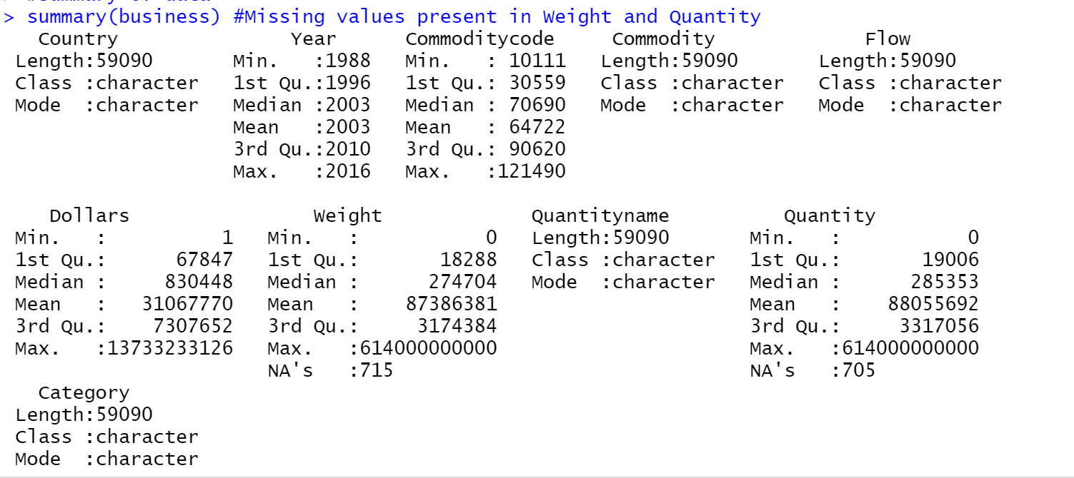
Data pre processing missing values :

Slide 5
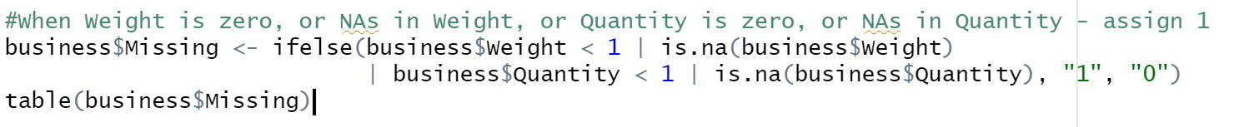
SET MISSING VALUES

Slide 6
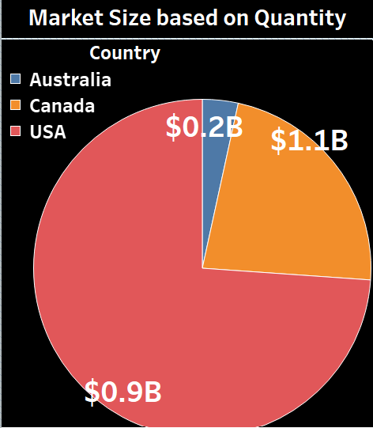
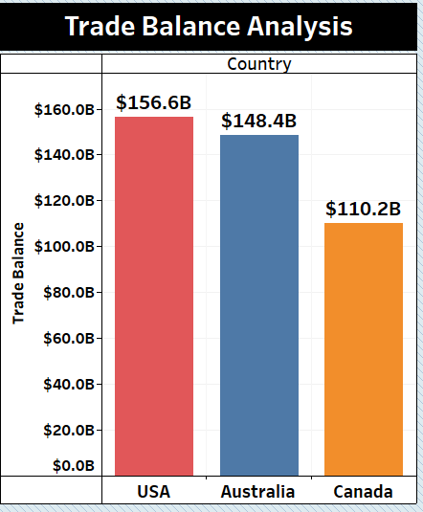
Pie chart AND BAR GRAPH

Slide 7
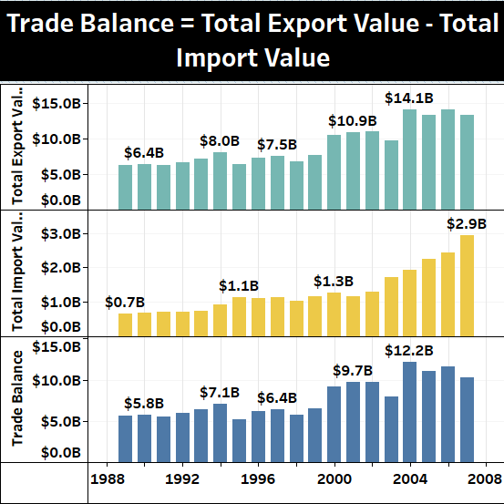
TRADE BALANCE

Slide 8
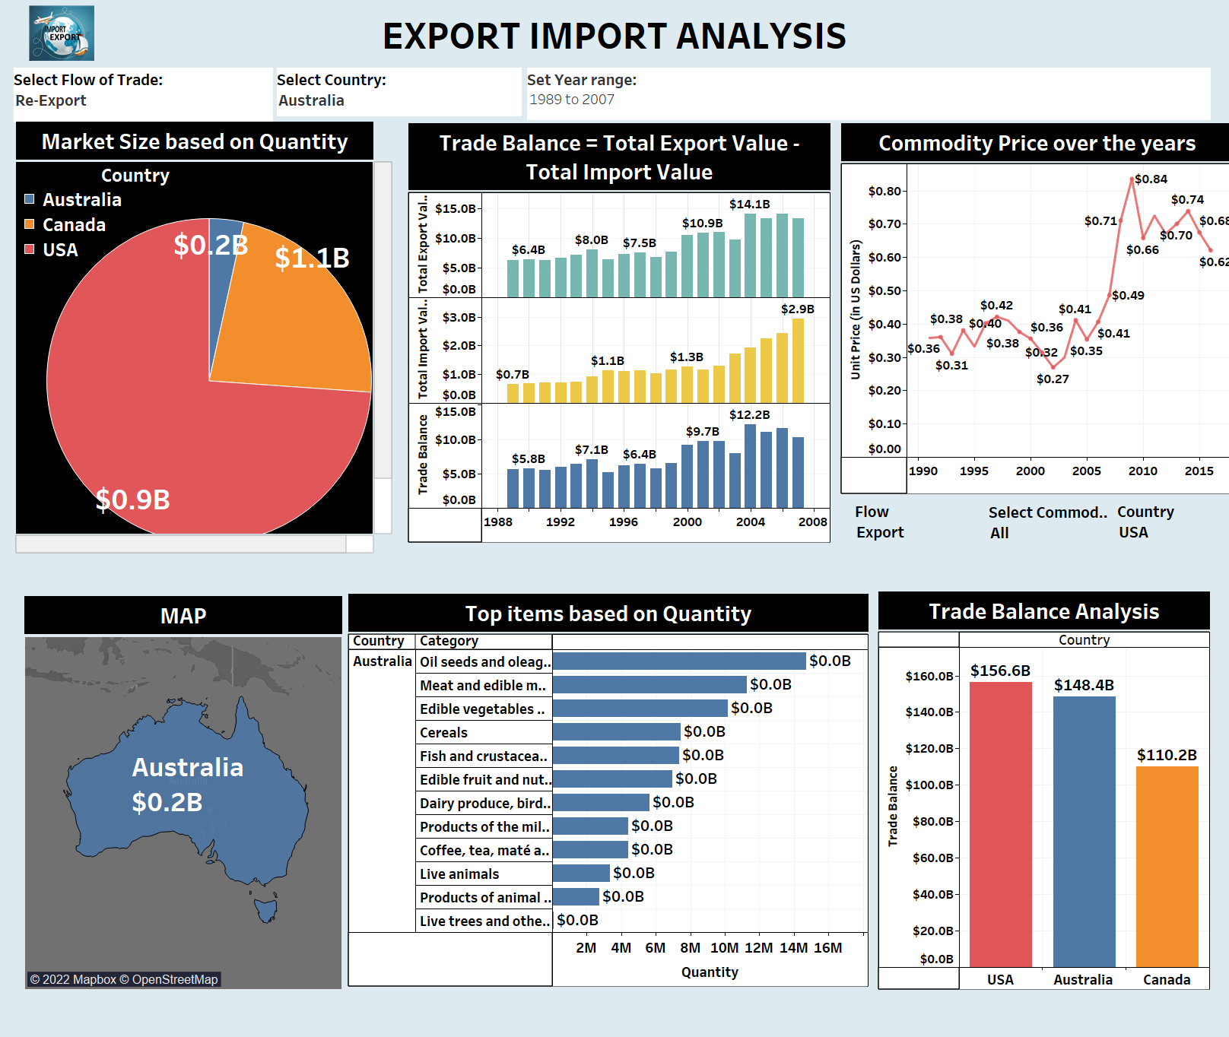
DASHBOARD
From here we set range of year

Slide 9
insights
We can get data country wise . Just select country for which you want to visualize the import and export graphs
We can also set a range for years by moving the slider ( Ex 2012-2016)
Different items import export quantity
Comparison between different countries on basis of quantity(filter is import , export, re export , re import)
Compare on the basis of trade balance analysis
Trade balance bar graph : Trade Balance = Export Value – Import Value

Slide 10


