Slide 1

Atliq Hardware
Consumer Goods Insights
for
Ad hoc Requests

Slide 2
01
Provide the list of markets in which customer "Atliq Exclusive" operates its business in the APAC region.

Slide 3
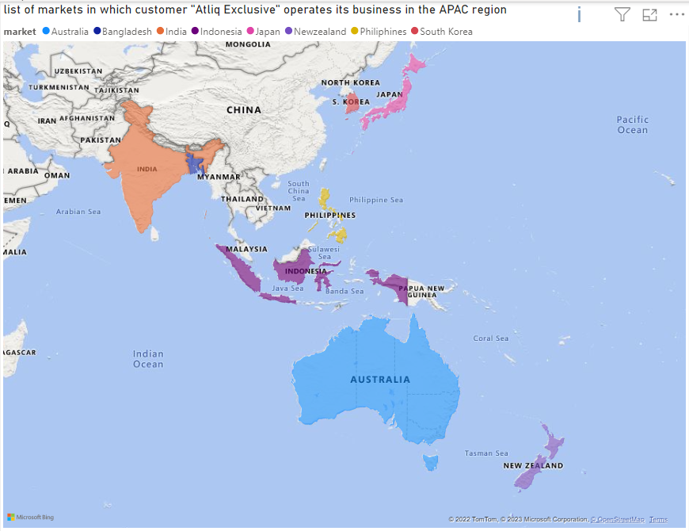
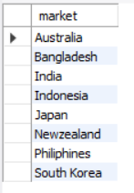
Output:
Output to visual
Insights:
Atliq Exclusive operates in 8 markets in the APAC region – Australia, Bangladesh, India, Indonesia, Japan, Philippines and South Korea.

Slide 4
02
What is the percentage of unique product increase in 2021 vs. 2020?

Slide 5

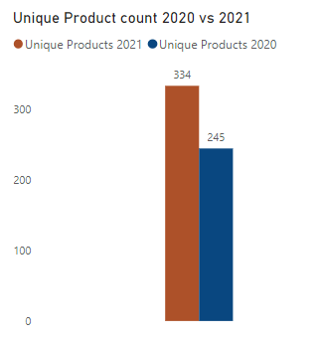
Output:
Output to visual
Insights:
There were only 245 unique products in the year 2020.
However, 89 new products were added in the year 2021, making the total count of unique products in 2021 to 334.
This led to an 36.33% increase in the unique products in 2021 vs 2020

Slide 6
03
Provide a report with all the unique product counts for each segment and sort them in descending order of product counts.

Slide 7
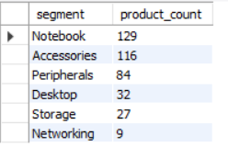
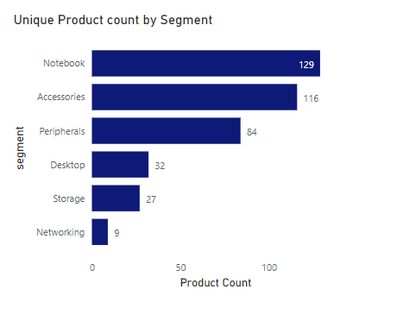
Output:
Output to visual
Insights:
The notebook segment has the most count of unique products followed by Accessories.
Networking segment has a very less number of unique products.

Slide 8
04
Follow-up: Which segment had the most increase in unique products in 2021 vs 2020?

Slide 9
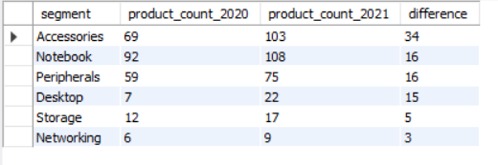
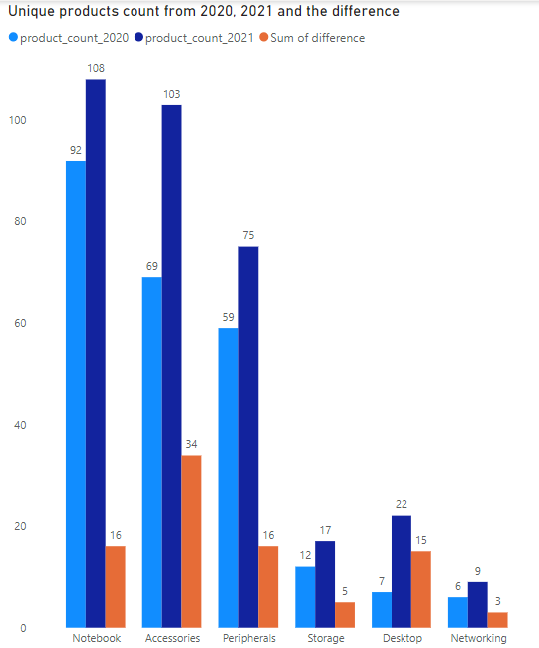
Output:
Output to visual
Insights:
The most significant difference was observed in the Accessories segment with a difference of 34 more products.
This is followed by Notebook, Peripherals and Desktop.
Storage and network segments have the least change, considering that their number of unique products in 2020 was less.

Slide 10
05
Get the products that have the highest and lowest manufacturing costs.

Slide 11

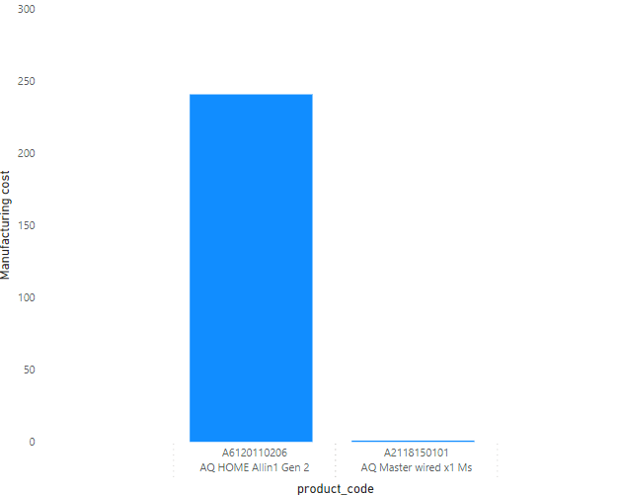
Output:
Output to visual
Insights:
Manufacturing cost is highest for the product “AQ Home Allin 1 Gen 2” and least for “ AQ Master wired x1 Ms”

Slide 12
06
Generate a report which contains the top 5 customers who received an average high pre_invoice_discount_pct for the fiscal year 2021 and in the Indian market.

Slide 13
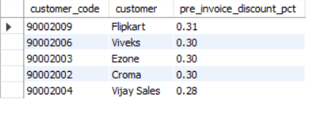
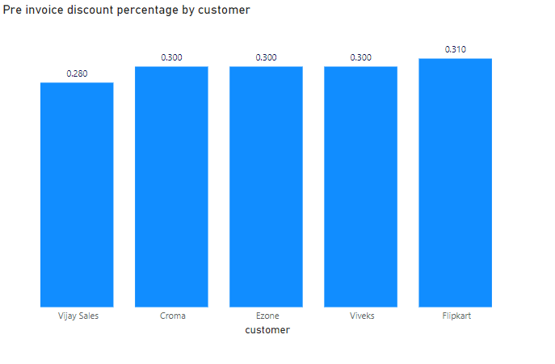
Output:
Output to visual
Insights:
In India, the top 5 customers who receive the highest pre-invoice discount percentage are Flipkart, Viveks, Ezone, Croma, Vijay Sales.
Flipkart gets the highest pre-invoice discount percentage amongst these companies with a discount of 0.31%

Slide 14
07
Get the complete report of the Gross sales amount for the customer “Atliq Exclusive” for each month .

Slide 15
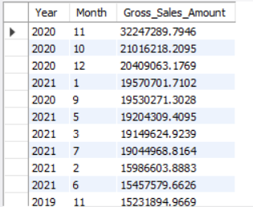
Output:

Slide 16
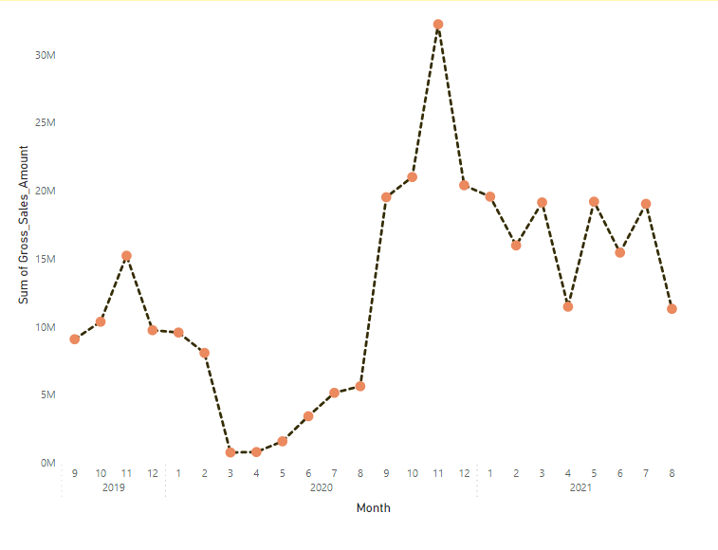
Output to visual

Slide 17
Insights:
The gross sales amount has decreased in 2020 and remained low throughout. This could be because of Covid19 effect.
In late 2020, this significantly improved and became high.
However early 2021 witnessed a reduction in gross sales amount, due to the second wave of Covid.

Slide 18
08
In which quarter of 2020, got the maximum total_sold_quantity?

Slide 19
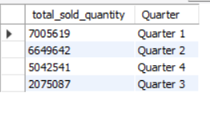
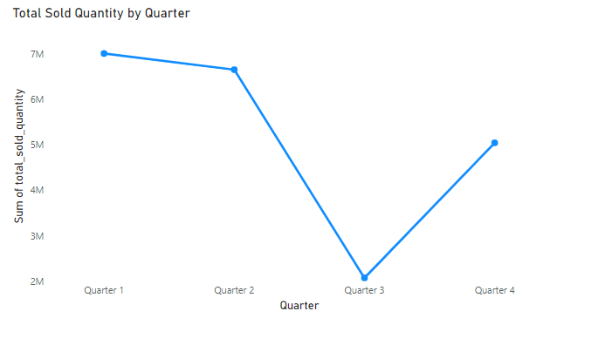
Output:
Output to visual
Insights:
Quarter 1 of 2020 witnessed the highest sales amount.
There was a decline in Quarter 2 and Quarter 3 which could be due to Covid impact.
However the sold quantity increased in Quarter 4.

Slide 20
09
Which channel helped to bring more gross sales in the fiscal year 2021 and the percentage of contribution?

Slide 21
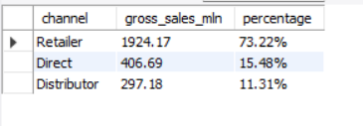
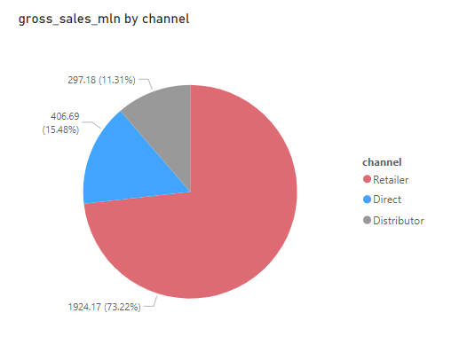
Output:
Output to visual
Insights:
Retailer channel brought in the highest gross sales amount with a whopping 73.22 % of the total.

Slide 22
10
Get the Top 3 products in each division that have a high total_sold_quantity in the fiscal_year 2021?

Slide 23
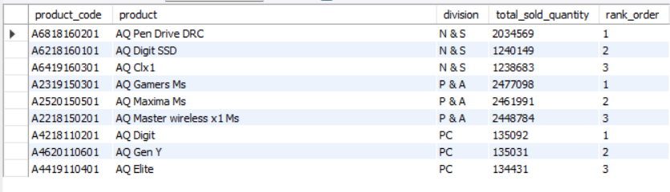
Output:

Slide 24
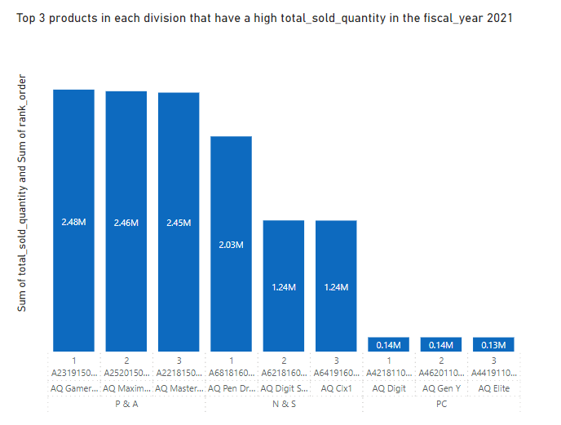
Output to visual

Slide 25
Insights:
In the N & S division, the top 3 products are AQ Pen Drive DRC, AQ Digit SSC amd AQ Clx1
In the P & A division, the top 3 products are AQ Gamers Ms. AQ Macima Ms and AQ Master Wireless x1 Ms
In the PC division, the top 3 products are AQ Digit, AQ Gen Y, AQ Elite.

Slide 26
THANKYOU

