Slide 1
Sales Analytics Dashboard
Data Analyst Internship – Task 4
Tool Used: Tableau
Dataset: Superstore Sales
By: Your Name

Slide 2
Objective
• Provide key insights into sales, profit, and product performance.
• Help stakeholders make informed business decisions through interactive visuals.

Slide 3
KPIs & Summary Cards
Visuals:
• Total Sales
• Total Profit
• Sales by Segment (Consumer, Corporate, Home Office)
Insights:
• Consumer and Technology categories contribute most to overall sales.

Slide 4
Product Analysis
Charts:
• Sales vs Profit (Bar)
• Category/Sub-category Performance (Pie or Bar)
Insights:
• Some sub-categories show high sales but low or negative profit (e.g., Tables).

Slide 5
Regional Insights
Visuals:
• Sales by Region
• Sales by State (Map View)
Insights:
• The West region performs best in sales, while some states show low profitability.

Slide 6
Time-Series Analysis
Chart:
• Monthly or Yearly Sales Trends
Insights:
• Sales peak during certain months/seasons – this helps in planning promotions.

Slide 7
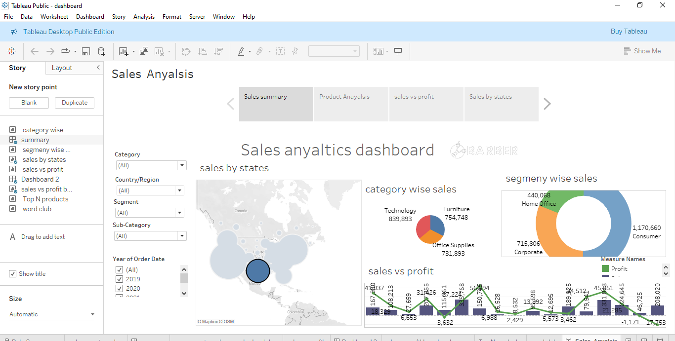
Dashboard View

Slide 8
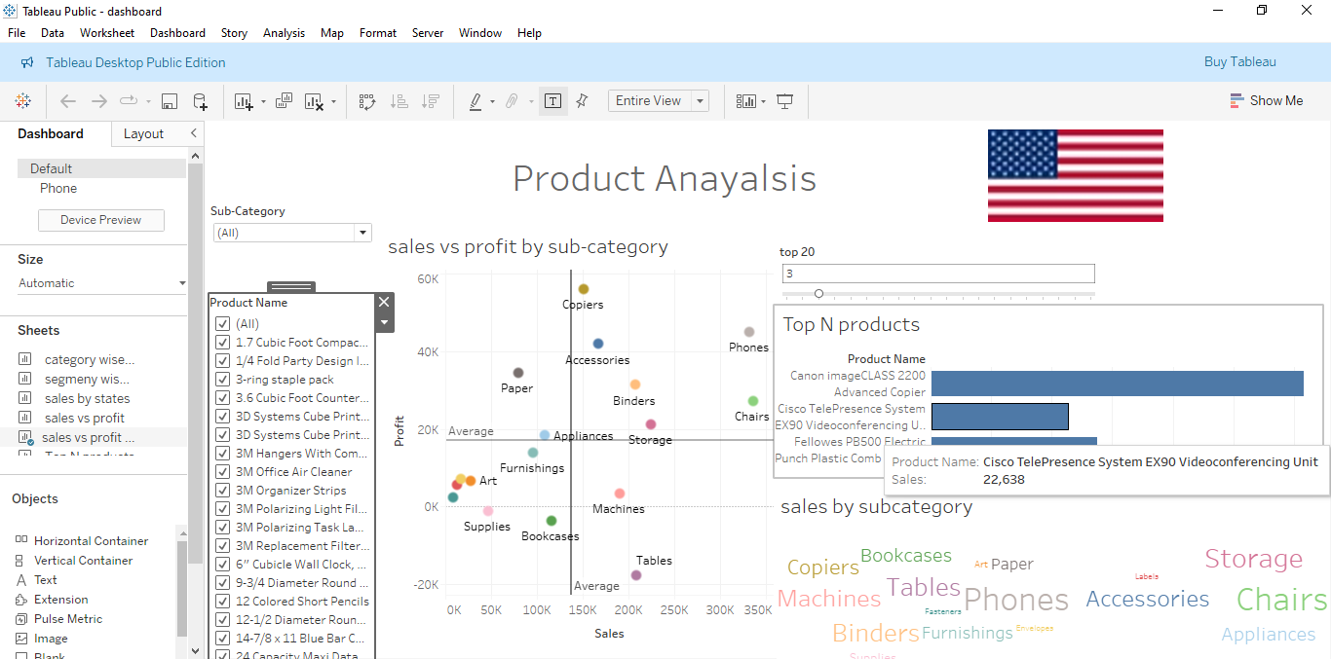

Slide 9
Include a screenshot of your full dashboard here.
Conclusion:
• The dashboard provides an at-a-glance view of sales performance and trends, helping businesses to focus on profitable areas and improve underperforming ones.

