Slide 1
People
Who’s Doing Api’s
Innovate
Scale
WIN
Technology
What We Do Api’s With
Process
How Api’s are Done
Automate
Analyze
Analytics
How are Api’s Analyzed

Slide 2
People
Who’s Doing Api’s
Innovate
Scale
WIN
Technology
What We Do Api’s With
Process
How Api’s are Done
Automate

Slide 3
SPECIFICATIE
BUILD ON DEV
DEPLOY to TEST
TEST
DEPLOY to
ACCEPT
ACCEPT
DEPLOY to
PROD
HANDOVER
to
SUPPORT
INTAKE
Spec is unclear
Not according to spec’s
not as intended

Slide 4
1) Educate:
2) Approve:
3) Evaluate:

Slide 5
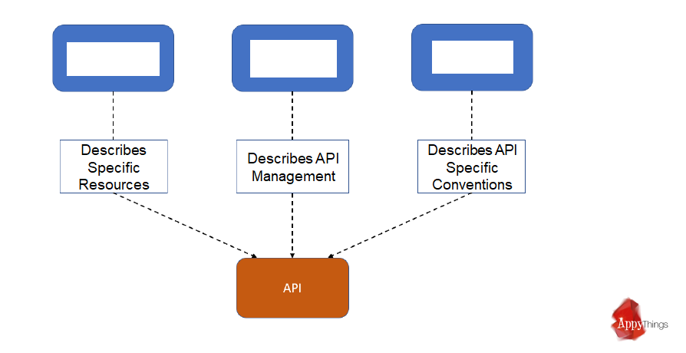
Building Blocks of Data Governance
Data Dictionary
(DD)
API Cookbook
(CB)
API Conventions
(AC)

Slide 6



Content of API Data Dictionary
legenda
Employees
absorbing Employee
CRM
preferences
bankAccount
System X
contact
paymentPlans
accounts
Legacy
invoices
ToDo
contact
payment
paymentPlanDetails
(measuringDevice)
address
address
type: <OneTimeCost>
bankAccount
orders
(orders)
person
lines
type: <serviceOrder>
payments
address
orderlines
location
agreements
lineDetails
address
organization
products
lineSubDetails
address
location
usage
legalForm

