Slide 1
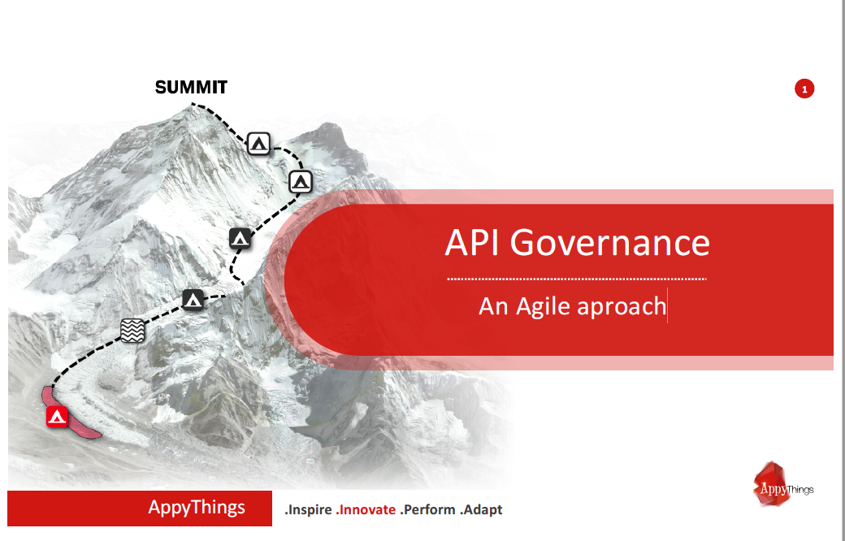

Slide 2

Why API Governance ?
API {1st} is not just a new tool. It is about opening up processes via a
simple stateless interface so people can easily integrate with them.
This only works when API’s are simple, easy to understand, universal and
consistent.
That is where API Governance comes in to play: To secure that we keep on
the right track.

Slide 3
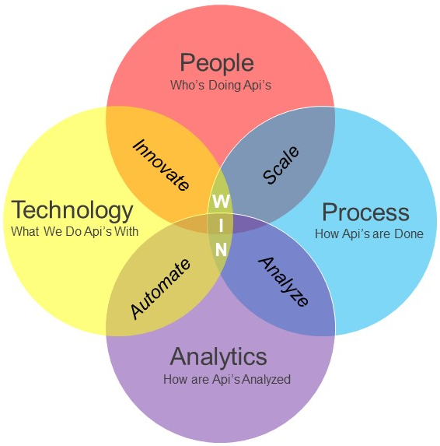

Slide 4
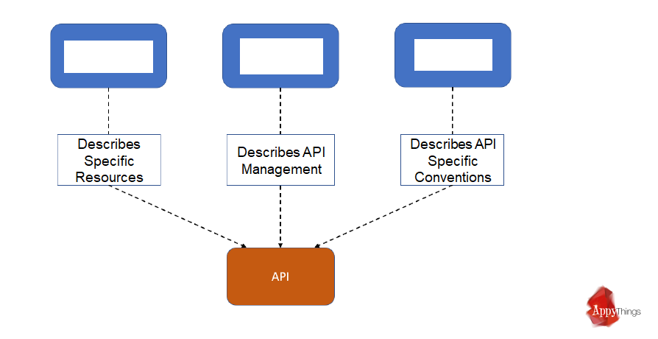
Building Blocks of Data Governance
Data Dictionary
(DD)
API Cookbook
(CB)
API Conventions
(AC)

Slide 5
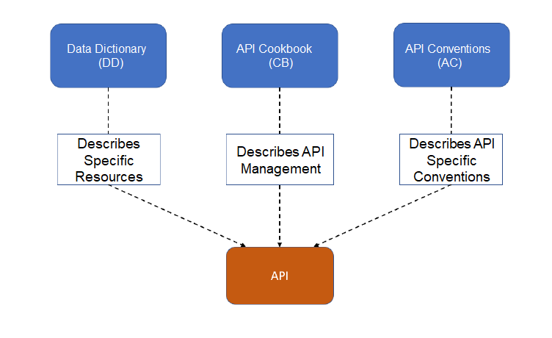
Building Blocks of Data Governance

Slide 6
SPECIFICATIE
BUILD ON DEV
DEPLOY to TEST
TEST
DEPLOY to
ACCEPT
ACCEPT
DEPLOY to
PROD
HANDOVER
to
SUPPORT
INTAKE
Spec is unclear
Not according to spec’s
not as intended

Slide 7
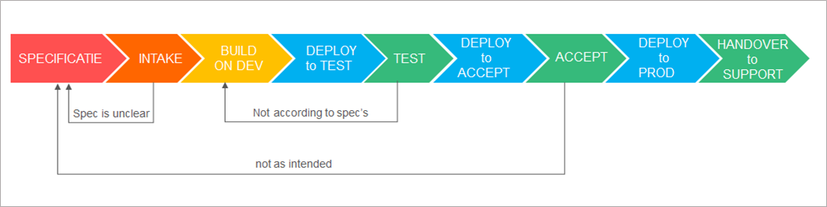

Slide 9
1) Educate:
2) Approve:
3) Evaluate:

Slide 10

Content of API Data Dictionary
Employees
absorbing Employee
preferences
bankAccount
contact
paymentPlans
accounts
Invoices
payment
contact
address
address
paymentPlanDetails
(measuringDevice)
type: <OneTimeCost>
bankAccount
orders
(orders)
person
lines
type: <serviceOrder>
payments
address
orderlines
location
agreements
lineDetails
address
organization
products
lineSubDetails
address
location
usage
legal Form

