Slide 1
Open Source Based API Integration

Slide 2
Key Business Objectives
Integration with Source Systems
Real-time analytics
Role based access controls
Business and IT process monitoring
Business KPI Management
Interactive dashboards
Responsive UI

Slide 3









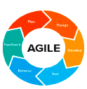

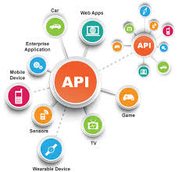
API Governance
API {1st} Programme
API Team
CIO
API Admin
Chief Architect
Data Dictionary
API Developer/Analyst
API Factory
APP Developer/Analyst
API Cookbook
Developers
Factory Manager
API Conventions
Architect
Tester
Methodology
Analytics
Technology
Notes:
API Governance Building Blocks
API Cookbook:
Describes how to build an API following the standards that the Integration Design Authority has set.
Data Dictionary:
Specifies the resources that are used in Solvay. This defines the path of your API.
API Conventions:
Includes naming conventions and error handling. The conventions are based on the REST
(Representational State Transfer) principles .

Slide 4
API Team
Position | Role | Comments
CIO | Sponsor | The CIO mandates the strategic change
Chief Architect | Sponsor | The Chief Architect is the evangelist for the API {1st} strategy.
Integration Architect | Design Authority | Responsible for the communication about Conventions, Cookbook, etc. within the organization
Solution Architect | Design Authority | Responsible for the exception handling and creation of new conventions / patterns.
Developer | API Team | Hands-on assistance to the Back-End teams for creating good API’s
CIO
API{1st}
strategy
Chief
Architect
Integration
Architect
API
Conventions
Design
Authority
Solution
Architect
API
Cookbook
Developer

Slide 5
Lifecycle/Processes
Notes:
AGILE methodology is a practice that promotes continuous iteration of development and testing throughout the software development lifecycle of the project. Both development and testing activities are concurrent.
Agile is a project management methodology that uses short development cycles called “sprints” to focus on continuous improvement in the development of a product or service.
Agile discovers what the customer and how to build the code and change things along the way.
Plan - Projects are envisioned and prioritized
Development - Design and develop software based on defined requirements
Test - QA (Quality Assurance) testing, internal and external training, documentation development
Release - QA (Quality Assurance) testing, internal and external training, documentation development, and final release of the iteration into production
Feedback - Accept customer and stakeholder feedback and work it into the requirements of the next iteration

Slide 6
Governance Technical Artifacts
Data Dictionary
API Cookbook
API Conventions
Describes Specific Resources
Describes API Management
Describes API Specific conventions
API
Notes:
API Governance Building Blocks
API Cookbook:
Describes how to build an API following the standards that the Integration Design Authority has set.
Data Dictionary:
Specifies the resources that are used in Solvay. This defines the path of your API.
API Conventions:
Includes naming conventions and error handling. The conventions are based on the REST
(Representational State Transfer) principles .

Slide 7

Data Dictionary
Employees
absorbing Employee
preferences
bankAccount
contact
paymentPlans
accounts
Invoices
payment
contact
address
address
paymentPlanDetails
(measuringDevice)
type: <OneTimeCost>
bankAccount
orders
(orders)
person
lines
type: <serviceOrder>
payments
address
orderlines
location
agreements
lineDetails
address
organization
products
lineSubDetails
address
location
usage
legal Form
Notes:
A place where business and/or technical terms and definitions are stored.
The data dictionary contains records that specify the data fields available in the API, including the display name and description of each field.
It specifies the resources that are used in Solvay. This defines the path of your API.

Slide 8
API Cookbook
Introduction
Structure and Flows
Proxy Request quadrant
Target Request Quadrant
Target Response Quadrant
Proxy Response Quadrant
Flows
Conditional Flows
Special flows
Relations in SAM
The API product
The developer
The developer application
SAM Naming conventions
API policies
Products
Developer application
Test application
Products
Developer application
Test application
API Provider
Key-value maps
Policies
Security Policies
Traffic Management Policies
Mediation Policies
Extension Policies
Message Logging
Error Handling
Swagger / Specification
Notes:
API Cookbook (CB) describes how to build an API on the API management platform from SAP. We give information about best practices and the API flows and structures. Besides that, you will find all the information you will need to build a secure, RESTfull API in SAP API Management. This cookbook also features code examples for easy implementation.

Slide 9
API Conventions
Notes:
This document describes Solvay specific choices on architecture and common practices that should be applied to build a
strong and save API: The API conventions

Slide 10








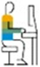
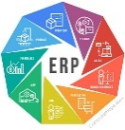
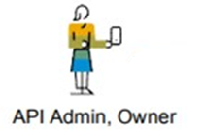
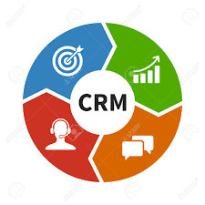
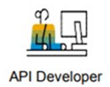


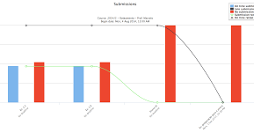


Frameworks & Accelerators
Client Applications
Backend
Systems
Automation Layer
API Gateway
Roles
Self Service
Security
Cache
Traffic
Cloud
Application Developer
API Layer
aaaaaaaaaaaaaaaaaaaaaaaaaaa
Business Logic(Micro-Services)
Template Service
ERP
kubernetes
Cluster
Docker container
Docker container
Docker container
API Admin, Owner
Orchestration
CRM
Devops
Business Process Flow
Docker
API Developer
DynamoDB
Data Storage
RDS
Elastic Search
Elasticache
Mainframe
S3Buckets
Analytics

Slide 11



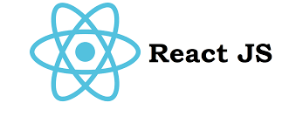


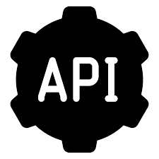

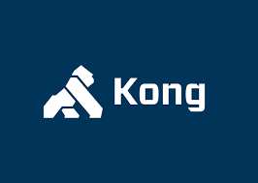
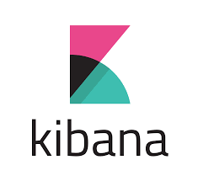
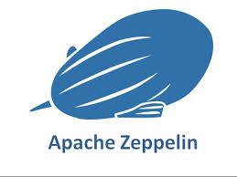








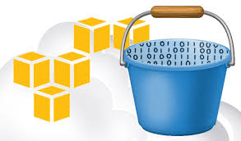


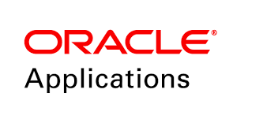
Technology View
Management Layer
UI Layer
API Layer
Analytics
Data Storage
Logs
Transactional / Operational Data
Meta / Reference Data
Data Processing
Data Access
Batch Processing
Real Time Data Processing
Amazon S3
Source Systems

Slide 12
Coop

Slide 13
Ladbrokes

Slide 14
Canon

