Slide 1
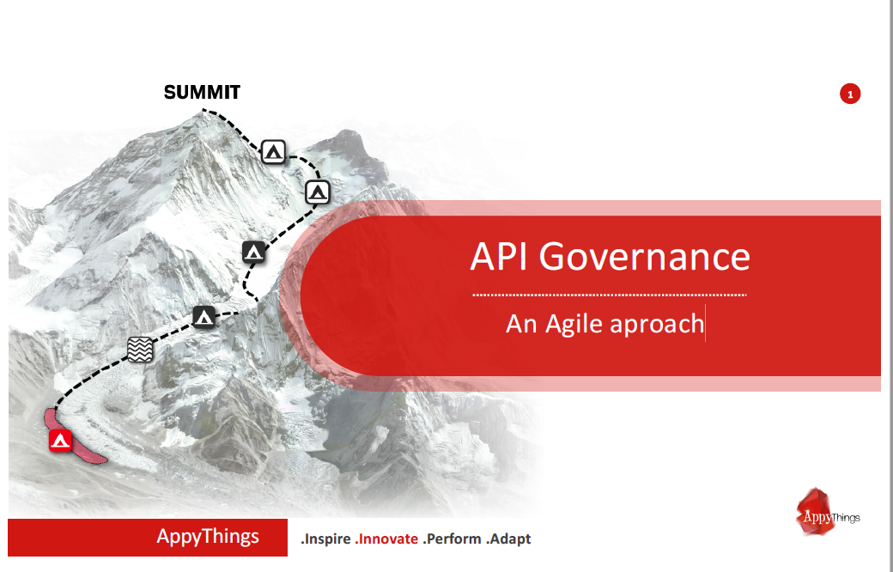

Slide 2

Why API Governance ?
API {1st} is not just a new tool. It is about opening up processes via a
simple stateless interface so people can easily integrate with them.
This only works when API’s are simple, easy to understand, universal and
consistent.
That is where API Governance comes in to play: To secure that we keep on
the right track.

Slide 3
People
Innovate
Scale
WIN
Technology
Process
Automate
Analyze
Analysis

Slide 4
Analyze

