Slide 1
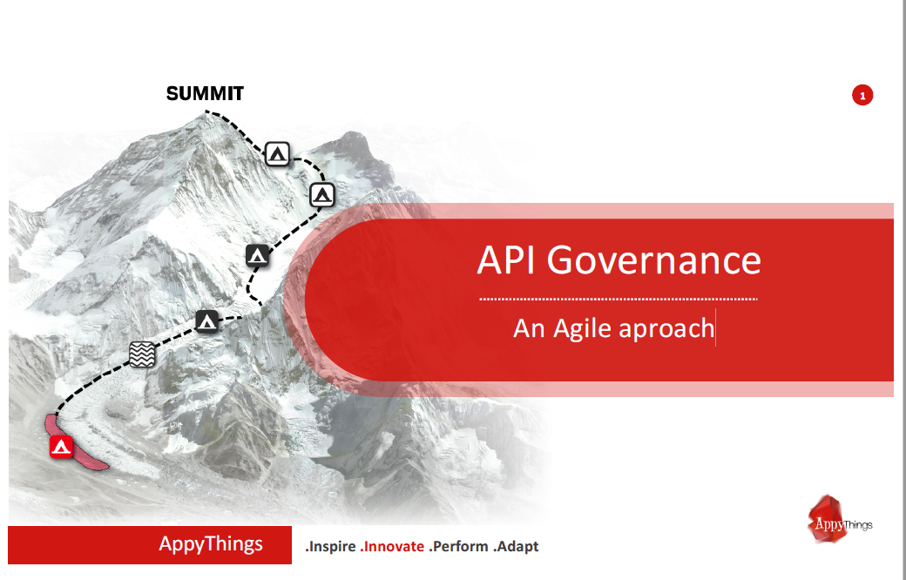

Slide 2

Why API Governance ?
API {1st} is not just a new tool. It is about opening up processes via a
simple stateless interface so people can easily integrate with them.
This only works when API’s are simple, easy to understand, universal and
consistent.
That is where API Governance comes in to play: To secure that we keep on
the right track.

Slide 3
People
Who’s Doing Api’s
Innovate
Scale
WIN
Technology
What We Do Api’s With
Process
How Api’s are Done
Automate
Analyze
Analytics
How are Api’s Analyzed

