Slide 1



SAP Cloud Platform
API Management Solution

Slide 2
LET'S HAVE A QUICK LOOK

Slide 3
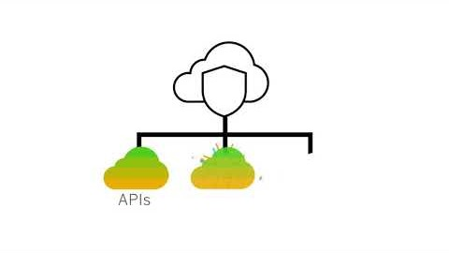

Slide 4
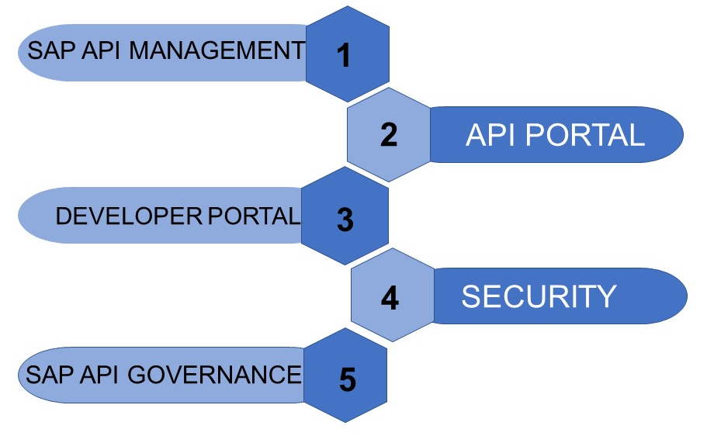
AGENDA
Notes:
This training materials talks about the following key elements of SAP API Management. We have generalized the complete SAP API management into these elements and explained in brief about each element in the continuing presentation.

Slide 5
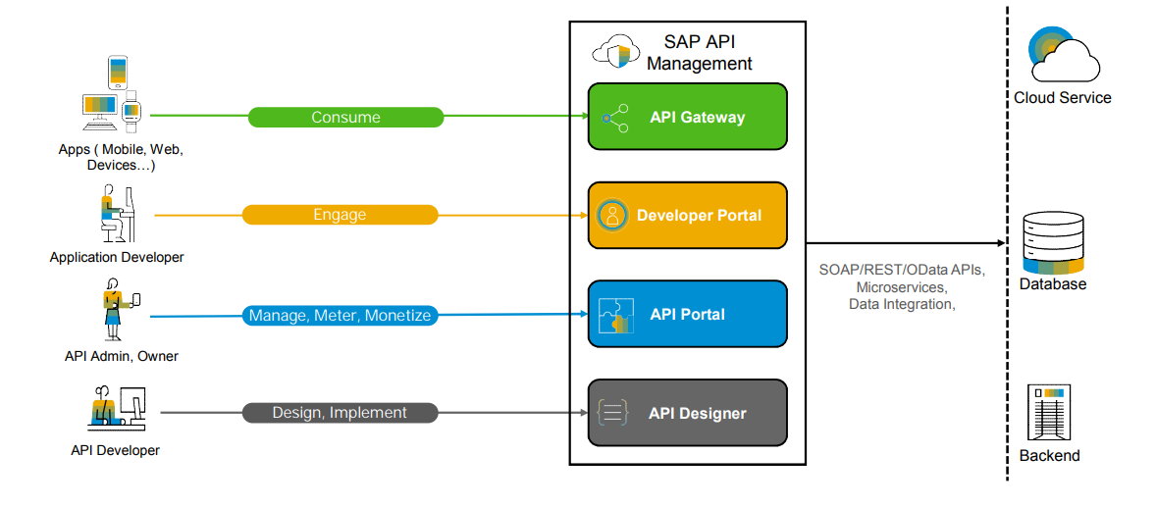
OVERVIEW
Notes:
As shown in the above diagram, SAP API Management has got three key components. API portal, Developer portal and Gateway system.
Components:
API Portal: Is used to design, develop, configure and deploy the API proxies
Developer Portal: Is used by the Application developers to register and consume already deployed API proxies
Gateway: The physical server that is used to deploy the APIs
Roles:
API Developer: Access the API Portal to design and implement the API proxies.
Application Developer: Access the Developer portal to register and consume the API proxies.
API Admin: Have the privileges to manage, analyze and monetize the API proxies in API Portal.

Slide 6
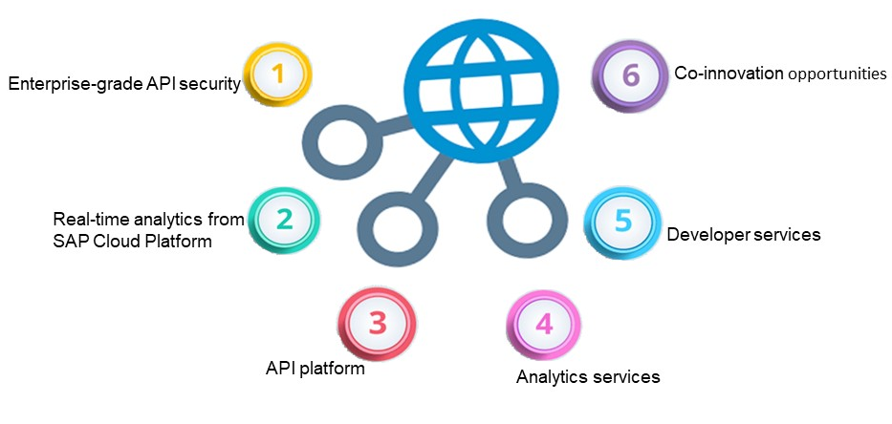
KEY COMPONENTS
Notes:
Key Components:
Enterprise-grade API security, traffic management, and monitoring
Real-time analytics from SAP Cloud Platform
API platform
Analytics services
Developer services
Co-innovation opportunities

Slide 7
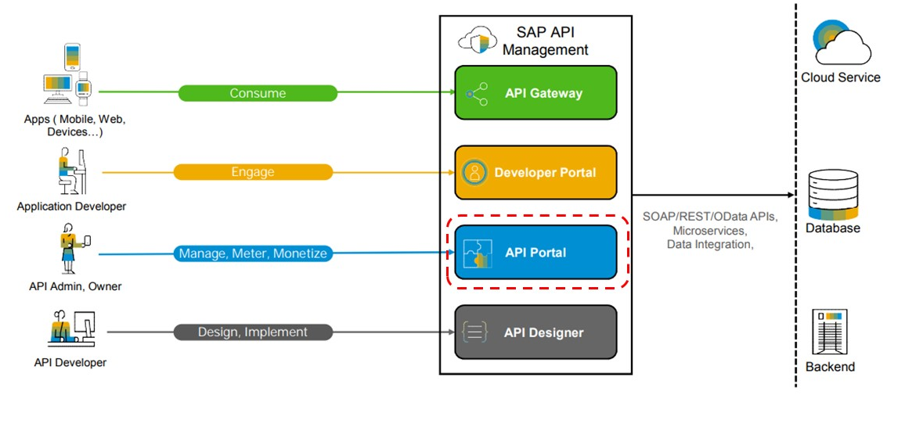
API PORTAL
LET'S HAVE A QUICK LOOK
Notes:
An application that provides a common platform for API designers to define and publish APIs.
Offers capabilities to configure systems, build and publish APIs, analyze and test APIs.
Provides powerful analytical tools to track your API usage.

Slide 8
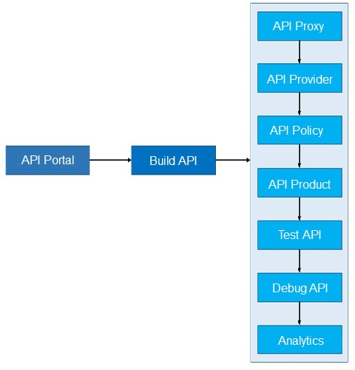
API PORTAL FUNCTIONALITIES
Notes:
API Portal is used to build and publish any API Proxy. We can create an API Proxy in 3 ways like using an API Provider, URL, etc. which will be explained in further sessions.
On creation of an API, it can be protected by applying security policies to it.
These API’s can be published to the users by adding them to an API Product which will be consumed in Dev portal.
Testing of these API Proxies can be done through the test console present in API Portal.
To diagnose and analyze the API flow be can debug the API’s.

Slide 9
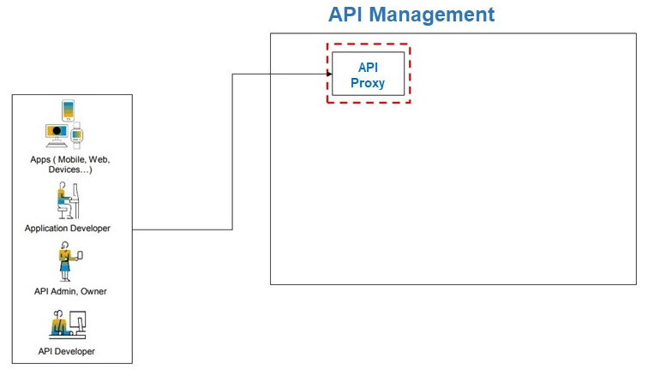
API PROXY
Notes:
An API is exposed in API Management as an API Proxy. An API Proxy is a discrete representation of an API. The API which contains the logic to connect to the target system.
It is implemented as a set of configuration files, policies, and code snippets that rely on the resource information provided by API Management.
The API Proxy decouples an API from any backend changes. This provides flexibility to application developers to continue calling the same API.

Slide 10
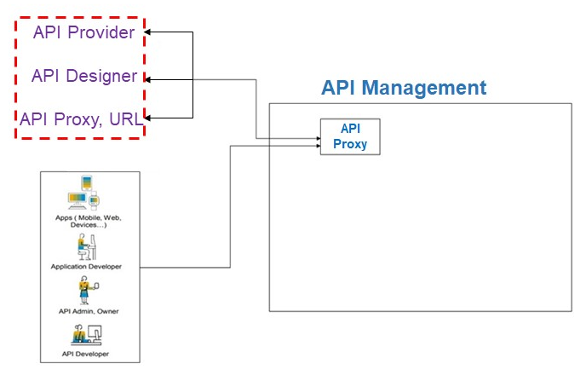
WAYS OF CREATING AN API PROXY:
Notes:
API/Designer
From designer: Creating proxy using designers, and designers like swagger.
Importing: Sap supports .json and .zip files to import a file.
Creating using API Portal
Provider: The API Provider is used to abstract the connection to the backend / target system.
Proxy: The API Proxy is the actual API which contains the logic to connect to the target system. Here you can model the flow, add security policies, transform the incoming message or look for content injections
URL: Enter the OData service URL in the URL field. For example: http://<host>:<port>/SFlight

Slide 11
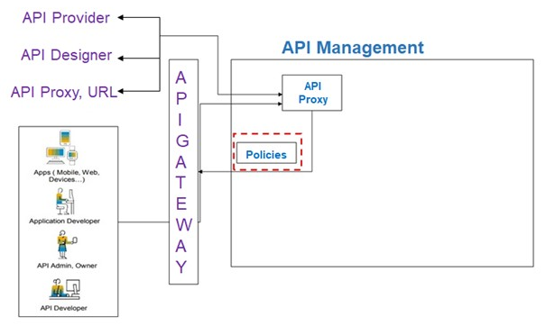
API POLICY
Notes:
Policies define a set of rules (such as, enforce security, control traffic, and so on) that is applied on the API.
Policies are applied to an API Proxy to customize its behavior.
Policies provide features to secure APIs, control the API traffic and transform message formats.
Use the Policy Designer to create policies in the API Portal.
Traffic Management Policies: The traffic management policies let us configure cache, control traffic quotas and spikes, set concurrent rate limits
Mediation Policies: These policies let us perform message transformation, parsing, validation and raise faults and alerts.
Security Policies: These policies controls the security related aspects for API Proxies
Custom Policies: These policies let us provide custom policy functionality, with support for features as service callout, message data collection, and calling Java, JavaScript and created Python behavior.

Slide 12
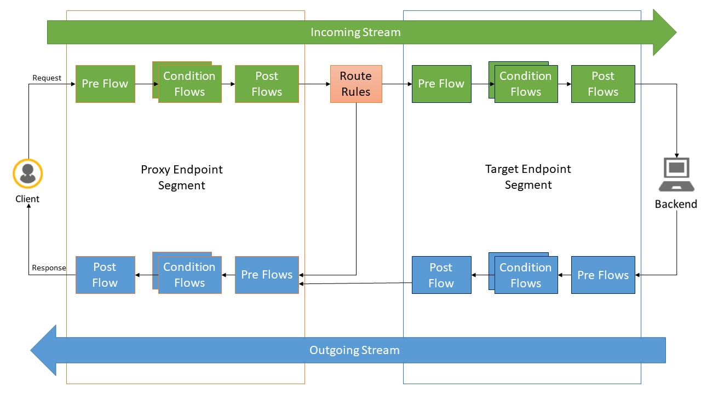
POLICY FLOW
Notes:
The Client initiates a request, which connects to the API Proxy endpoint (Incoming Request), following PreFlow, Conditional Flow, PostFlow, and then traverses the diagram to the right, hitting the Target Service, which is then processed, and returned to the Target Endpoint (Outgoing Response), traversing to the left until it is returned to the Client. A policy could be placed in any of the 12 Flow points.
API Proxy Endpoint
Incoming request – Requests from external source (User application, B2B resource, etc.) to the API Proxy residing on SAP API Management
Outgoing response – Data request sent from API Proxy residing on SAP API Management to original request source.
Target Endpoint
Incoming request – Requests from API Proxy on SAP API management to Target Endpoint
Outgoing response – Data response from Target endpoint to API Proxy on SAP API management, in response to request received from API Proxy.
Pre-Flow
Always executes before any other flows. The policies defined in the pre-Flow are applied to every message that passes through an endpoint.
Conditional Flows
Execute only when a conditional statement defined for the Flow evaluates to true. These conditions tell the Proxy, “if you see this, then do that.”
Post-Flow
Always executes after all other Flows. Like Pre-Flow, the policies defined in the Post-Flow are applied to every message.

Slide 13
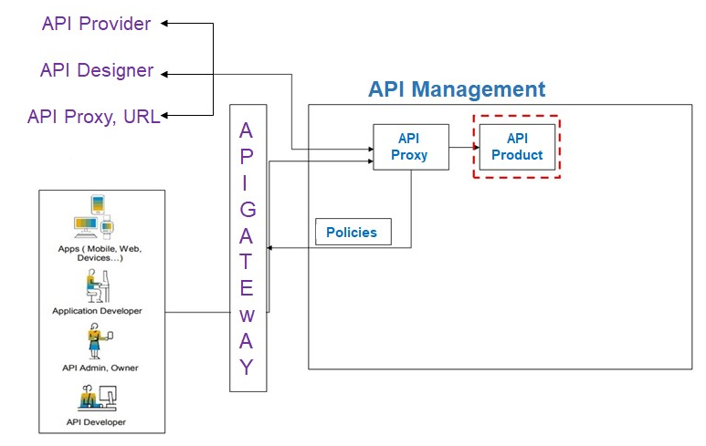
API PRODUCT
Notes:
A Product is a bundle of APIs. It contains metadata specific to your business for monitoring or analytics.
Instead of publishing APIs individually, it is easier to bundle related APIs together as a Product and publish it.
A product is a vehicle that lets the Application developer know which APIs are exposed on the API Management portal.
After including the required APIs to a Product, the Product is published to the Catalog, where the Product is available for Application developers to browse through.

Slide 14
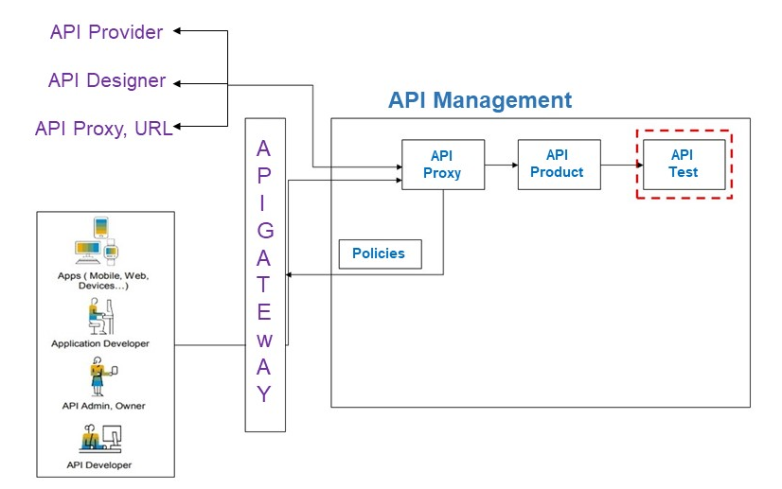
TEST API’s
Notes:
API Management provides an API Test Console, which enables you to test your APIs. Testing an API is essential to understand the runtime behavior of the APIs.

Slide 15
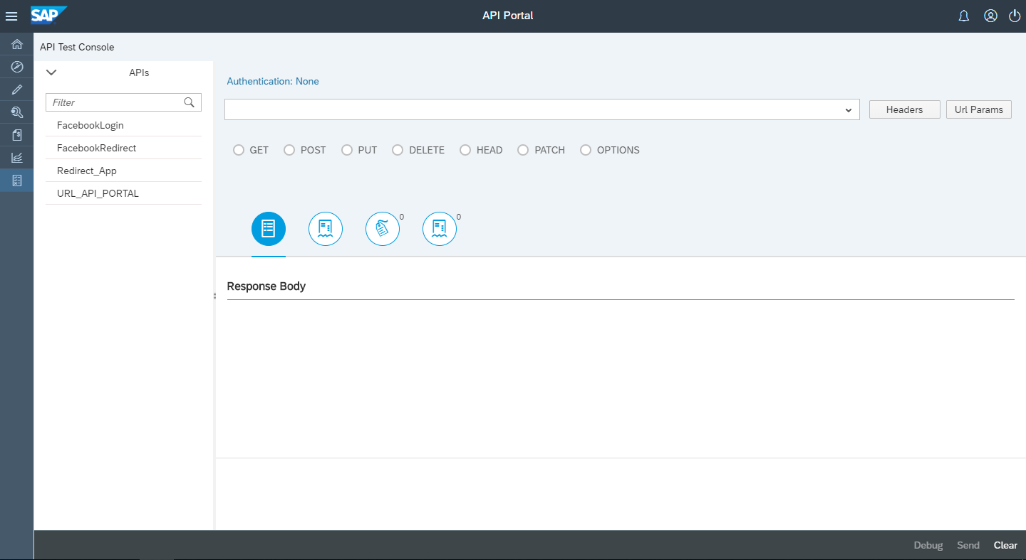
TEST CONSOLE
Notes:
The Test console allows you to explore the resources associated with an API and execute the operations.
Use the API Test Console to test the runtime behavior of APIs
The API Test Console allows you to test OData and REST-based services.

Slide 16
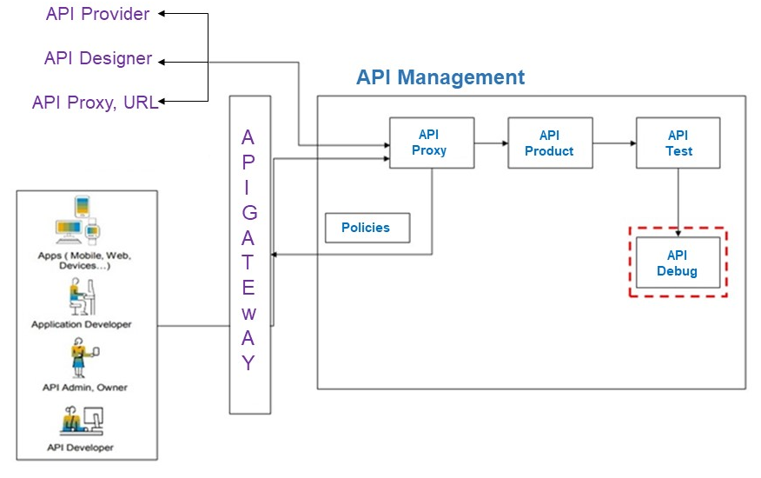
DEBUG API’s
Notes:
Debug an API proxy to troubleshoot and monitor them in API Management, by probing the details of each step through the API proxy flow.

Slide 17
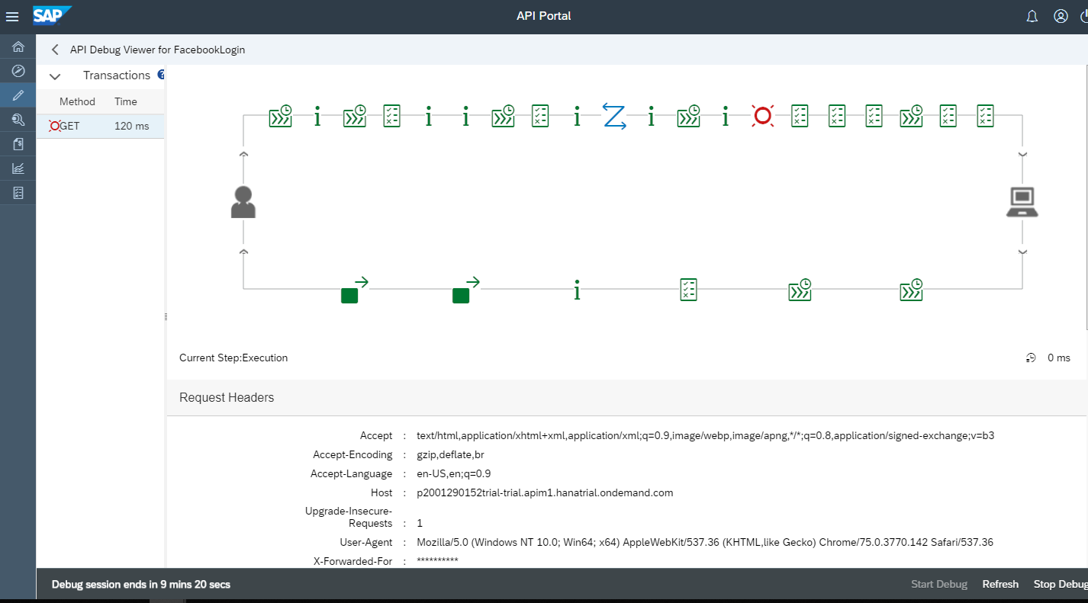
DEBUG CONSOLE
Notes:
When you start the debug, the API records details of each step in the processing pipeline. While the debug session is running, messages and contextual data are captured from live traffic.
The debugger enables you to detect and diagnose errors in your application.
It allows you to control the execution of your program by setting breakpoints, suspending threads, stepping through the code, and examining the contents of the variables

Slide 18
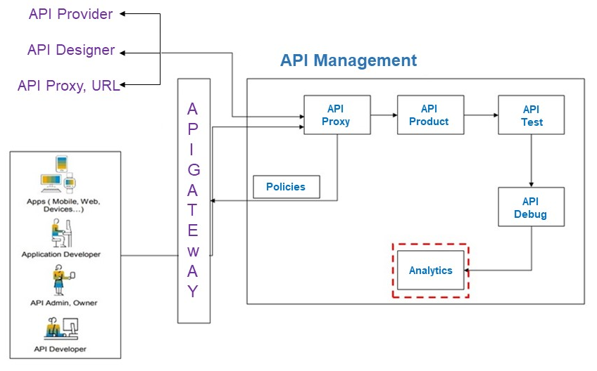
ANALYTICS
Notes:
API Management provides comprehensive analytics capabilities to understand the various patterns of API consumption and performance.
There are two variants of Analytics dashboard available for analyzing API reports in API Management:
API Analytics: The analytics dashboard provides a comprehensive view of analytical charts and KPIs relevant to the performance of the APIs.
Advanced API Analytics: Advanced API Analytics brings to you the all new analytics dashboard, providing powerful tools and in-depth reports for analyzing your API usage and performance.

Slide 19
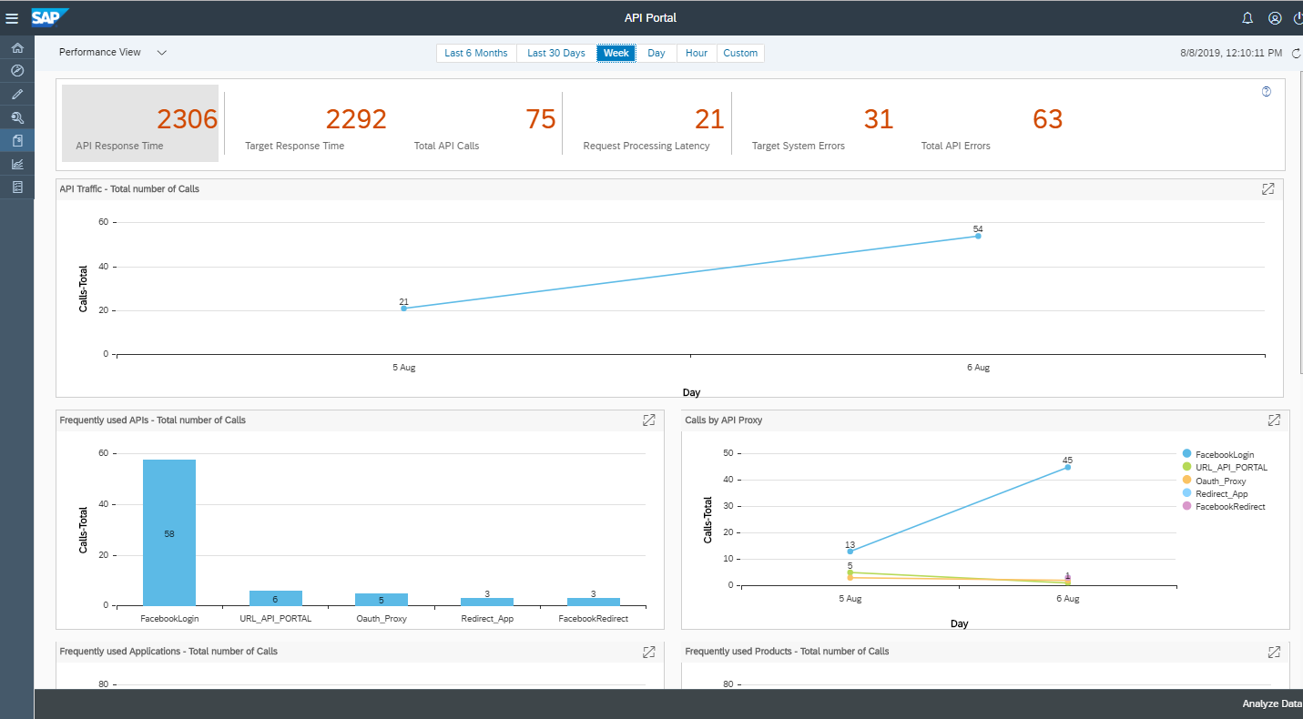
ANALYTICS CONSOLE
Notes:
The API Analytics server uses the runtime data of the APIs to analyze the information. The runtime data is gathered, analyzed, and displayed as charts, headers, and key performance indicators (KPIs).
The Analytics Dashboard has some common features such as the views you can choose, the time range for which you want to display data, resize charts, and so on. The following lists common features on the dashboard:
Views: The dashboard provides three views:
Performance View: Displays the performance-related charts and KPIs, such as API traffic for a specific period of time.
Error View: Displays error-related charts and KPIs, such as total number of API errors.
Custom View: Displays custom charts that you created by selecting measures, dimension, and chart type.
Time interval: Displays data only for the selected period of time. For example, time interval of months, weeks, and so on.
Resize charts: Resize charts from small, medium to large.

Slide 20
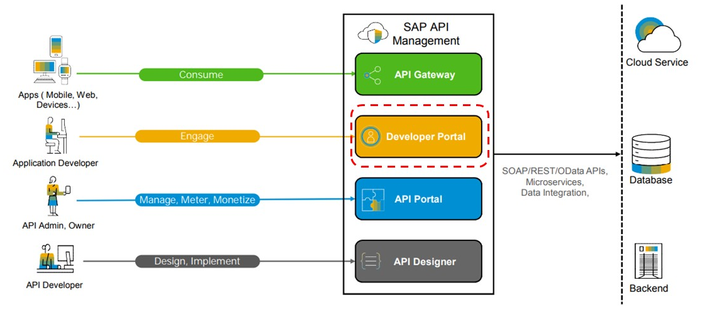
DEVELOPER PORTAL
Notes:
Developer portal offers capabilities to onboard application developers, explore and test APIs, create and subscribe to Applications.
An application that provides a common platform for Application developers to consume APIs.

Slide 21
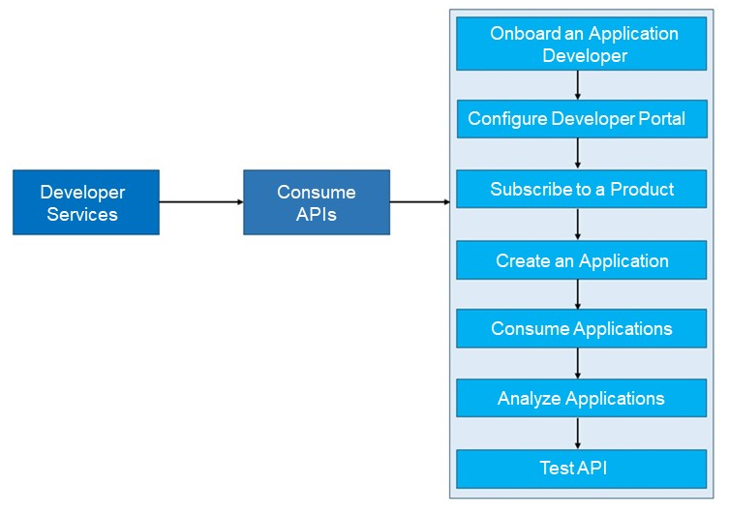
DEVELOPER FUNCTIONALITIES
Notes:
To access the Developer portal functionalities, the user has to be On boarded as application developer.
Then he/she has to configure the developer portal.
Products which are created in API Portal has to be consumed in Dev portal, for this the product has to be subscribed to an application.
Create a new application and consume that application for the API Key and Secrete.
These applications can be tested through the test console in Dev portal.

Slide 22
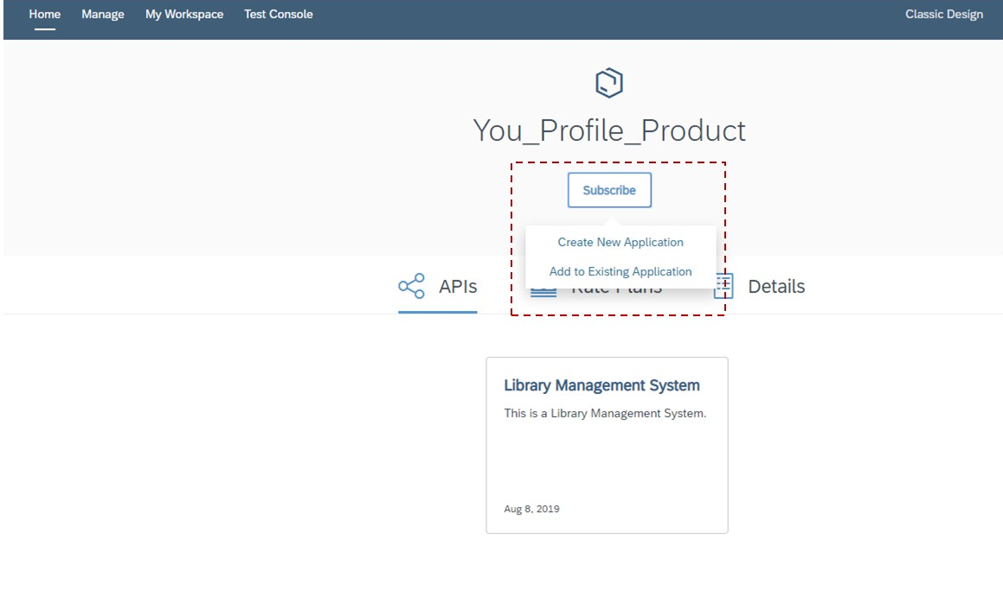
SUBSCRIBE A PRODUCT:
Notes:
To consume the APIs, an Application developer must subscribe to an Application.
It is by subscribing to an Application that you return to the developer the key required to access the APIs.

Slide 23
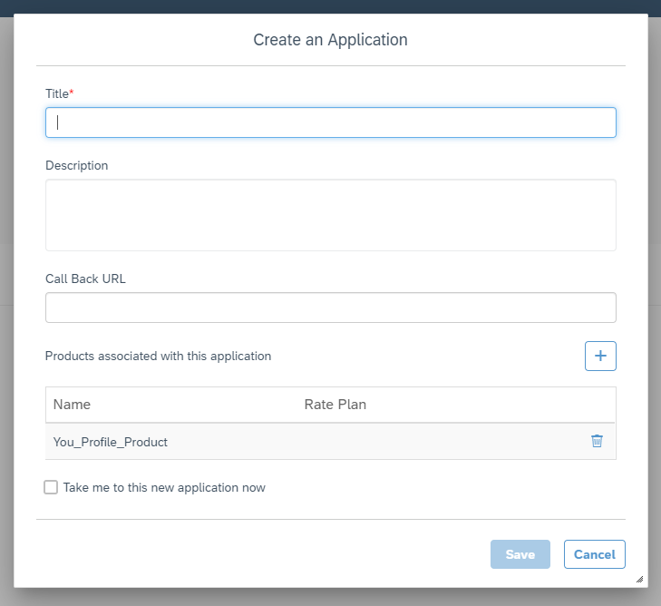
CREATE AN APPLICATION:
Notes:
Application is a discreet representation of the actual developer’s application. It provides the developer with an API key to pass-in with every request to the API.
An Application developer can create on or more applications to consume APIs.
On the API Product, you have the option to create a new subscription or add the product to an existing subscription. Having a subscription (application) is a prerequisite to consume the APIs productively.

Slide 24
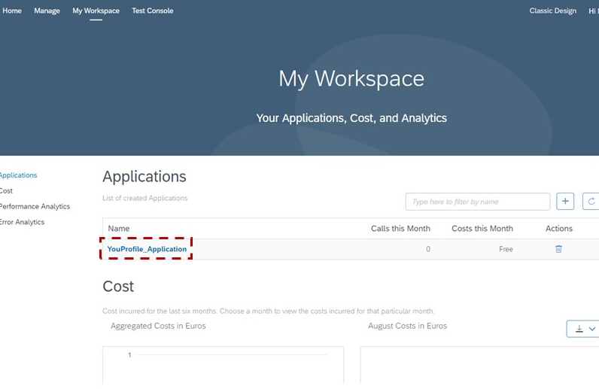
VIEW APPLICATION:
Notes:
There is ‘My Workspace’ where an application developers can see all the subscriptions (applications) and analytics for the APIs you have consumed.

Slide 25
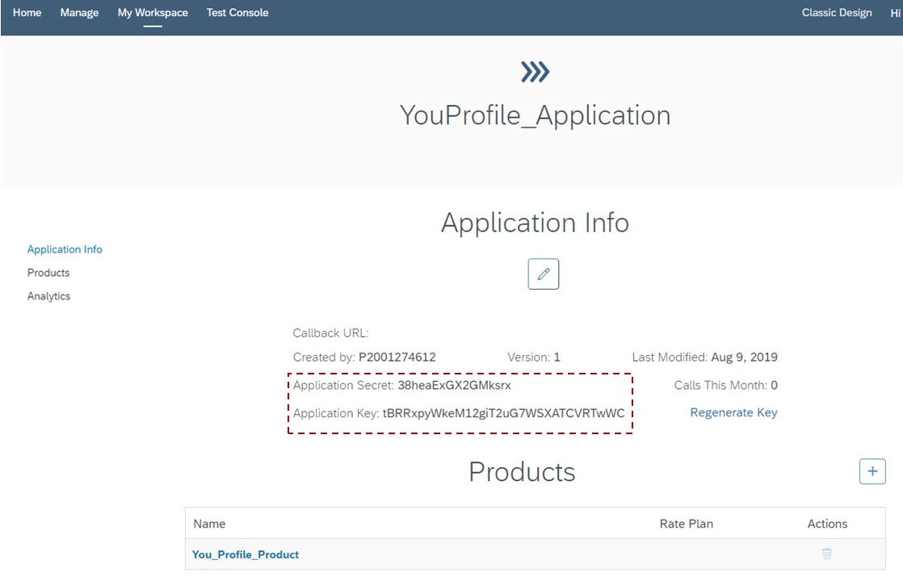
CONSUME APPLICATION:
Notes:
To consume ,Click on the applications which reveals the Application key & secret and allows you to regenerate the same.

Slide 26
SECURITY
SAP API Management supports the following security policies:
Spike Arrest
IP Whitelisting
Verify API Key
Basic Authentication
OAuth
Notes:
SAP API Management service provides few important security policies which are used to protect the API’s.
These policies can be implemented within SAP platform and also outside the SAP platform.

Slide 27
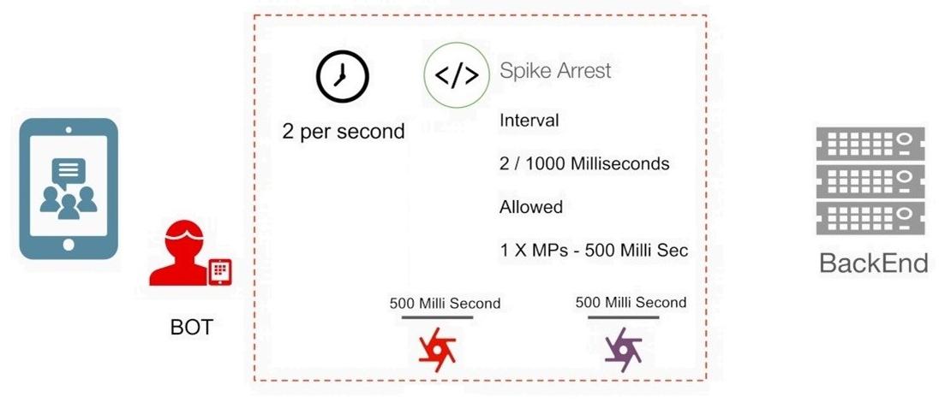
SPIKE ARREST:
The Spike Arrest policy protects against traffic spikes with the <Rate> element.
Notes:
Spike Arrest is described a way to generally protect against traffic spikes rather than a way to limit traffic to a specific number of requests. Your APIs and backend can handle a certain amount of traffic, and the Spike Arrest policy helps you smooth traffic to the general amounts you want.
To prevent spike-like behavior, Spike Arrest smooth’s the number of full requests allowed by dividing your settings into smaller intervals:

Slide 28
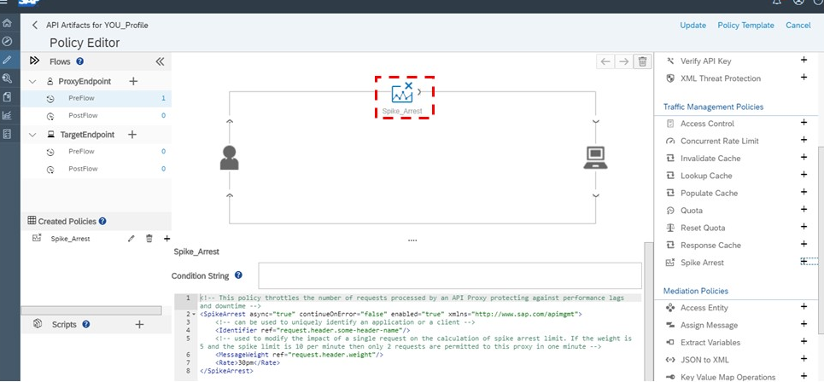
SPIKE ARREST FLOW
Notes:
Per-minute rates get smoothed into full requests allowed in intervals of seconds. For example, 30pm gets smoothed like this: 60 seconds (1 minute) / 30pm = 2-second intervals, or 1 request allowed every 2 seconds. A second request inside of 2 seconds will fail. Also, a 31st request within a minute will fail.
Per-second rates get smoothed into full requests allowed in intervals of milliseconds. For example, 10ps gets smoothed like this: 1000 milliseconds (1 second) / 10ps = 100-millisecond intervals, or 1 request allowed every 100 milliseconds. A second request inside of 100ms will fail. Also, an 11th request within a second will fail.

Slide 29
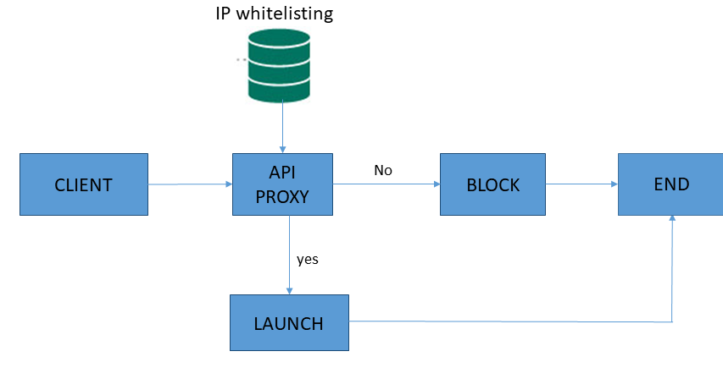
ACCESS CONTROL(IP WHITELISTING)
The IP Whitelist policy allows you to create an explicit list of IPs that can access your deployed endpoints. IP addresses that aren’t on this white list are rejected.
Notes:
Specify match rules for the two permitted actions (ALLOW or DENY).
Specify the IP address (Source Address element) for each match rule. Also, configure a mask for each IP address. You allow or deny access based on a mask value on the IP address.
Mention the order in which the rules are to be executed.

Slide 30
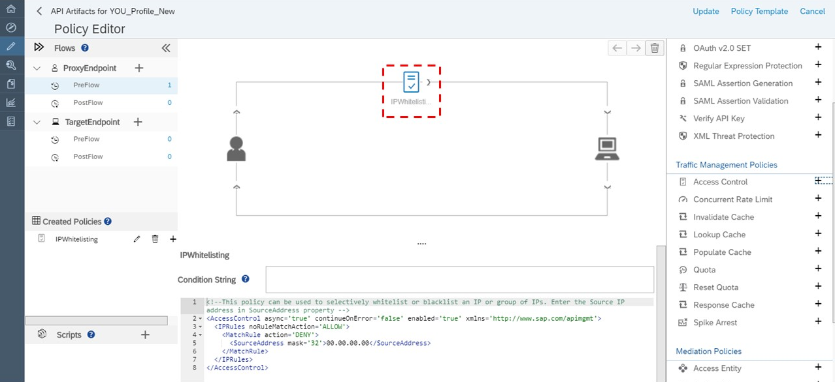
IP WHITELISTING FLOW
Notes:
The system executes the first matching rule in the defined order, and then subsequent matching rules are skipped. If the same rule is configured with both ALLOW and DENY actions, the rule that is defined first is executed and the subsequent rule is skipped.

Slide 31
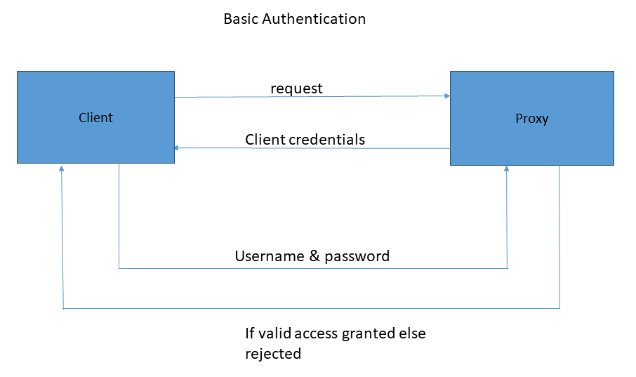
BASIC AUTHENTICATION
Basic Authentication policy takes a username and password, Base64 encodes them, and writes the resulting value to a variable.
Notes:
Basic authentication policy in SAP API Management system allows to protect the proxies. It validates the user credentials upon which grants access to user.
It can be applied pre-flow or post flow of the process. Here user sends a request to proxy and response to enter the client credentials. It validates the credentials and authorizes the user.

Slide 32
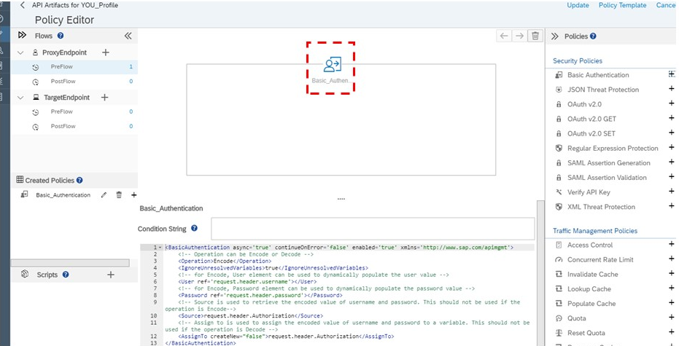
BASIC AUTHENTICATION
Notes:
This policy does not enforce Basic Authentication on a request to an API proxy. Instead, you use it to Base64 encode or decode credentials, typically when connecting to a backend server or using a service callout policy that requires Basic Authentication.
The username and password are commonly stored the key/value store and then read from the key/value store at runtime.
Provide the sap gateway login credentials applying the authentication and while logging into the API Proxy.

Slide 33
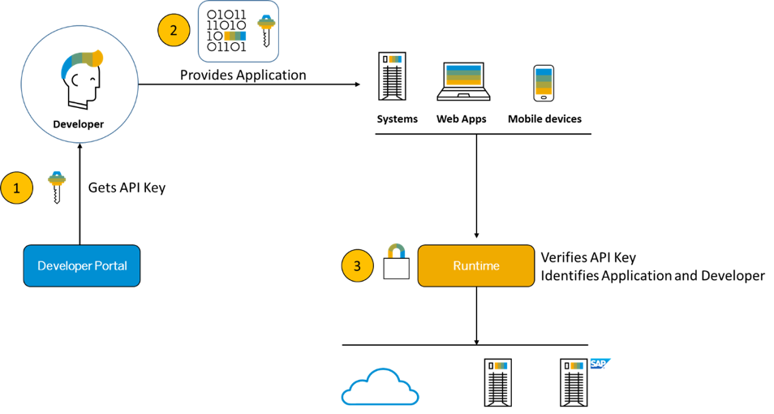
VERIFY API KEY
One of the mechanisms to prevent unauthorized access to APIs exposed over the internet is to use the verify API key policy.
Notes:
The policy will prevent unauthorized users from call the API, only users with valid app key will be able to access API
API Management automatically generates API keys on behalf of applications. It enables API providers to view and approve API keys. By applying a policy of the type Verify API Key, you can enforce verification of API keys at runtime. This ensures that no application can access a protected API without a valid key.
The only setting required for the Verify API Key is the expected location of the API key. This policy can be attached to request or response stream of the proxy endpoint or target endpoint

Slide 34
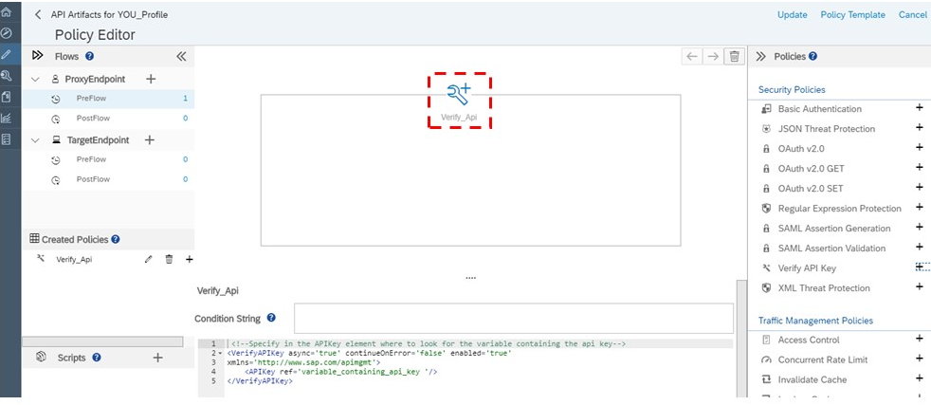
VERIFY API KEY FLOW
Notes:
After applying the Policy, consume the API Proxy by adding the API to a product.
The created product is appeared in the developer portal, which can consumed. After consuming collect the Application Key from the application.
Pass the App key in header to the API Proxy. This way we can access the API Proxy.

Slide 35
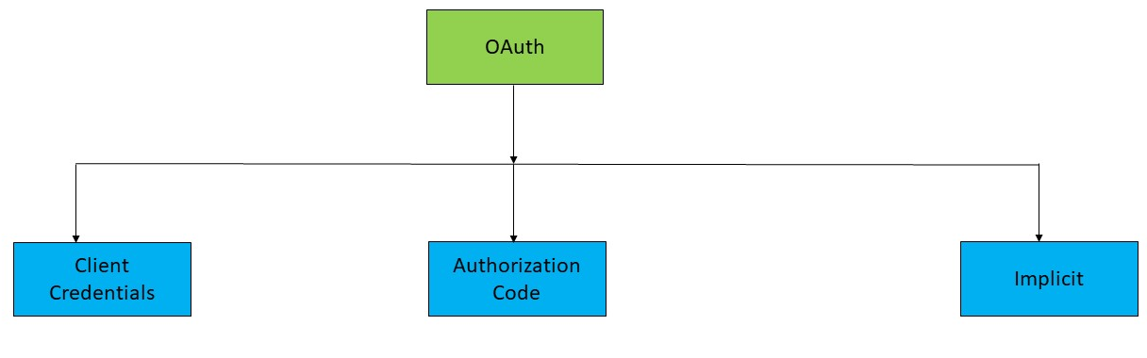
OAUTH 2.0
Notes:
OAuth is an open standard for access delegation, commonly used as a way for Internet users to grant websites or applications access to their information on other websites but without giving them the passwords.
SAP API Management platform supports 3 OAuth grant types. They are:
Client credentials
Authorization code
Implicit

Slide 36
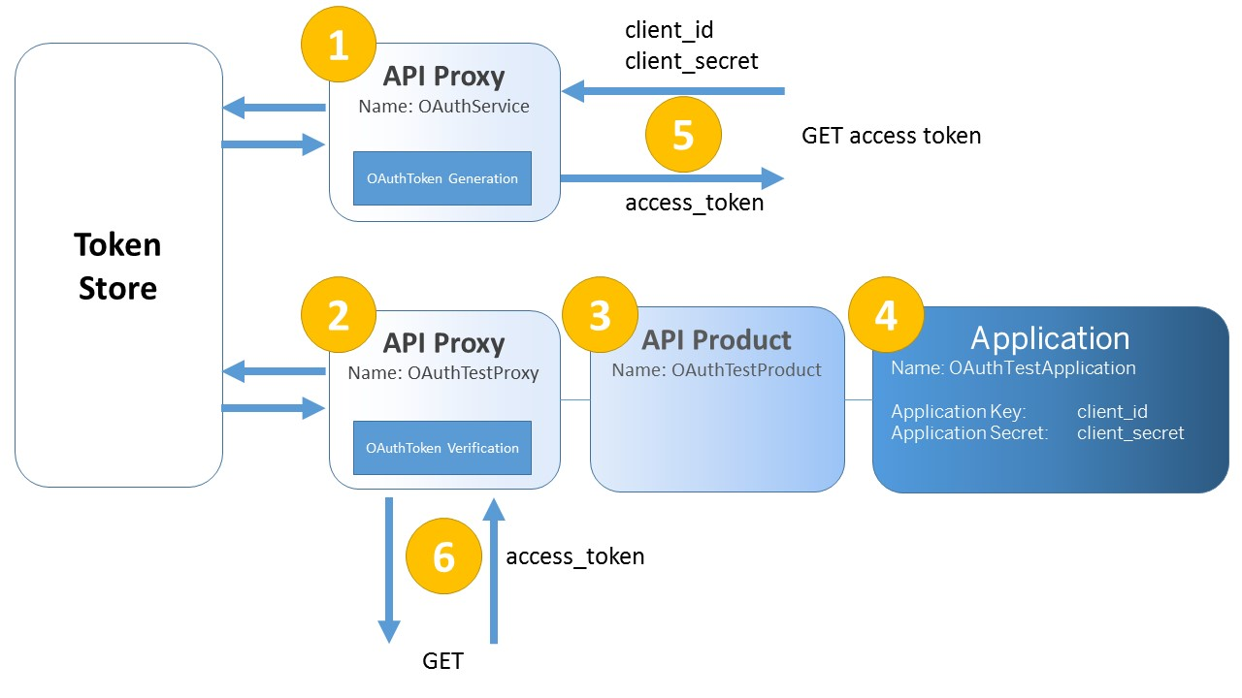
CLIENT CREDENTIALS
The Client Credentials grant type is used to gain the access token using the client credentials.
Notes:
Create an API Proxy that is a “token endpoint” (using the OAuth policy). This API will generate the access token for instance, but could also revoke or refresh tokens.
Create a second API proxy, to be the protected resource (using the OAuth policy).
Add the second API proxy to an API Product.
Create an application and add the API Product .This application has an application key and an application secret, corresponding to the client_id and client_secret required by OAuth to generate the token.
Now use token endpoint to get an access token, using the credentials of the application.
Use the access token to get access to the protected resource, the dummy API proxy.

Slide 37
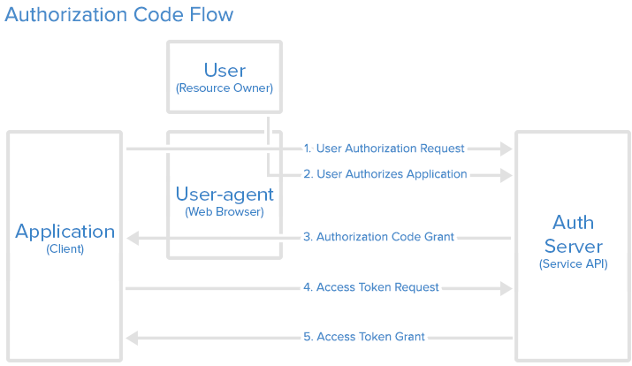
AUTHORIZATION CODE
The Authorization Code grant type is used by confidential and public clients to exchange an authorization code for an access token.
Notes:
Application requests authorization to access service resources from the user. If the user authorized the request, the application receives an authorization grant.
Application requests an access token from the authorization server (API) by presenting authentication of its own identity, and the authorization grant.
If the application identity is authenticated and the authorization grant is valid, the authorization server (API) issues an access token to the application. Authorization is complete.
The application requests the resource from the resource server (API) and presents the access token for authentication.
If the access token is valid, the resource server (API) serves the resource to the application.

Slide 38
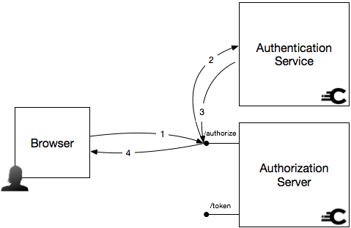
IMPLICIT GRANT TYPE
The Implicit flow is a less complicated flow than the code flow. It starts out in the same way as the code flow, with the client making an authorization request to the OAuth server.
Notes:
Implicit flow is made for public clients that cannot authenticate themselves. So the trust here instead lies in a parameter called redirect_URI. The OAuth server needs to have registered a URL for the client, where the response will be sent. The response will only be sent there, so if a malicious application fools a user into initiating a delegation process, the response will always go back to the real application.
Since this is for public clients, a Refresh Token won’t be issued. That means that new Access Tokens can only be received by involving the user.

Slide 39
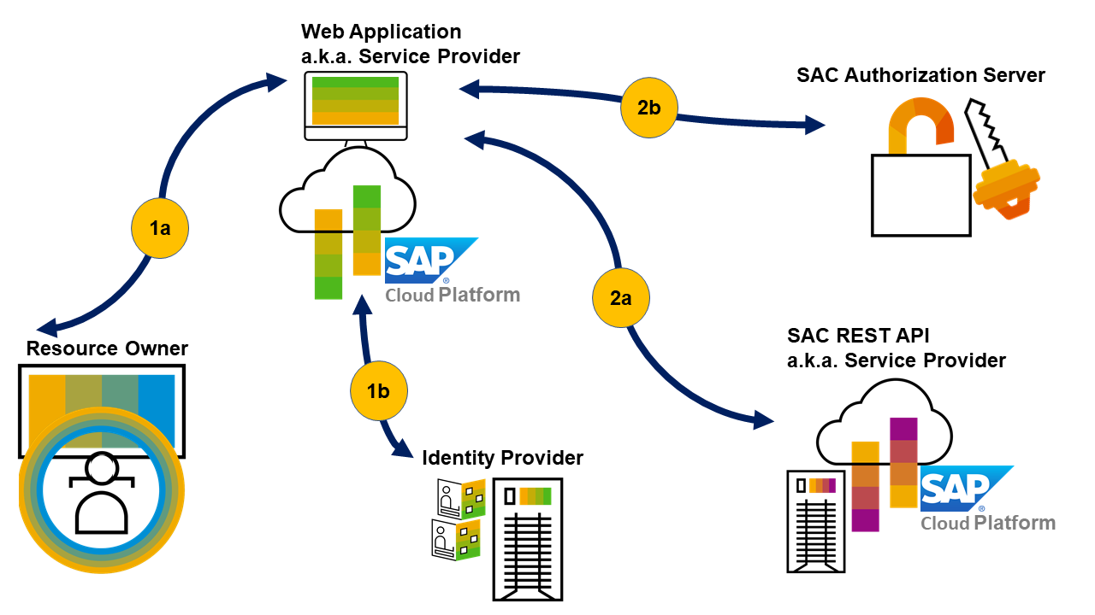
CUSTOM IDP
Notes:
By default SAP API Management has a default IDP which can be customized and different IDP’s can be added.
This is done using the security service of SAP API management. The trust tab in security holds this feature of customizing IDP.
This will be explained in detailed in the exercise document.

Slide 40
Click Here to refer the exercise……

