Slide 1
DATA ANALYTICS PROJECT
CUSTOMER DATA
ANALYSIS
Customer Behaviour | Revenue | Product Performance
Tools used: MySQL and Power BI
Prepared by: G. Sandhya

Slide 2
1. Project Overview
Purpose and business questions
• Analyse customer shopping patterns, product quantities, revenue, payment preferences, shopping mall performance, and time-based sales.
• Investigate how shopping distribution differs by gender and age group.
• Identify which product categories and shopping malls contribute most to the displayed sales measures.
• Build an interactive Power BI dashboard so the results can be explored using filters.

Slide 3
2. Dataset Overview
Istanbul shopping transaction dataset, 2021–2023
• Dataset contains 99,458 records and shopping activity from 10 malls.
• Fields used: invoice_no, customer_id, gender, age, category, quantity, price, payment_method, invoice_date, shopping_mall.
• The columns support customer segmentation, quantity analysis, revenue comparisons, payment-method analysis, mall comparisons, and date-based reporting.
• The dataset was imported for SQL analysis and Power BI reporting.

Slide 4
3. Data Quality Checks
Checks performed before analysing
• Checked the dataset for blank cells; the check found no blanks.
• Checked for duplicate records; no duplicates were found.
• Reviewed the column names and field meanings before building queries and visuals.
• Important validation: invoice_date was initially imported into Power BI as text. Confirm it is converted to a Date data type before relying on the time-series chart.

Slide 5
4. SQL Database & Analysis
MySQL was used for database work
• Connected to the provided project database using the supplied connection details.
• Worked with the customer table in the project schema; the Power BI imported table was named customer_data.
• Used SQL aggregations and grouping to analyse customer distribution, quantities sold, revenue, age groups, product categories, shopping malls, and payment methods.
• SQL was used to answer the business questions and support the reporting workflow.
• Do not include database passwords, private host details, or other credentials in a public portfolio.

Slide 6
5. Power BI Dashboard Design
How the final report was organised
• Imported the analysis data into Power BI and created ten visuals across the analysis pages.
• Built a final dashboard page with a deep-blue/purple header and KPI cards.
• Added Gender and Shopping Mall slicers to interactively filter the report.
• Used a consistent colour theme and arranged the charts in a grid for quick comparison.
• The screenshot pages that follow show the actual dashboard you provided.

Slide 7
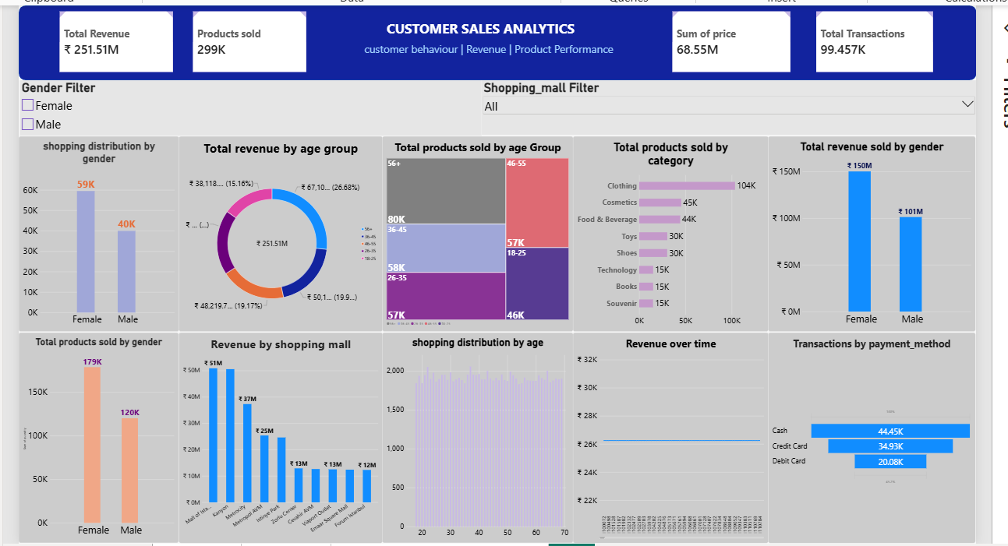
6. Actual Dashboard — Full View
Screenshot supplied from your Power BI report

Slide 8
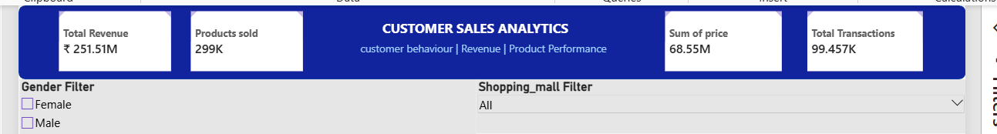
7. Dashboard Screenshot — KPIs & Filters
Actual screenshot crop: headline indicators and slicers
KPIs shown: Total Revenue ₹251.51M • Products sold 299K • Sum of price 68.55M • Total Transactions 99.457K
Filters: Gender (Female / Male) and Shopping Mall.

Slide 9
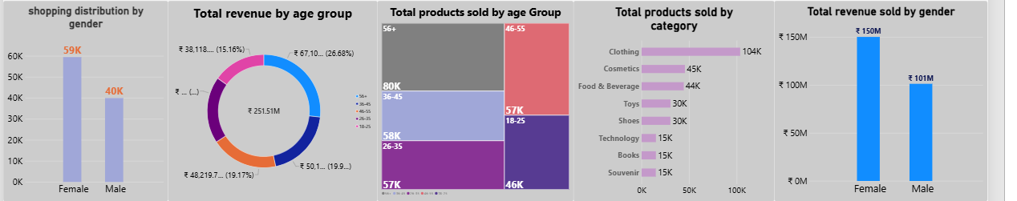
8. Dashboard Screenshot — Customer & Product Charts
Actual screenshot crop: first row of charts
Charts include shopping distribution by gender, revenue by age group, products sold by age group, products sold by category, and revenue by gender.

Slide 10
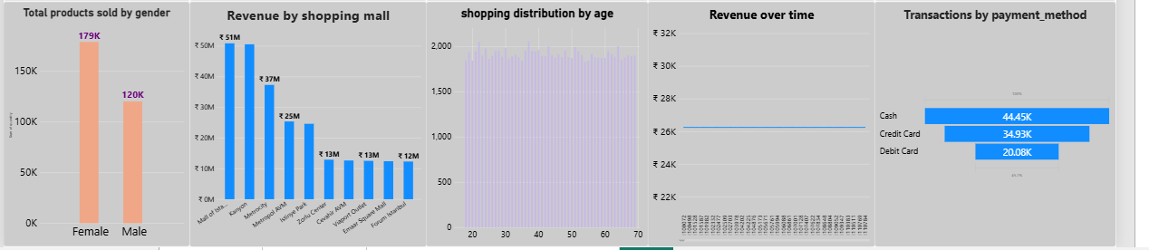
9. Dashboard Screenshot — Mall, Age, Time & Payment Charts
Actual screenshot crop: second row of charts
Charts include products sold by gender, revenue by shopping mall, shopping distribution by age, revenue over time, and transactions by payment method.

Slide 11
10. Ten Visualisations in the Report
What each chart is intended to show
• Shopping distribution by gender — compares Female and Male shopping counts.
• Total revenue by age group — compares revenue across age bands.
• Total products sold by age group — compares quantity across age bands.
• Total products sold by category — compares product-category quantities.
• Total revenue by gender — compares revenue between genders.
• Total products sold by gender — compares quantity between genders.
• Revenue by shopping mall — compares revenue across malls.
• Shopping distribution by age — shows shopping counts by age.
• Revenue over time — examines revenue by date/time period.
• Transactions by payment method — compares Cash, Credit Card, and Debit Card.

Slide 12
11. Findings Visible in the Dashboard
Descriptive observations from the screenshot
• Shopping distribution is about 59K for Female customers and 40K for Male customers.
• Products sold are about 179K for Female customers and 120K for Male customers.
• Revenue by gender is displayed at approximately ₹150M for Female customers and ₹101M for Male customers.
• Clothing is the largest category in the quantity chart at about 104K, followed by Cosmetics (about 45K) and Food & Beverage (about 44K).
• Cash is the most common payment method shown (about 44.45K transactions), followed by Credit Card (34.93K) and Debit Card (20.08K).
• The largest age-group quantity block shown is 56+ at about 80K; verify age-group definitions before presenting this as a final conclusion.

Slide 13
12. Additional Observations & Validation
Checks needed before drawing firm conclusions
• The leading mall bar is approximately ₹51M; the next displayed bars are around ₹50M and ₹37M.
• Revenue over time looks nearly flat around ₹26K in the screenshot. Validate the date field, aggregation, and chart granularity.
• The Total Revenue KPI (₹251.51M) differs from Sum of price (68.55M). Confirm the exact measure definitions before explaining the difference.
• The transaction KPI displays 99.457K while the dataset has 99,458 rows; this may be a display-rounding/measure issue to verify.
• These are descriptive patterns in this dataset, not proof of what caused customer behaviour.

Slide 14
13. Recommendations
Possible actions supported by the analysis
• Use the slicers to compare genders and shopping malls before making segment-specific decisions.
• Review Clothing demand and inventory availability because Clothing leads the displayed quantity chart.
• Ensure cash, credit-card, and debit-card payment options remain available; cash has the highest count in the chart.
• Compare mall revenue with footfall, store size, promotions, and operating costs before recommending investment changes.
• Improve chart label readability and validate the time-series measure before presenting final business conclusions.

Slide 15
14. Conclusion
Project outcome and skills demonstrated
• Combined MySQL analysis and Power BI visualisation into a retail customer-sales analysis project.
• Created an interactive dashboard covering customer segments, product categories, payment methods, shopping malls, and time-based reporting.
• Practised data-quality checking, SQL aggregation, visual design, KPI reporting, and communicating business observations.
• Before submission, validate the revenue measures and date-based chart, then save the PPT and dashboard files together.

Slide 16
15. SQL Query Logic — Gender & Product Quantity
Examples of the aggregation logic used in the analysis
Example: compare quantity sold by gender
How to explain it
SELECT gender, SUM(quantity) AS products_sold
FROM customer
GROUP BY gender
ORDER BY products_sold DESC;
SUM(quantity) adds the quantity values for each gender. GROUP BY creates one result per gender. The output can be compared with the Power BI “Products sold by gender” chart.
This is a representative query pattern. Use your saved SQL script if you need to show the exact query submitted.

Slide 17
16. SQL Query Logic — Category & Mall
Group by category or mall to compare product demand and revenue
Category quantity pattern
Mall revenue pattern
SELECT category, SUM(quantity) AS products_sold
FROM customer
GROUP BY category
ORDER BY products_sold DESC;
SELECT shopping_mall, SUM(price) AS sum_price
FROM customer
GROUP BY shopping_mall
ORDER BY sum_price DESC;
Measure note: if revenue is defined as quantity × price, use that validated measure instead of SUM(price). These examples illustrate query structure, not necessarily the exact saved SQL text.

Slide 18
17. SQL Query Logic — Payment Method
Recorded query used to count transactions by payment method
What it does
SELECT payment_method, COUNT(*) AS total_transactions
FROM customer
GROUP BY payment_method
ORDER BY total_transactions DESC;
Counts records for each payment method, then sorts from highest count to lowest. It supports the “Transactions by payment method” chart.
Displayed result: Cash is highest, followed by Credit Card and Debit Card.

Slide 19
18. Every Power BI Visual — Explanation 1
Customer, age and category visuals
1. Shopping distribution by gender
Compares shopping/transaction counts for Female and Male customers.
2. Total revenue by age group
Compares the displayed revenue measure across age bands.
3. Products sold by age group
Treemap size represents product quantity by age group.
4. Products sold by category
Shows which categories account for more units; Clothing is the largest shown.
5. Total revenue by gender
Compares the displayed revenue measure between gender groups.

Slide 20
19. Every Power BI Visual — Explanation 2
Gender quantity, mall revenue, age distribution, trend and payment
6. Products sold by gender
Compares the total quantity for Female and Male customers.
7. Revenue by shopping mall
Compares the revenue measure across the ten shopping malls.
8. Shopping distribution by age
Shows how shopping counts vary by age.
9. Revenue over time
Intended to show changes over time; the date type and axis need validation.
10. Transactions by payment method
Compares Cash, Credit Card and Debit Card transaction counts.

Slide 21
20. How to Present the Dashboard
A simple speaking guide for explaining the report
• Start with the four KPI cards to describe the overall scale shown in the report.
• Explain that Gender and Shopping Mall are slicers; changing them filters the visuals.
• Move from customer comparisons to product-category demand, then payment method and mall revenue.
• Use the screenshot observations as approximate values unless you have validated the exact underlying measures.
• Finish by mentioning the date and revenue-measure validation checks so the audience understands the limitations.

Slide 22
21. Findings — Detailed Interpretation
What the visible charts suggest
• Female customers appear higher than male customers in shopping counts, product quantity and the displayed revenue measure.
• Clothing is the largest product category by quantity in the screenshot; Cosmetics and Food & Beverage follow.
• Cash has the highest transaction count in the payment-method visual, followed by credit and debit cards.
• Revenue differs across malls; the top bars appear near ₹51M and ₹50M in the screenshot.
• The age-group visuals show variation, but the exact age bands and measure definitions should be confirmed before stating a firm ranking.

Slide 23
22. KPI Definitions & Final Validation
Checks to make before presenting the dashboard as final
• Total Revenue is shown as ₹251.51M; Sum of price is shown as 68.55M. Confirm how each measure is calculated.
• Products sold is shown as 299K. Confirm that the measure sums quantity, rather than counting rows.
• Total Transactions is displayed as 99.457K, while the dataset has 99,458 rows. Check the count measure and display rounding.
• Convert invoice_date from text to Date/DateTime and verify the revenue-over-time chart uses a useful date granularity.
• Check the age-group boundaries, axis labels, currency units and any truncated labels.

Slide 24
23. Recommendations & Limitations
Responsible use of the analysis
• Review Clothing inventory and availability because it leads the quantity chart.
• Continue supporting all three payment methods; the observed payment distribution alone does not explain customer preference.
• Use slicers to compare genders and malls, then validate findings against additional business data before taking action.
• Compare mall revenue with footfall, store size, promotions and operating costs before recommending resource allocation.
• The project is descriptive: it shows patterns in this dataset but cannot prove causation or explain customer motivation.

Slide 25
24. Final Project Summary
The end-to-end work completed
DATASET
SQL
POWER BI
99,458 rows • 10 malls • 2021–2023
MySQL schema project_customer_segmentation; table customer; aggregation and grouping across business questions.
10 visuals, KPI cards, Gender and Shopping Mall slicers, and multiple report pages.
Outcome
The project combines SQL-based analysis and Power BI visualisation to compare customer behaviour, product demand, payment choices, mall revenue and time-based reporting.

Slide 26
THANK YOU
Customer Data Analysis | MySQL + Power BI
Questions & Discussion

