Slide 1

Travel Website
Presented By:
Vandana Gurram
Sandhya Allu

Slide 2
Presented By:
Vandana Gurram
Sandhya Allu

Slide 3
Description
A travel website is a website that provides travel reviews, trip fares, or a combination of both. Over 1.5 billion people book travel per year, 70% of which is done online.
People travel for short-term to other places from their normal place of residence and during these temporary visits consume goods and services like transportation, accommodation, etc., and the entire process is known as tourism.
The tourism industry revolves around providing enjoyment and pleasurable experiences.

Slide 4

Problem Statement:
It's hard to find the best places to travel and good transport facility with reasonable cost .This app provides very good transport facility .
It makes easy for you to find the best places and travel across the world with your friends and family.

Slide 5


Slide 6
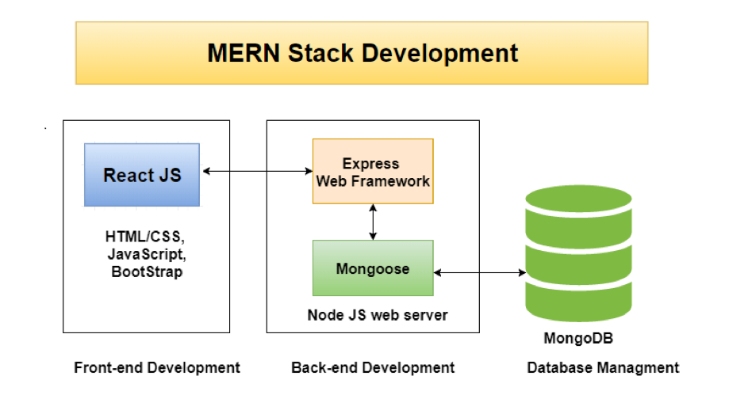

Slide 7
Software Requirements
Windows –10
Languages : MEAN & MERN
Front end : HTML , CSS , BOOTSTRAP , Angular
Back end : Node JS
Database : MySQL
Web Server : Localhost

Slide 8
Hardware Requirements:
Processor : Core i3
SSD : 236GB
Memory :12GB RAM
Screen

Slide 9
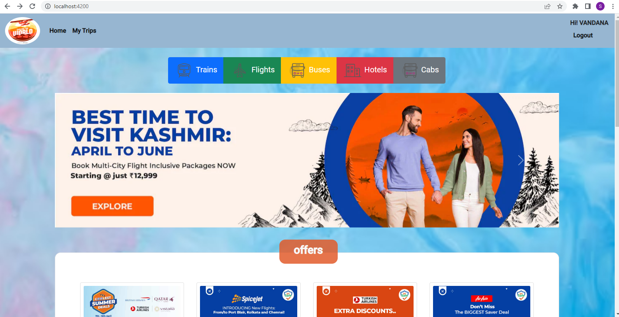

Slide 10
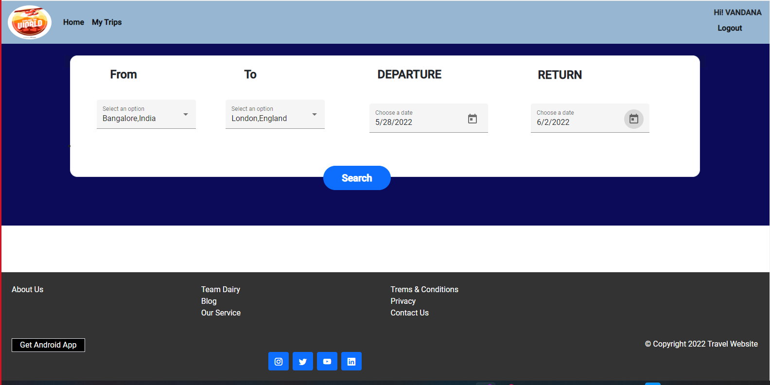

Slide 11
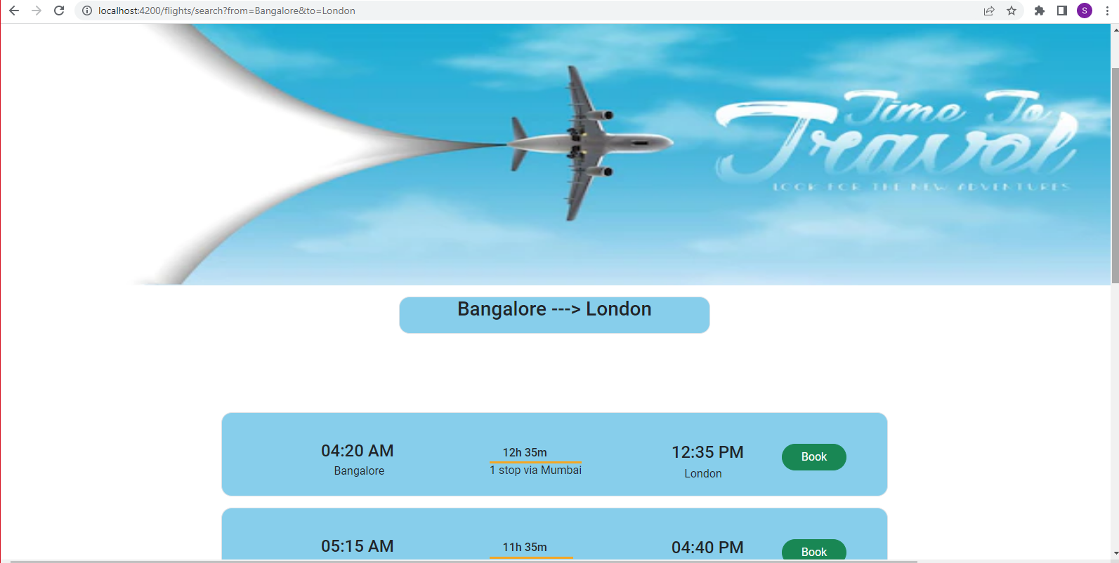

Slide 12
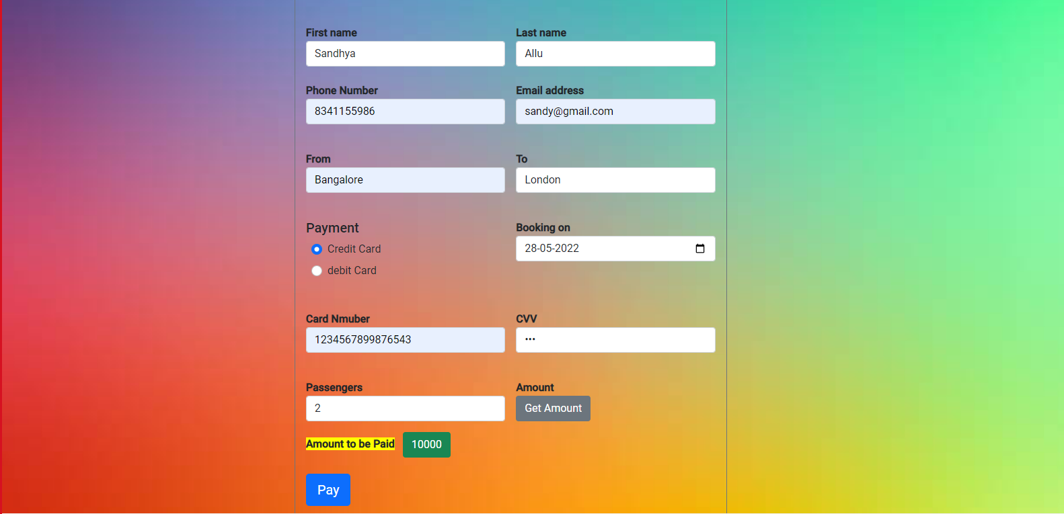

Slide 13
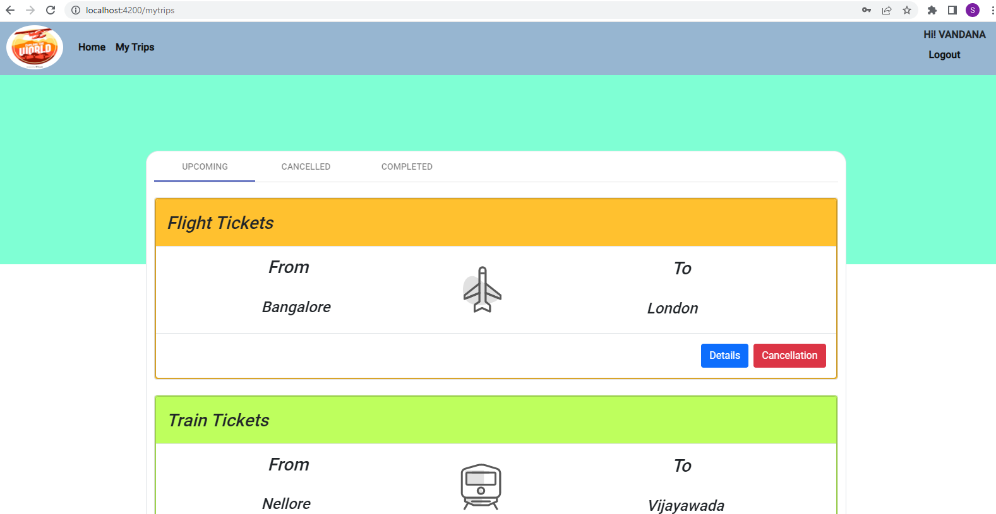

Slide 14

Thank You

