Slide 1


Achanta Lakshmi Sandhya
Final Project

Slide 2
KEYLOGGER AND SECURITY
A keylogger is a type of surveillance technology used to monitor and record each keystroke typed on a specific computer's keyboard. This can include passwords, emails, chat messages, and any other typed information. Keyloggers can be used for various purposes, ranging from legitimate to malicious.
The use of keyloggers is heavily regulated and can be illegal if used without consent. In many jurisdictions, installing a keylogger without the knowledge and consent of the person being monitored is considered an invasion of privacy and is subject to legal penalties. It's essential to understand and comply with local laws regarding surveillance and data privacy when considering the use of keyloggers.

Slide 3


AGENDA
Introduction to Keyloggers and Security
Understanding the Problem Statement
Overview of the Project
Identifying the End Users
Introducing Your Solution
Highlighting the unique value proposition
Discussing the key Modelling Approaches
Presenting Results And Findings
3/21/2024 Annual Review

Slide 4

PROBLEM STATEMENT
Develop a robust and secure keylogger software that effectively logs keystrokes on a target system while implementing strong encryption and access controls to prevent unauthorized access to the logged data, ensuring privacy and data integrity.
3/21/2024 Annual Review

Slide 5

PROJECT OVERVIEW
Brief Description of the Project's Scope and Objectives
Overview of Keylogger Detection and Prevention Strategies
Importance of Developing Effective Solutions in the Cybersecurity Landscape

Slide 6

WHO ARE THE END USERS?
Organizations and IT Administrators
Security Professionals
IT Administrators
Parents and Guardians
Individual Users

Slide 7

SOLUTION AND ITS VALUE PROPOSITION
1.Enhanced Security Awareness:
Understanding Threats: Educate users and organizations about the potential risks posed by keyloggers.
Proactive Measures: Equip stakeholders with knowledge to detect and prevent keylogging attacks.
2. Comprehensive Protection Strategies:
Safeguarding Sensitive Information: Highlight methods to protect personal and organizational data from keylogging threats.
Robust Countermeasures: Provide effective solutions to mitigate the impact of keylogging, including software updates, antivirus solutions, and behavioral monitoring.
3. Data Privacy Assurance:
Compliance with Regulations: Ensure adherence to data protection regulations and standards to avoid legal and financial repercussions.

Slide 8
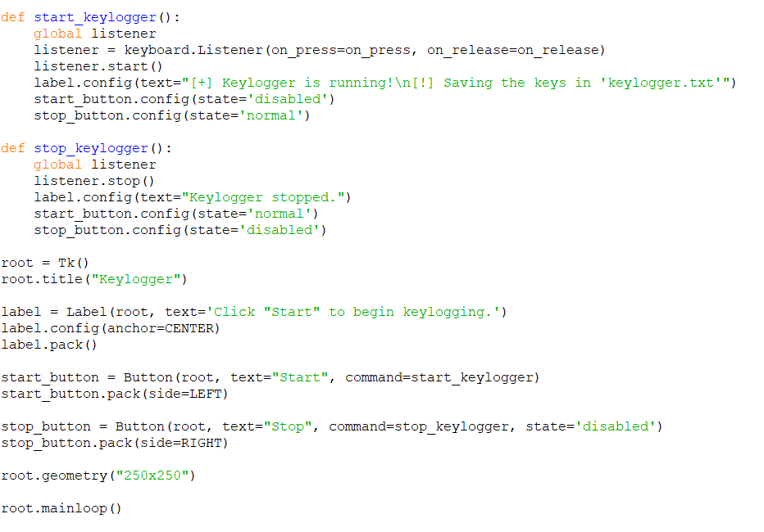

Slide 9

THE WOW IN YOUR SOLUTION
Real-time Security Monitoring: Implementing real-time monitoring of website traffic and user interactions to detect suspicious behavior or potential security threats, such as SQL injection attempts or XSS (Cross-Site Scripting) attacks.
Two-Factor Authentication : Implement two-step verification to add an extra layer of security beyond passwords, thwarting keyloggers from compromising your accounts
Biometric Authentication : Enhance security with biometric authentication methods
Client-side Security Measures: Deploying client-side security measures, such as script monitoring and integrity checks, to detect and prevent unauthorized modifications to website scripts or injected malicious code.
.
3/21/2024 Annual Review
9

Slide 10
MODELLING
Install required python libraries in command prompt like,
1. pip install pynput
2. pip install json
Initialization of Keylogger Set up the main GUI window and initialize the global variables for key logging.
Capturing of keystrokes Start capturing key events when the ‘Start’ button is pressed. Log key press and release events.
Data Logging into text files Update text and Json log files with captured key events.
Stop Logging Stop capturing key events when the ‘Stop’ button is pressed.
10

Slide 11
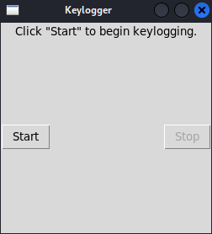
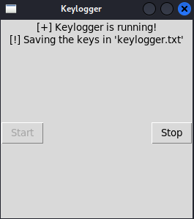
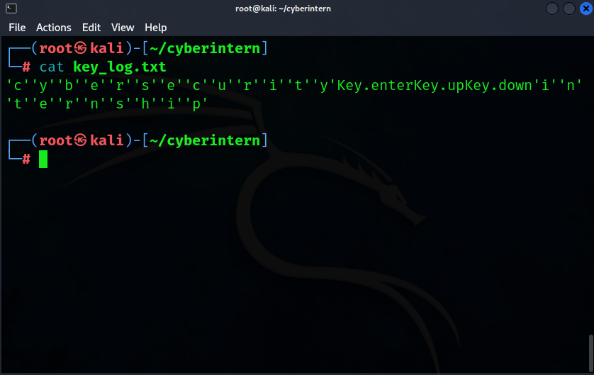
RESULTS
11

Slide 12
Output Explanation
When we click on the start button the keylogger will start.
Then you can type on your keyboard.
Whatever you type on your keyboard will be saved or recorded in a text file which is located in your project directory.

Slide 13
GitHub Link
https://github.com/sandhya547/KeyLogger.git

Slide 14


