Slide 1
Migrating & Integrating Java Applications in IBM Bluemix
ECOD

Slide 2




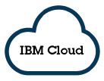




Tomcat ->WAS Liberty ->Liberty in Bluemix
TTTTT
WCMT
WAMT
On-Premises
On-Premises
SQL Database
2
Notes:
The Tomcat application, RedbookLibrary is running on-premises using Derby database. We migrate Tomcat server configuration and application configuration to WebSphere Liberty
(a) Migrate Tomcat Server Configuration
Next , we run the WAMT on the application running in WAS Liberty to determine if the application can be migrated to Liberty runtime in Bluemix.

Slide 3
Further Discussions :
Migration from Competitive AppServers
WebLogic
JBoss
Migration from WebSphere Network Deployment Topologies
Liberty Runtime,
IBM Containers,
Application Server hosted in Cloud
OpenStack VMs
Connect to On-premises resources
Use SecureGateway
Notes:
Migration from Competitive AppServers
WebLogic
JBoss
Migration from WebSphere Network Deployment Topology
Options : Liberty Runtime
IBM Containers
Application Server hosted in Cloud (on Pure Application Systems

Slide 4
Further Discussions (cont.) :
Connect to On-premises resources
Connect and Compose
Secure Gateway
Extend your Applications
API Management
Cleanse Application Data
DataWorks

Slide 5

Integration: Connecting Bluemix Apps to Existing Resources
Cloud
+
Enterprise
Hybrid IT

Slide 6
Examples of Integration Points
Connect a Bluemix application with a
1. On-premise database
2. System of record that has a RESTful API,
especially non-public API
3. On-premise WebSphere MQ messaging system
4. On-premise LDAP identity provider

Slide 7
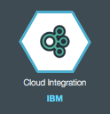
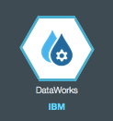
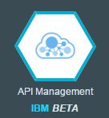


IBM Hybrid Integration Services
Enabling two speed IT by integrating Systems of Engagement, Insight, and Record
Secure Gateway
Securely connect and manage access to data and applications in other clouds, enterprise data centers and locally on developer laptops. Flexible gateway topology
API Management
Publish, promote, and oversee APIs in a scalable environment. Discover on-premise APIs and define new ones. Socialize to community and publish to partner Bluemix orgs.
Secure Gateway
API Management
DataWorks
Visual refine data and robustly move data to cloud targets. Data refine services include: Shaping data, load, profile, classify, address cleansing, provision masked data,
DataWorks

Slide 8

Secure Gateway
Secure
Gateway

Slide 9
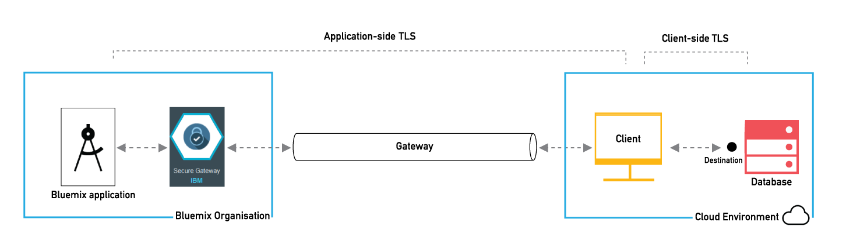
Overview
Secure Gateway service provides a secure way to access on-premises or cloud data from your Bluemix application through a secure passage (Gateway)
Data is typically accessed from a System of Record (SoR), such as an application or database

Slide 10
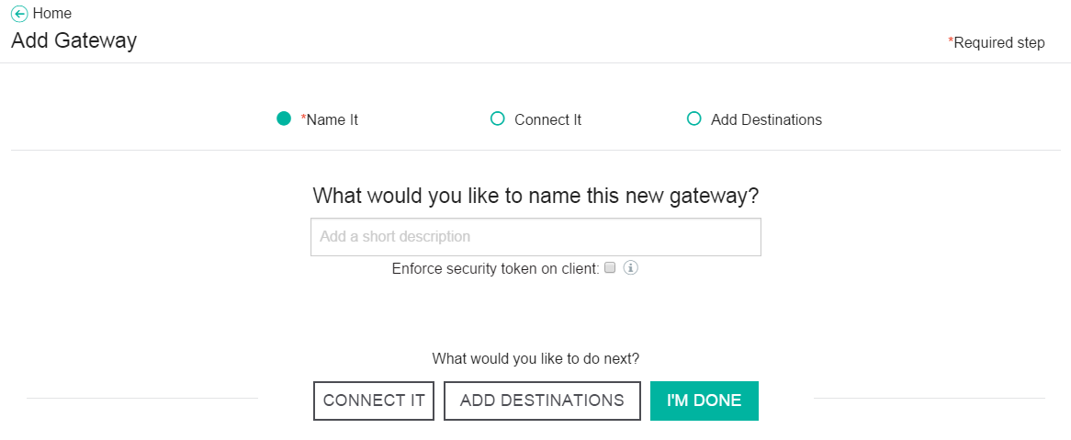
Gateway
Contains the configuration information for establishing a tunnel between the Secure Gateway client running in your environment and Bluemix
To enforce increased security over who is able to start a gateway, an optional security token can be provided when they connect the Secure Gateway client

Slide 11
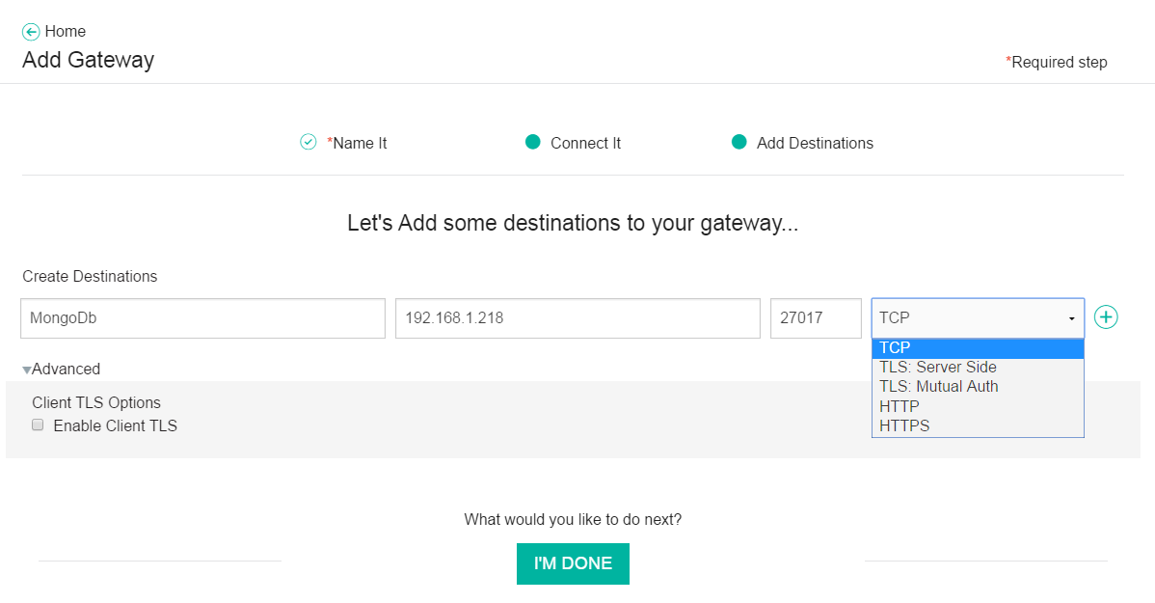
Destinations
Specifies how to connect to the system resource
One per system resource (system of record, database of record, etc.)
Consists of a short description, an IP address or hostname, a port, and any options

Slide 12
Security
Each destination can optionally use Transport Layer Security (TLS) protocol
Application-side TLS
Secures access between the Bluemix app and the cloud environment client
Client-side TLS
Secures access between the cloud environment client and the destination
The two can be set independently

Slide 13
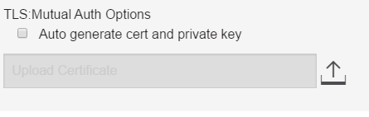
Application-side Security
TCP
No TLS – No certificates, no encryption
No authentication is provided
Bluemix application communicates directly to the gateway
TLS Server Side
TLS is enabled
Secure gateway will generate a certificate to prove its authority
You need to accept the server certificate into your Bluemix application truststore
TLS Mutual Auth
Option 1: Auto-generate certificate and private key
Option 2: Upload existing keys to the gateway
HTTP
HTTPS

Slide 14
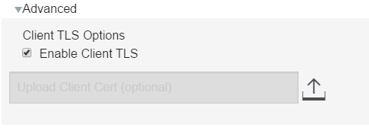
Client-side Security
Required for users connecting to a HTTPS backend
Destination's certificate is verified against known certificate authorities
If the certificate (PEM) is self signed, it must be attached to the cloud environment client
Attaching the certificate
Can be done during the creation/edit of the destination
Via rest call
curl -k --request PUT https://sgmanager.ng.bluemix.net/v1/sgconfig/<gateway_id>/destinations/<destination_id>/cert -F "client_cert=@./mongodb.pem" -H "Authorization: Bearer <security_token>

Slide 15
Cloud Environment Client
A process that runs in the on-premises or cloud side of the gateway
Has network visibility to the Bluemix application and to the destination(s)
Multiple destination(s) may need multiple clients
Initiates connection with the gateway in Bluemix
Forwards requests from the gateway to the destinations

Slide 16
Additional Resources
Bluemix Docs: Secure Gateway
https://www.ng.bluemix.net/docs/services/SecureGateway/index.html
Bluemix Secure Gateway: Yes, you CAN get there from here!
https://developer.ibm.com/bluemix/2015/03/27/bluemix-secure-gateway-yes-can-get/
Securing Destinations with TLS in Bluemix Secure Gateway
https://developer.ibm.com/bluemix/2015/04/17/securing-destinations-tls-bluemix-secure-gateway/
Actionable Architecture: Secure Hybrid Data Warehouse on Bluemix (Big Data Workshop 1)
https://developer.ibm.com/bluemix/docs/actionable-architecture-secure-hybrid-data-warehouse-bluemix-big-data-workshop-1/

Slide 17
Scenario: Connect to a remote database
Customer has a DB2 database
IP address: 192.168.10.20
Port: 50000
Create a gateway with a destination for the database
Name: Customer database
IP address: 192.168.10.20
Port: 50000
TLS: TCP
Gateway will have a destination
Destination ID: nklKrI9JxZM_4xV
Cloud Host : Port: cap-sg-prd-1.integration.ibmcloud.com:15000
Destination Host : Port: 192.168.10.20:50000
Application connects to
cap-sg-prd-1.integration.ibmcloud.com:15000

Slide 18
Scenario: Connect to a remote web services provider
ACME Corp’s Ordering application has a RESTful API
Hostname: http://restgateway.acme.com/ordering/api
Port: 8399
Create a gateway with a destination for the database
Name: ACME Order API
IP address: restgateway.acme.com
Port: 8399
TLS: TCP
Gateway will have a destination
Destination ID: c7BRcEQd3eB_hmy
Cloud Host : Port: cap-sg-prd-1.integration.ibmcloud.com:15999
Destination Host : Port: restgateway.acme.com:8399
Application connects to
cap-sg-prd-1.integration.ibmcloud.com:15999

Slide 19
Scenario: Connect to a remote IBM MQ
Data center has a running IBM MQ backbone
Formerly known as WebSphere MQ
How can a Bluemix application connect to MQ in the data center?
We first need to understand MQ Light

Slide 20

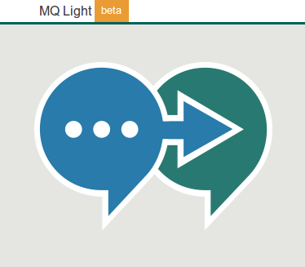


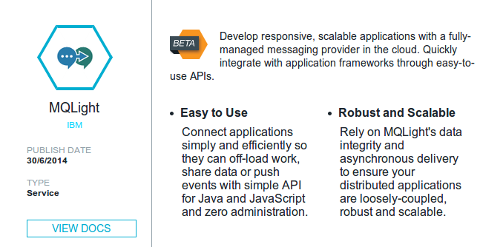
MQ Light: Software and Cloud
Messaging that application developers will love to use, helping them make responsive applications that scale easily
Available as software download or full cloud service in Bluemix
Trivial to acquire and get started : just download, unzip and start coding
Open APIs crafted to feel natural in a range of popular languages
Tooling that makes app development easy

Slide 21
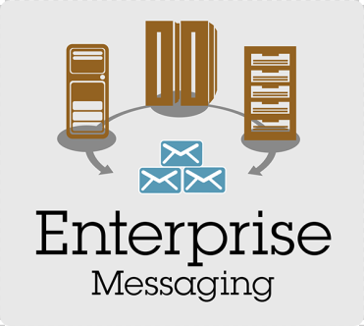
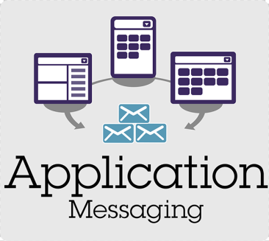
IBM Messaging Portfolio
IBM MQ
Formerly known as WebSphere MQ
Enterprise messaging backbone
Supports JavaMessaging System (JMS) API
JMS is part of Java EE
MQ Light
Its own messaging system
Application messaging
MQ Light API: A new RESTful API
Not JMS, but supports the same send/receive tasks
MQ Light service in Bluemix
MQ Light as a service
For connecting (parts of) Bluemix apps to each other
Not for external connections (though clients can connect externally)
Supports MQ Light API and JMS
Interoperability
MQ Light does not connect to IBM MQ

Slide 22


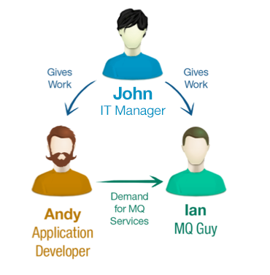
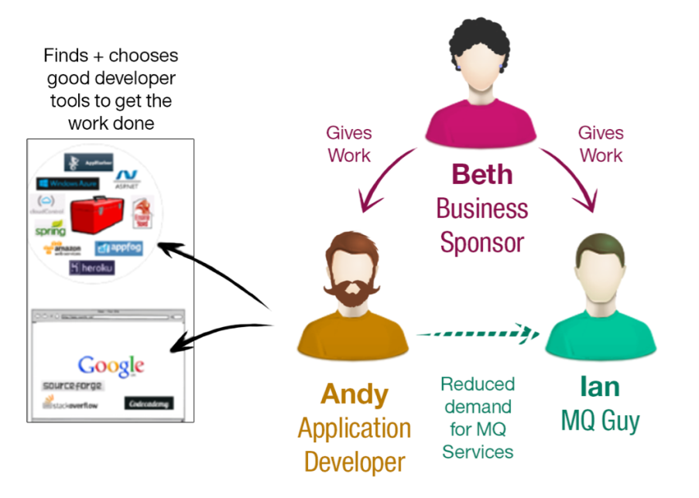
The journey that got us here…
Share,
re-use and save!
I need to access some messaging services. I own the apps.
Before
Now
MQ Light
IBM MQ
Notes:
5-10 years ago IT controlled how apps were developed.
Introduce persona :
Andy; developer writing core business logic,
Iain : owns, runs and maintains core, shared infrastructure (MQs case connecting disparate systems)
Not mocking this : almost every piece of core infrastructure is run like this

Slide 23


Use Cases
Worker Offload
Intensive work offloaded and distributed amongst worker processes to be performed asynchronously
- Processing images or videos
- Performing text analytics
Event Driven
Take one or more actions when something interesting happens
- Email logs and update dashboards when build finishes
- Upload videos once finished transcoding
Notes:
Worker offload : scalability
Biggest, most obvious use case
Work that can be processed asynchronously is performed by a separate processes, which can then be scaled independently
i.e. image / video processing, analytics, etc
Event driven : avoiding the inefficiencies of polling
Driving multiple parts of an application when something happens. i.e.

Slide 24

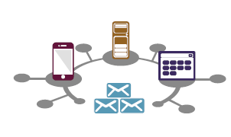

MQ Light API
Alternative to JMS
Uses AMQP 1.0 protocol – Advanced Message Queuing Protocol
RESTful API implemented by
MQ Light
MQ Light service in Bluemix
IBM MQ v8.0.0.2 using AMQP channel type
MQ support for MQ Light (Beta) now available
MQ Light
IBM MQ
Beta in v8.0.0.2
MQ Light for Bluemix
Developer coding in Python, Ruby, JavaScript, Java, C#, PHP
Builds application and uses MQ Light messaging and tests in local developer sandbox
Deploy seamlessly to MQ Light, MQ or MQ Light Service

Slide 25
MQ Light Alternatives
Other AMQP providers in Bluemix
Besides MQ Light
CloudAMQP
Gives Bluemix apps access to services hosted by CloudAMQP
Service provides managed, highly available, RabbitMQ clusters in the cloud
http://marketplace.ibmcloud.com/apps/75
http://www.cloudamqp.com/docs/index.html
No JMS support?
rabbitmq
Experimental
RabbitMQ message queue
Open source
https://www.rabbitmq.com/documentation.html
JMS client in vFabric
https://www.vmware.com/support/pubs/vfabric-rabbitmq.html

Slide 26
Bluemix MQ Architectures
Application
If Java, app code can use JMS or MQ Light API
If Node.js, etc., app code probably uses MQ Light API
Messaging: IBM MQ queue manager
Architecture 1: JMS
Application using JMS (MQFAP) -> Secure Gateway -> IBM MQ (with JMS API)
Architecture 2: MQ Light API
Application using MQ Light API (AMQP) -> Secure Gateway -> IBM MQ (v8.0.0.2 or later)

Slide 27
Scenario: Connect to a remote IBM MQ (JMS)
ACME Corp’s MQ messaging system has a queue manager
Hostname: mq-gateway.acme.com
Port: 1414
Create a gateway with a destination for the database
Name: ACME MQ JMS
IP address: mq-gateway.acme.com
Port: 1414
TLS: TCP
Gateway will have a destination
Destination ID: c8BRcEQd3eB_rcq
Cloud Host : Port: cap-sg-prd-1.integration.ibmcloud.com:15998
Destination Host : Port: mq-gateway.acme.com:1414
Application connects to
cap-sg-prd-1.integration.ibmcloud.com:15998

Slide 28
Scenario: Connect to a remote IBM MQ (MQ Light API)
ACME Corp’s MQ messaging system has a queue manager
Hostname: amqp://mq-gateway.acme.com
Port: 5672
Create a gateway with a destination for the database
Name: ACME MQ AMQP
IP address: mq-gateway.acme.com
Port: 5672
TLS: TCP
Gateway will have a destination
Destination ID: c8AScEQd3eB_rcq
Cloud Host : Port: cap-sg-prd-1.integration.ibmcloud.com:15997
Destination Host : Port: mq-gateway.acme.com:5672
Application connects to
cap-sg-prd-1.integration.ibmcloud.com:15997

Slide 29
Scenario: Connect to a remote LDAP provider
Customer has a LDAP provider
Such as IBM Security Directory Server (f.k.a. IBM Tivoli Directory Server)
IP address: 192.168.10.30
Port: 389
Create a gateway with a destination for the database
Name: Customer LDAP
IP address: 192.168.10.30
Port: 389
TLS: TCP
Gateway will have a destination
Destination ID: bjlKsI7JxZM_3sC
Cloud Host : Port: cap-sg-prd-1.integration.ibmcloud.com:15123
Destination Host : Port: 192.168.10.30:389
Application connects to
cap-sg-prd-1.integration.ibmcloud.com:15123

Slide 30

API Management
API
Management

Slide 31
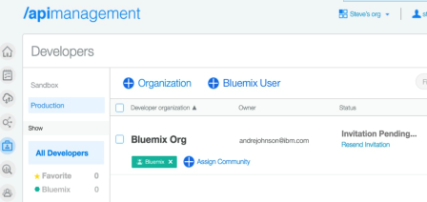
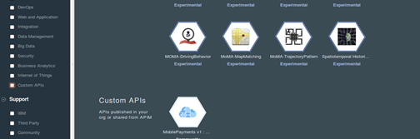
IBM Hybrid Integration Services
IBM API Management on Bluemix
Enterprise API Management for all of your Bluemix APIs
Value: Secure, Control, Publish, Analyze and Manage your APIs. Discover APIs from on premise sources.
Key Capabilities:
Manage your APIs– Manage your Bluemix APIs to allow secure, governed and monitored usage
API Discovery– Discover APIs from on prem sources such as System Z and IBM Integration Bus and publish them into Bluemix
Socialize- Invite partners to consume and interact via the Developer Portal and publish into their Bluemix orgs
What’s new?
A Bluemix service that seamlessly launches an API Management experience to extend your API reach
2

Slide 32
API Management & Bluemix – 5 Things it enables
1
Built-in API Management capability in Bluemix
Sign up & Provision your account & get access to API Management service right within Bluemix
2
2
Design & Define your APIs
Design APIs that proxy to your Bluemix application endpoint or assemble new APIs through mashup of multiple Bluemix application endpoints
3
Publish & Share your APIs with Bluemix users
Share your APIs by publishing back to your own Bluemix org or other partner Bluemix org
4
Bind Bluemix Apps to the APIs
Consumer can bind their Bluemix apps to your APIs and obtain API keys & secrets
5
Manage & Analyze your API usage
Get all other functionalities of API Management including analytics of who is using your API & how much is it being used

Slide 33
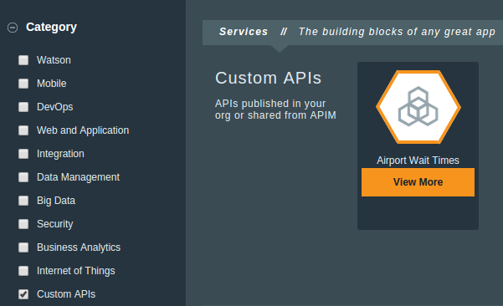
Custom APIs on the Bluemix Palette

Slide 34
Secure Gateway and API Management
Scenario: A Bluemix app wants to use functionality in an on-prem system of record (SoR)
Existing System of Record (SoR)
Simplest case: Functionality has a RESTful API described by a Swagger doc
API is private; not exposed outside of the data center
Use Secure Gateway to access API
Gateway client acts as bridge making API accessible from Bluemix
REST client in Bluemix app can now use SoR’s API
Use API Management to add API to Bluemix org’s palette of services
Use SoR’s Swagger doc to create a corresponding API plan in Bluemix
Publish the staged plan to Bluemix as a custom API, which adds it to the palette
Later …
Bluemix app developer
Instantiates a custom API just like any other service
App is now bound with access to the API provider
App -> Custom API -> Gateway -> Gateway client -> Destination (SoR’s RESTful API)
P.S.: Also useful for public APIs (no Secure Gateway necessary)

Slide 36
API Management Resources
Bluemix docs: Getting started with the API Management service
https://www.ng.bluemix.net/docs/#services/APIManagement/index.html
Getting started with the Bluemix API Management Service
https://developer.ibm.com/bluemix/2015/04/06/getting-started-bluemix-api-management-service/
Integrate your on-premises data with the cloud by leveraging Bluemix Hybrid Integration
https://developer.ibm.com/bluemix/2015/05/27/bluemix-hybrid-integration/
Build a managed API with IBM Bluemix
http://www.ibm.com/developerworks/cloud/library/cl-bluemix-api-mgmt-app/index.html
Manage your APIs with the new IBM Bluemix Service
http://heidloff.net/nh/home.nsf/article.xsp?id=12.03.2015142254NHEHPV.htm
Good Health demo by Kyle Charlet - GoodHealth​zSoRBluemi​x.mp4
Secure Gateway, API Management, IMS, zConnect, Bluemix Mobile
https://w3-connections.ibm.com/files/app#/file/e308d04d-2a81-4320-859e-e0ba5b97d553

Slide 37

DataWorks
DataWorks

Slide 38
















IBM® DataWorks™
IBM’s Data Refinery
Data
Applications
Business Users
Making Data
Useful and Available
to Everyone that Needs it
When they Need it
Application Developers
Can easily find the data they need to accelerate data based business decisions using timely accurate and trusted information
Can quickly develop data-rich applications by embedding data services into applications quickly leveraging industry standard APIs
IT Users
Can enable self-service data access to end users and deliver data faster while still maintaining data governance and security
Notes:
DataWorks is IBM's data refinery. The IBM® data refinery provides a lightweight, cloud-based set of data access and refinement services and makes useful and fit-for-purpose data quickly and easily available to everyone across the enterprise that need it when they need it.
IBM DataWorks ingests raw data, and provides services to enable you to easily address activities such as data preparation, data movement and delivery while also meeting associated privacy and security concerns before distributing data to end users.
Different roles within an organization benefit from the value of DataWorks:
Business users can easily find and use the data they need to accelerate data based business decisions using timely, accurate and trusted information.
Application developers can quickly develop data-rich applications by easily embedding IBM DataWorks data services into new or existing applications leveraging industry standard application programming interfaces (APIs).
IT users such as DBAs, data stewards and custodians can break free from routine data requests by enabling self-service access to data using elastic deployment through the cloud and deliver data faster while maintaining important controls such as data governance and security. This allows IT users to focus on additional value for an organization such as corporate standards, security, data governance and complex requirements.
DataWorks saves time and resources by reducing the effort to provision and refine quality and trusted data and make it fit for use.

Slide 39
IBM® DataWorks™
Cloud-based
Data Services
For Users and Applications
DataWorks Service
The DataWorks Service is GA today and available on IBM® Bluemix free of charge
The DataWorks Service provides a set of well documented, industry standard REST APIs
The DataWorks APIs enable developers to embed DataWorks services in applications to create data-rich applications and provision data from cloud and on-premise data sources
DataWorks Software-as-a-Service Applications
IBM® DataWorks™ Forge – The DataWorks Software-as-a-Service application – Beta !
IBM® DataWorks™ embedded within IBM® Watson™ Analytics – 1H 2015
IBM® DataWorks™ embedded within IBM® dashDB – 2H 2015
IBM® DataWorks™ embedded within IBM® Cloudant – 2H 2015
Notes:
IBM® DataWorks™ delivers cloud-based data services and makes fit-for-purpose data available quickly and easily to users and applications across the enterprise. DataWorks ingests raw data and provides a set of data services to enable you to easily address activities such as data movement, preparation and delivery while also meeting data privacy and security concerns before distributing the refined data for end user consumption.
The DataWorks service is GA today and is available on the IBM Bluemix public cloud as a free no charge service. The service is a collection of cloud-based data access and refinement application programming interfaces (APIs) and tooling for application developers to quickly embed into new and existing applications. Developers can leverage and implement the DataWorks APIs using a well documented, industry standard REST interface. The DataWorks APIs enable developers to embed and interoperate with feature-rich data access and refinement capabilities to create data-rich applications that classify, cleanse, privatize and provision data between cloud and on-premise data sources.
The IBM DataWorks service capabilities are also seamlessly embedded in applications and will soon be available in Software-as-a-Service applications such as IBM Watson Analytics, IBM dashDB, IBM Cloudant as well as in the new stand-alone IBM DataWorks Forge application coming soon in 2015 with a GA date TBD.

Slide 40
IBM® DataWorks™
DataWorks Service
Data Load API
Copies data between data sources
Supports Cloud and on-premise sources
Supports IBM cloud data sources as targets
Securely copy on-premise data to cloud data sources using a secure gateway
Requires the configuration of a Secure Gateway service
Data can be classified as sensitive prior to it being copied to the target
Data classified as sensitive is automatically masked before it is copied to the target
Utilizes the Optim data privacy providers
Data Profiling API
Classifies and analyzes data to understand its structure and content
What type of data is it – Dates, numeric, character, XML, string etc.
What is the length and format of the data
Identifies and classifies what type of data it is; Name, credit card number, telephone number, postal code, national identifiers etc.
Address Cleansing API
Standardizes US address data
Only supports US addresses in the US Bluemix environment
Probabilistic Match API – New and Experimental
Identify duplicate customer records to build a 360 degree view of a customer
Notes:
40
The IBM DataWorks service provides data access and refinement APIs to load, profile, mask, cleanse and provision data securely between cloud or on-premise data sources. A new and experimental Probabilistic Match API is also available on Bluemix to identify duplicate customer records to build a 360 degree view of a customer record using probabilistic algorithms.
Data Load – Copies data between cloud and on-premise data sources. The list of supported sources and targets are contained on the next two slides.
Note – At this point in the discussion you can click on the sources hyperlink and it will take you to slide 6 that maps out the supported sources. Discuss slide 6 per the speaker notes and then right mouse click on the slide in presentation mode and select “Previous” to get you back to this slide and then click on the targets hyperlink and it will take you to slide 7 that maps out the supported targets. Right mouse click on the slide in presentation mode and select “Previous” to get you back to this slide.
You can securely load on-premise data to the cloud by accessing on-premise data using a secure gateway to protect your enterprise from security intrusions. It requires that you follow a simple configuration process to use a Secure Gateway service that is available on Bluemix to access on-premise data sources from the cloud.
If you use the classification capability of the data profiling service you can classify the data at the source as sensitive. By doing so, the data load service can automatically protect the sensitive data by invoking the Optim data privacy providers and provision the data, masked and privatized, to the target.
Data Profiling – Data Profiling analyzes your data source to understand and gain new insight into the structure and content of the data. Users can leverage this API to gather information about the data, such as column value distributions and data types. Or, identify higher value data attributes --for example e-mail addresses, Social Security Numbers, National IDs or credit card numbers so that your application can take action, such as masking sensitive data for HIPAA or PCI compliance. Additionally, you may classify each field in a data domain to identify fields that contain sensitive data or fields to use for statistical or predictive analysis.
Address Cleansing – Validate and improve the accuracy of your location data by standardizing US addresses. Use this API to enrich partial addresses, such as when ZIP codes or state abbreviations are missing. Address cleansing is only supported in the United States Bluemix environment and only support US addresses.
Probabilistic Match (New and experimental) – Match customer information within and across sources for operations and analytics. Patented probabilistic fuzzy match algorithms return accurate search results and relevancy scores that can be trusted to identify duplicate customer records and support building a 360 degree view of the customer.

Slide 41
Self-service Data Preparation – Use Cases
App Developer
IT Administrator
Access to data in mobile app: An extension of the “Shadow DB synch” use case. In the mobile rewards app the developer needs to access the data that is being uploaded in the shadow DB. Rather than using a generic data access like ODBC the developer prefers to use purpose specific APIs that access the data and return richer objects in formats like JSON.
Control data workflows from a web app: Based on events coming from IoT sensors and systems of engagement (mobile, social) an app developer needs to trigger automated workflows (that were created by business analysts, data scientist and IT administrators) to move, cleanse and transform data.
Warehouse expansion to the cloud: A Customer needs to quickly stand a warehousing project on the cloud using dashDB for a new project that expands existing capabilities on-premise. They need a solution for quickly on-boarding a subset of their existing data (<10 TB) from Netezza.
Shadow DB synchronization: A retail company is building a mobile rewards app. In order to reduce latency in their app they decided to cache on-prem order history data in a Cloudant database. The data is made up from a subset of their sales DB. Prior to loading the data needs to be cleansed and consolidated to match the requirements of the rewards app and it needs to be refreshed on a daily basis.

