Slide 1
Bridge Design Pattern

Slide 2
The bridge design pattern is a structural pattern used to decouple an abstraction from its implementation so that the two can vary independently.
In other words, by using the bridge pattern, we can configure an abstraction with an implementor object at run-time.

Slide 3
Bridge patterns decouple the abstract class and its implementation classes by providing a bridge structure between them.
This bridge uses encapsulation, aggregation, and inheritance to separate responsibilities into various classes.
The bridge pattern is useful when both the class and what it does vary, often because changes in the class can be made easily with minimal prior knowledge about the program.
The bridge pattern allows us to avoid compile-time binding between an abstraction and its implementation. This is so that an implementation can be selected at run-time.

Slide 4
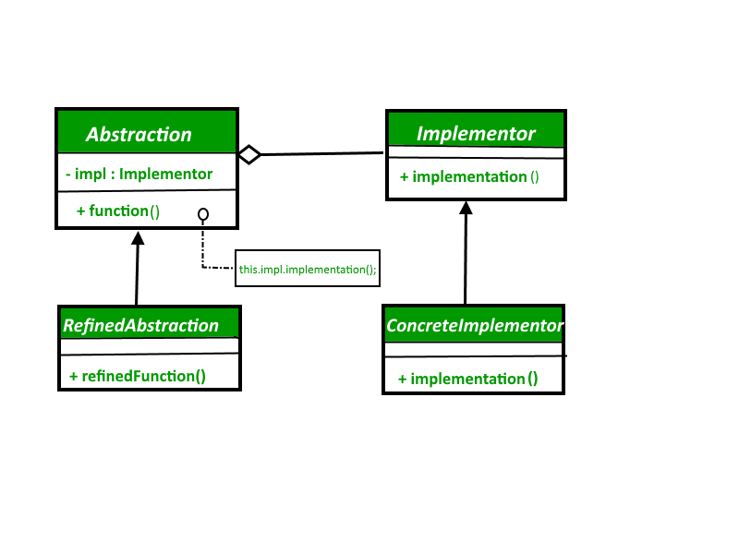
UML diagram

Slide 5
Example : Vehicle Manufacturers
Suppose there is a company that manufactures various types of vehicles, like bikes, cars, and buses. There are frequent changes in the vehicle, as new models of bikes and cars can be introduced and have different processes to manufacture them. There can be other new vehicles, like a scooter or truck in future as well.
All the vehicle has to do is use the WorkShop to produce, assemble, or quality check (test) its work using the work() method for production.
workshop interface will act as a bridge between various types of vehicles and its manufacturing work

Slide 6
Example : Vehicle Manufacturers
Vehicle
+joinWorkShop()
+manufacture()
+minWorkTime()
implements
implements
implements
Bike
Car
Bus
+manufacture()
+minWorkTime()
+manufacture()
+minWorkTime()
+manufacture()
+minWorkTime()
<<interface>>
Workshop
+work()
ProduceWorkShop
AssembleWorkshop
PaintWorkshop
+work()
+work()
+work()

Slide 7
Relation with Other Patterns
Bridge is usually designed up-front, letting you develop parts of an application independently of each other. On the other hand, Adapter is commonly used with an existing app to make some otherwise-incompatible classes work together nicely.
Bridge, State, Strategy (and to some degree Adapter) have very similar structures. Indeed, all of these patterns are based on composition, which is delegating work to other objects. However, they all solve different problems. A pattern isn’t just a recipe for structuring your code in a specific way. It can also communicate to other developers the problem the pattern solves.
You can use Abstract Factory along with Bridge. This pairing is useful when some abstractions defined by Bridge can only work with specific implementations. In this case, Abstract Factory can encapsulate these relations and hide the complexity from the client code.
You can combine Builder with Bridge: the director class plays the role of the abstraction, while different builders act as implementations.

