Slide 1
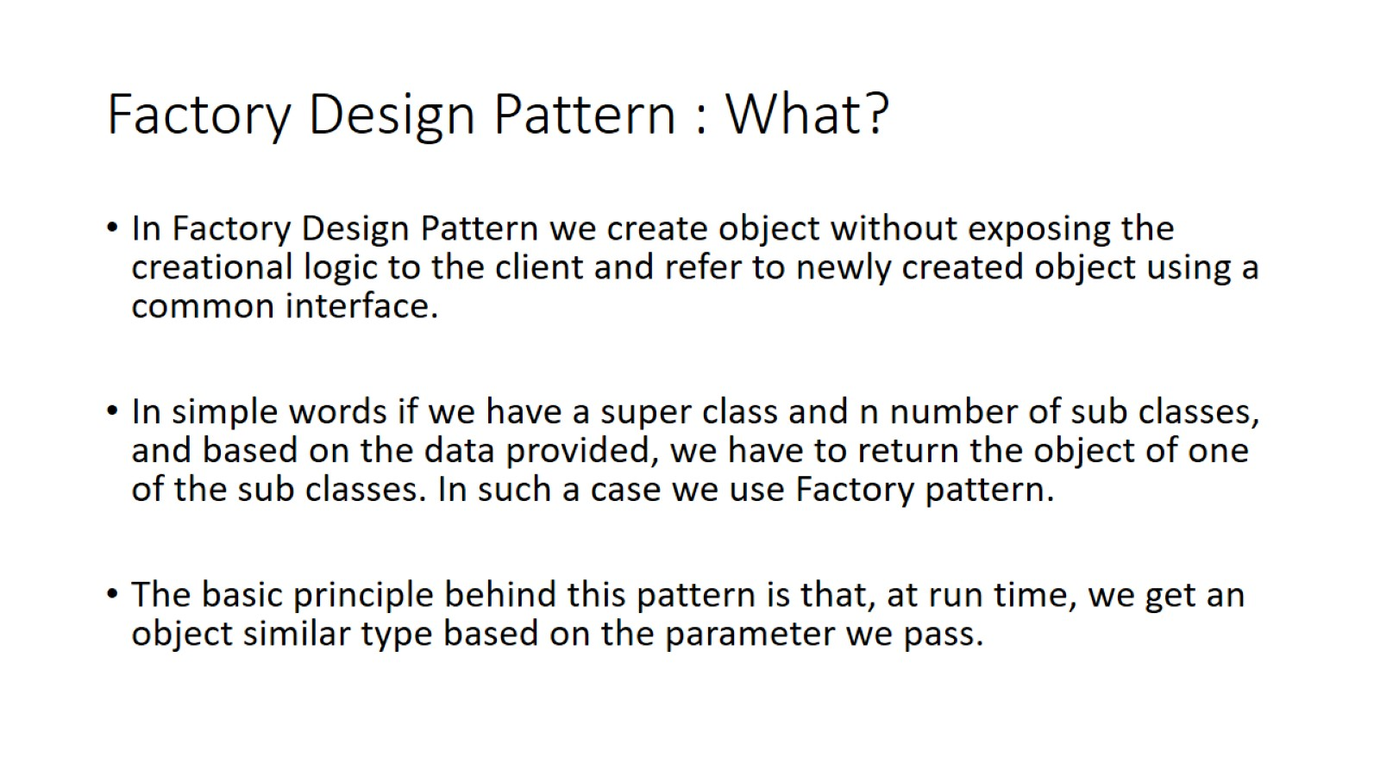
Factory Design Pattern : What?

Slide 2
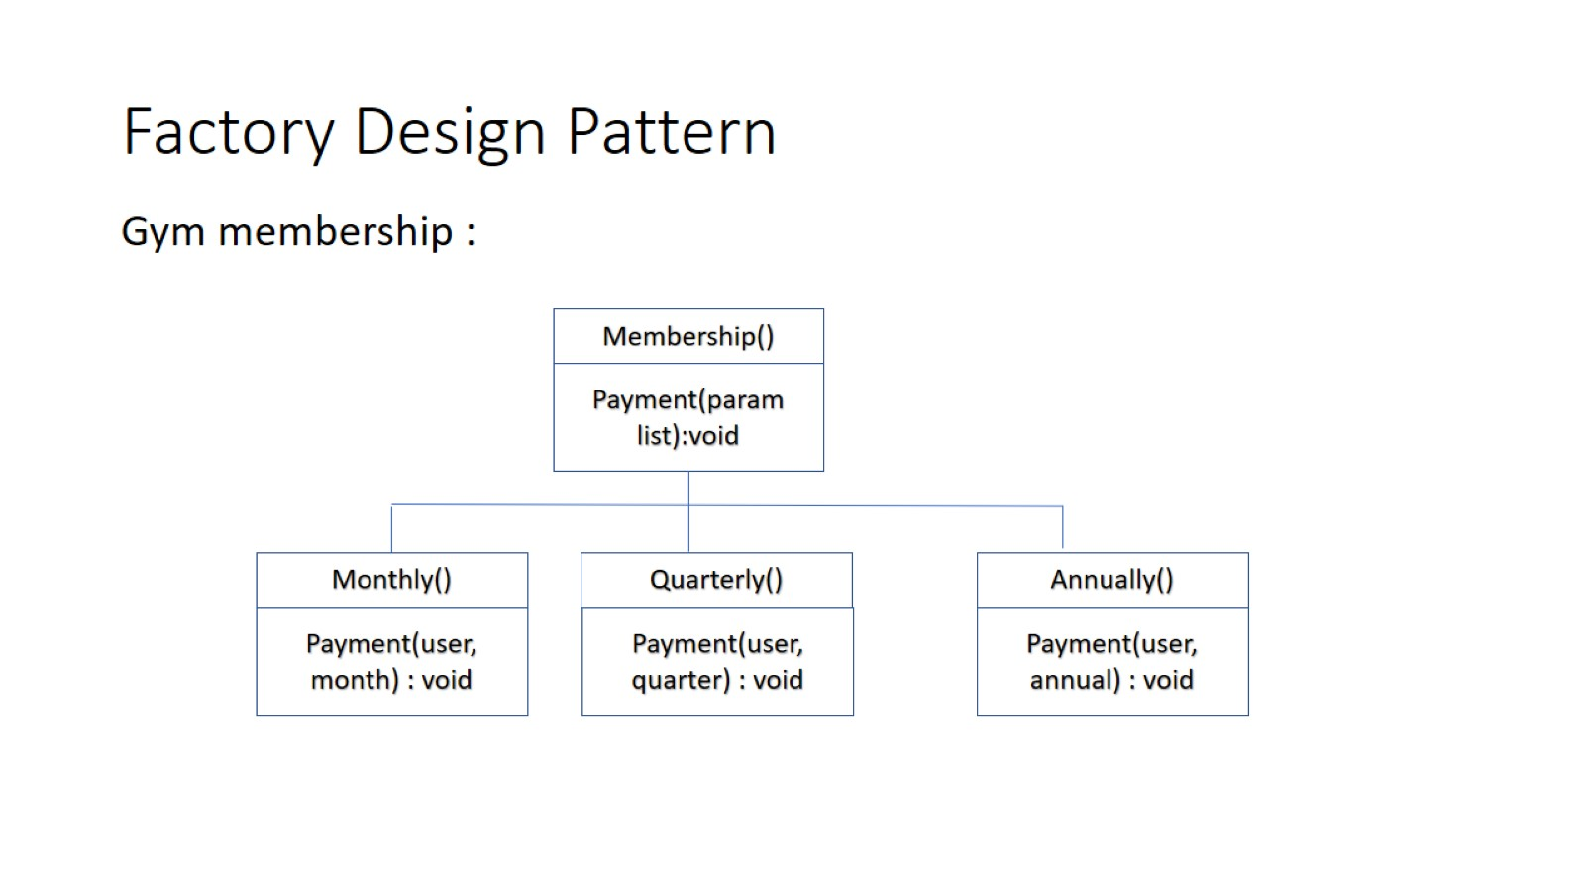
Factory Design Pattern

Slide 3
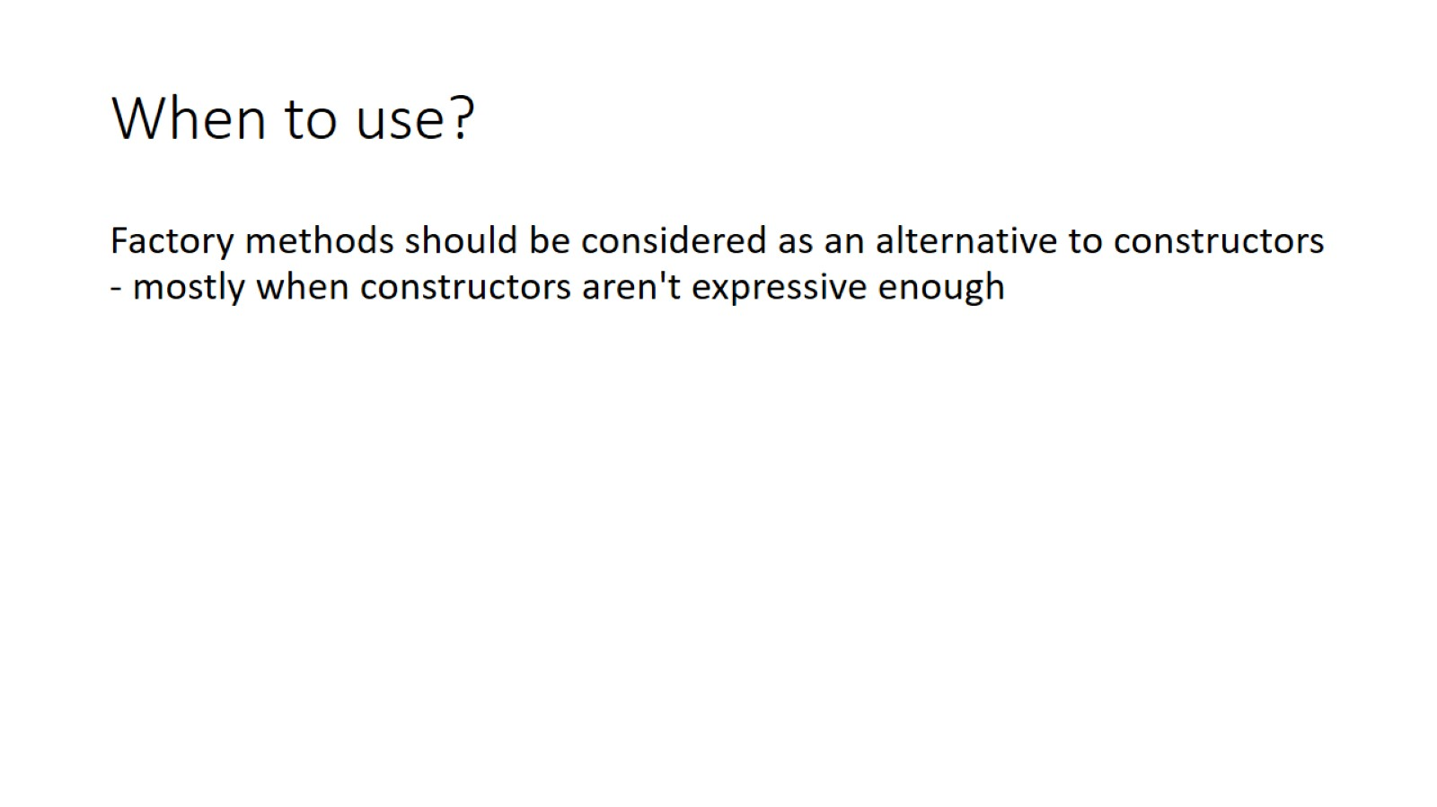
When to use?

Slide 4
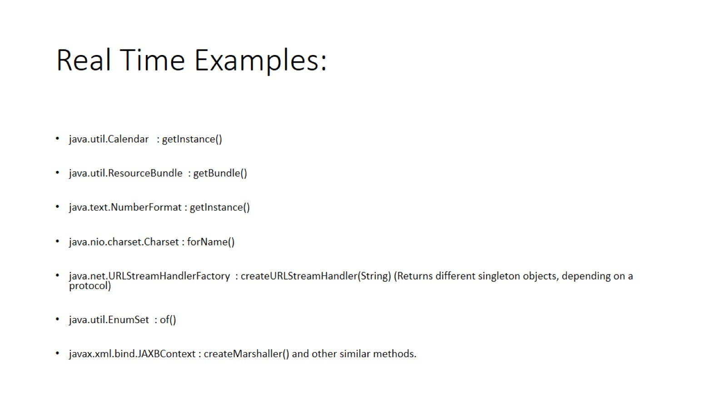
Real Time Examples:

