Slide 1
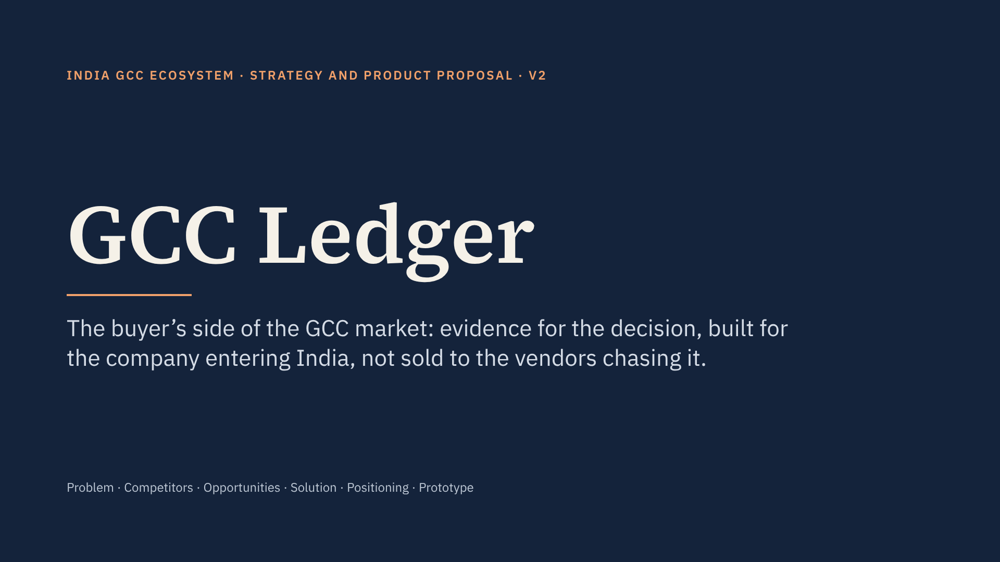
Notes:
Version 2. What changed from v1: competitors are named and compared honestly, the three differentiators lead the solution, paid introductions are gone from the business model, every other player has a defined role, and there are new slides on sizing, pros and cons, limitations and extra risks.

Slide 2
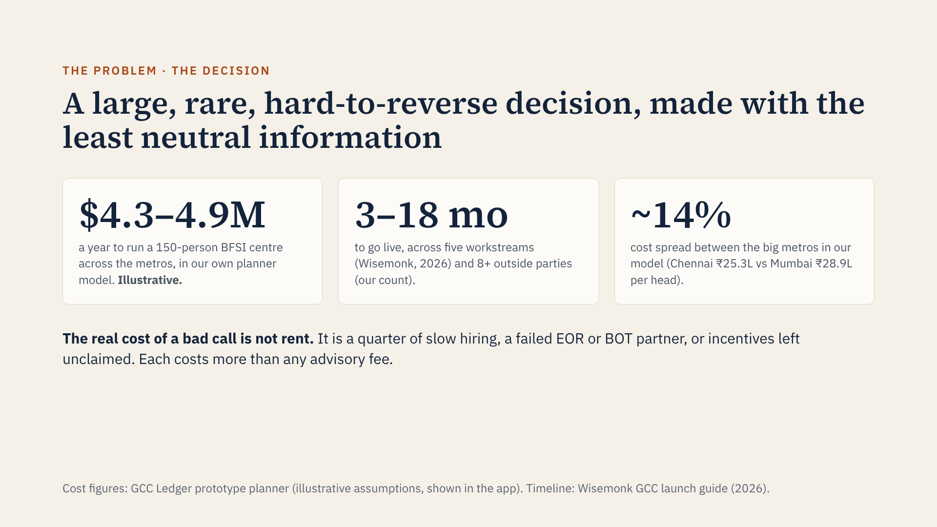
Notes:
v2 opens with the decision instead of the count gap. The cost numbers come from re-running our own prototype’s planner and are illustrative, not sourced market data. The point they make is robust though: because cost differs so little between metros, the expensive mistakes are about talent, speed and partner quality, which is exactly where neutral information is missing.

Slide 3
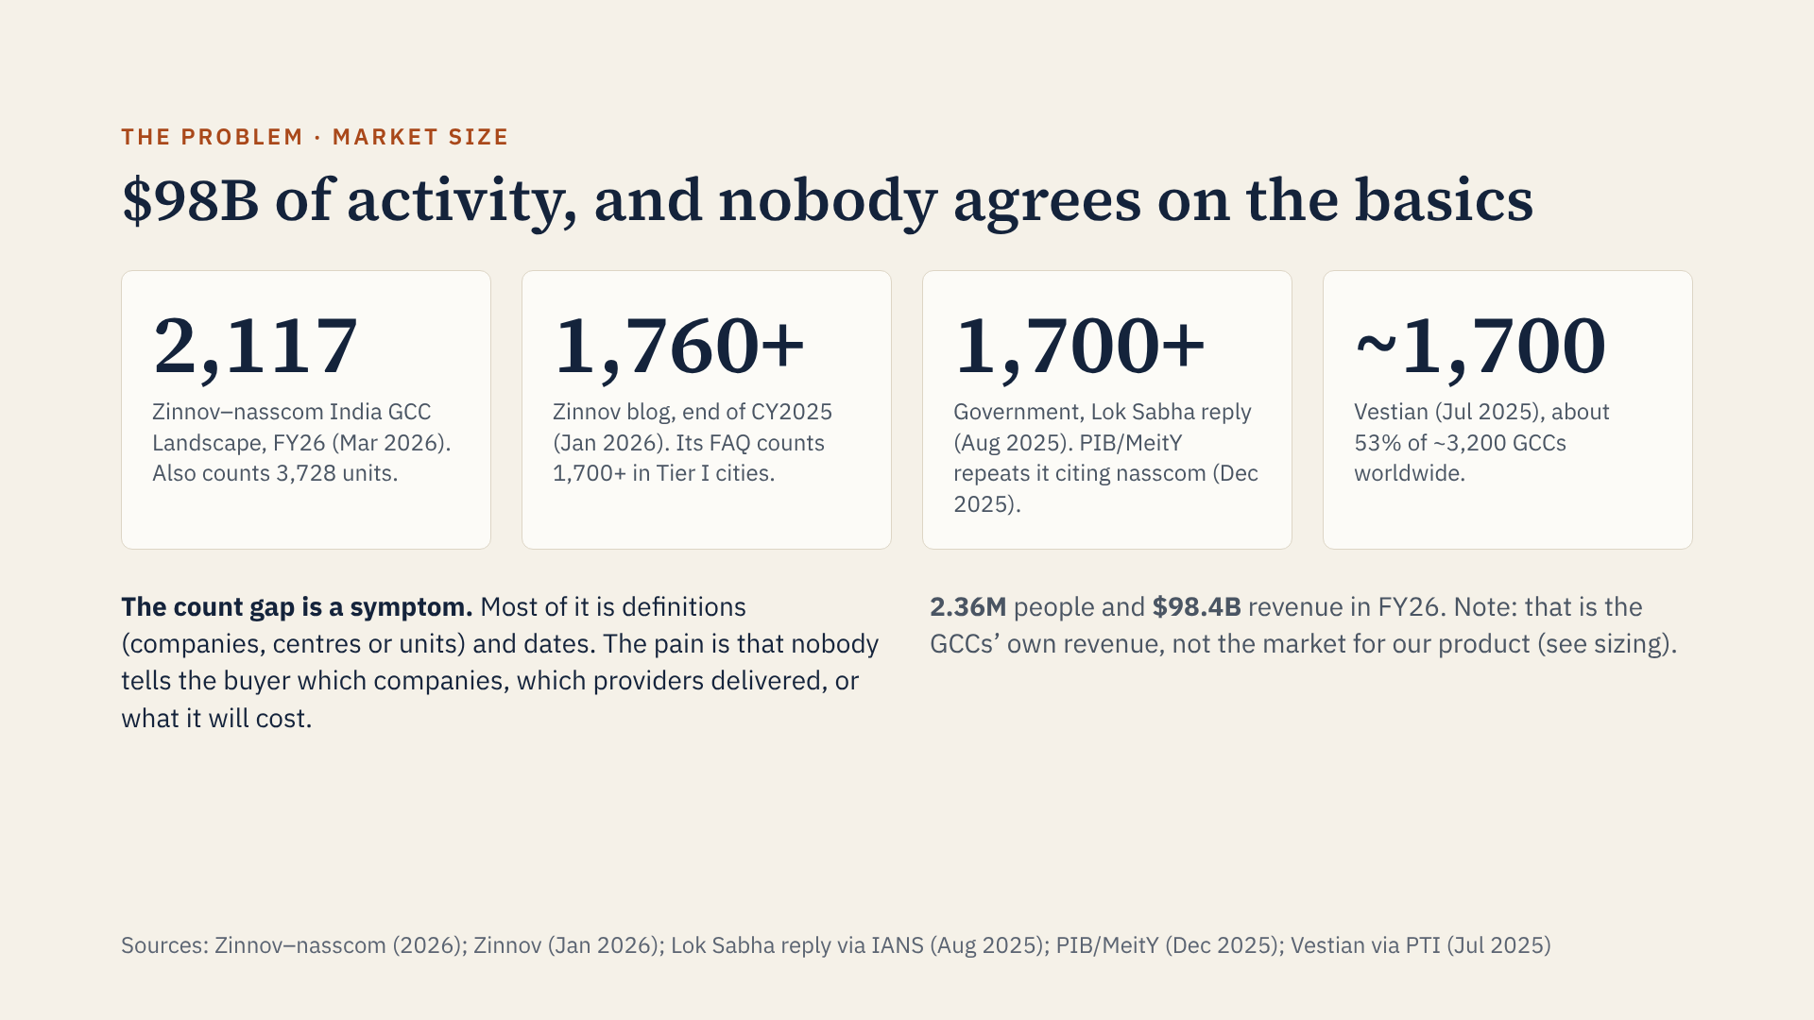
Notes:
Four credible sources, four different answers within twelve months. A sharp reviewer will say the numbers agree once you read the footnotes, and mostly they do. That is why v2 treats the count gap as a symptom: the real pain is the decision on the previous slide. Also be clear that $98B is GCC revenue, not our addressable market.

Slide 4
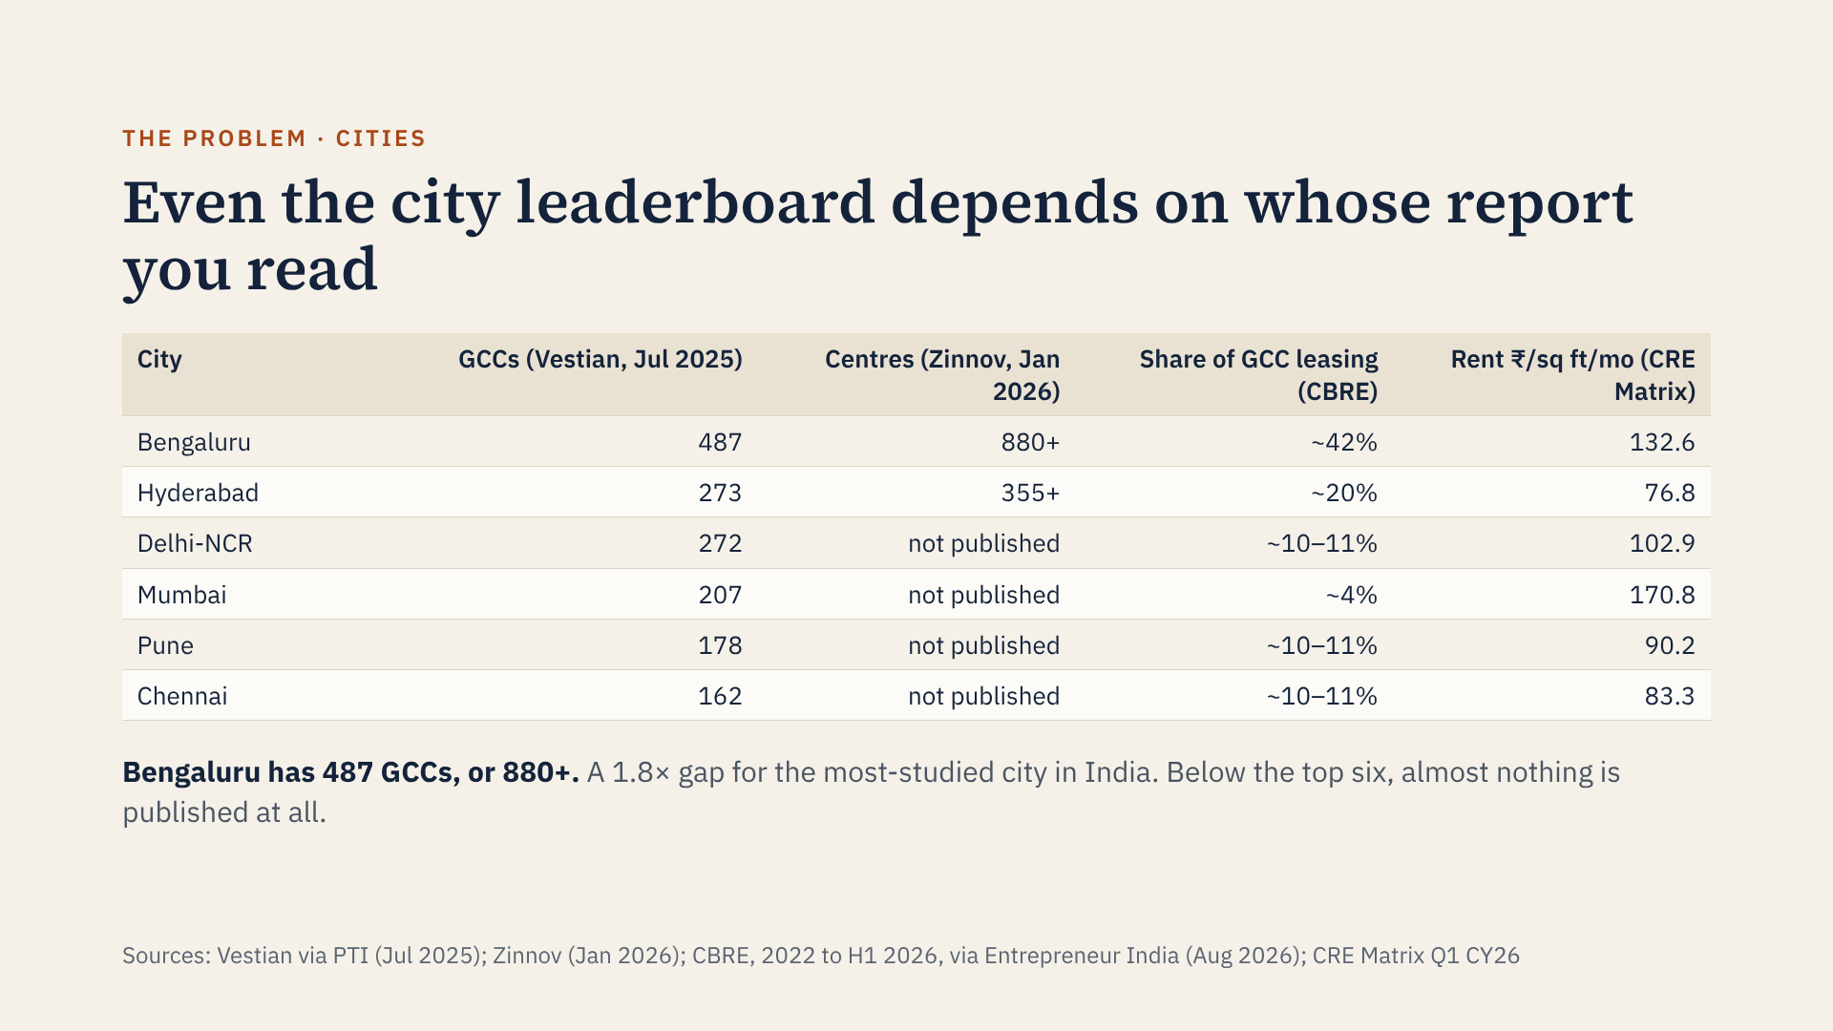
Notes:
The Vestian and Zinnov figures likely differ because one counts parent companies and the other counts centres. That is fine, but nobody tells the buyer which is which. Leasing share and rent come from two more sources with different time windows. An entering company has to stitch this together itself.

Slide 5
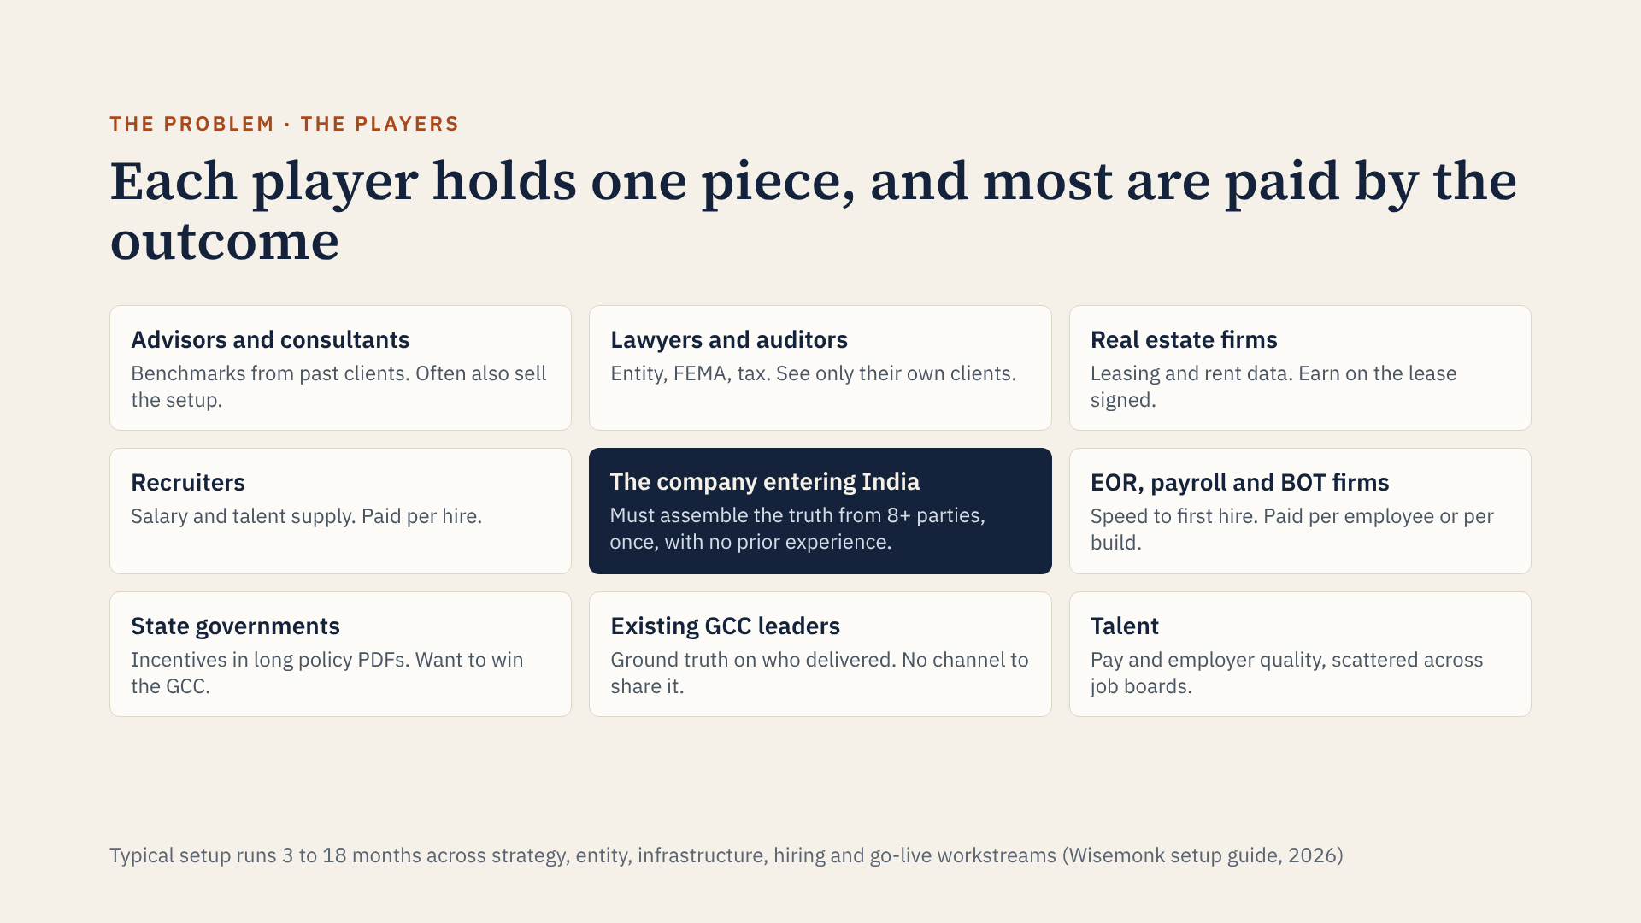
Notes:
The entering company sits in the middle of a chain where almost every information holder is also a seller. Advisors, brokers, recruiters and EOR firms all have real knowledge, but each sees only their slice and earns from a particular decision. The people with the most honest information, existing GCC leaders, have no structured way to share it.

Slide 6
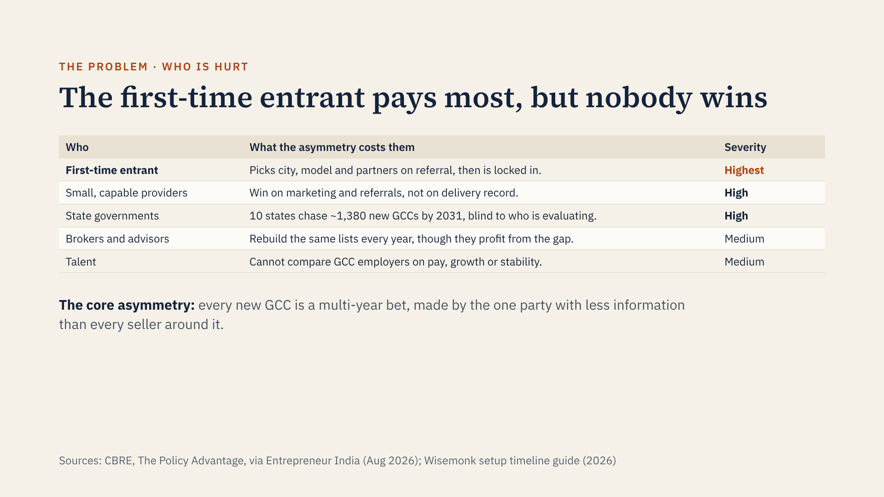
Notes:
Severity here is our judgement, not a measured figure. For the entrant, the decision slide gives the scale: a commitment of roughly $4.3–4.9M a year for a 150-person centre, illustrative. The entrant is hurt most because the decision is large, rare and hard to reverse: once you sign a lease, incorporate and hire 150 people, switching cities costs years. States are an underrated loser: ten of them have written GCC policies and set a combined target of about 1,380 new GCCs and 1.18 million jobs, but they compete blind.

Slide 7
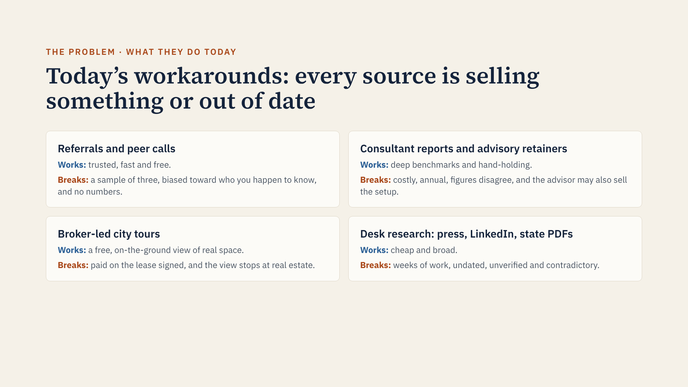
Notes:
None of these workarounds is bad; each is good at one thing. The gap is a neutral, sourced, current reference that sits underneath all of them. Notably, everyone who holds structured data today either sells advice, sells space, or sells people.

Slide 8
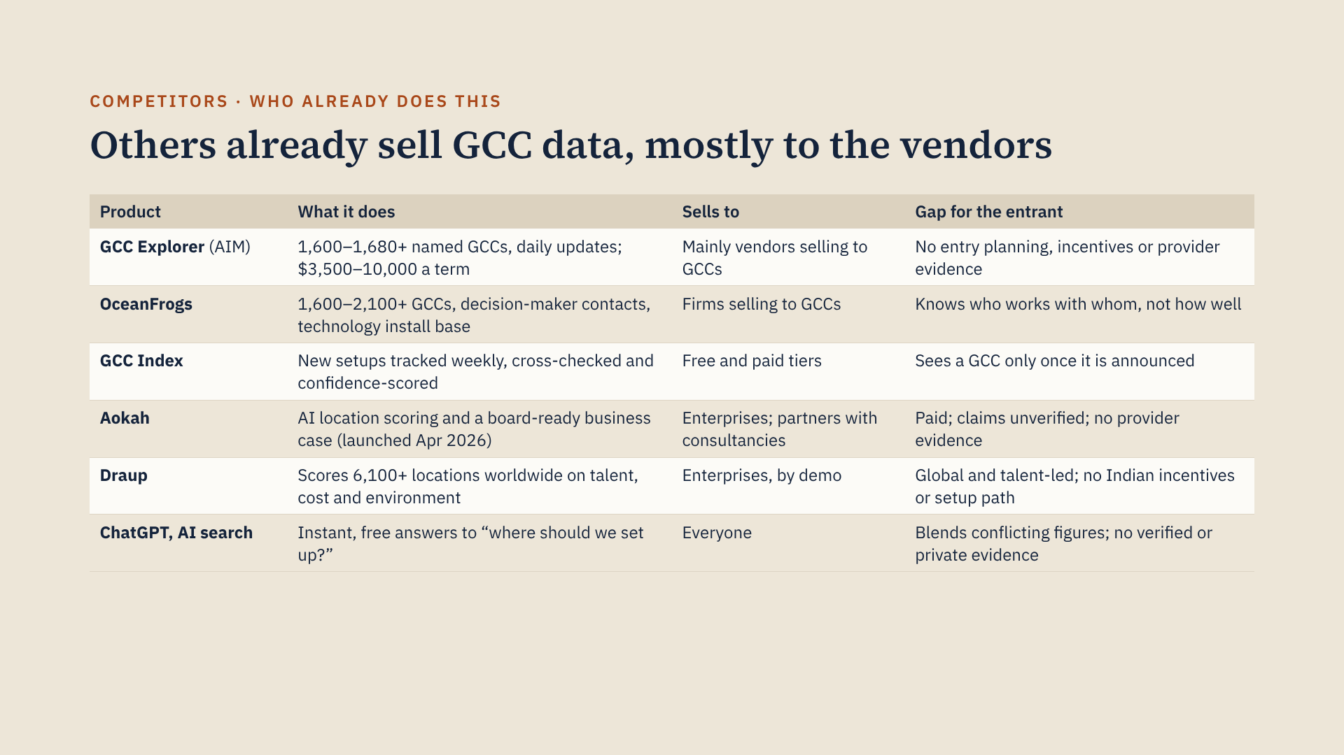
Notes:
Ranges show where the competitors’ own pages disagree: GCC Explorer says 1,600+ on its FAQ and pricing pages and 1,680+ on its list page; OceanFrogs says about 1,600 companies on one page and 2,100+ on another. All figures are from their own websites or press releases, checked 22 October 2026, and Aokah’s claims are unverified press-release statements. Also in the field but not shown here: Zinnov–nasscom’s annual landscape (Zinnov also sells setup), Everest and ISG provider ratings at about $6,499 a report, Embark’s free cost calculator, brokers’ research, and setup firms such as ANSR and Inductus that advise for free and earn on the setup.

Slide 9
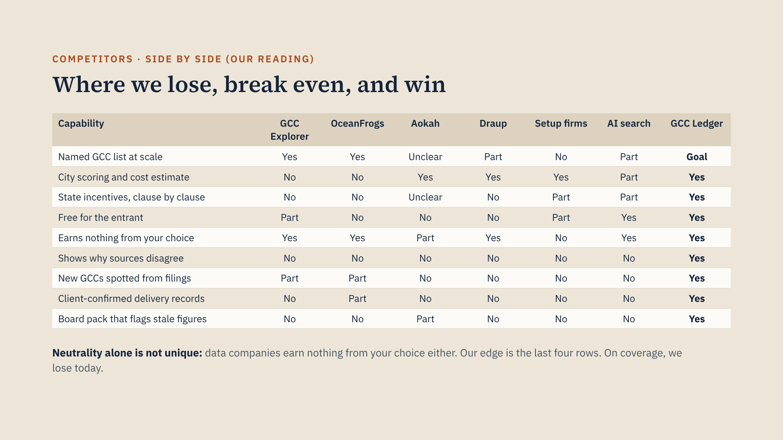
Notes:
All ratings are my reading of each product’s public pages, so the whole table is judgement, not fact. GCC Ledger’s column is the product as planned; the prototype demonstrates each row on seed data (52 GCCs against GCC Explorer’s 1,700 or so), which is why the first row says Goal. Where we are only level (AI assistant, cost calculator, city scoring, announcement tracking) we should not lead with those features.

Slide 10
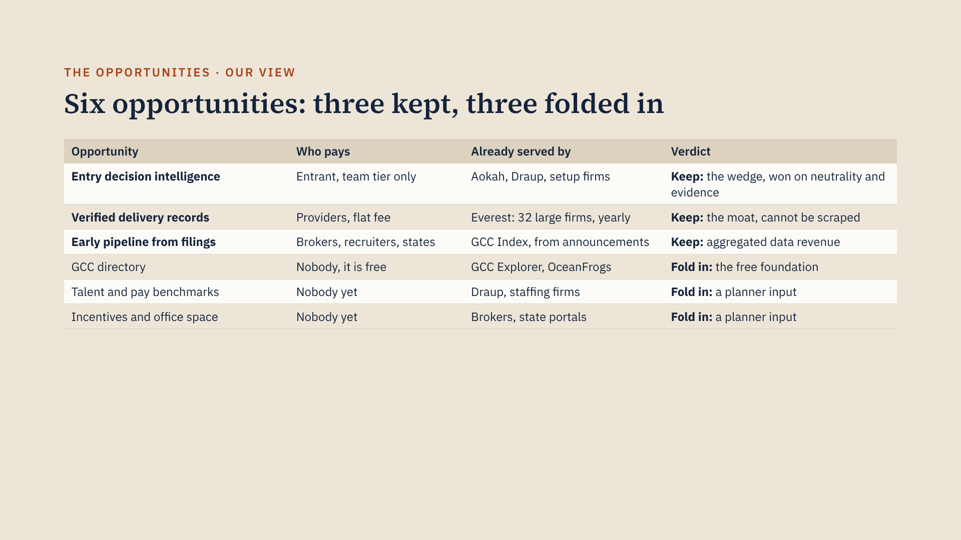
Notes:
These verdicts are our judgement. The big change from v1: the GCC directory is no longer the revenue engine, because GCC Explorer and OceanFrogs already sell lists of GCCs to vendors. We keep a directory, but as the free foundation everything else stands on. Talent, incentive and office data are real pains, but others own them or they are thin alone, so they become inputs to the planner rather than products.

Slide 11
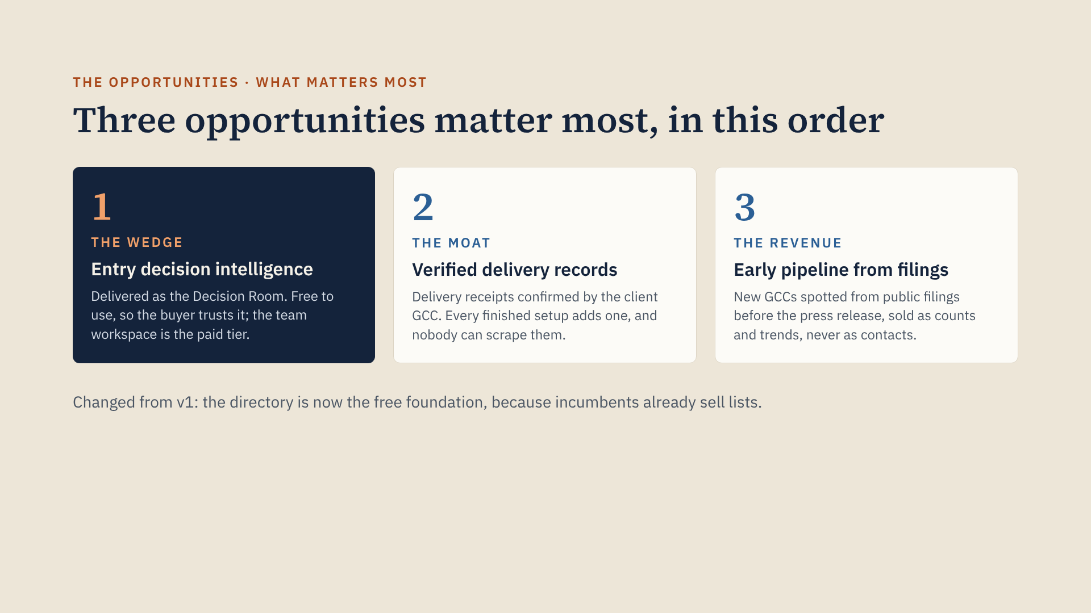
Notes:
Why this order: the wedge creates trust and demand, every completed setup gives us a chance to collect a confirmed delivery record, and the filings pipeline earns money from brokers, recruiters and states without selling anyone’s contact details. Starting with a paid directory would put us head to head with GCC Explorer and OceanFrogs on their strongest ground.

Slide 12
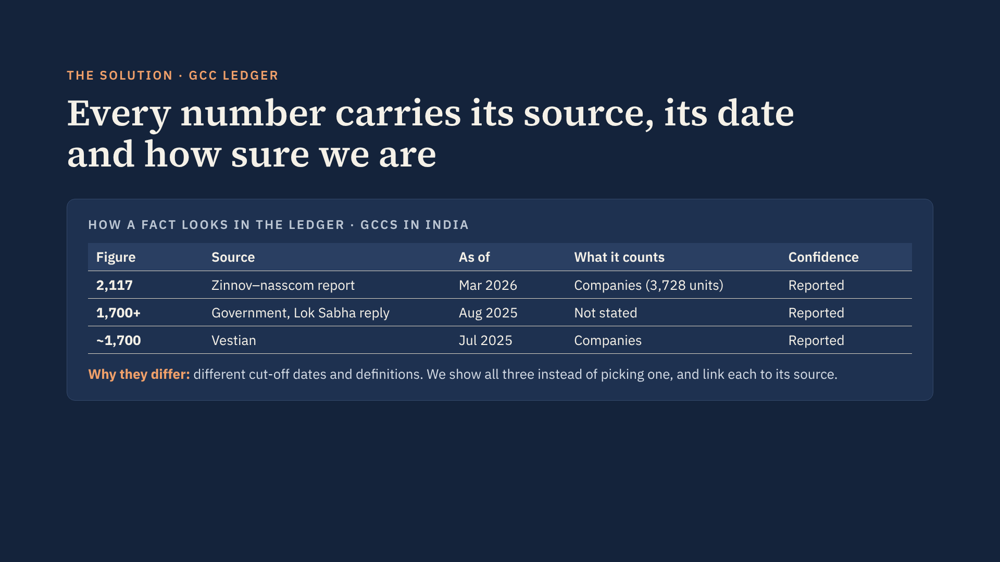
Notes:
This is the product principle and the positioning in one line. Most sources pick a number and print it. We keep every competing value, tag it with source, date, what it counts and a confidence tier, and let the user see the disagreement. That is what makes the Ledger trustworthy enough for a board memo.

Slide 13
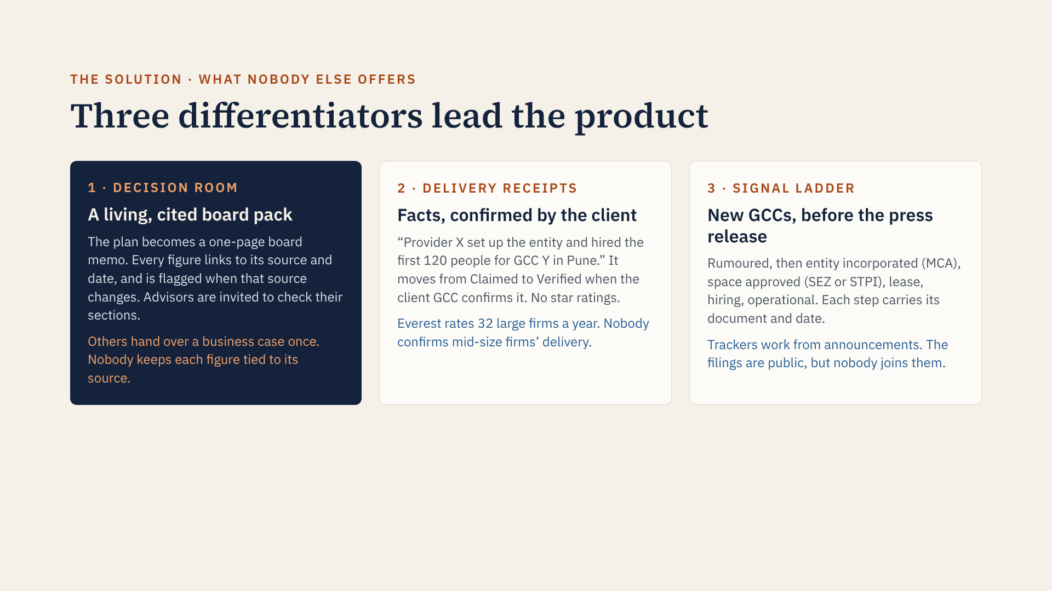
Notes:
These three lead because they are the hardest to copy: the Decision Room needs our source-linked data model, receipts need relationships with GCC leaders, and the signal ladder needs a pipeline that reads scattered approval minutes and filings. All three are in prototype v2, with the signal ladder showing six real announcements plus two labelled illustrative rows. Receipts record verifiable facts rather than opinions, which avoids the NDA and defamation problems that kill review sites in B2B.

Slide 14
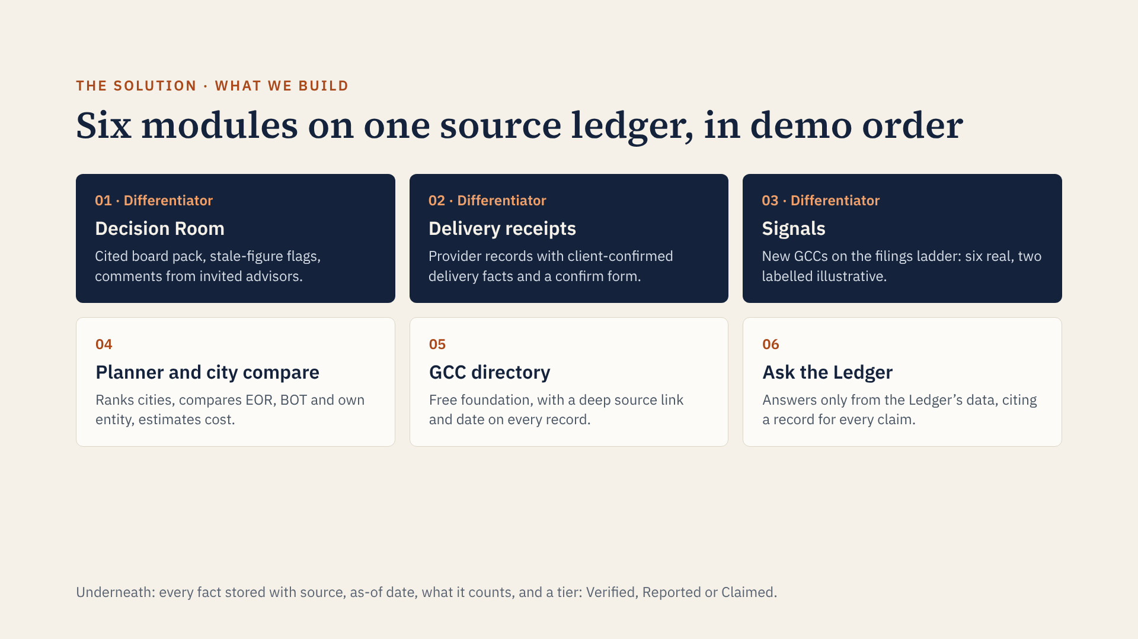
Notes:
The order on this slide is the demo order in prototype v2. The three dark cards are the differentiators; the three light ones are table stakes where we are roughly level with competitors, so we show them but do not lead with them. There are deliberately no contact lists and no lead export: leaving them out is part of the positioning.

Slide 15
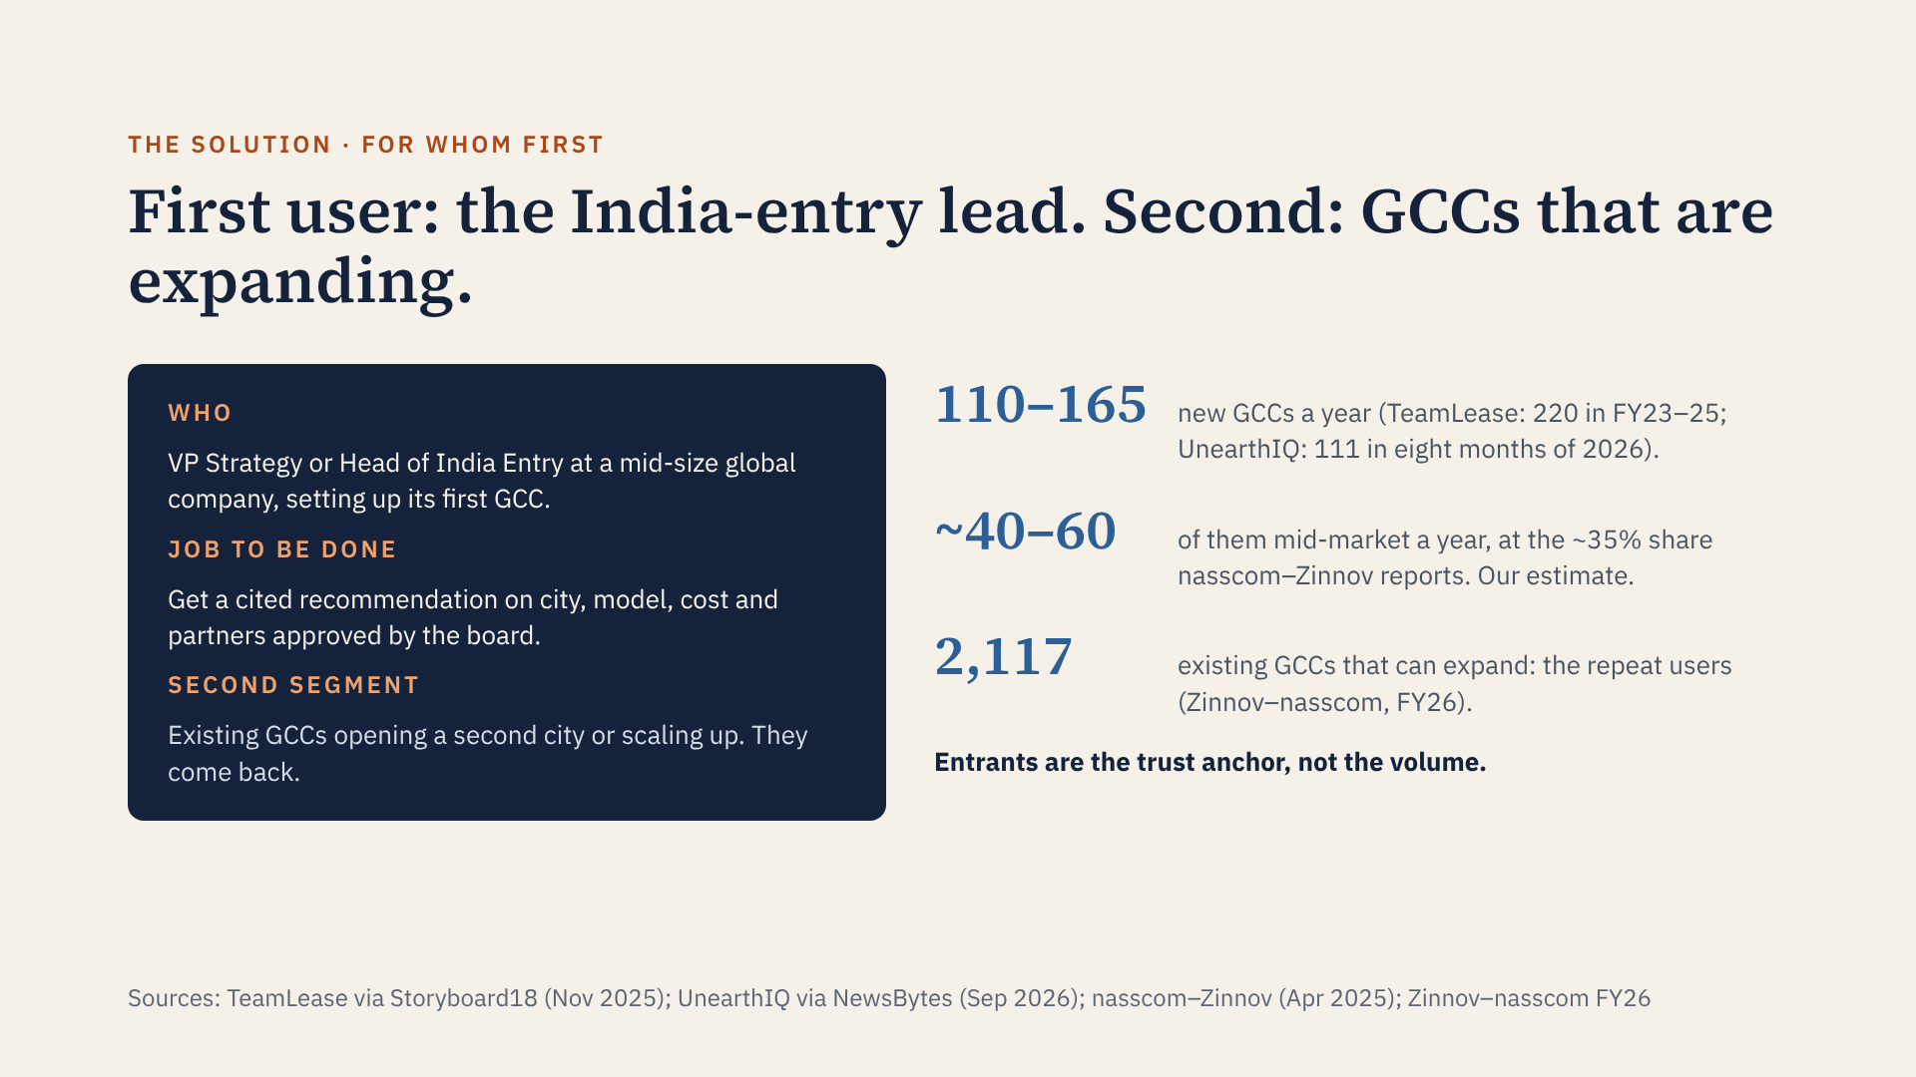
Notes:
v1 implied a big first-user market. In fact only about 40 to 60 new mid-market GCCs open each year, each deciding once. So we say it plainly: the first-timer is where the need is sharpest and where trust is earned, while the volume comes from existing GCCs expanding and from data buyers. The 40 to 60 figure is our arithmetic from two sourced numbers, not a published figure.

Slide 16
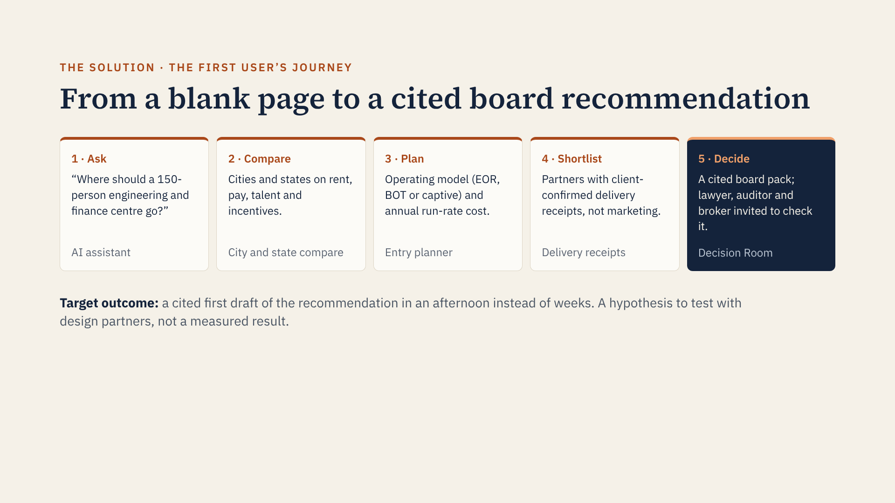
Notes:
Walk through prototype v2 along these five steps; the Decision Room is the hero moment. The point is that each step is something the entry lead does today with a different person or report; we put them on one screen, on one consistent dataset, with the sources visible. The last line is a target we want to validate, so I have labelled it as such.

Slide 17

Notes:
The entity-resolution step is where most reports go wrong: one company can have several centres and several legal units across cities, which is why counts range from about 1,700 to 3,728. AI does the heavy lifting on extraction from PDFs, filings and press; humans review anything that changes a headline number. Provider claims start as Claimed and move up only with public evidence or a verified client confirmation.

Slide 18
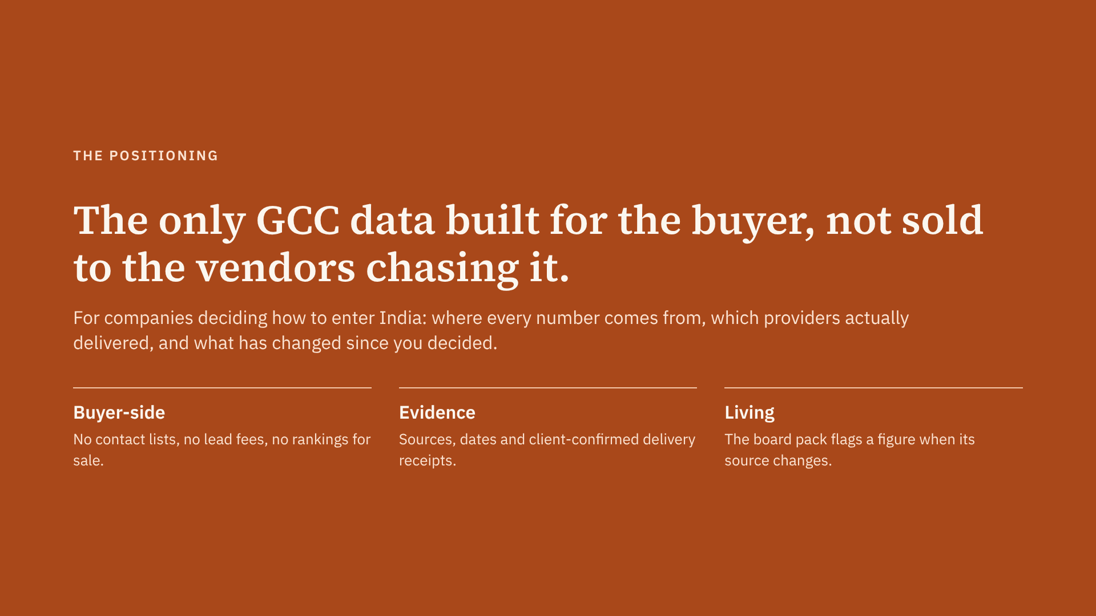
Notes:
v1 said “we don’t earn from the decision you make” while selling paid introductions. v2 removes that contradiction. Against advisors and brokers the edge is neutrality; against data companies such as GCC Explorer, which are also neutral, the edge is who we serve and the evidence they do not have. We still cite nasscom, Zinnov and CBRE rather than compete with them.

Slide 19
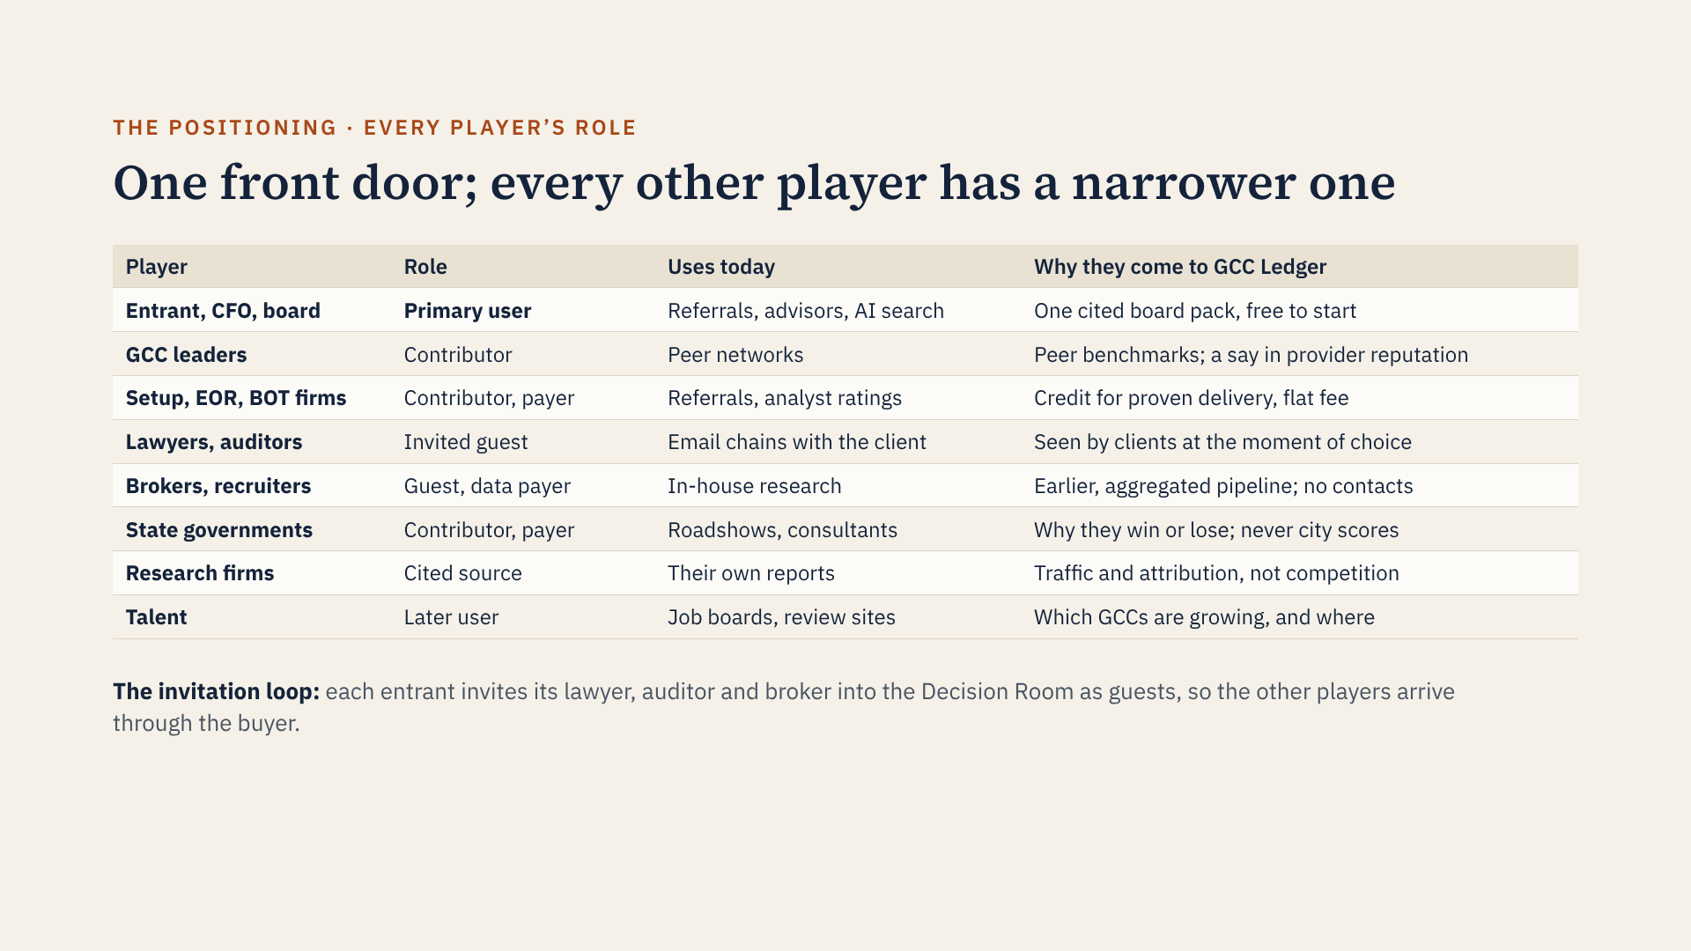
Notes:
This answers whether other players belong: yes, but not as equal users. Building ten products at once would dilute everything. The entrant’s own CFO and board are added because the entry lead’s real job is getting a decision approved. Research firms such as nasscom and Zinnov stay a cited source. States can buy benchmarks of their own performance but never pay for city scores, which would be a visible conflict.

Slide 20
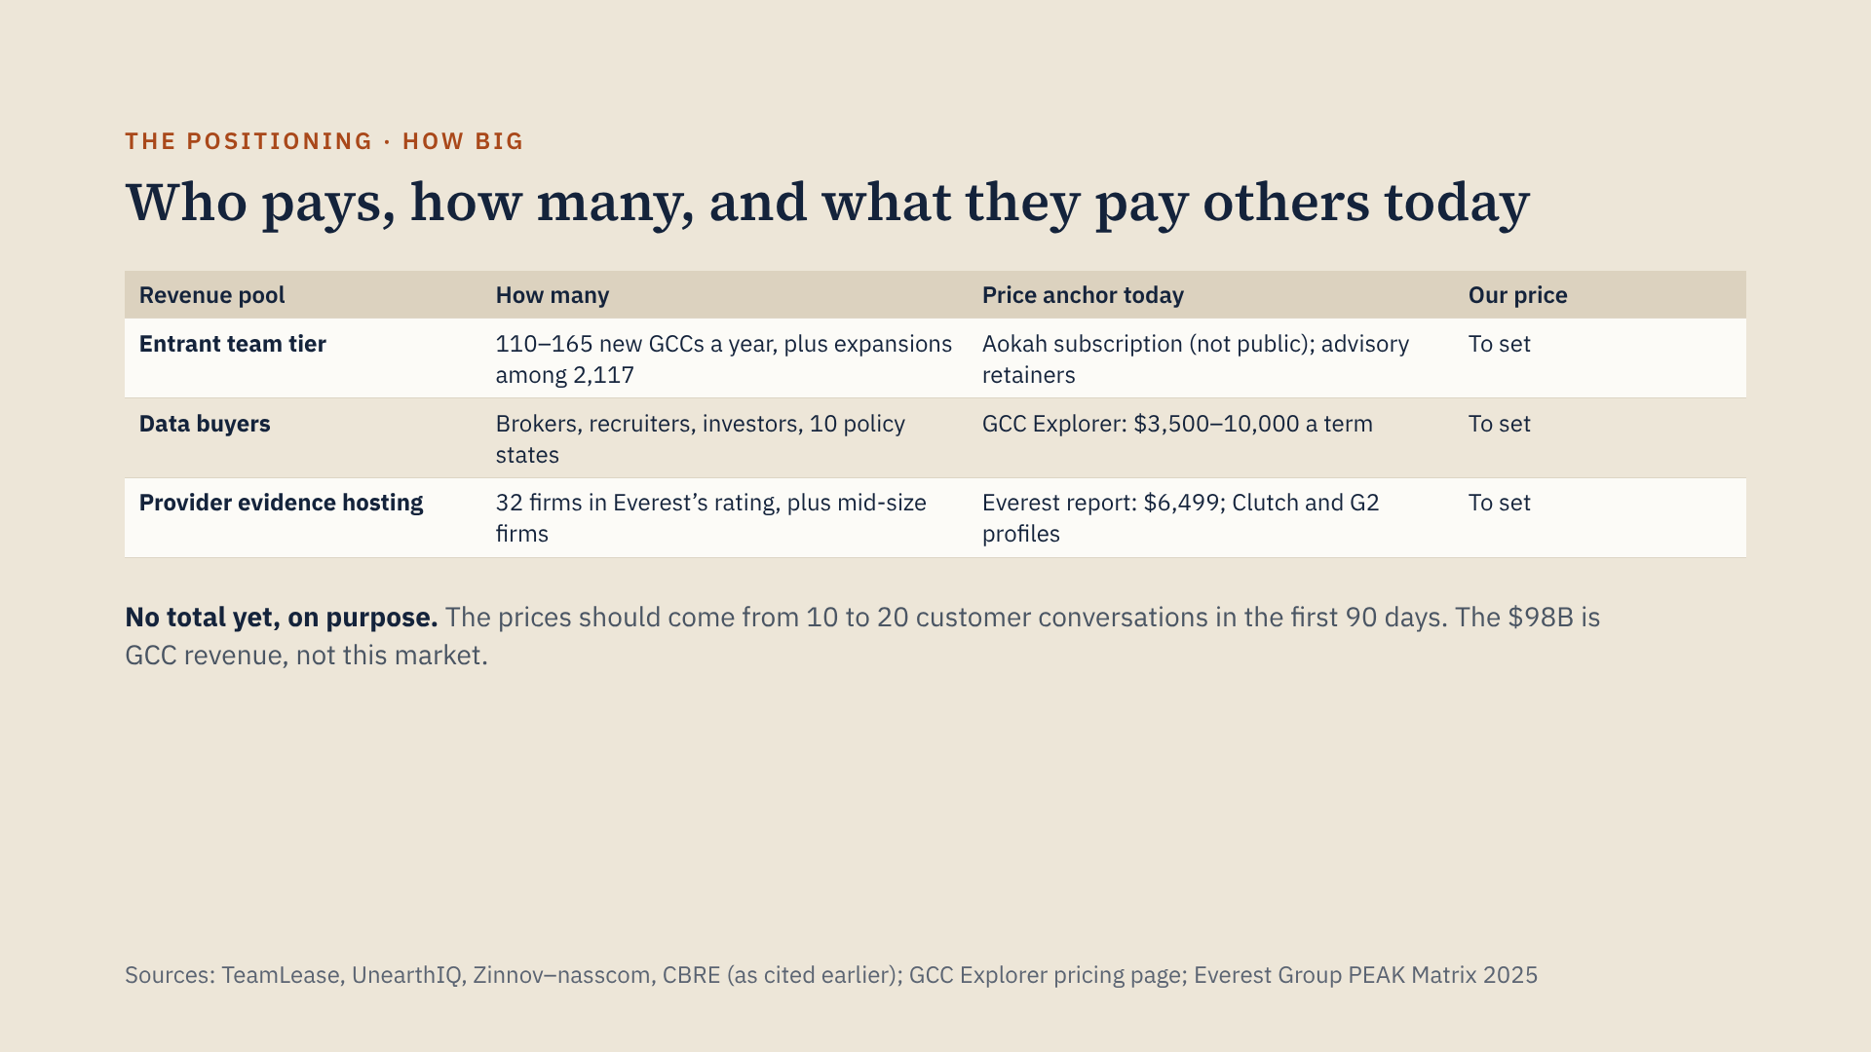
Notes:
A sharp reviewer will ask for the market size, and the honest answer is that it is not $98B. This slide shows the bottom-up structure with sourced counts and sourced price anchors from what buyers already pay competitors. I have left our own prices open rather than invent them. If you want a number in the room, multiply your own price assumptions by these counts and own the arithmetic.

Slide 21
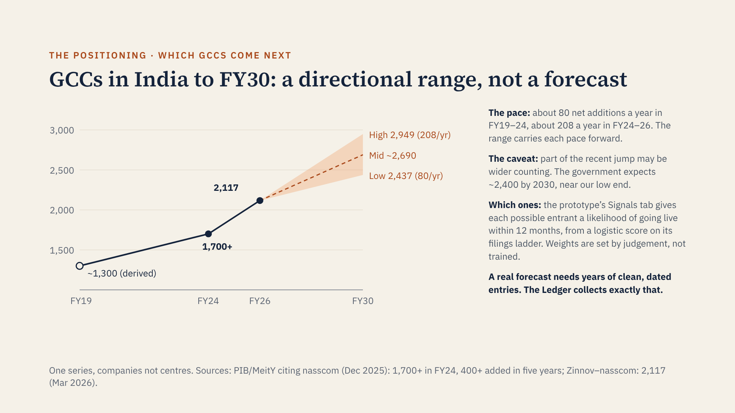
Notes:
This answers the brief’s question about which GCCs are coming next, without overclaiming. FY19 is derived: the government says 400 or more GCCs were added in the five years to FY24, which reached 1,700 or more, so FY19 was roughly 1,300. Carrying the slower FY19 to FY24 pace forward gives 2,437 by FY30; carrying the faster FY24 to FY26 pace gives 2,949; the midpoint is about 2,690. The government’s own expectation of about 2,400 centres by 2030 sits near the low end. The faster recent pace may partly reflect wider counting, for example of mid-market GCCs, so this is a range, not a forecast. These are net additions, new GCCs minus closures and mergers; gross-new figures such as Vestian’s roughly 150 a year sit near the central pace, as a cross-check. The likelihood-to-enter score is a logistic function of which ladder steps are documented: intercept minus 2.0, announced plus 2.0, entity incorporated plus 1.0, space approved plus 1.5, lease signed plus 1.5, hiring plus 1.0. So announced only gives 50%, announced plus lease gives 82%. The weights are judgement, shown openly, not trained; a fitted model needs a few years of outcomes, which the platform would collect. The prototype shows the same numbers in its matching chart.

Slide 22
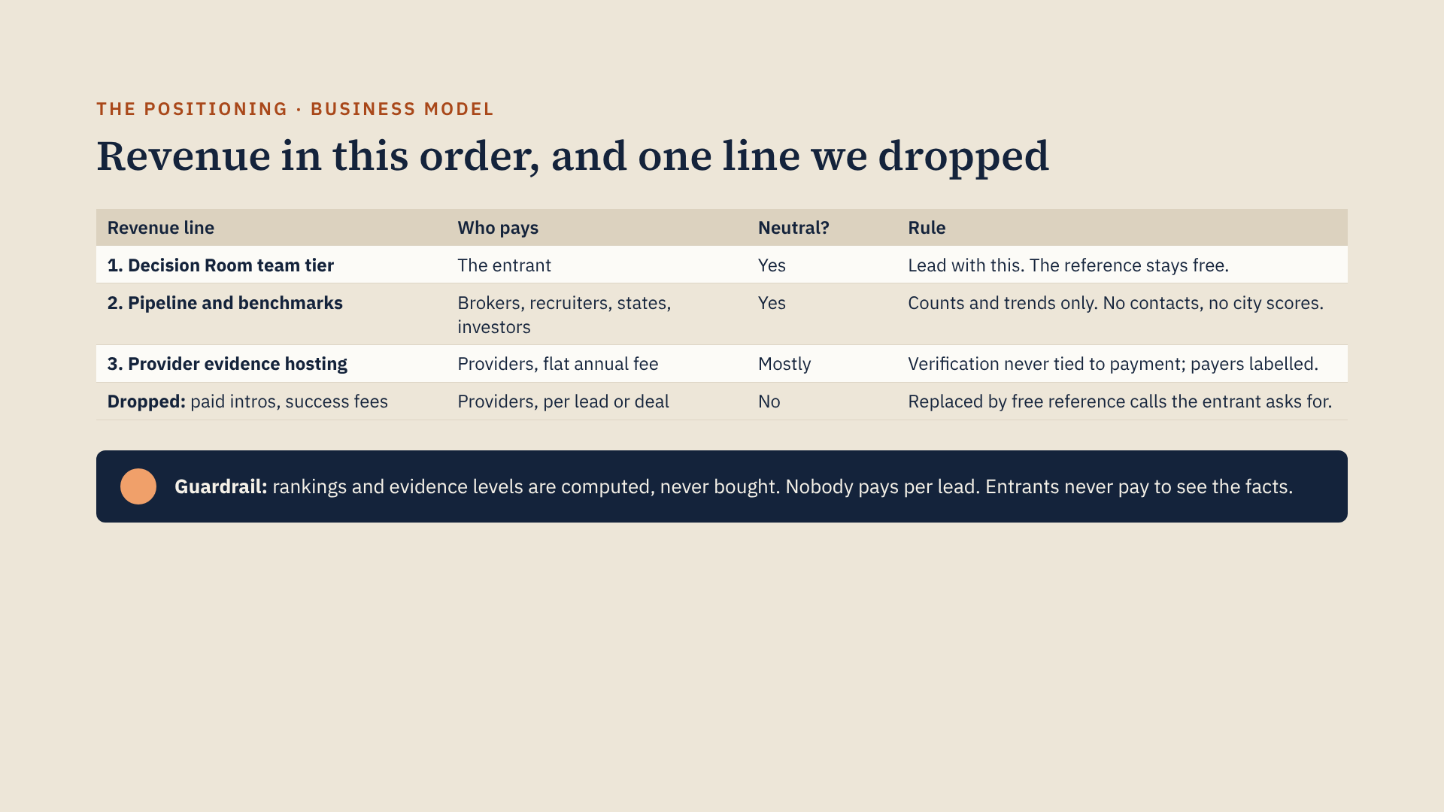
Notes:
v1 had paid introductions in Phase 2, which is a commission by another name and contradicted the neutrality line. They are gone. The entrant pays only for the collaborative workspace, never for the facts. Data buyers get aggregated counts and trends, not personal contact details, which also keeps us clear of India’s data protection law and distinct from GCC Explorer and OceanFrogs. Sequence: free reference and design partners first (0 to 6 months), then the team tier and provider hosting, then data products. Phase timings are planning assumptions.

Slide 23
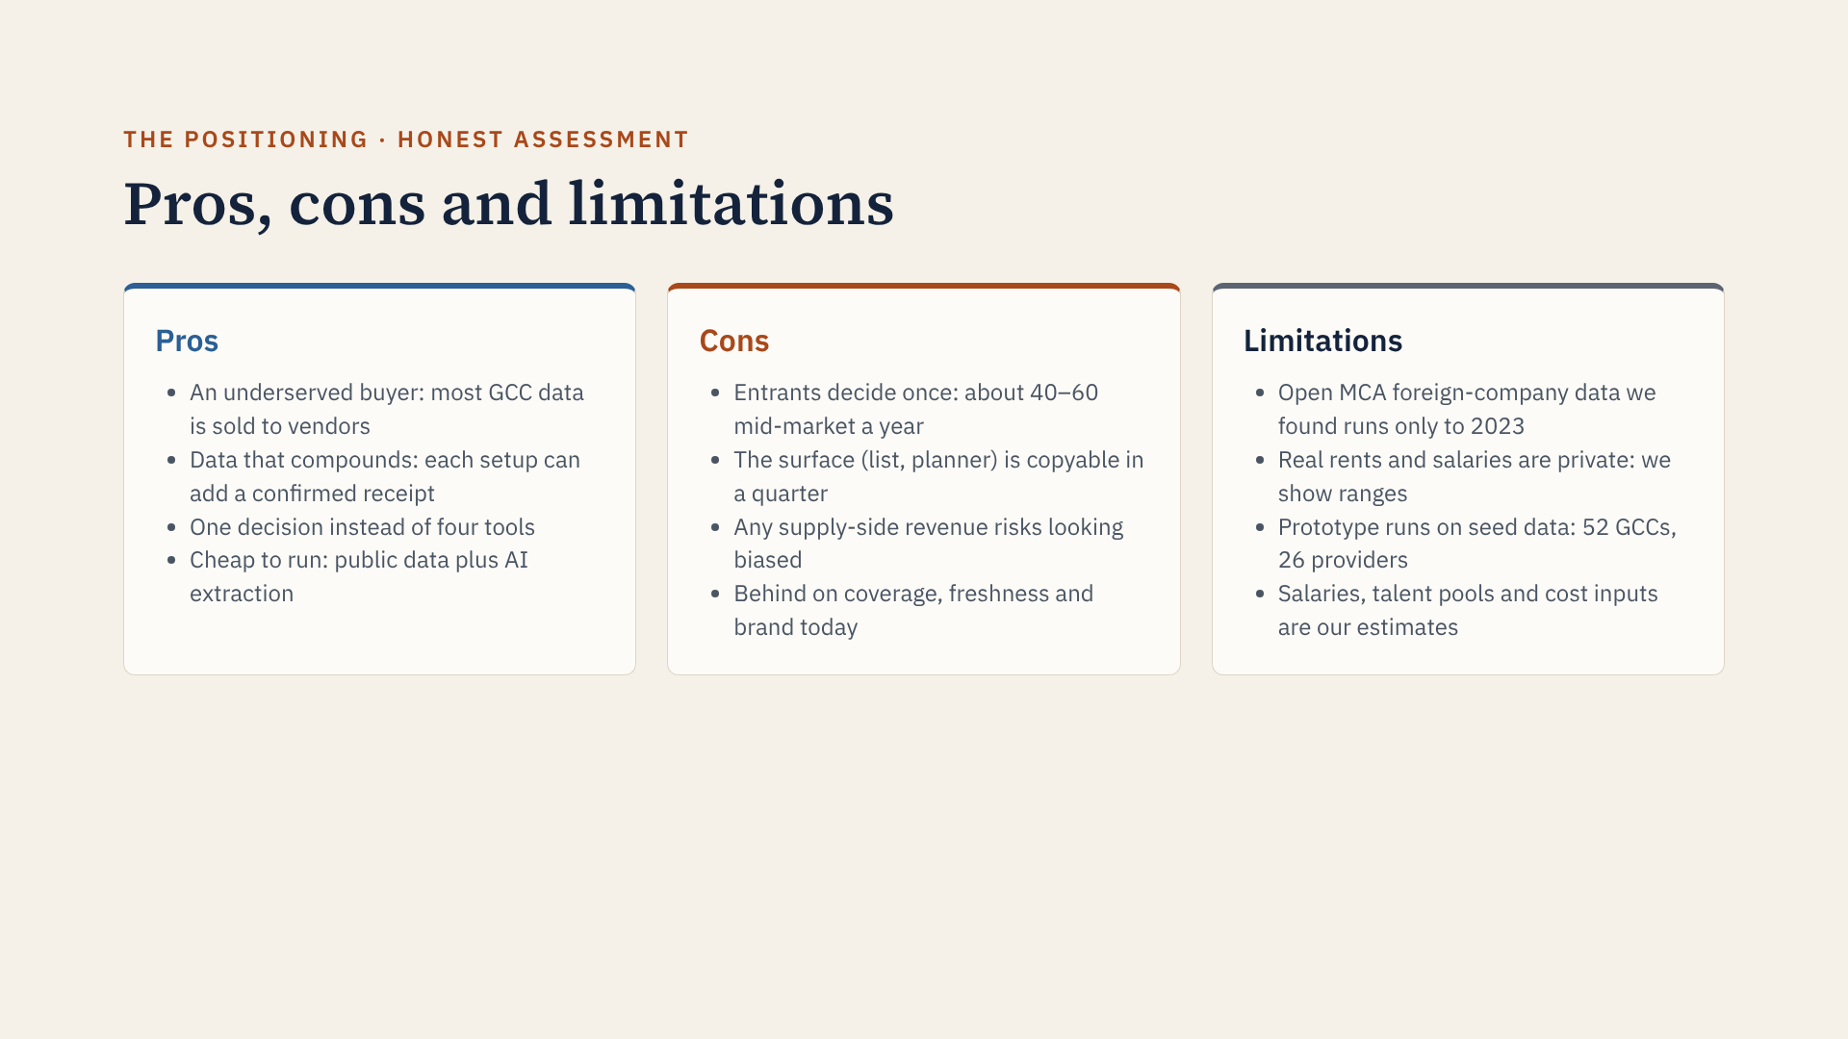
Notes:
How each con is answered: one-off entrants are kept with peer benchmarks and expansion planning, and existing GCCs are the second segment; the copyable surface is why we invest early in receipts and the filings pipeline, which need relationships; bias is handled by the revenue rules on the previous slide; and on coverage we simply say we are behind today. The limitations are stated on the prototype itself too.

Slide 24
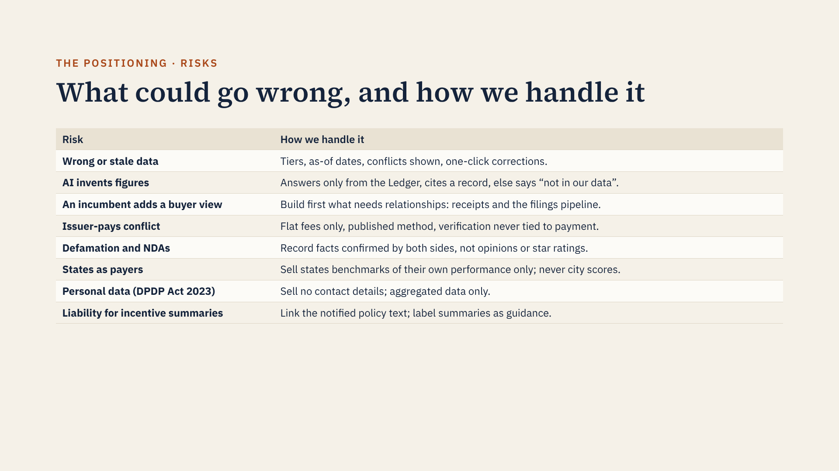
Notes:
The first two were in v1. The other six are new in v2 and are the ones a sharp reviewer is most likely to raise. The biggest risk remains trust: one confidently wrong number in a board pack and the entrant never comes back, which is why prototype v2 rebuilds the state policy table from CBRE’s list. Check it against the notified policy texts before presenting.

Slide 25
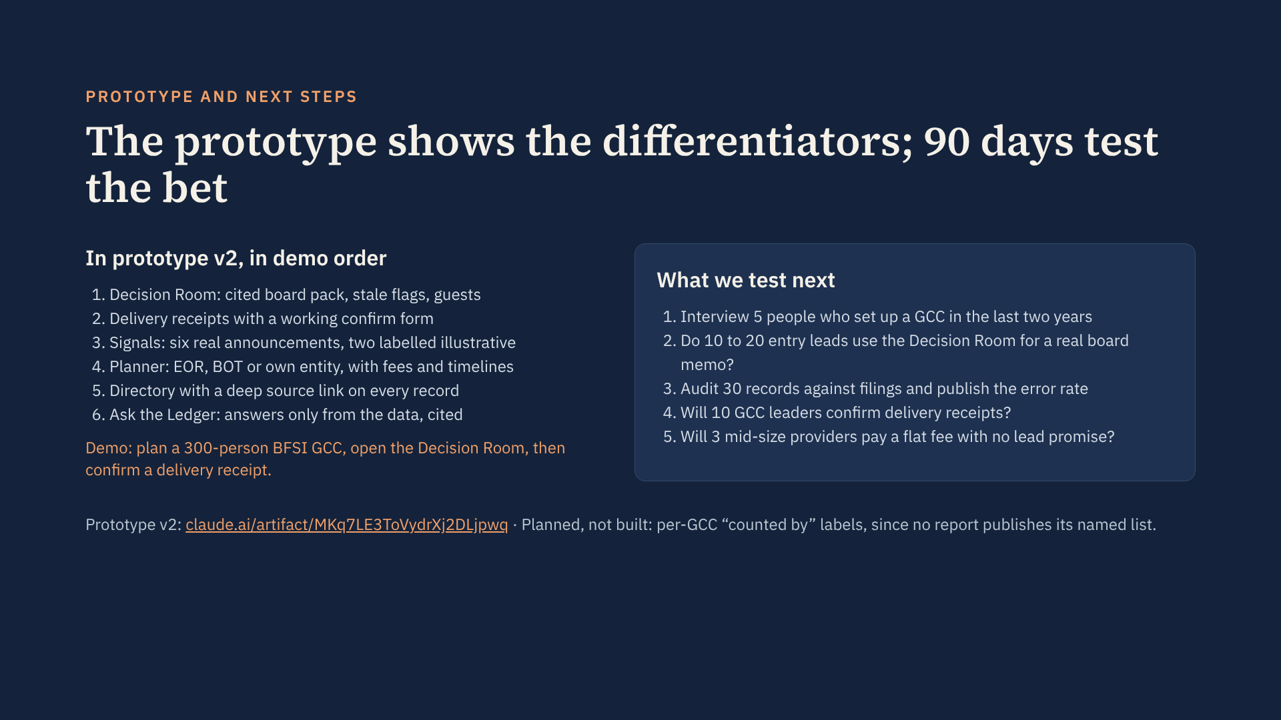
Notes:
The tests target the riskiest assumptions in order: that entry leads want a neutral source at all (we have no interviews yet, so that comes first), that they will use it for a real decision, that our data is accurate, that GCC leaders will confirm facts, and that providers will pay without leads. In the demo, confirm the ANSR delivery receipt for Arch Capital. Ask the Ledger now answers from the data even outside Claude, so reviewers without a Claude account can try it.

Slide 26


