Slide 1

Module 2 – ADM Version control and GIT
Presented By,
Asst Prof. Sandhya C,
Dept of CA,
SNGCE

Slide 2
Contents
Version Control
Types of Version Control
Introduction to GIT
Terminologies
Install and configure GIT
‹#›

Slide 3
Version control
It is a software that helps software developers to work together and maintain a complete history of their work
Version control is the means by which different versions and drafts of a document (or file or record or dataset) are managed
It involves a process of naming and distinguishing between a series of draft documents which lead to a final (or approved) version, which in turn may be subject to further amendments
It allows you to revert selected files back to a previous state, revert the entire project back to a previous state, compare changes over time, see who last modified something that might be causing a problem, who introduced an issue and when, and more
‹#›
Notes:
‹#›

Slide 4
Functions of version control
Allows developers to work simultaneously.
Does not allow overwriting each other’s changes.
Maintains a history of every version
‹#›

Slide 5
Benefits of VC
Traceability
Identifiability
Clarity
Reduced duplication
Reduced errors
‹#›

Slide 6
Types of Version control systems
Local version control system
Ex: RCS (Revision Control System)
Centralized version control system (CVCS)
Ex: Subversion, Perforce, ClearCase, Visual SourceSafe
Distributed/Decentralized version control system (DVCS)
Ex: Git, Bit Bucket, Mercurial etc
‹#›

Slide 7

Local Version Control System
‹#›

Slide 8
Centralized version control system
One central code repository
Requires a connection to perform most operations
Checkout
Commit
Merge
Branch
View History
Can retrieve just the files you need
Limited capability for offline work
Conceptually simple
Merging files are very difficult
‹#›

Slide 9
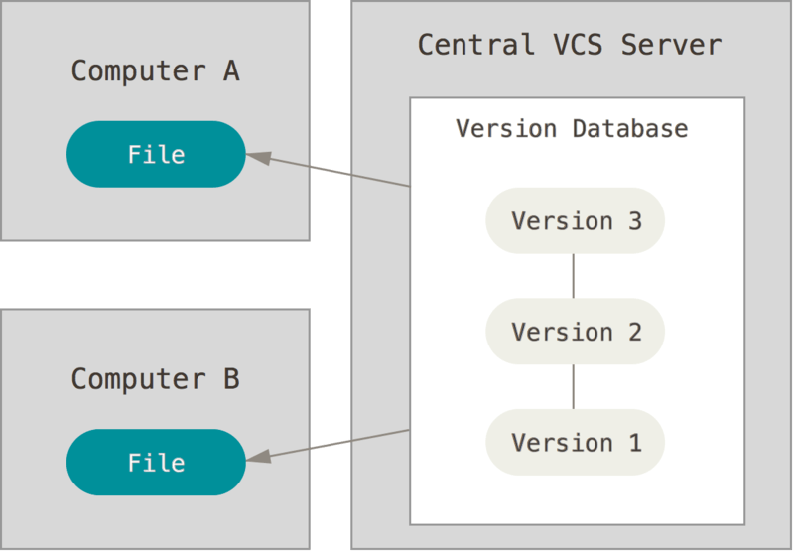
Centralized version control system
‹#›

Slide 10
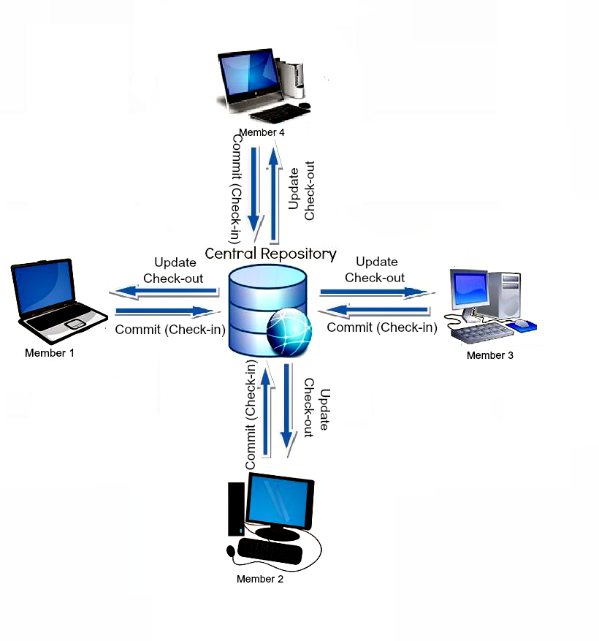
Fig: Centralized VCS
‹#›

Slide 11
distributed version control system
No central code repository
Does not require connection
Can only retrieve an entire repository
Merging files is easy
Higher learning curve
‹#›

Slide 12
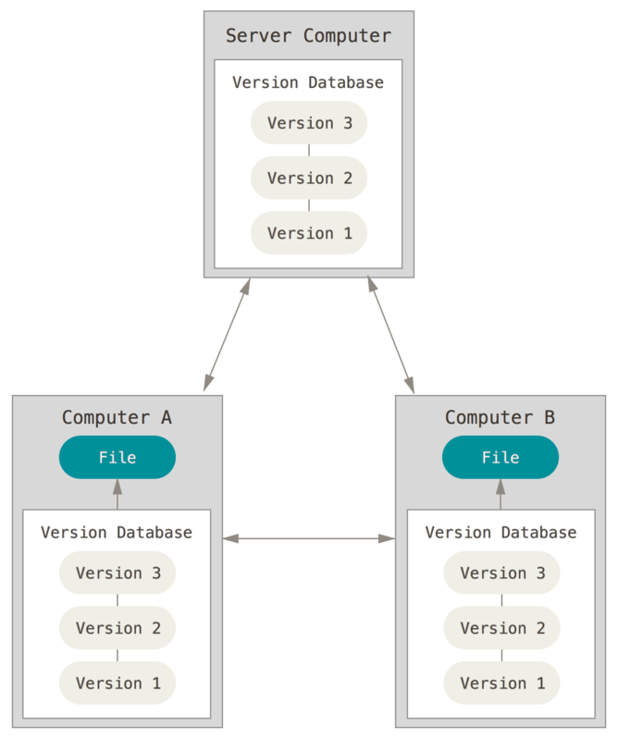
Distributed version control system
‹#›

Slide 13
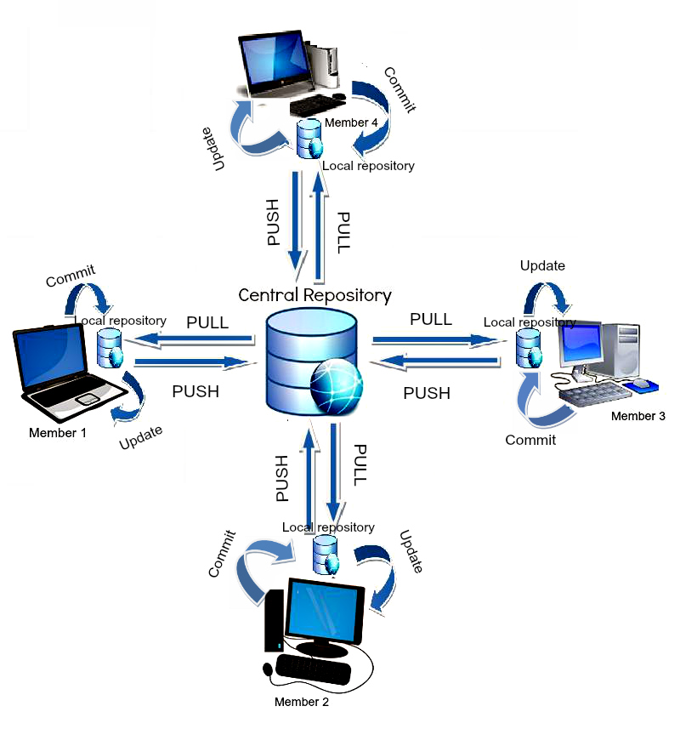
Fig: Distributed VCS
‹#›

Slide 14
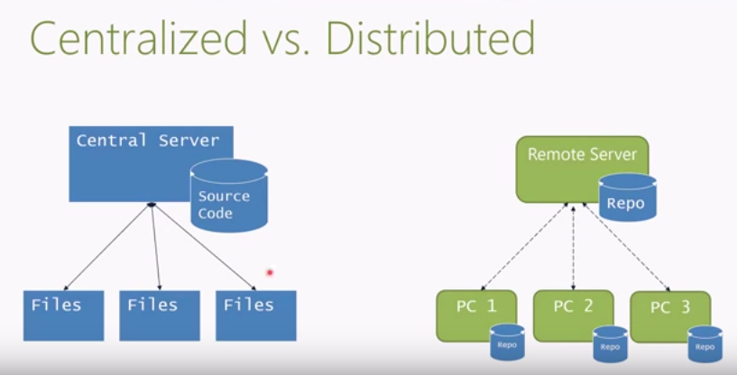
‹#›

Slide 15
Why use distributed system
Work fully offline
Encourages frequent commits
Easy to switch work
Powerful tools for viewing and rewriting history
Increasingly popular
‹#›

Slide 16
Why NOT use distributed system
Harder to use day to day
Few non – open source projects needs the ability to rewrite history
GIT does not handle binaries well
Security is defined at the repository level
‹#›

Slide 17
GIT
‹#›

Slide 18
What is GIT ?
Git is currently the most popular implementation of a distributed version control system.
Git originates from the Linux kernel development and was founded in 2005 by Linus Torvalds.
It is used by many popular open source projects, e.g., the Android or the Eclipse developer teams, as well as many commercial organizations.
The core of Git was originally written in the programming language C, but Git has also been re-implemented in other languages, e.g., Java, Ruby and Python.
‹#›

Slide 19
Git History
Came out of Linux development community
Linus Torvalds, 2005
Initial goals:
Speed
Support for non-linear development (thousands of parallel branches)
Fully distributed
Able to handle large projects like Linux efficiently
‹#›

Slide 20
How Git Is Different
Git is a bit different from traditional version control systems
Distributed vs. Centralized(DVCS VS CVCS)
There are generally two models in version control systems: centralized and distributed.
Tools such as Subversion typically require a network connection to a centralized server. when we make a change to your project and then commit that change, which is sent to the centralized server to track. Other developers can then immediately access your changes.
Distributed version control systems, such as Git, break the process of committing code and sharing it with others into two parts. You can commit your code to your local private repository without having to talk to a centralized server, removing the need to be connected to a network to make a change.
‹#›
Notes:
‹#›

Slide 21
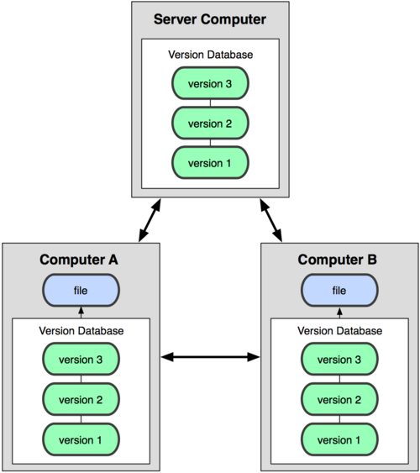

Git uses a distributed model
Centralized Model
Distributed Model
(CVS, Subversion, Perforce)
(Git, Mercurial)
‹#›
Result: Many operations are local
Notes:
‹#›

Slide 22
Advantages of GIT
Free and open source
Git is released under GPL’s open source license. It is available freely over the internet. You can use Git to manage property projects without paying a single penny. As it is an open source, you can download its source code and also perform changes according to your requirements.
Fast and small
As most of the operations are performed locally, it gives a huge benefit in terms of speed. Git does not rely on the central server; that is why, there is no need to interact with the remote server for every operation. The core part of Git is written in C, which avoids runtime overheads associated with other high-level languages. Though Git mirrors entire repository, the size of the data on the client side is small. This illustrates the efficiency of Git at compressing and storing data on the client side.
‹#›

Slide 23
Advantages of GIT [contd..]
Implicit backup
The chances of losing data are very rare when there are multiple copies of it. Data present on any client side mirrors the repository, hence it can be used in the event of a crash or disk corruption.
Security
Git uses a common cryptographic hash function called secure hash function (SHA1), to name and identify objects within its database. Every file and commit is check-summed and retrieved by its checksum at the time of checkout. It implies that, it is impossible to change file, date, and commit message and any other data from the Git database without knowing Git.
‹#›

Slide 24
Advantages of GIT [contd..]
No need of powerful hardware
In case of CVCS, the central server needs to be powerful enough to serve requests of the entire team. For smaller teams, it is not an issue, but as the team size grows, the hardware limitations of the server can be a performance bottleneck. In case of DVCS, developers don’t interact with the server unless they need to push or pull changes. All the heavy lifting happens on the client side, so the server hardware can be very simple indeed.
Easier branching
CVCS uses cheap copy mechanism, If we create a new branch, it will copy all the codes to the new branch, so it is time-consuming and not efficient. Also, deletion and merging of branches in CVCS is complicated and time-consuming. But branch management with Git is very simple. It takes only a few seconds to create, delete, and merge branches.
‹#›

Slide 25
Tasks – performing using git
Take snapshots of files over time – we can restore earlier versions of files from snapshots
Works on multiple versions of a file in parallel
‹#›

Slide 26
Git Repository
A Git repository contains the history of a collection of files starting from a certain directory
Git supports the creation of repositories targeting the usage on a server.
Bare repositories are supposed to be used on a server for sharing changes coming from different developers. Such repositories do not allow the user to modify locally files and to create new versions for the repository based on these modifications.
Non-bare repositories target the user. They allow you to create new changes through modification of files and to create new versions in the repository. This is the default type which is created if you do not specify any parameter during the clone operation.
A local non-bare Git repository is typically called local repository
‹#›

Slide 27
Private vs. Public Repositories
Each developer who is sharing code with other developers has at least two
repositories: a private and a public repository.
The private repository is the one that exists on your computer and is the one you make commits to.
Public repositories are the repository that you use to share your changes with
other developers. Multiple developers might have access to push changes to
the same public repository, or each developer may have their own public
repositories.
You can push to and fetch from multiple repositories. This allows you to pull in changes from another developer who’s working on the same project.
‹#›

Slide 28
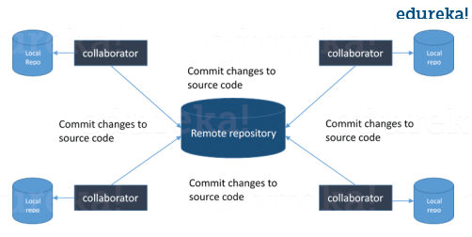
‹#›

Slide 29
Conceptual areas of git repository
Working Area
Staging Area (Index)
History or Repository
‹#›

Slide 30
Working Directory and Staging Area or Index
The working directory is the place where files are checked out
other CVCS, developers generally make modifications and commit their changes directly to the repository.
But Git uses a different strategy. Git doesn’t track each and every modified file. Whenever you do commit an operation, Git looks for the files present in the staging area.
Only those files present in the staging area are considered for commit and not all the modified files.
‹#›

Slide 31
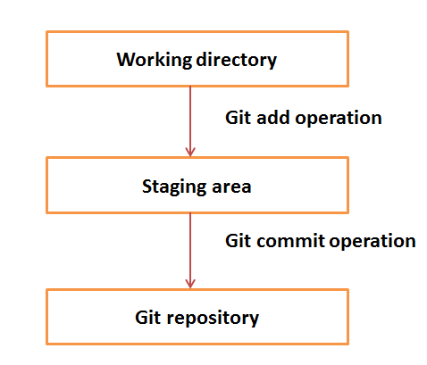
Fig : Conceptual areas of GIT Repository
‹#›

Slide 32
Working Area
History or Repository
Staging Area (Index)
F1 F2
F3
Commit B
F1 F2
F3
Commit A
.git directory
Fig: Conceptual Areas of a GIT repository
‹#›

Slide 33
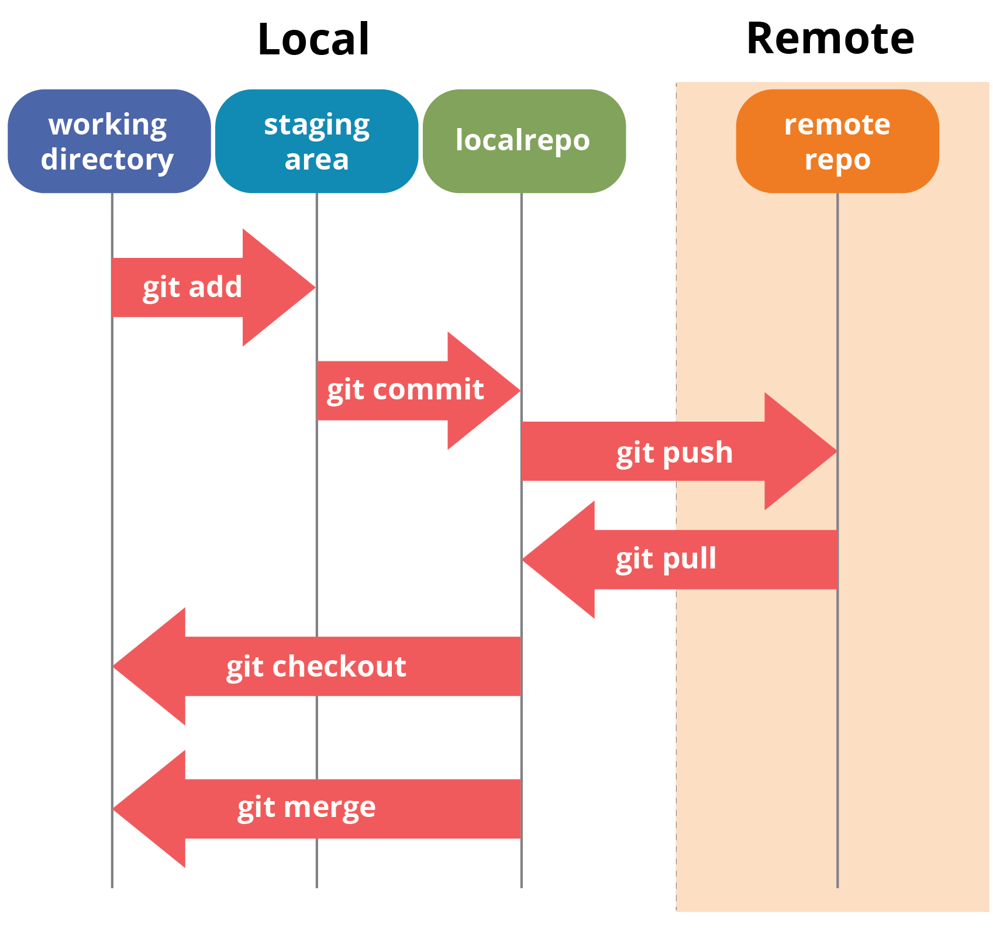
Stages in GIT
‹#›

Slide 34
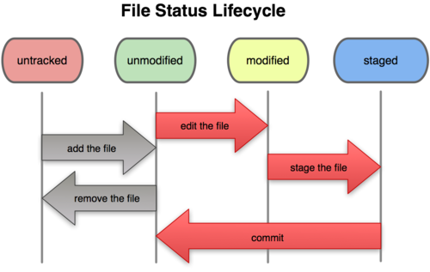
Git file lifecycle
‹#›

Slide 35
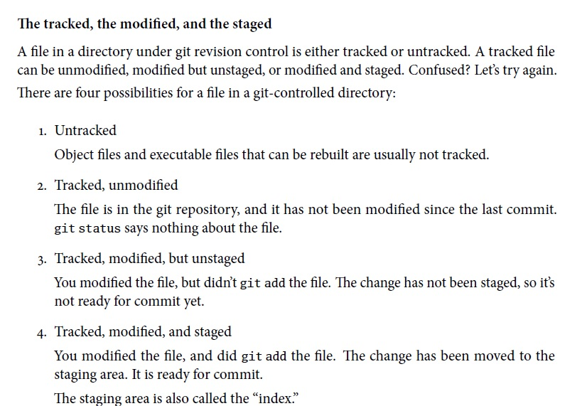

Slide 36
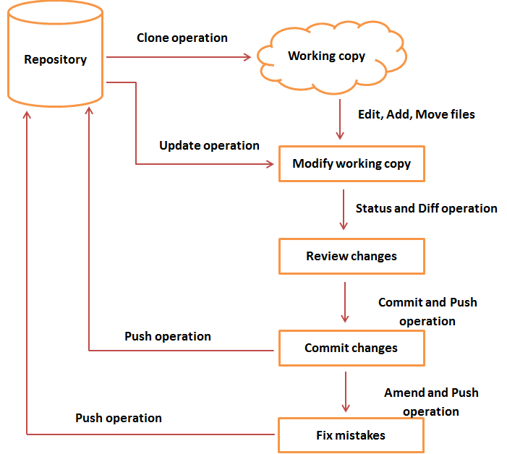
Fig : Lifecycle of GIT or Workflow of GIT
‹#›

Slide 37
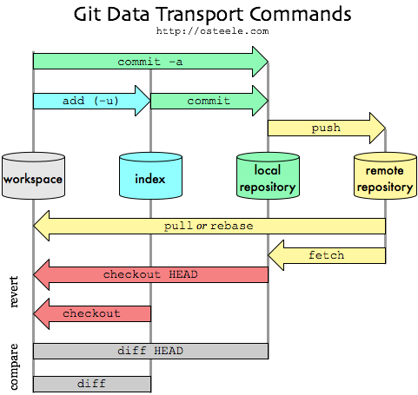

Slide 38
Practice question
Difference between Centralized and Distributed Version control system in a tabular form
‹#›

Slide 39
Terminologies
Commit : it holds the current state of the repository. A commit is also named by SHA1 hash. You can consider a commit object as a node of the linked list Every commit object has a pointer to the parent commit object
Tree – is an object, which represents a directory. It holds blobs as well as other sub-directories. A tree is a binary file that stores references to blobs and trees
Blob - stands for Binary Large Object. Each version of a file is represented by blob. A blob holds the file data but doesn’t contain any metadata about the file. It is a binary file, and in Git database, it is named as SHA1 hash of that file
‹#›

Slide 40
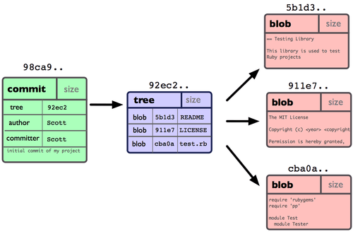

Slide 41
Terminologies [ contd ..]
Pull : this operation copies the changes from a remote repository instance to a local one. The pull operation is used for synchronization between two repository instances. This is same as the update operation in Subversion
Push : this operation copies changes from a local repository instance to a remote one. This is used to store the changes permanently into the Git repository. This is same as the commit operation in Subversion
Clone : this operation creates the instance of the repository. Clone operation not only checks out the working copy, but it also mirrors the complete repository. Users can perform many operations with this local repository
‹#›

Slide 42
Terminologies [contd..]
Revision : it represents the version of the source code Revisions in Git are represented by commits These commits are identified by SHA1 secure hashes
HEAD : is a pointer, which always points to the latest commit in the branch. Whenever you make a commit, HEAD is updated with the latest commit. The heads of the branches are stored in .git/refs/heads/ directory
URL : it represents the location of the Git repository; Git URL is stored in config file
‹#›

Slide 43
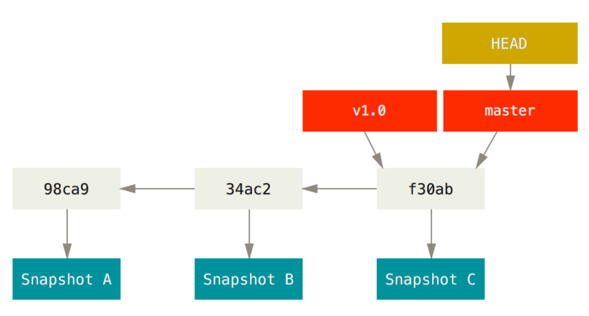

Slide 44
Terminologies [contd..]
Branch : they are used to create another line of development By default, Git has a master branch, which is same as trunk in Subversion; usually, a branch is created to work on a new feature; once the feature is completed, it is merged back with the master branch and we delete the branch Every branch is referenced by HEAD, which points to the latest commit in the branch; whenever you make a commit, HEAD is updated with the latest commit
‹#›

Slide 45
Terminologies [contd..]
Tags : assigns a meaningful name with a specific version in the repository; they are very similar to branches, but the difference is that tags are immutable It means, tag is a branch, which nobody intends to modify; once a tag is created for a particular commit, even if you create a new commit, it will not be updated. Usually, developers create tags for product releases
‹#›

Slide 46

Commit Graph
Delete file F2
Commit C F1
Edit file F1
Commit B F1, F2
Add file F1,F2
Commit A F1, F2
git init
Net Auto
Creates a repo Net Auto
‹#›

Slide 47
Commit IDs Instead of Revision Numbers
Centralized VCS have the benefit of having one system that doles out revision
numbers. Because everyone is committing and sharing their code in one
repository, that repository can control what numbers it assigns to a particular
commit.
That model doesn’t work in a decentralized system.
Who’s to say which commit is actually the second commit, me or you?
Git uses commit IDs that are SHA-1 hashes instead.
The hash is based on the code, what came before it, who made the commit, when they made it, and a few other pieces of metadata.
The chances are incredibly small of there being two different commits with the same commit ID
‹#›

Slide 48
Forking Is Good(branch,split,divide ,subdivide)
A fork is a copy of a repository. Forking a repository allows you to freely experiment with changes without affecting the original project.
Most commonly, forks are used to either propose changes to someone else's project or to use someone else's project as a starting point for your own idea.
largest Git communities online, GitHub, www.github.com
‹#›

Slide 49
Git Installation and configuration
‹#›

Slide 50
Install GIT – Linux command prompt
[ubuntu ~]$ sudo apt-get install git-core
[sudo] password for ubuntu:
[ubuntu ~]$ git --version
git version 1.8.1.2
‹#›
Notes:
sudo apt-get install git-core
sudo apt-get install git-doc
sudo apt-get install git-svn
sudo apt-get build-dep git-core git-doc git-svn
‹#›

Slide 51
Environment set up - configuration
Git provides the git config tool, which allows you to set configuration variables.
Git stores all global configurations in .gitconfig file, which is located in your home directory.
To set these configuration values as global, add the --global option, and if you omit --global option, then your configurations are specific for the current Git repository
You can also set up system wide configuration. Git stores these values in the /etc/gitconfig file, which contains the configuration for every user and repository on the system
To set these values, you must have the root rights and use the --system option
‹#›

Slide 52
Setting username and email
[SANDHYA PC@ sandhya]$ git config --global user.name “Sandhya C“
[SANDHYA PC@ sandhya]$ git config --global user.email “ c_sandhya@gmail.com “
‹#›

Slide 53
Setting up – default
By default, Git uses the system default editor, which is taken from the VISUAL or EDITOR environment variable. We can configure a different one by using git config
[SANDHYA PC @ sandhya]$ git config --global core.editor vim
Setting default merge tool
Git does not provide a default merge tool for integrating conflicting changes into your working tree. We can set default merge tool by enabling following settings
[SANDHYA PC @ sandhya]$ git config --global merge.tool vimdiff
SANDHYA PC@ sandhya]$ git config –global color.ui.auto // Turn colors on wherever possible in Git UI
List Git setting
To verify your Git settings of the local repository, use git config –list command as given below:
[SANDHYA PC @ sandhya] $ git config --list
‹#›

Slide 54
Basis Git commands
[SANDHYA PC@ sandhya]$ mkdir <directory name>
SANDHYA PC@ sandhya]$ cd <directory name >
SANDHYA PC@ sandhya]$ git init
SANDHYA PC@ sandhya]$ ls – a
SANDHYA PC@ sandhya]$ cat > <<filename>>
SANDHYA PC@ sandhya]$ git add
SANDHYA PC@ sandhya]$ git commit –m ”some commit message”
SANDHYA PC@ sandhya]$ git status
SANDHYA PC@ sandhya]$ git log
SANDHYA PC@ sandhya]$ git log –oneline
‹#›

Slide 55
GIT HUB – Account creation
‹#›

Slide 56
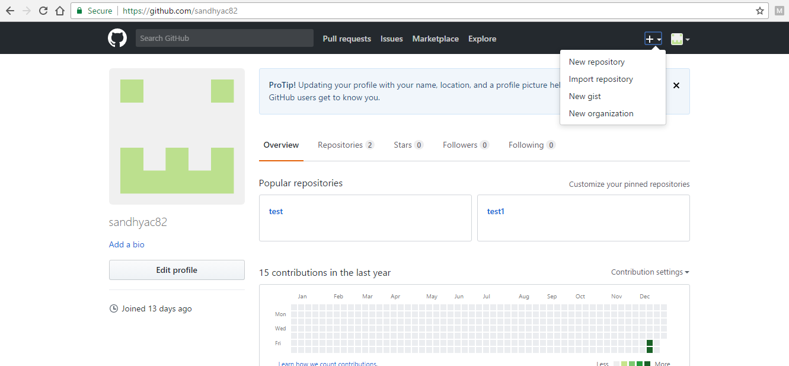
Git – Creating account in Github and a creating a new repository
Go to www.github.com and sign up for a account.
Log in to the account created
‹#›

Slide 57
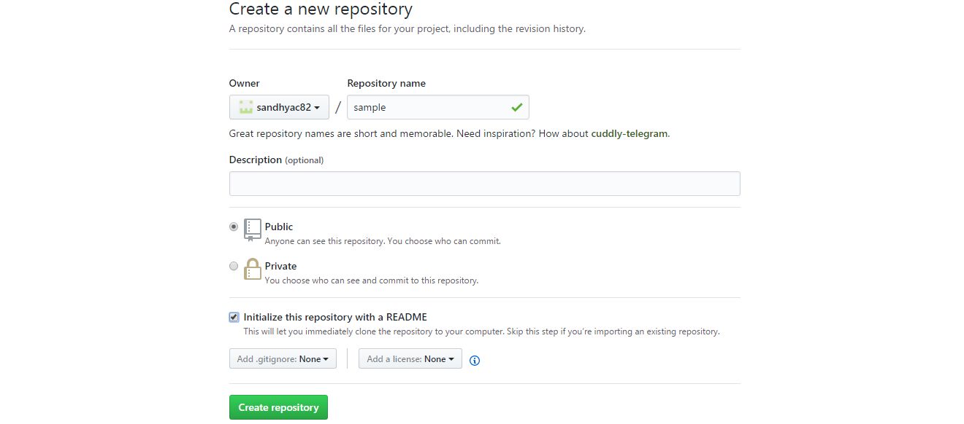
‹#›

Slide 58
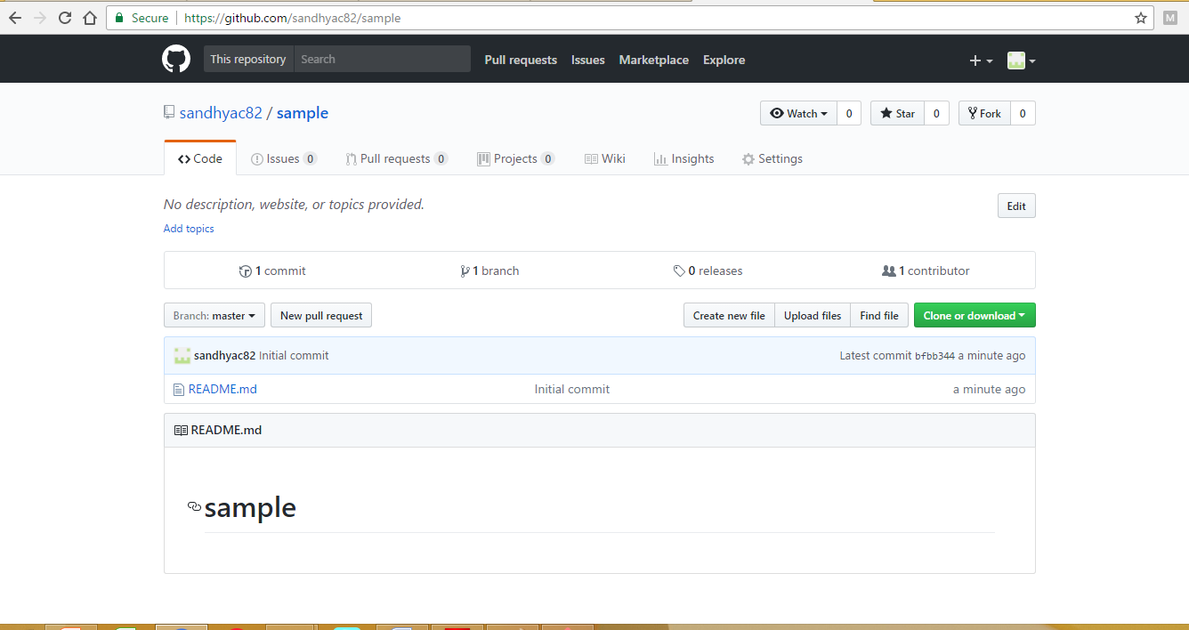
‹#›

Slide 59
GIT COMMANDS
‹#›

Slide 60
Creating a bare repository
A bare repository is nothing but the .git folder itself i.e. the contents of a bare repository is same as the contents of .git folder inside your local working repository
Use bare repository on a remote server to allow multiple contributors to push their work
Let us initialize a new repository by using init command followed by --bare option. It initializes the repository without a working directory. By convention, the bare repository must be named as .git
[gituser@CentOS project.git]$ git --bare init
Initialized empty Git repository in /home/gituser-m/project.git/
‹#›

Slide 61
git init -Initializes a git repository – creates the initial .git directory in a new or in an existing project Example : git init
Initialized empty Git repository in /home/username/GIT/.git/
git config - Sets configuration values for your user name, email, gpg key, preferred diff algorithm, file formats and more.
The git config command is a convenient function that is used to set Git configuration values on a global or local project level. These configuration levels correspond to .gitconfig text files. Executing git config will modify a configuration text file
‹#›

Slide 62
Practice exercise
Create a new account in Git hub
Install GIT using command prompt
Create a directory “net auto” on your local file system
Move to the newly created directory and add a text file with the help of an editor like vi
Add contents to the text file, save and exit
Initialize an empty git repository using the directory to hold the file and contents
Configure username and email and connect to the git hub global account
‹#›

Slide 63
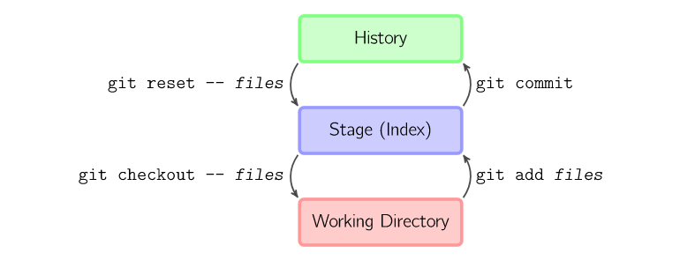
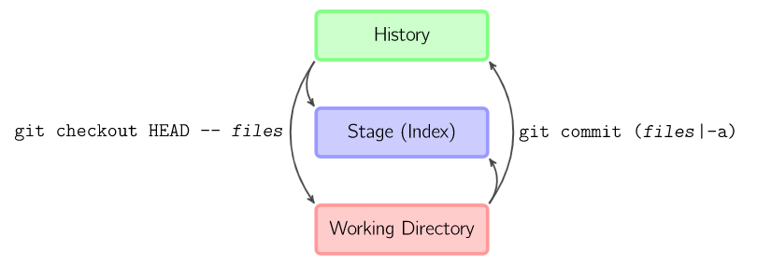
‹#›

Slide 64
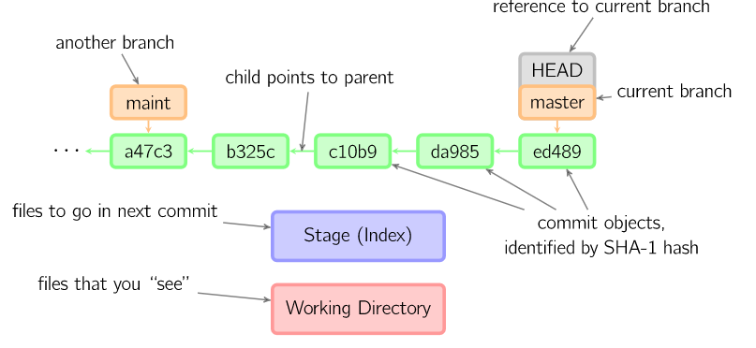
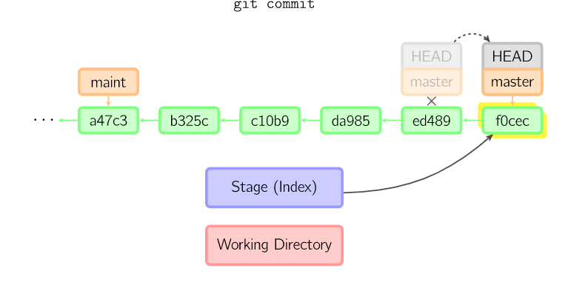
Fig: Ex of Commit
‹#›

Slide 65
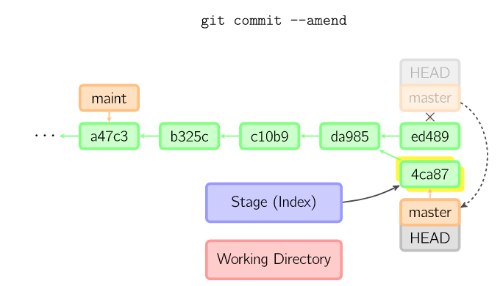
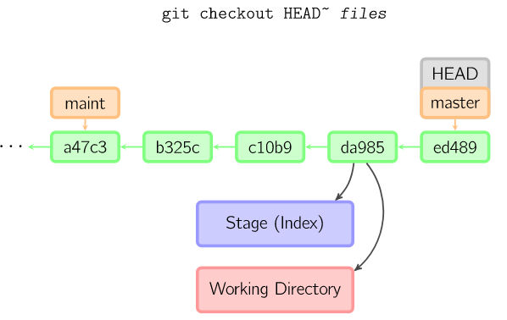
‹#›

Slide 66
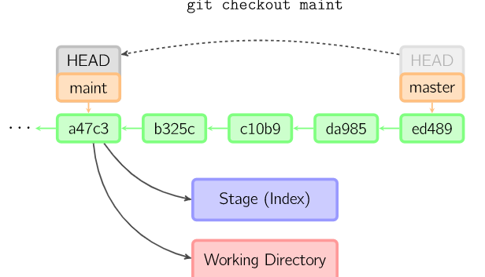
‹#›

Slide 67
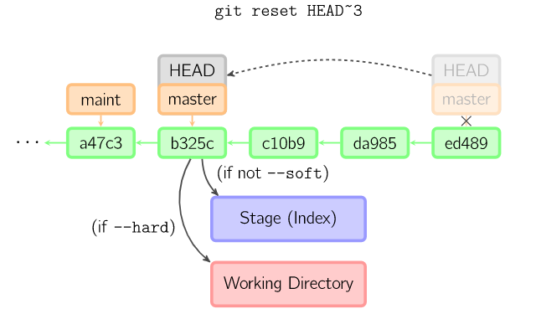
‹#›

Slide 68
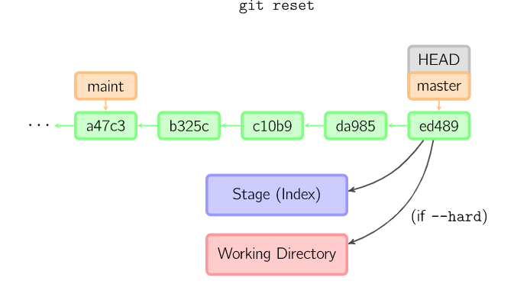
‹#›

Slide 69
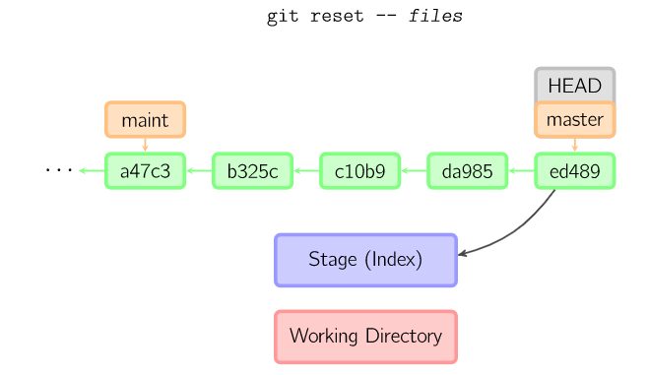
‹#›

Slide 70
References
http://scmquest.com/centralized-vs-distributed-version-control-systems/
https://www.youtube.com/watch?v=_yQlKEq-Ueg
https://www.youtube.com/watch?v=uFyJRxqLCvY
‹#›

Slide 71
THANK YOU
‹#›

