Slide 1

Department of Computer Science and Engineering Academic Year (2023-24) 22CSE48 - Mini Project Tic Tac Toe Application
Team Members
1NH22CS004- Aajnya Narayan Prabhu- 4A
1NH22CS053- C R Sandhya- 4A
Guided By
Ms. Asha Rani Borah
Senior Associate Professor
Dept. of CSE, NHCE

Slide 2
Contents
Objectives
Abstract
Requirement Specification
Design
Methodology
Implementation Roadmap

Slide 3
Objectives
The primary objective of a Tic Tac Toe application is to provide a digital platform for users to play the classic two-player game of Tic Tac Toe. Here are the detailed objectives:
Gameplay Experience:
User Interface: Create a user-friendly interface that replicates the traditional 3x3 grid for playing Tic Tac Toe.
Interaction: Allow users to take turns marking their symbol in the grid cells.
Win Conditions: Automatically detect and announce the winner when three of the same symbols are aligned horizontally, vertically, or diagonally.
Draw Condition: Identify and announce a draw when all cells are filled without a winner.

Slide 4
User Options:
Single Player Mode: Provide an option for users to play against an AI opponent with varying levels of difficulty.
Multiplayer Mode: Allow two players to play against each other on the same device.
Customization: Allow users to customize the appearance of symbols.

Slide 5
Abstract
The Tic Tac Toe application is a digital version of the classic two-player game, featuring a user-friendly interface with a 3x3 grid. It automatically detects win and draw conditions and supports both single-player and multiplayer modes. In single-player mode, users can challenge an AI with adjustable difficulty, while multiplayer allows two users to play on the same device. The application also offers customization options for symbols and is designed to be responsive and accessible across various devices.

Slide 6
Requirement Specification
Functional Requirements
User Interface:- The application must display a 3x3 grid for the game board.
- The interface must allow users to select their symbol.
- The application must visually update the game board after each move.
Gameplay Mechanics: - The application must alternate turns between the two players.
- The application must check for win conditions after each move.
- The app must announce a draw when all cells are filled without a winner.
- The application must allow users to reset the game to start a new round.
Game Modes: - The application must provide a single-player mode where the user plays against an AI.
- The AI must have at least two difficulty levels: easy and hard.

Slide 7
- The application must provide a multiplayer mode.
Non-Functional Requirements
Performance: - The application must respond to user actions within 100 milliseconds.
-The application must perform AI computations efficiently to avoid noticeable delays.
Usability: - The application must have an intuitive and easy-to-use interface.
Compatibility: - The application must run on multiple platforms, including Windows, macOS, and Linux.
Reliability: - The application must handle invalid user inputs gracefully without crashing.
By adhering to these functional and non-functional requirements, a robust, user-friendly, and efficient Tic Tac Toe application can be developed.

Slide 8
Hardware Requirements
1. Development Machine:
- Processor: Intel Core i5 or equivalent
- RAM: 8 GB minimum
- Storage: 500 MB available space for development tools and project files
- Display: Monitor with a minimum resolution of 1280x720
- Graphics: Integrated graphics sufficient
- Input Devices: Keyboard and mouse
2. Testing Devices:
- PC/Laptop: Additional machines with different OS (Windows, macOS, Linux) to test cross-platform compatibility

Slide 9
Software Requirements
1. Development Environment:
- Operating System: Windows 10/11, macOS
- Java Development Kit (JDK): JDK 8 or higher
- Integrated Development Environment (IDE): IntelliJ IDEA
2. Version Control:
- Version Control System: Git
- Repository Hosting Service: GitHub
3. User Interface Development:
- JavaFX: For creating the graphical user interface (GUI)

Slide 10
Design
Outline of design
Setup the Board: The main window for the application.
Create the Grid: A 3x3 grid of buttons for the Tic Tac Toe board.
Add Action Listeners: To handle the button clicks.
Display the Current Player: Indicate whose turn it is.
Check for Win Conditions: Determine if a player has won after each move.
Key Points
JFrame: The main window for the application.
JPanel: Used to create the grid layout for the Tic Tac Toe board.
JButton: Represents each cell in the Tic Tac Toe grid.
ActionListener: Handles button clicks to update the board and check game status.
JLabel: Displays the current player's turn or the game's result.

Slide 11
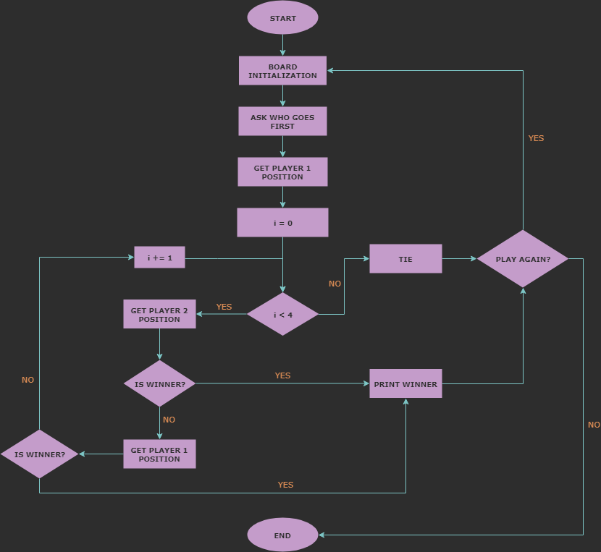

Slide 12
Methodology
The concept of the Tic Tac Toe application in Java is to create an engaging and intuitive digital version of the classic two-player game. This application will feature a clean and responsive user interface, support both single-player (against AI) and multiplayer modes, and include essential game functionalities such as turn management and win/draw detection

Slide 13
Implementation Roadmap
To implement a Tic Tac Toe game in Java, the following tools are commonly used:
Java Development Kit (JDK):
- Toolset for developing Java apps, the Java compiler and runtime environment.
2. Integrated Development Environment (IDE):
- IntelliJ IDEA: These IDEs provide code editors, debugging tools, and project management features to facilitate development.
3. Swing Framework:
- JFrame: Main window container.
- JPanel: Used for organizing the layout and holding components like buttons.
- JButton: Represents individual cells in the Tic Tac Toe grid.
4. Event Handling:
- ActionListener: Interfaces to handle button click events.

Slide 14
Framework for implementing
1. Define the Board
Create a structure to represent the game board. This can be a 3x3 grid represented as a 2D array or any suitable data structure.
2. Game Logic
Implement functions to handle:-
Initializing the board.
- Printing the current state of the board.
- Making a move and updating the board.
- Checking for a win condition (horizontal, vertical, diagonal).
- Checking if the board is full (tie condition).
3. Player Interaction
- Alternately prompt players to input their move.
- Validate input to ensure it's within board boundaries and on an empty cell.

Slide 15
4. Main Game Loop
- Initialize the board.
- Print the board.
- Use a loop to alternate turns between players until a win or tie condition is met.
- Display the winner or declare a tie at the end of the game.
Summary
This framework outlines the essential components needed to implement a basic Tic Tac Toe game. It covers board representation, game logic, player interaction, and the main game loop.

Slide 16


