Slide 1
FINAL PROJECT
GROUP MEMBERS
SRIKANTH GEMBALI
JHANSI BUSSA
AGASTYA KATKAM
KANDARP BAROT

Slide 2

PROBLEM STATEMENT
This project presents mathematical optimization to form 5 groups of 3 students from class of 15 students. Our objective is to maximize the chance of success for every group.

Slide 3
PARAMETERS CONSIDERED
HOURS WORKED
The GPA range considered is from 2.5 to 4.0.
GPA
The range for this engagement is 1 to 15 days.
ATTENDENCE
The range of hours worked is 10 to 30 hours.

Slide 4
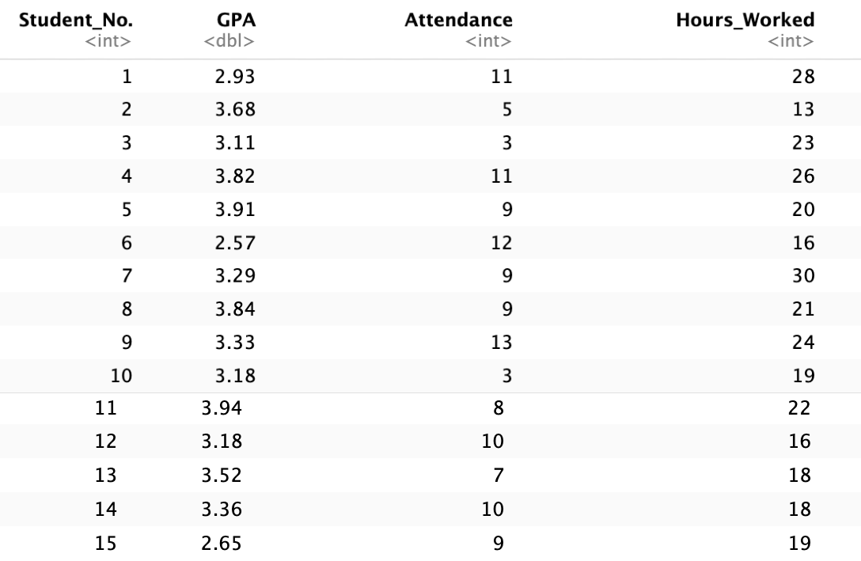

Slide 5

OBJECTIVE FORMULATION
MAX Z =
Student $X_{i}$ in group $Y_{j}$, i.e. ${X_{i}Y}_{j}$,
where $i$ = 1,2,3,4,5,6,7,8,9,10,11,12,13,14,15 student & $j$ = 1,2,3,4,5 group
With 15 students divided into 5 groups, there are 75 Decision Variables in this LP model.

Slide 6
CONSTRAINTS
Group Constraints
Group Constraints: There are 5 groups, and each group should have 3 students. RHS is equal to 3.
Student Constraints: There are 15 students, and each student should be assigned to only 1 group. RHS is equal to 1.
GPA Constraints: Using the average of GPA on RHS.
Attendance Constraints: Using the average of Attendance on RHS.
Hours Worked Constraints: Using the average of Hours worked on RHS.
Student Constraints
GPA Constraints
Attendance Constraints
Hours Worked Constraints

Slide 7

This is an LP Model problem. We are solving LP model using lpsolve package in R.
Steps in solving the model:
Data generation using R's randomization function
Implementation of the formulated model in R using "lpSolveAPI" package

Slide 8
RESULTS
GROUP 1
STUDENTS- 1,4,9
GROUP 2
STUDENTS- 6,7,8
GROUP 3
STUDENTS- 5,11,14
GROUP 4
STUDENTS- 12,13,15
GROUP 5
STUDENTS- 2,3,10

Slide 9
CONCLUSION
Based on the solved model, the solution presented in the image represents the optimal arrangement of students into groups. This configuration is designed to maximize the likelihood of success in successfully completing the group project. Below are the groups:
GROUP 1: 1,4,9
GROUP 2: 6,7,8
GROUP 3: 5,11,14
GROUP 4: 12,13,15
GROUP 5: 2,3,10

Slide 10
THANK YOU

