Slide 1
Effective Java 3rd edition differences and review
Book Author: Josh Bloch
Reviewed By: Heath Elliott

Slide 2
Effective Java 2nd edition review
Its useful

Slide 3
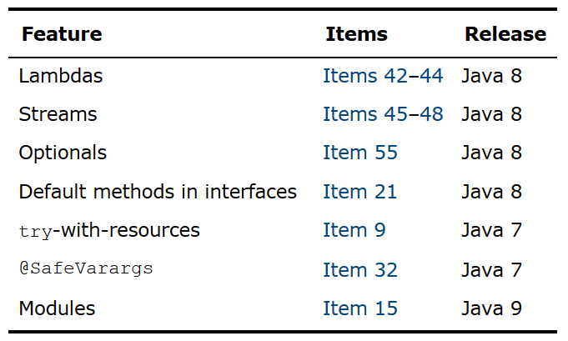
Differences to 2nd Edition
Introduction Section

Slide 4

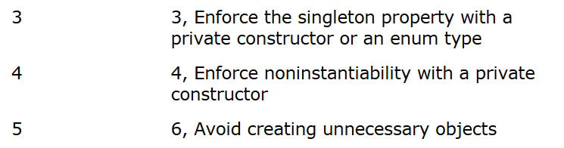
Differences to 2nd Edition Item Numbers
Appendix: Items Corresponding to Second Edition

Slide 5
What is 5 now?
Item 5: Prefer dependency injection to hardwiring resources
Brand new for 3rd edition

Slide 6
Also updates Item 1
Mentions Item 5
New selection on “fifth advantage of static factories”

Slide 7
Other new items
Item 25: Limit source files to a single top-level class

Slide 8
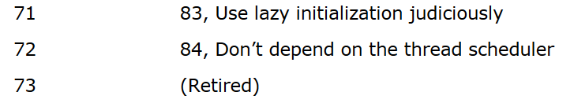
Removals

Slide 9
What was Item 73?
Item 73: Avoid thread groups
Already noted that they were obsolete in 2nd Edition
Still present in Java 9 (without any Deprecation warnings)

Slide 10
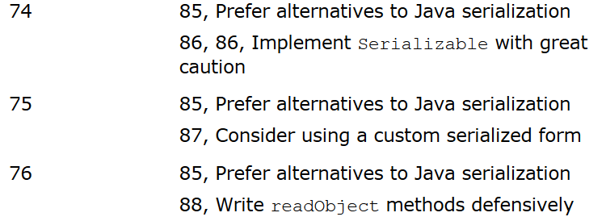
Rewrites

Slide 11
Corresponds to …
Chapter 12: Serialization

Slide 12
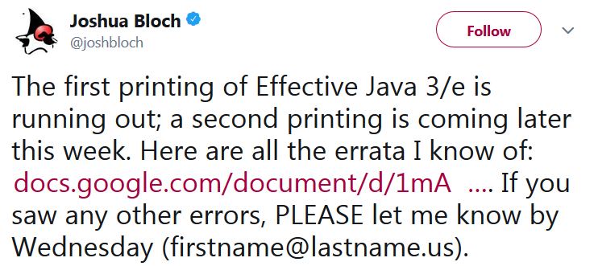

Errata

Slide 13
Item 83 Example has a Bug
Item 83: Use lazy initialization judiciously
Race condition in “Double-check idiom” example that returns null
2nd Edition was correct, will be fixed in the 3rd printing of 3rd Edition
Errata link: https://docs.google.com/document/d/1mAeEgQu4H4ADxa03k7YaVDjIP5vJBvjVIjg3DIvoc8E/edit

Slide 14
Summary
Still useful
New items on new language features most helpful
Other changes exist

